Slide 1
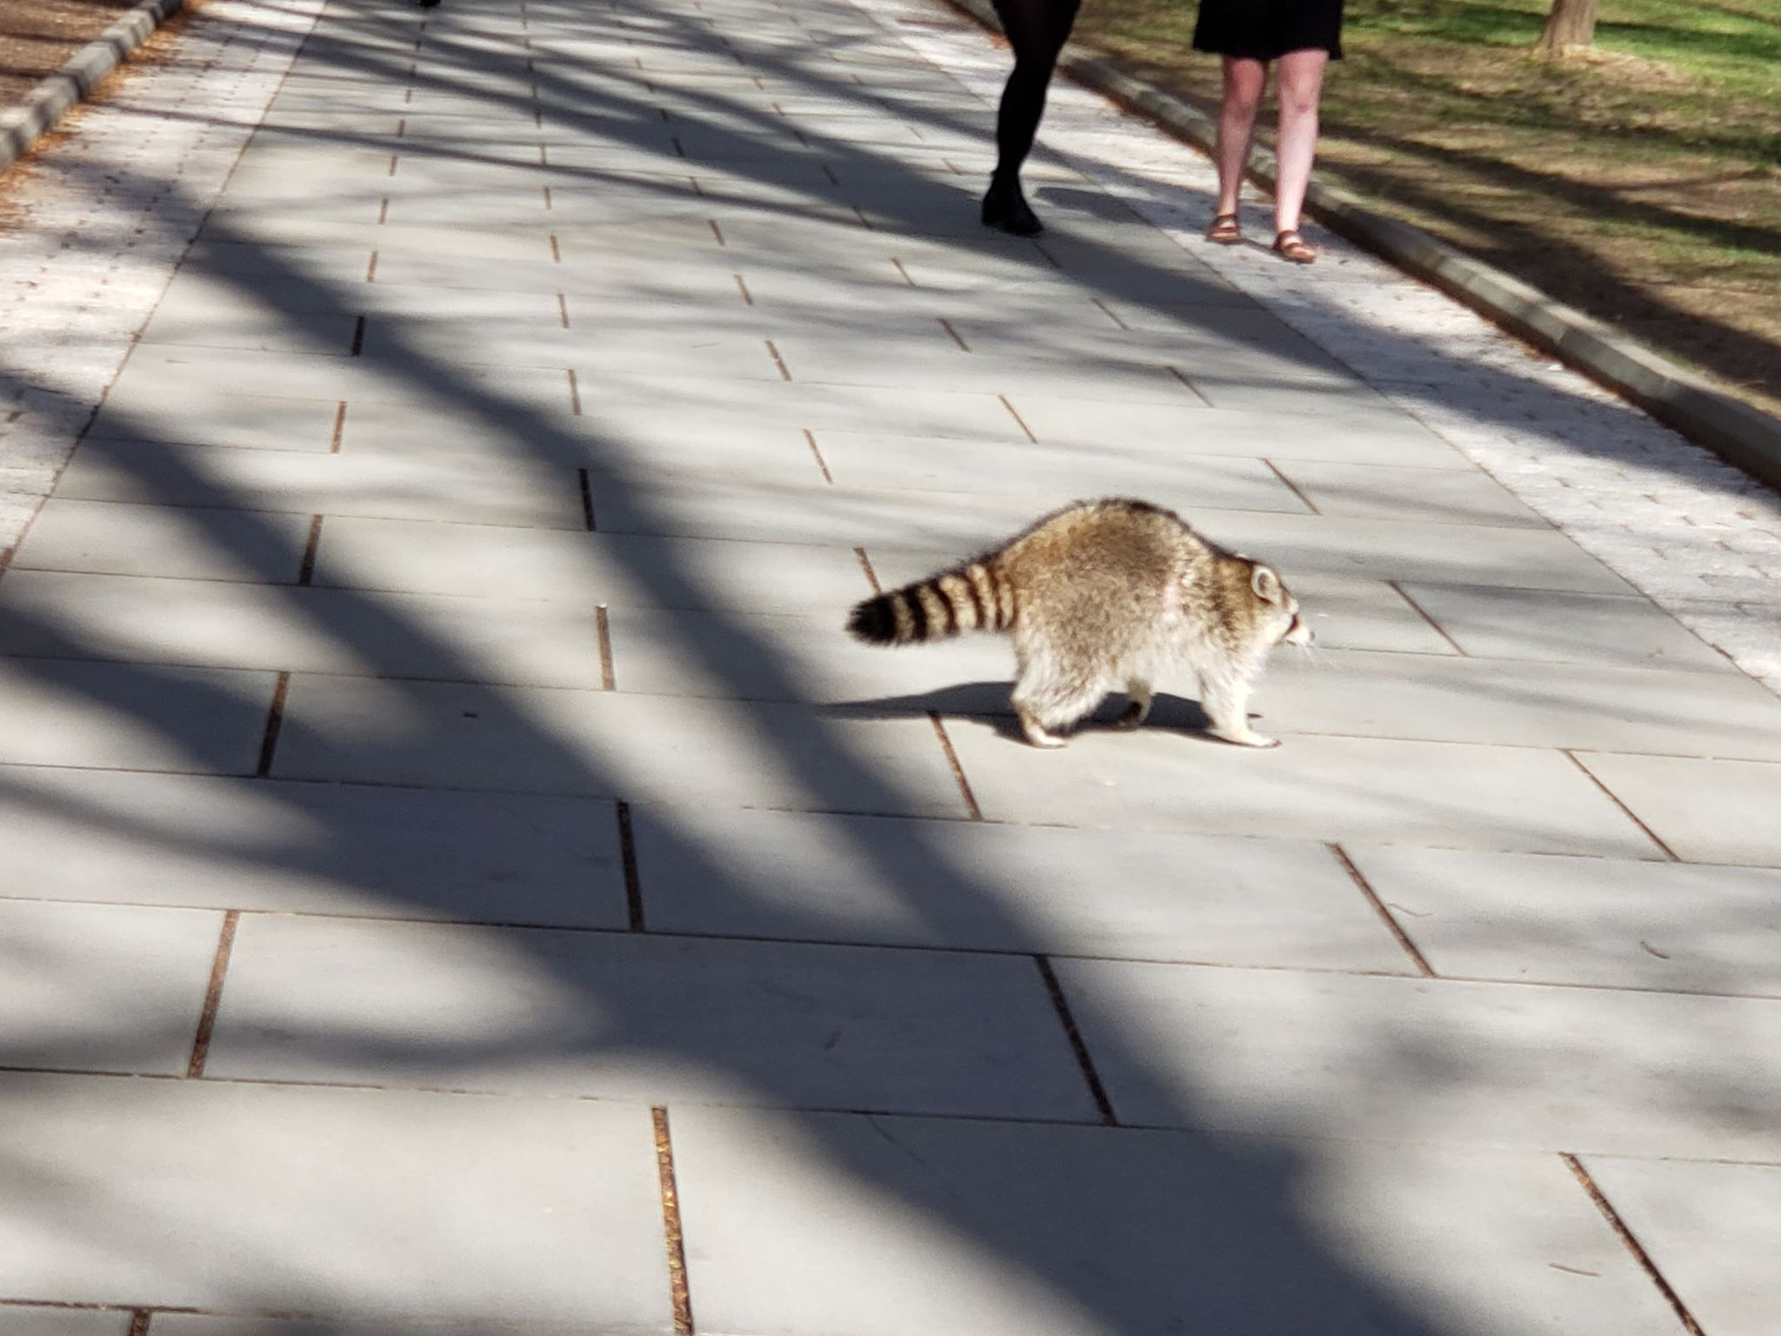
Chubby: Distributed Lock Service
Sherry Bai and Haochen Li
A chubby raccoon on McCosh Walk. Photo by Yang Song ‘20

Slide 2
Problem Statement
Chubby (OSDI ‘06) is a distributed locking service built by Google.
Our goal is to implement a lock service like Chubby in Go using the Raft protocol.

Slide 3
Key Idea
Chubby is designed to provide coarse-grained advisory locks, intended to be held for longer durations (hours or days).
Allows developers to use familiar lock-based semantics for distributed coordination issues (e.g., leader election)
Easier to use and easier to integrate into existing systems compared to a client library for consensus.
The design emphasis is on reliability and availability, rather than on high performance.

Slide 4
Key Challenges
How to maintain easy-to-understand semantics so that developers can easily introduce replication/primary election into existing projects?
How to ensure reliability and availability, even during failover events?

Slide 5
System Architecture
Chubby involves two primary components:
Library: exposes a filesystem-like API that clients use to interact with Chubby servers.
Open/close a file handle; delete a file; get/set contents of a whole file; acquire/release a lock
Any file or directory can be used as a lock.
Servers: organized into sets of five servers called cells. Chubby state changes are replicated across servers via a consensus protocol (Paxos).

Slide 6
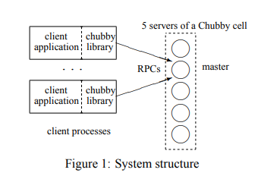
System Architecture

Slide 7
Technical Details: Sessions and Leases
Chubby clients maintain sessions with Chubby cell masters.
Each session has an associated lease. Clients send KeepAlive RPCs to master servers to extend the lease.
Leases end when either party explicitly ends the lease, or when the master fails to respond to a KeepAlive after the client lease timeout (12s) + failover grace period (45s).

Slide 8
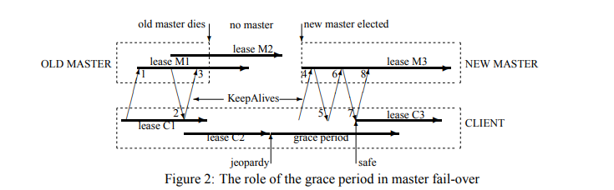
Technical Details: Sessions and Leases

Slide 9
More Technical Details
Programming language: Go
We will use the Raft protocol for consensus.
The original Chubby service uses some version of Multi-Paxos, but open-source Raft implementations are easier to find, better maintained, and easier to use.
We will use the Go implementation of Raft by Hashicorp: https://github.com/hashicorp/raft

Slide 10
Implementation Status
Finished setting up underlying distributed key-value store for the lock service using the Hashicorp Raft library.
We will treat files as key-value pairs (filepath, contents) in the key-value store. This is okay because Chubby only performs whole-file reads/writes.
We have brought up a cell of five nodes locally and tested that the cell behaves properly.
Clients can currently interact with our system by sending RPC requests over TCP. We have not yet implemented sessions or leases.

Slide 11
Evaluation Plan
We will use Docker Compose to bring up five Chubby nodes, each running in a separate Docker container.
We will use the chaos testing tool Pumba (https://github.com/alexei-led/pumba) to introduce random node failures. This will allow us to ensure that Chubby behaves properly during failover events.
We will use Pumba to introduce network delays and partitions.
We will test how our system performs under heavy load.
This may require us to tune certain parameters (e.g., client lease times, failover grace period) for optimal performance.

Slide 12
Plan for Final Month
Currently setting up Docker environments for each node. We will probably test out Pumba on our current barebones system before proceeding with the rest of the implementation.
Finish implementing all procedures in the Chubby library API.
Implement sessions/leases.
Perform correctness, performance, and fault-tolerance evaluations using Pumba.
Implement more advanced functionality, such as lock sequencers, if there is time.

