Slide 1
Student Presentation Kafka: Exactly Once Semantics
COS 518: Advanced Computer Systems
Jinzheng Tu
03/13/19

Slide 2
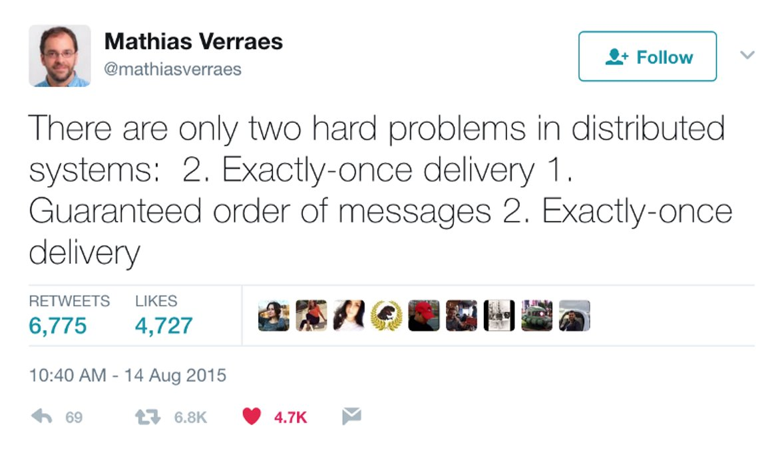
Problem Statement / Motivation
Stream processing: distributed version of wc(1)
Read a line
Split by space
Group by word, count occurrences
For correctness, we desire exactly once processing from end-to-end

Slide 3


Previous Solutions
Written in Erlang
At-least-once semantics
Written in Java
Exactly-once semantics
Transaction support
Written in Java
Exactly-once semantics
Transaction support

Slide 4
Key Challenges
Exactly Once: In a distributed publish-subscribe messaging system, various failures may cause a single message to appear twice in the messaging system, leading to incorrect result.
Broker failure
RPC (network) failure
Client failure

Slide 5
Key Challenges
Transactional Messaging: Atomically read/write multiple messages to multiple partitions
Consume one line from LINES
Split by spaces
Publish all the words into WORDS

Slide 6
Key Idea: Sequence Number
Producer send a sequence number with each message
Broker can then detect if it's a new message or just a previous one retried.
What if the producer fail?
Use transaction!

Slide 7
Key Idea: Coordinators
An internal topic, transaction topic, is organized by a unique module called transaction coordinator
Consumer offests, used to denote if a consumer (group) has taken or not taken a certain message, is organized by another moduled called consumer coordinator

Slide 8
Key Result (Evaluation)
Minimal overhead per transaction:
Exactly-once in-order is 3% slower than at-least-once in-order (1 in-flight)
Exactly-once in-order is 20% slower then at-lesat-once out-of-order (5 in-flights)
However, Stream API suffers from exactly-once semantics, when the commit interval is short (100ms):
15%-30% thoroughput degradation

Slide 9
Impact
Kafka is now a very popular – de facto the only:
open source
large-scale
distributed
messaging/stream processing system.
2016: LinkedIn Yahoo Twitter Netflix Square Spotify Pinterest Uber Goldman Sachs Tumblr PayPal Box Airbnb Mozilla Cisco Etsy Tagged Foursquare StumbleUpon Coursera Shopify Cerner Oracle Oracle Golden Gate CloudFlare Mate1.com Inc. Boundary Ancestry.com DataSift Spongecell Wooga AddThis Urban Airship Metamarkets Simple Gnip Loggly RichRelevance SocialTwist Countandra FlyHajj.com uSwitch InfoChimps Visual Revenue Oolya Datadog VisualDNA Sematext Wize Commerce Quixey LinkSmart LucidWorks Big Data Cloud Physics Graylog2 Yieldbot LivePerson Retention Science Strava Outbrain SwiftKey Yeller Emerging Threats Hotels.com Helprace Exponential Livefyre Exoscale Cityzen Data Criteo The Wikimedia Foundation OVH Helpshift Parsely VividCortex Trivago Ants.vn IFTTT Homeadvisor Skyscanner IBM Message Hub iPinYou MailChimp ...
https://cwiki.apache.org/confluence/display/KAFKA/Powered+By

Slide 10
Technical Details

Slide 11
Key Idea: Idempotent Producer
Every producer is assigned a unique identifier, PID
Managed by Apache Zookeeper
Within a single producer, w.r.t. every partition to publish,
Every message is tagged with a sequence number
Increase 1 each time
Broker rejects duplicated message or missing ones by checking if the sequence number increases exactly 1 each time

Slide 12
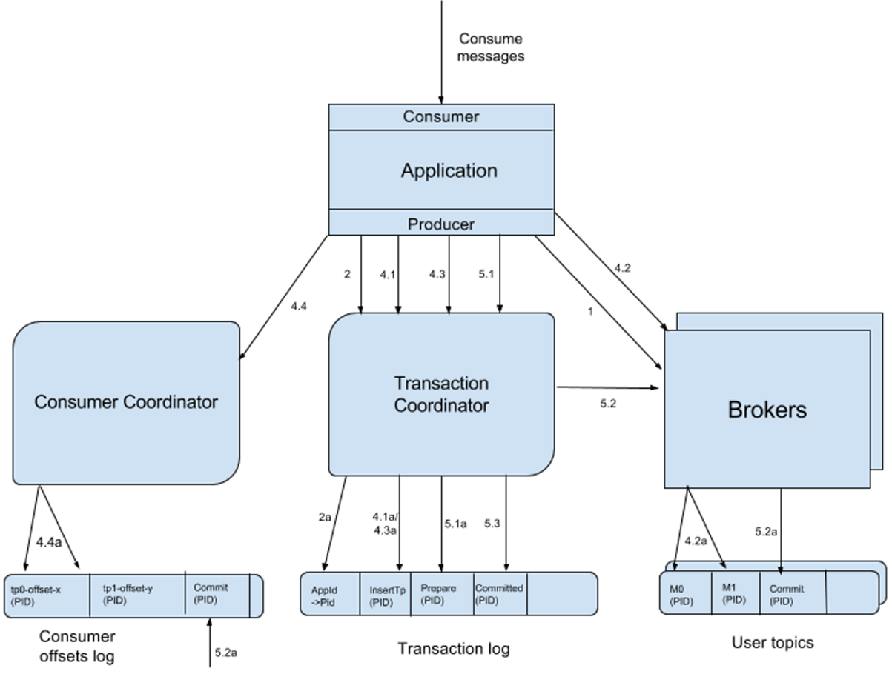
Key Idea: Transactional Messaging

Slide 13
Key Idea: Transactional Messaging
Every application has a unique TransactionID
which persists across producer failure
Transaction coordinator maintains (in memory)
A map from TransactionID to PID
A map from PID to transactional state, last update
Both coordinators rely on memory to store the transactional metadata; persist if commits, forget if aborts
Consumers are offered both committed messages and non-committed (speculative) messages for performance

Slide 14
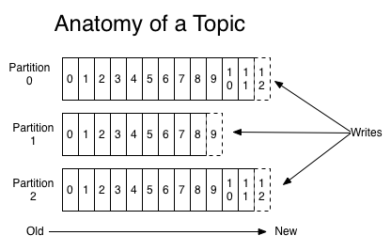
Logical view of Kafka: Publish
Topic
Publish
Producer
Different partitions store different messages.
Producer choose one partition to publish.
Data are never removed when being read​ by clients;
Instead, they are removed when certain time (say, two days) passed since published.​

Slide 15
Logical view of Kafka: Deliver
Consumer
Group
Consumer
Deliver
Consumer
All partitions of a topic deliver their message to every consumer group
Within a group, only one consumer should receive the message.

Slide 16
Physical view of Kafka cluster
Server 1
Server 2
Each partition may be distributed and replicated by a set of servers;
Leader-follower design

