Slide 1
Student Presentation Optimizing Space Amplification in RocksDB
COS 518: Advanced Computer Systems
Jennifer Lam
February 27, 2019

Slide 2
Problem Statement / Motivation
Machines resources are underutilized.
CPU usage is < 40%.

Slide 3
Problem Statement / Motivation
Machines resources are underutilized.
CPU usage is < 40%.
Too little useful data stored per node.

Slide 4
Problem Statement / Motivation
Machines resources are underutilized.
CPU usage is < 40%.
Too little useful data stored per node.
Migrating to storage on SSD’s.

Slide 5
Problem Statement / Motivation
Machines resources are underutilized.
CPU usage is < 40%.
Too little useful data stored per node.
Migrating to storage on SSD’s.
Low query rate.

Slide 6
Resource Underutilization at Facebook
Machines resources are underutilized.
CPU usage is < 40%.
Too little useful data stored per node.
Migrating to storage on SSD’s.
Low query rate.
Bottleneck: space amplification.

Slide 7



Prior Solutions

Slide 8
Key Idea
RocksDB is an embedded KV storage engine that optimizes space efficiency (SSD’s).

Slide 9
Key Idea
RocksDB is an embedded KV storage engine that optimizes space efficiency (SSD’s).
Ensures that read/write latencies are within some acceptable bound.

Slide 10
Key Idea
RocksDB is an embedded KV storage engine that optimizes space efficiency (SSD’s).
Ensures that read/write latencies are within some acceptable bound.
Reduces space usage by using LSM-tree based storage + a series of optimization techniques.

Slide 11
Key Challenges
Aggressively reduce space amplification = all data stored / useful data stored.

Slide 12
Key Challenges
Aggressively reduce space amplification = all data stored / useful data stored.
LSM tree
Dynamic level size
Compression (of sstables)

Slide 13
Key Challenges
Aggressively reduce space amplification = all data stored / useful data stored.
Tradeoff between space amplification vs read/write amplifications: RUM conjecture.

Slide 14
Key Challenges
Aggressively reduce space amplification = all data stored / useful data stored.
Tradeoff between space amplification vs read/write amplifications: RUM conjecture.
Tiered compression
Bloom filters
Prefix bloom filters.

Slide 15
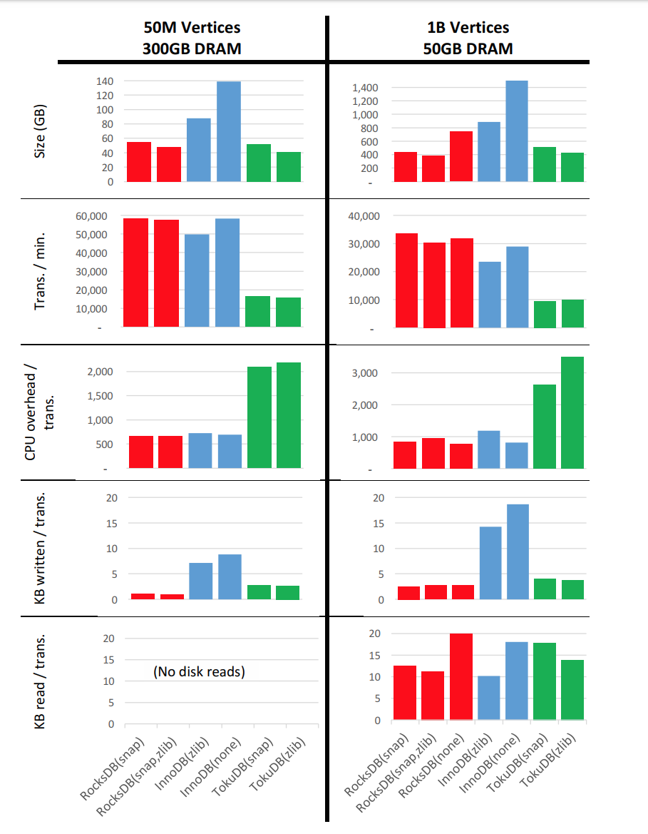
Key Result (Evaluation)

Slide 16
Key Result (Evaluation)
Storage space used by RocksDB 50% lower than storage space used by InnoDB.
Data written to storage is 10-15% of what InnoDB wrote.
Number and volume of reads is 10-15% higher in RocksDB than InnoDB (acceptable).

Slide 17
Impact
First LSM-tree based storage engine to demonstrate competitive performance on OLTP workload.
Exploits storage on SSD’s.

Slide 18

Impact
MyRocks (MySql)
Dragon
Stylus

Slide 19




Impact
MyRocks (MySql)
Dragon
Stylus

Slide 20
Technical Details

Slide 21
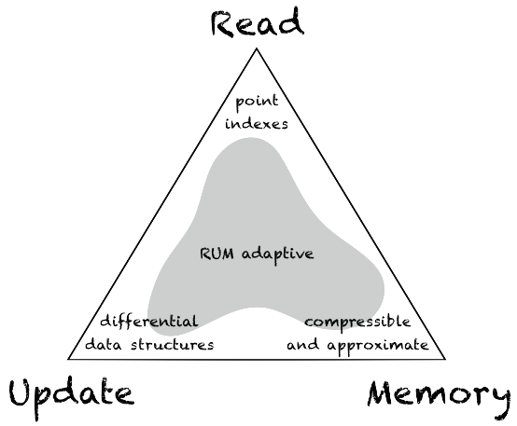
Key Idea: Tradeoffs

Slide 22
Key Idea: Tradeoffs
Tiered Compression:
Storage space vs. CPU overhead
Level 0-2 remain uncompressed
Last level is strongly compressed
Levels in between are weakly compressed.

Slide 23
Key Idea: Tradeoffs
Bloomfilters (per level):
Reduced IO + CPU overhead vs. storage space
No bloomfilter at the last level -> bloomfilter is so huge it hogs the cache when it is read in.
Bloomfilter at every level other than that.

Slide 24
Key Idea: Tradeoffs
Bloomfilters (per level):
Reduced IO + CPU overhead vs. storage space
No bloomfilter at the last level -> bloomfilter is so huge it hogs the cache when it is read in.
Bloomfilter at every level other than that.
Prefix Bloomfilters (help with range queries)

Slide 25
Key Idea: Space Amplification Reduction
Space Amplification = all data stored / meaningful data stored
Dynamic level sizing (usually 10, sometimes 8).
Compression of SSTables.
Strong compression: 25% of original space
Weak compression: 40% of original space

Slide 26
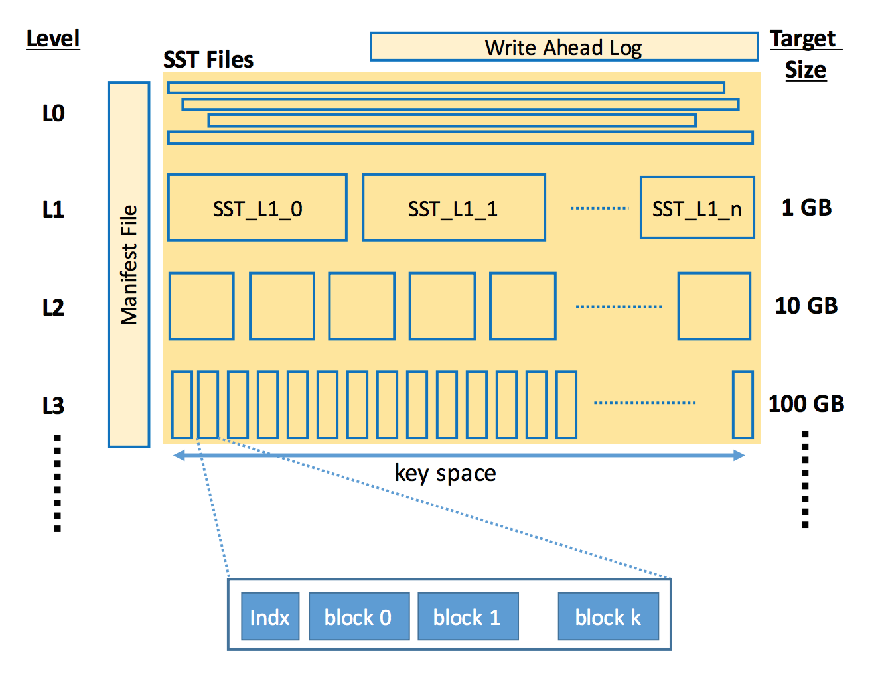
Key Idea: LSM-tree Based Storage

