Slide 1
Calvin: Fast Distributed Transactions for Partitioned Database Systems
COS 518: Advanced Computer Systems
James Heppenstall
February 20, 2019

Slide 2
Motivation
Trend 1: Move away from supporting ACID database transactions across multiple partitions
Some commercial systems (Dynamo, MongoDB) provide no transactional support
Other systems (Azure, Megastore) only provide limited transactionality
Notes:
Trend 1 (2012): Distributed database design moving away from supporting ACID database transactions across multiple partitions in favor of scalability.
Burden of ensuring atomicity and isolation left to application developer, resulting in increased complexity, slower development, etc.
Examples: Amazon Dynamo, (eponymous) MongoDB, Microsoft Azure, Google Megastore, etc.
Counterexample: VoltDB provides full ACID transactions but ceases (or limits) concurrent transaction execution across multiple partitions.

Slide 3
Motivation
Trend 2: Reversal of reduced consistency guarantees with respect to replication
Older systems (Dynamo, PNUTS) reduce consistency guarantees for replicated data, citing CAP Theorem
Newer systems (Megastore, Spinnaker) support strongly consistent replication
Notes:
Trend 2 (2012): Distributed database design seeing reversal of reduced consistency guarantees with respect to replication.
Authors claim improving global information infrastructure makes network partitions rare (CAP Theorem becoming less relevant).
Strongly consistent (i.e. linearizable) systems can often achieve 99.9% uptime in practice.
Old Examples: Amazon Dynamo, Yahoo PNUTS, etc.
New Examples: Google Megastore, IBM Spinnaker, etc.

Slide 4
Calvin
Layer running on top of a non-transactional storage system, transforming it into a shared-nothing, (near)-linearly scalable distributed database system that provides high availability¹ and full ACID transactions
¹ “High availability” means database can fail over on the fly with no downtime (different from CAP Theorem)
Notes:
Calvin: Provides layer between storage system and client application that handles strongly consistent replication, serial scheduling of distributed transactions, concurrency control, and network communication.

Slide 5
Previous Solutions
IBM System R* (1980s): Pioneered distributed transactions
Relied on distributed commit protocol (think 2PC) among partitions to ensure atomicity and durability
Held transaction’s locks for duration of commit protocol to ensure isolation
High contention footprint
Low throughput
Notes:
IBM System R*: Distributed database management system using presumed abort (PA) and presumed commit (PC), both extensions of the two-phase commit (2PC) protocol.
Contention Footprint: The total duration that a transaction holds its locks (including the duration of any commit protocol).
Problem with holding locks during the commit protocol is the multiple network round-trips, increasing contention and reducing throughput.
Authors focus on pessimistic concurrency control but do mention that optimistic schemes are far from ideal due to cascading aborts.

Slide 6
Key Idea
Design Principle: Move as much heavy lifting as possible to earlier in transaction pipeline, before locks are acquired
Low contention footprint
Key Technical Idea: Deterministic locking protocol that eliminates need for distributed commit protocols
High throughput
Notes:
Design Principle: When multiple partitions must agree on how to handle a transaction, they do so outside of transactional boundaries.

Slide 7
Determinism is Useful
Transactions either commit or abort
Transaction aborts fall into two categories:
Nondeterministic: Node failures
Deterministic: Distributed deadlock, transaction logic forcing an abort, etc.
Deterministic aborts can be detected before locks are acquired
Doesn’t need to be part of commit protocol
Notes:
Nondeterministic Aborts: Node failures.
Deterministic Aborts: Distributed deadlock, transaction logic forcing an abort (i.e. an inventory stock level would fall below zero otherwise), etc.
Clearly, deterministic aborts can be detected and sometimes even corrected before locks are acquired (doesn’t need to be part of the commit protocol).
Nondeterministic aborts, on the other hand, inherently need to be part of the commit protocol.

Slide 8
Determinism is Useful
Consider the following:
Client application sends transaction requests
Replicate and log transaction requests at each partition
Produce globally ordered, serial log of transaction inputs
Execute relevant transaction inputs on each replica (acquiring locks of course)
Notes:
Thought Experiment
Client application sends transaction requests.
Synchronously replicate (via Paxos/RAFT consensus protocols) and log transaction requests at each partition.
Produce a globally ordered, replicated log of transaction inputs equivalent to some serial order of transactions to ensure isolation.
Execute relevant transaction inputs on each replica (acquiring locks for concurrency control).

Slide 9
Determinism is Useful
If we guarantee the final state of replicas do not diverge, we can design a system in which node failures do not abort transactions
Some replica takes over to complete transaction
Nondeterministic aborts can be ignored
Eliminates need for distributed commit protocol at end of transaction
Low contention footprint
Notes:
Failed node can recover from a replica, or alternatively, by replaying transactional inputs in its log (using checkpoints to optimize).
Determinism: Eliminates need for a distributed commit protocol at the end of a transaction (i.e. the need to check for a node failure which could cause a nondeterministic abort).

Slide 10
Deterministic Locking Protocol
If the concurrency control layer of the database is modified to acquire locks in the order of the agreed upon transactional input (and several other minor modifications are made), all replicas can be made to emulate the same serial execution order, and database state can be guaranteed not to diverge.

Slide 11
Technical Details

Slide 12
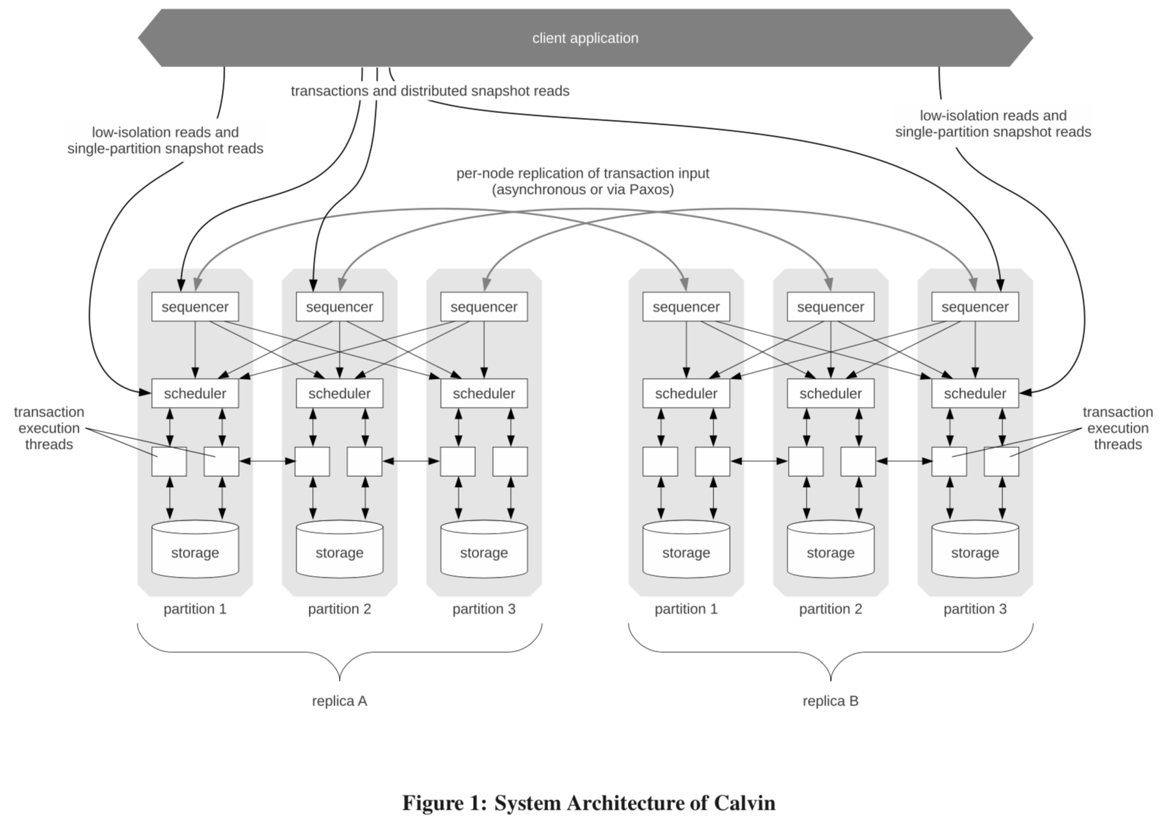
System Architecture

Slide 13
System Architecture
Sequencing Layer:
Intercepts batches of transactional inputs
Places them in a global, serial, and replicated transactional input sequence (think log)
Scheduling Layer:
Executes transaction inputs using deterministic locking protocol
Storage Layer:
Simple CRUD interface
Notes:
Sequencing Layer
Intercepts batches of transactional inputs (10ms epochs).
Places them in a global, serial, and replicated transactional input log (interleaves batches in a deterministic, round-robin manner).
Scheduling Layer
Executes transaction inputs using deterministic locking protocol (five phases outlined in section 3.2)
Allows for concurrency via a pool of transaction execution threads.
Storage Layer

Slide 14
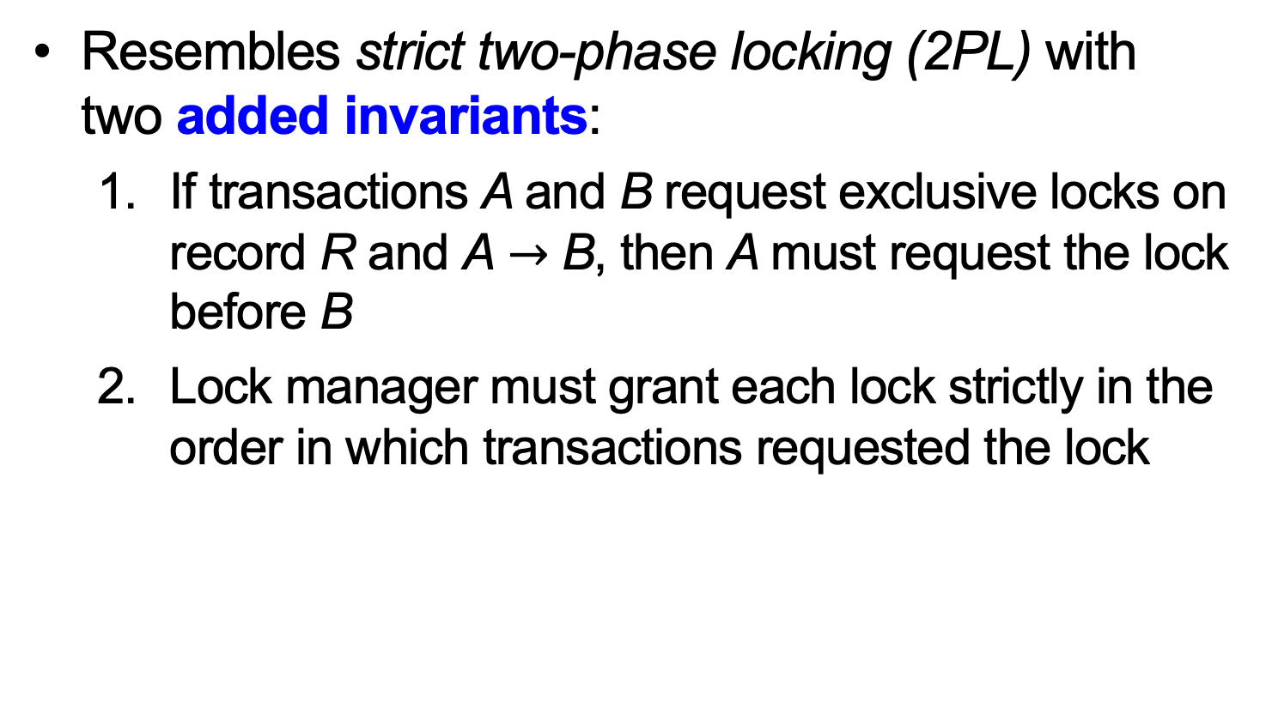
Deterministic Locking Protocol
Resembles strict two-phase locking (2PL) with two added invariants:
If transactions A and B request exclusive locks on record R and A $→$ B, then A must request the lock before B
Lock manager must grant each lock strictly in the order in which transactions requested the lock

Slide 15
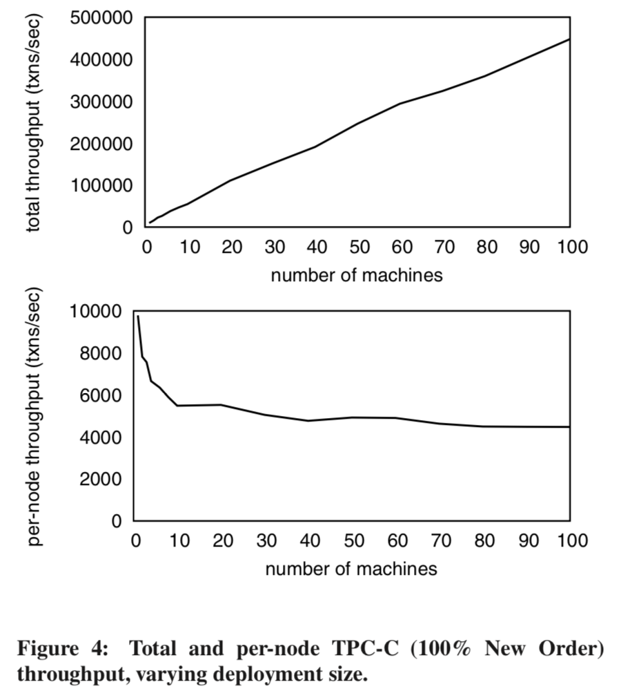
TPC-C Benchmark
Notes:
TPC-C Benchmark: Simulates distributed transactions requiring a high degree of isolation.
Calvin is able to achieve around 5,000 txns/sec on clusters larger than 10 nodes and scales linearly.
Authors note that the current world record holder runs 504,161 txns/sec, which can be achieved on an approx. 100 node cluster.

Slide 16
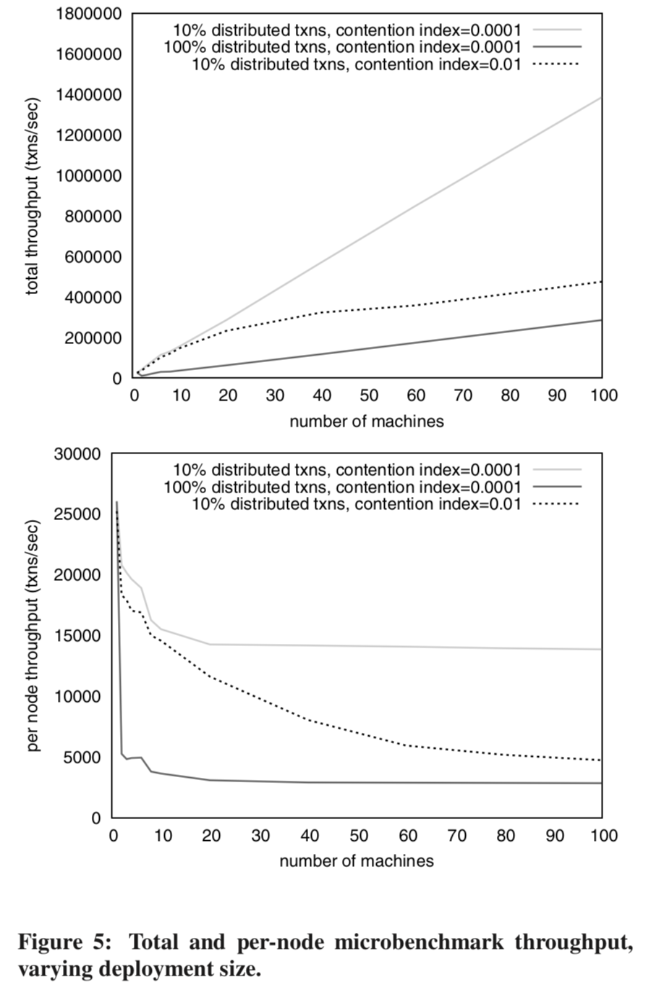
Microbenchmark Experiments
Notes:
Microbenchmark: Mimicks TPC-C benchmark but allows for finer adjustments to the workload (in particular the contention index).
Shape of scalability curve can be attributed to serializing/deserializing remote reads, context switching while waiting for remote reads, setting up, executing, and cleaning up after transaction completes at all participating nodes even though it counts once for throughput.
Throughput per-node is limited in Calvin to that of the slowest machine and execution progress skew (other nodes will eventually have to wait for the slowest one).

Slide 17
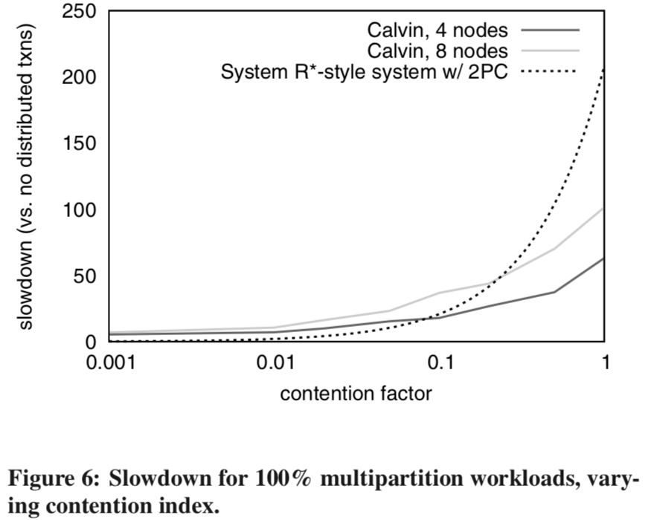
Handling High Contention
Notes:
Calvin with 8 nodes experiences greater slowdown than Calvin with 4 nodes as the contention factor increases.
Execution Progress Skew: Every machine gets slightly ahead or behind of others due OS thread scheduling, network latencies, random variations, etc.
Execution progress skew forces machines to wait for each other, thereby reducing throughput.
It is worth noting that the system R*-style system with 2PC is a theoretical result (very poor comparison).

Slide 18
Evaluation / Impact
Shows that geographically replicated, ACID-compliant, transactional databases with high availability and near-linear scalability are feasible
Paper cited hundreds of times
Influenced design of FaunaDB
Notes:
Calvin paper was published in SIGMOD 2012, slightly before the Spanner paper was published in OSDI 2012.
Both papers showed that geographically replicated, ACID-compliant, transactional databases with high availability and near-linear scalability are feasible and practical.
FaunaDB: Calvin influenced the design of this commercial system.

