Slide 1

There Is More Consensus in Egalitarian Parliaments
Authors: Iulian Moraru, David G. Anderson, Michael Kaminsky
Presenter: Sherry Bai

Slide 2
Background
State machine replication: make all (non-faulty) processors in a distributed system execute same commands in same order
Paxos consensus protocol
One slot (instance) per command
All non-faulty processors agree on one command to assign to each instance
Voting for different instances can be concurrent

Slide 3
Paxos Overview
1. Replica receives command request from client
2. Tries to become leader of unused instance
Send Prepare messages to majority of peers
Replica R
A
B
...
1
2
3
4
5
6
7
8
Instances

Slide 4
Paxos Overview
1. Replica receives command request from client
2. Tries to become leader of unused instance
Send Prepare messages to majority of peers
Replica R
A
B
...
1
2
3
4
5
6
7
8
Instances

Slide 5
Paxos Overview
3. If ACKs received from majority of replicas, propose command
Send Accept messages to majority of peers
4. If ACKS for Accept received from majority of peers, commit locally
Replica R
A
B
C
...
1
2
3
4
5
6
7
8
Instances

Slide 6
Paxos Overview
3. If ACKs received from majority of replicas, propose command
Send Accept messages to majority of peers
4. If ACKS for Accept received from majority of peers, commit locally
Committing takes at least 2 RTT!
Difficult to achieve high throughput in practical system
Replica R
A
B
C
...
1
2
3
4
5
6
7
8
Instances

Slide 7
Optimizing Paxos
Multi-Paxos: Single stable master controls all instances
Master can become a bottleneck
Availability problem when master fails
Mencius: Distributes master responsibilities round-robin
New instance cannot be committed before previous instances
Progresses at speed of slowest replica
Generalized Paxos: Non-conflicting writes committed out of order

Slide 8
Egalitarian Paxos (EPaxos)
Dynamic and decentralized ordering of instances
Commands committed independently, with ordering constraints attached
At command execution, each replica uses constraints to arrive at same ordering

Slide 9
Egalitarian Paxos (EPaxos)
High throughput through uniform load balancing
No master: any replica can handle client requests
Low commit latency in the wide-area
1 RTT for fast path commits (common case); 2 RTT for slow path
Client can communicate with geographically-closest replica
Graceful performance degradation when replicas are slow or crash
Requires only simple majority of replicas to be non-faulty
Quorums can be chosen to avoid slow/unresponsive replicas

Slide 10
Replica State
Each replica owns a “row” instead of contending for instances
Ordering constraints (dependencies) determine final execution order
Replica P
D
...
Replica Q
B
...
Replica R
A
C
...
1
2
3
4
5
6
7
8
Instances

Slide 11
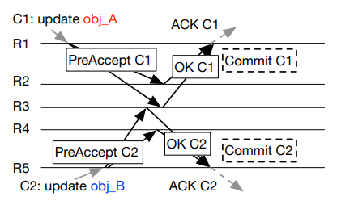

Commit Protocol: Fast Path
Replica L can commit command γ in 1 RTT if γ does not interfere with other commands
Must receive fast-path quorum of PreAccept responses with same dependencies and sequence number for γ as
stored in L
Fast-path quorum:

Slide 12
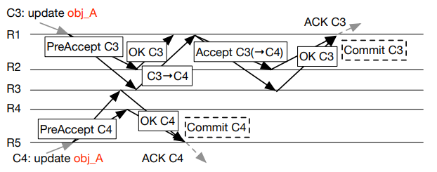
Commit Protocol: Slow Path
L must send additional Accept message to simple majority of replicas with updated dependencies and sequence number
On receiving ACKs from simple majority: commit

Slide 13
Execution Algorithm
Build dependency graph for γ recursively from γ’s dependency list
Topologically sort strongly connected components
Sort within strongly connected components by sequence number
Execute in order
C
A
B
E
F
D

Slide 14
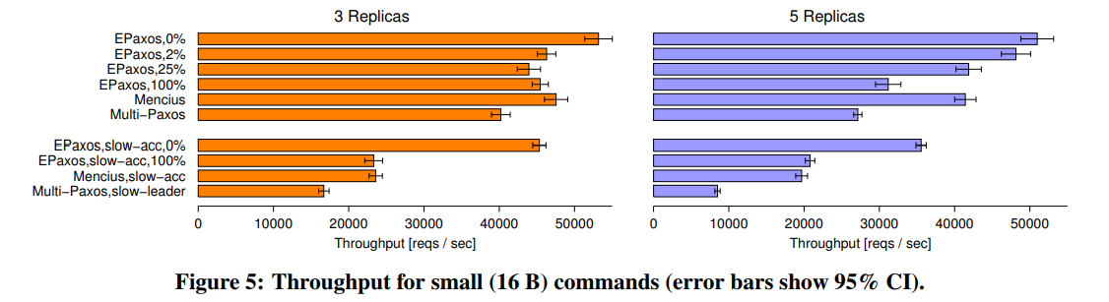
High Throughput Within Clusters
Notes:
EPaxos with high conflict rates: 1 extra round per command
Bottom: one node slow

Slide 15
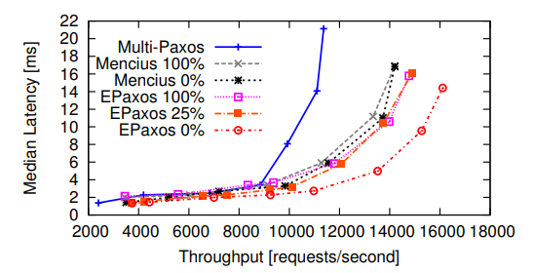
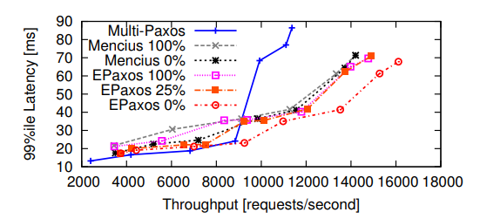

High Throughput Under Increasing Load

Slide 16
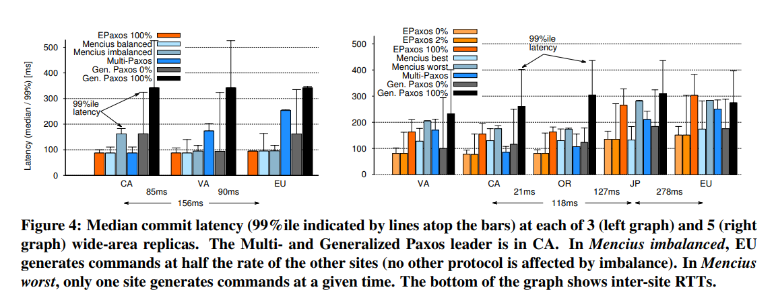
Low Commit Latency in the Wide-Area

Slide 17
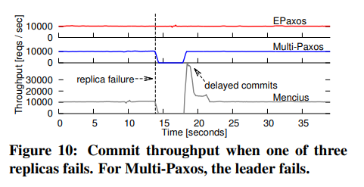
Resilience to Replica Failures

Slide 18
Related and Future Work
Raft (Ongaro et al., 2014)
Emphasizes understandability; less performant than EPaxos under some conditions
Follow-up work on quorum leases (Moraru et al. 2014)
Allow a majority of replicas in a Paxos-like system to perform strongly consistent local reads
Well-suited for leaderless Paxos variants such as EPaxos: no master that needs to be included in every quorum

