Slide 1
Student Presentation Spanner: Google’s Globally-Distribute Database
COS 518: Advanced Computer Systems
Zoya Shoaib
20 February, 2019

Slide 2
Problem Statement / Motivation
Manually sharding data is tedious
Every minute the system is down, google is losing millions of dollars
System Needs:
Horizontally Scaling Database
ACID properties with global consistency
High Availability

Slide 3
Previous Solutions
Dynamo DB
Presented a key-value eventually consistent DB but it was only replicates within a region
Megastore
Did not achieve high performance for distributed transactions
Scatter
Implements non-blocking commit protocol which is more expensive than 2PC
Provides a variant of snapshot isolation that doesn't work across data centers

Slide 4
Key Idea
True Time API
Global wall-clock time with bounded uncertainty
Assigning global commit timestamps to transactions allows the system to create a serialization order
Uses Atomic clocks and GPS to keep TrueTime uncertainty small
Lock-free read only transactions
Non-blocking stale read only transactions

Slide 5
Key Challenges
How to create a highly scalable system that is globally consistent, fault-tolerant, available, and fast?
How to have strong consistency with wide-area replication?
How can replication configuration for data can be dynamically controlled by applications?
How to calculate a global wall-clock time?

Slide 6
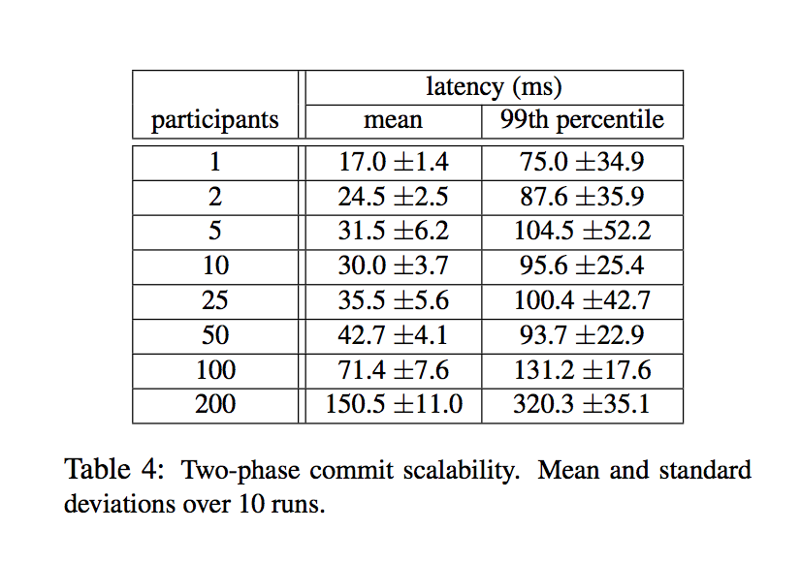
Key Result (Evaluation): Latency
With increased replicas, the latency stays roughly constant
RO transactions throughput increases
With 2PC, scaling up to 50 participants is reasonable in both mean and 99th percentile

Slide 7
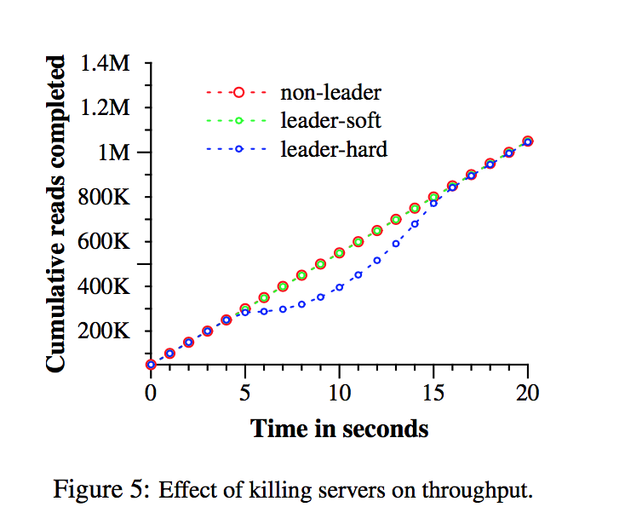
Key Result (Evaluation): Availability

Slide 8
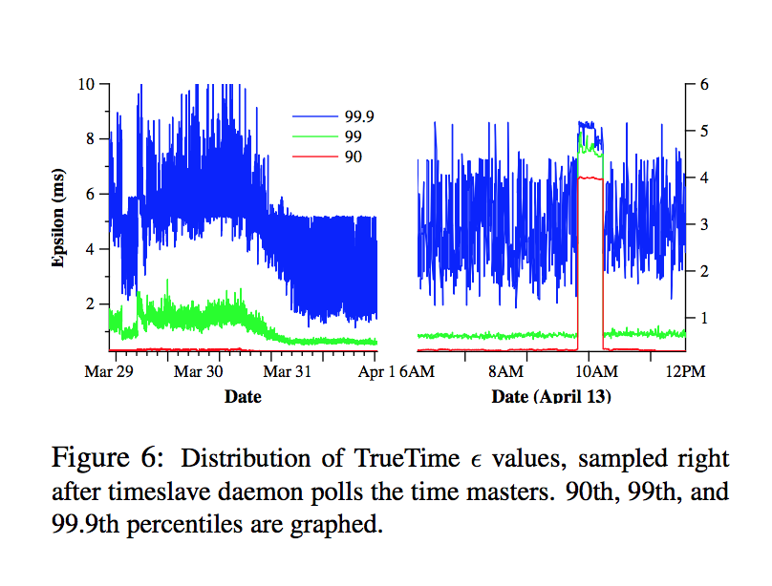

Key Result (Evaluation): True Time
Is $ε$ truly a bound on clock uncertainty?
Problem would occur if drift was greater than 200 microseconds
Faulty clocks?
How bad does $ε$ get?
Doesn’t get worse than 10ms

Slide 9
Impact
Makes it easier for developer to build applications because they can choose:
Which data center contains which data
How far data is from its users (lower read latency)
How far replicas are from each others (lower write latency)
How many replicas are maintained (durability, availability, and read performance)
Globally consistent reads and externally consistent reads and writes

Slide 10
Technical Details

Slide 11
Overall Structure
Dozens of zones (data centers)
Per zone, 100-1000s of servers
Per server, 100-1000of shards (tables)
Every shard is replicated for fault-tolerance
Replicated using Multi-Paxos
Every transaction is kept consistent using True Time

Slide 12
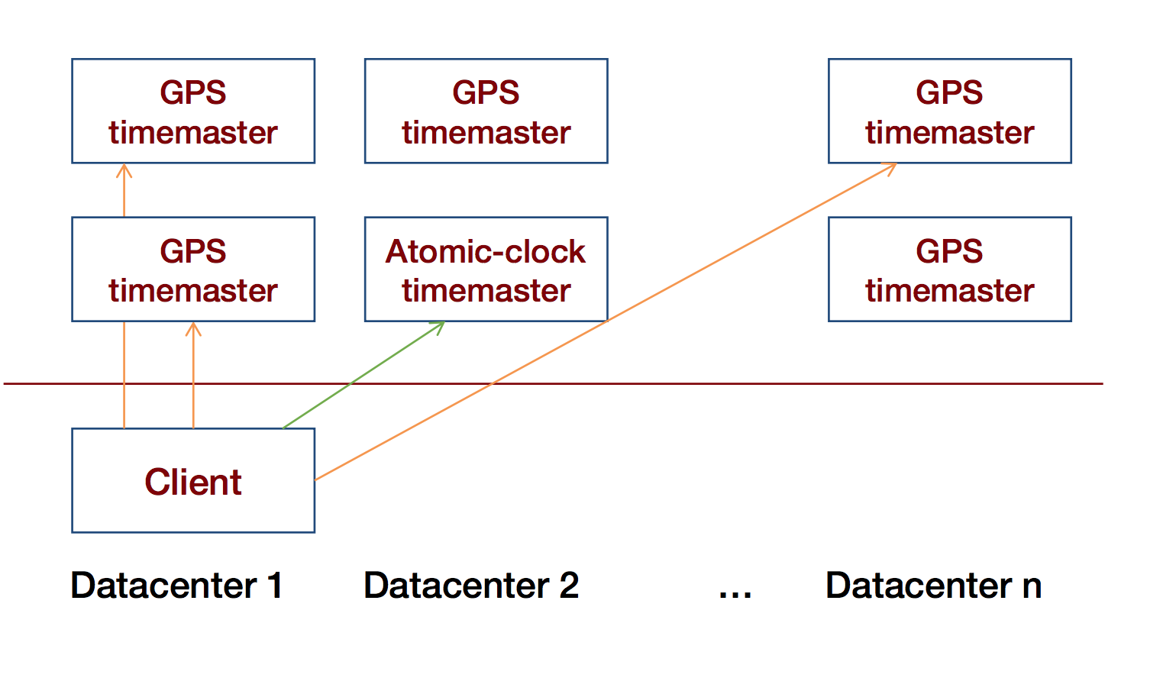
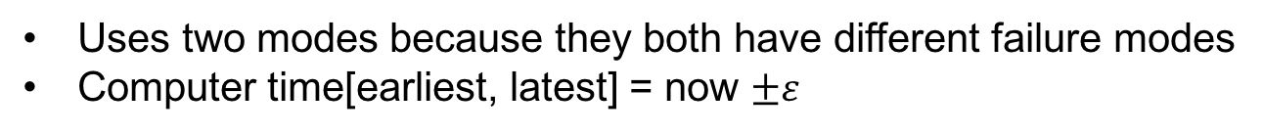
True Time
Uses two modes because they both have different failure modes
Computer time[earliest, latest] = now $±ε$
Notes:
Image reference: https://www.cs.princeton.edu/courses/archive/fall18/cos418/docs/L16-spanner.pdf

Slide 13
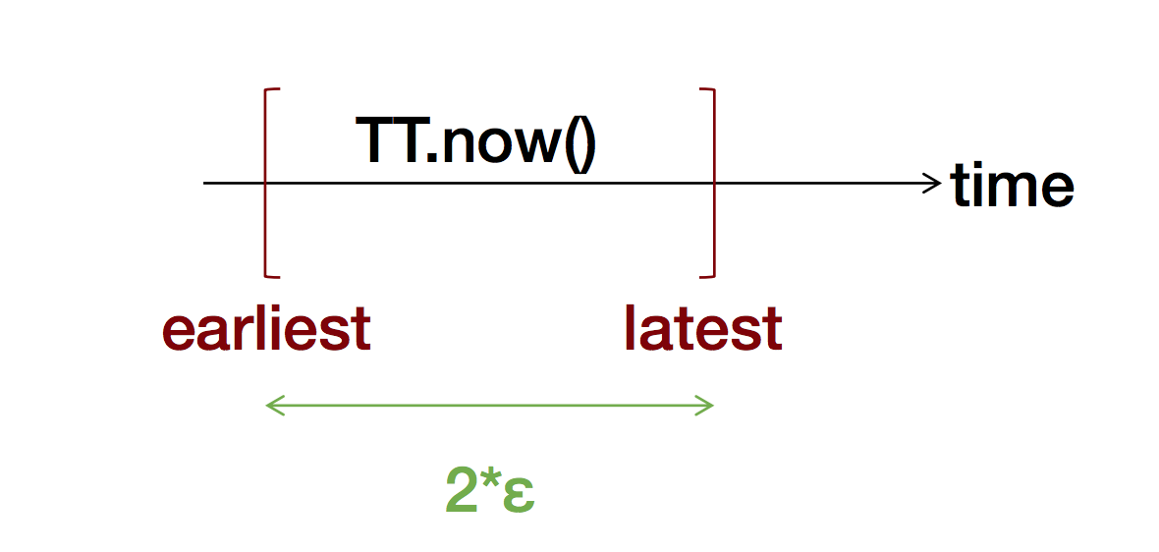
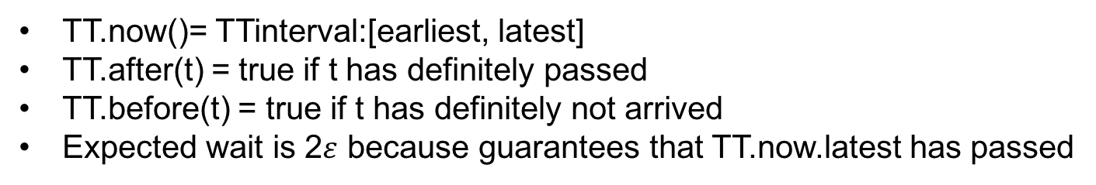
True Time API
TT.now()= TTinterval:[earliest, latest]
TT.after(t) = true if t has definitely passed
TT.before(t) = true if t has definitely not arrived
Expected wait is 2$ε$ because guarantees that TT.now.latest has passed
Notes:
Image reference: https://www.cs.princeton.edu/courses/archive/fall18/cos418/docs/L16-spanner.pdf

Slide 14
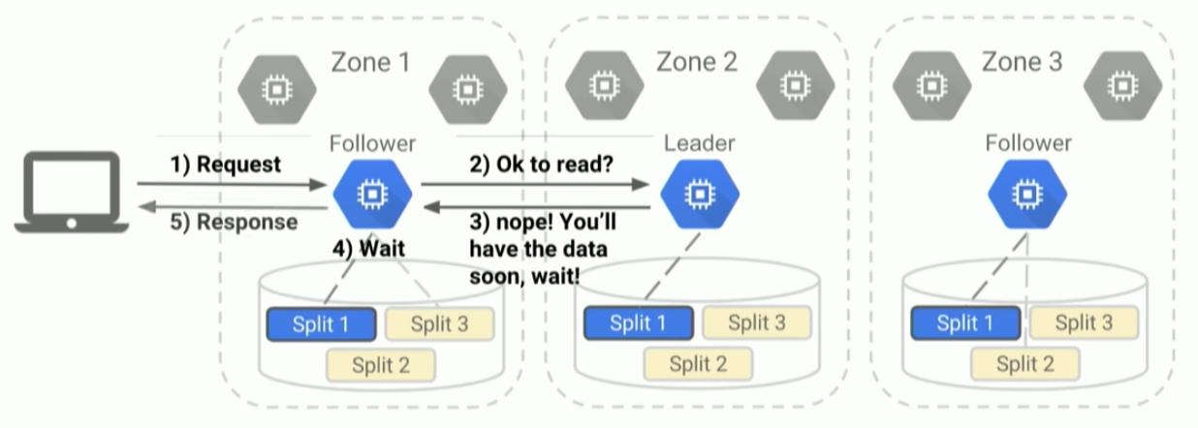
Read-Only Transactions
All transactions are assigned a wall-clock commit time (s)
T_{safe}: all replicas track how up to date they are
All transactions with s < T_{safe} are committed
Client Sends Request
If yes, follower response
s_{read} = TT.now.latest()
If no, follower will wait until s_{read}< T_{safe} and then respond
Stale reads have lower response time
Notes:
Image reference: https://www.youtube.com/watch?v=SB-z3GL9gVY

Slide 15
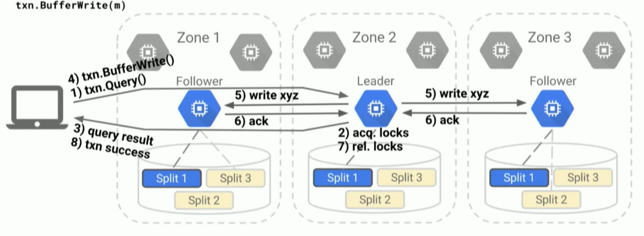
Read-Write Transactions
Assigns timestamps after all locks have been acquired and before any locks have been released
Invariants: Timestamps are assigned in a monotonically increasing order even across leaders
Client issue 2PC after buffering the write
Notes:
Image reference: https://www.youtube.com/watch?v=SB-z3GL9gVY

