Slide 1
Flash storage
COS 518: Advanced Computer Systems
Lecture 9
Michael Freedman

Slide 2
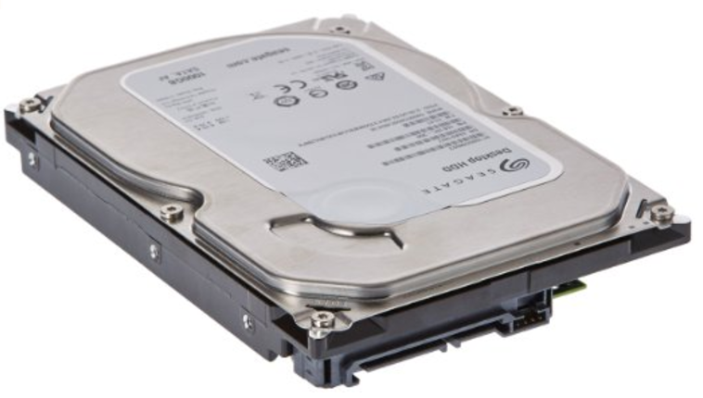
~2016
Seagate ($50)
1TB HDD 7200RPM
Model: STD1000DM003-1SB10C
Operation | HDD Performance
Sequential Read | 176 MB/s
Sequential Write | 190 MB/s
Random Read 4KiB | 0.495 MB/s 121 IOPS
Random Write 4KiB | 0.919 MB/s 224 IOPS
DQ Random Read 4KiB | 1.198 MB/s 292 IOPS
DQ Random Write 4KiB | 0.929 MB/s 227 IOPS
http://www.tomshardware.com/answers/id-3201572/good-normal-read-write-speed-hdd.html

Slide 3
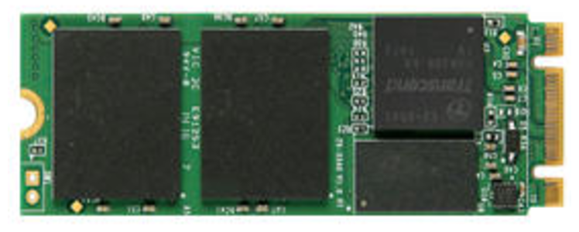
~2016
Seagate ($50)
1TB HDD 7200RPM
Model: STD1000DM003-1SB10C
Samsung ($330)
512 GB 960 Pro NVMe PCIe M.2
Model: MZ-V6P512BW
Operation | HDD Performance | SSD Performance
Sequential Read | 176 MB/s | 2268 MB/s
Sequential Write | 190 MB/s | 1696 MB/s
Random Read 4KiB | 0.495 MB/s 121 IOPS | 44.9 MB/s 10,962 IOPS
Random Write 4KiB | 0.919 MB/s 224 IOPS | 151 MB/s 36,865 IOPS
DQ Random Read 4KiB | 1.198 MB/s 292 IOPS | 348 MB/s 84961 IOPS
DQ Random Write 4KiB | 0.929 MB/s 227 IOPS | 399 MB/s 97,412 IOPS
http://www.tomshardware.com/answers/id-3201572/good-normal-read-write-speed-hdd.html
http://ssd.userbenchmark.com/SpeedTest/182182/Samsung-SSD-960-PRO-512GB

Slide 4
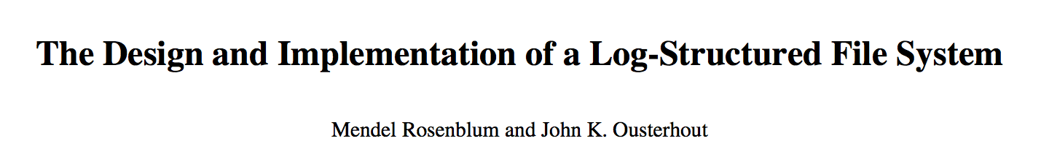
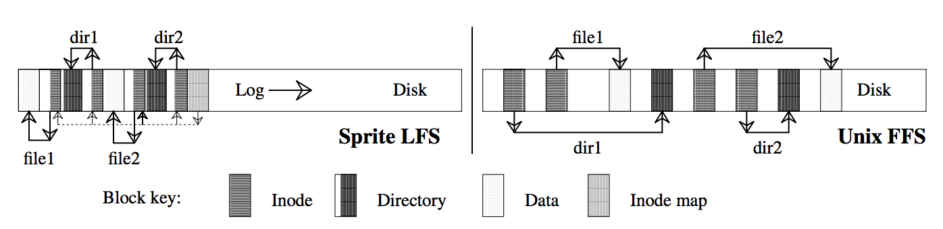
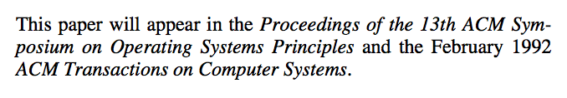
Idea: Traditionally disks laid out with spatial locality due to cost of seeks
Observation: main memory getting bigger → most reads from memory
Implication: Disk workloads now write-heavy → avoid seeks → write log
New problem: Many seeks to read, need to occasionally defragment
New tech solution: SSDs → seeks cheap, erase blocks change defrag

Slide 5
Flash: Storing individual bits

Slide 6

Threshold Voltage (V_{th})
Flash cell
Flash cell
1
0
Normalized V_{th}
Notes:
A flash cell stores different amount of charges in the floating gate to represent different states.
A flash cell that stores a single bit has two states, 1 and 0.
The different states are represented as an analog threshold voltage of the cell, which is shown on the x-axis.
In reality,

Slide 7
Threshold Voltage (V_{th}) Distribution
Probability Density Function (PDF)
1
0
Normalized V_{th}
Notes:
In reality, due to program variation, the threshold voltage of each state is actually distributed across a range.
We typically represent this range on a graph of probability density function as a hump of threshold voltage distribution.

Slide 8
Read Reference Voltage (V_{ref})
Probability Density Function (PDF)
V_{ref}
1
0
Normalized V_{th}
Notes:
In reality, due to program variation, the threshold voltage of each state is actually distributed across a range.
We typically represent this range on a graph of probability density function as a hump of threshold voltage distribution.

Slide 9
Multi-Level Cell (MLC)
Erased (11)
P1 (10)
P2 (00)
P3 (01)
Normalized V_{th}
Notes:
Today’s flash memory typically use multi-level cell that actually store 2 bits instead of 1 bit.
To represent two bits, we now need 4 threshold voltage states, the erased, P1, P2, and P3 states.
For example, if the cell’s threshold voltage is between P1-P2 Vref and P2-P3 Vref, the cell is in P2 state.
In the rest of our talk, we will not show the erased state, because the erased state is less affected by retention loss.

Slide 10
Flash: Storing many bits

Slide 11
Flash: Bit vs. page-level access
NOR flash
Cells connected in parallel to bit lines
Cells can be read and written to individually
NAND flash
Cells connected in series, consuming less space
Smaller area needed to implement certain capacity
Reduce cost per bit, increase max chip capacity
Cells can only be written and read at the page level

Slide 12
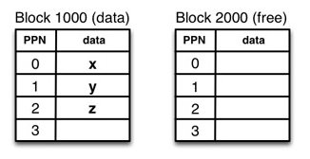
NAND Flash: Architecture
Architecture:
Pages: 8-16 KB, assembled into
Blocks: 4-8 MB

Slide 13
NAND Flash: Reading / writing
Always read an entire page:
Can only read entire aligned page from SSD
Always write an entire page:
To change single byte, need to write entire page
Pages cannot be overwritten
Page can be written only if the “free” state.
Updating: Read page to internal register, modify, then write to free page
Erases are aligned on block size
To make a page “free”, need to erase it
Erasures can only occur at block boundary

Slide 14
Why Erase then Write? Hardware limitation
A freshly erased, blank page of NAND flash has no charged gates; it stores all 1s.
1s can be turned into 0s at the page level, but one-way process.
Turning 0s back into 1s is a difficult operation b/c it uses high voltages.
Difficult to confine the effect only to desired cells; high voltages can change adjacent cells.

Slide 15
Implication: Buffer small writes
To maximize throughput:
Keep small writes into a buffer in RAM
Perform large batch write when buffer full
Suited well for log-structured write (e.g., LSM trees)

Slide 16
SSD architecture

Slide 17
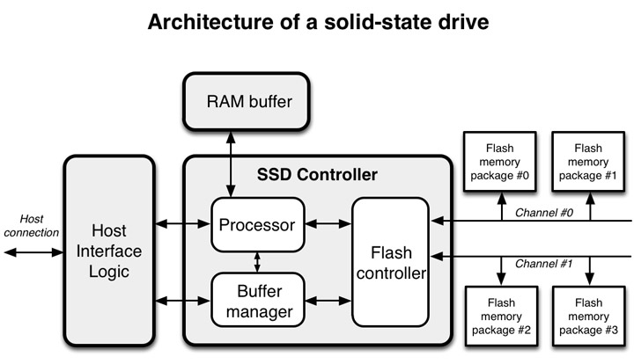
SSD: Solid State Driver
Host Interface Logic
SSD Controller
RAM Buffer
Flash Memory Package

Slide 18
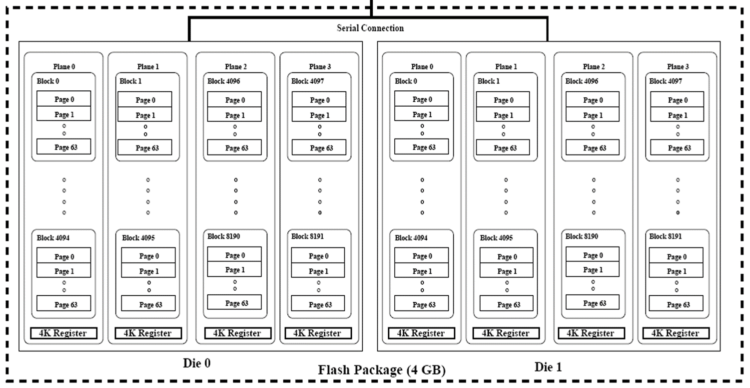
SSD: Solid State Driver
Host Interface Logic
SSD Controller
RAM Buffer
Flash Memory Package

Slide 19
Last twist
Disk lifetime: each page can only be written some fixed number of times:
SLC: 100,000 P/E cycles
MLC: 3,000 P/E cycles
TLC: 100 P/E cycles
When blocks get bad, take them out of rotation
Need indirection layer to not use bad pages
Want to load balance writes over pages!
FTL: Flash-Translation Layer for “wear leveling”

