Slide 1
The Akamai Network: A Platform for High Performance Internet Applications
Presenter: Narek Galstyan

Slide 2
Last Time: Technology of CDNs Today: More on motivation, applications and little hacks
Motivations for Akamai platform
How to come internet’s inherent limitations?
Detailed look at the Akamai platform components

Slide 3
Speed is very important for the end user
40% of customers will wait no more than 3secs(old measurement, probably much less now)
Internet is best effort, not enough for what we want from it
Internet’s limitations are particularly visible in the wide area communication
Peering links are congested as this is not where money is
Inefficient routing, BGP ignores AS most of topology when routing

Slide 4
Inefficient communications protocols TCP, HTTP not best for many use cases (video, http websites loading multiple objects)
Traffic demands are spiky. Single origin servers have hard time dealing with this
The network is slow in implementing changes

Slide 5
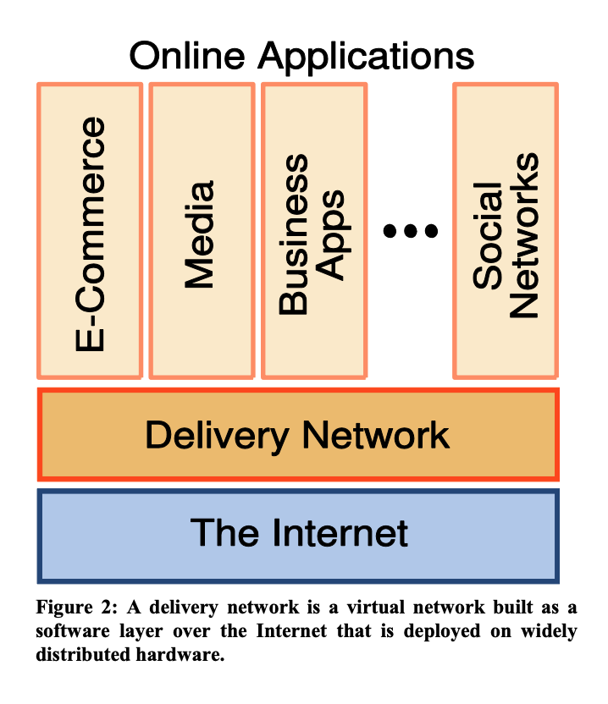

Slide 6
Motivations for Akamai platform
How to come internet’s inherent limitations?
Create a highly distributed network
Design for reliability and scalability
Limit necessity for human management
Design for performance

Slide 7
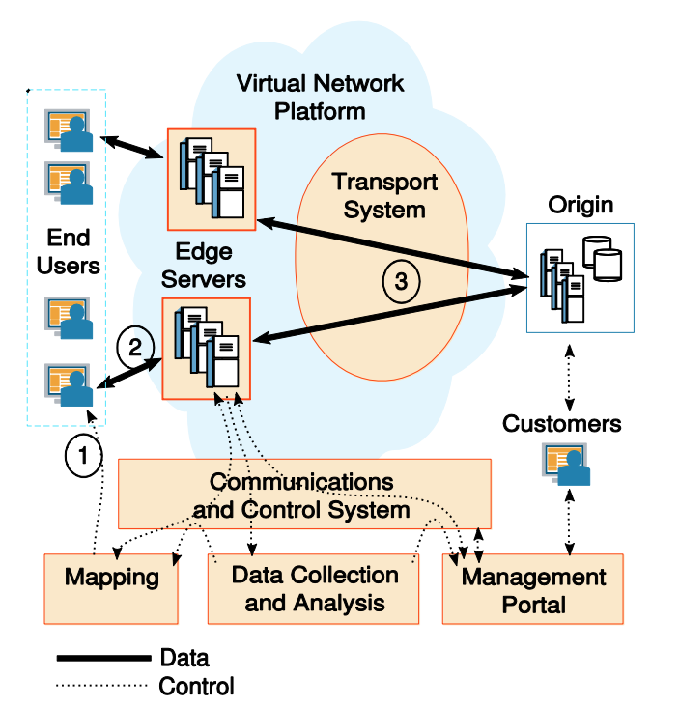

Slide 8
Detailed look at the Akamai platform components
High Performance Streaming
Application Delivery

Slide 9
High Performance Streaming
Most popular networks account for about half of the traffic.
To deliver quality video streaming, one needs guarantees about the other half as well (which often cross multiple networks).
Solution: create small deployments in many networks
Improves performance even when edge server does not have the content
Notes:
Tiered distribution
They also have entral servers that are well connected to their edges so even when the edges do not have the requested content they can quickly get it,

Slide 10
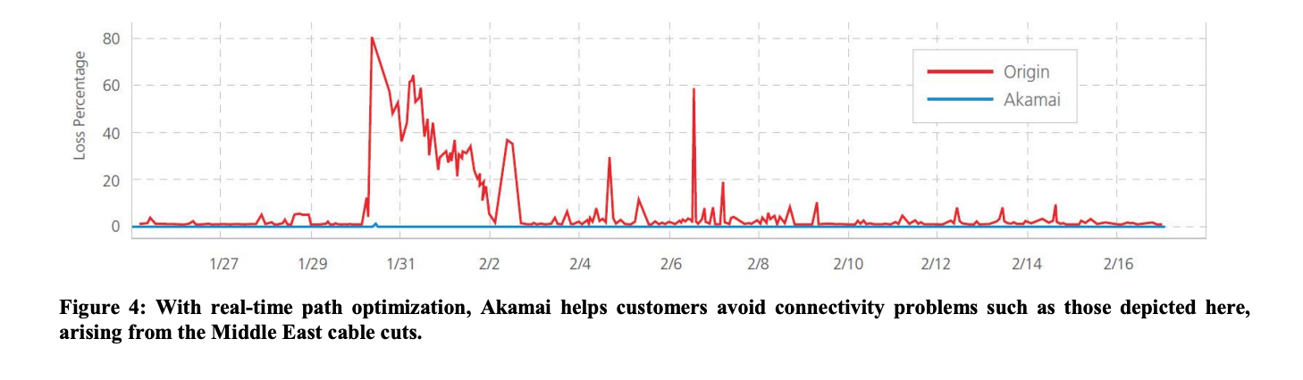
High Performance Streaming
Redundancy and multi level failover
Notes:
Tiered distribution
They also have entral servers that are well connected to their edges so even when the edges do not have the requested content they can quickly get it,

Slide 11
Application delivery
Edge server caching
Edge server network awareness
Path optimization
Loss reduction through multi-path
Use pools of connections between servers
Optimal TCP window sizing due to network awareness
Intelligent retransmission
Edge Computing
Notes:
Use akamai edge servers to make wide area internet commuunications faster and more reliable
They had application optimiations but these are no longer relevant

Slide 12
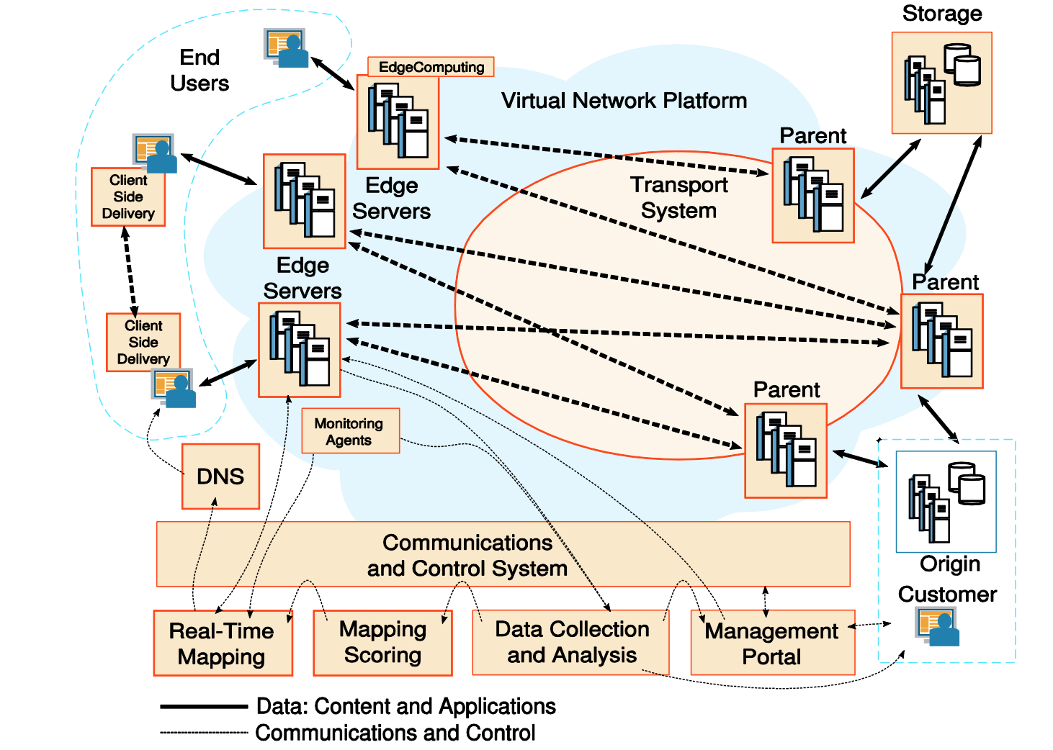
Edge Servers and Mapping system
Notes:
Also talk about
Communications and control system
Real tiem distrubition
Point to point RPC
Dynamic config
Key management infrastruture
Data collection and analusis
Log collection
Rea time monitoring
Storage as alternative origin
Parent as origin cache
Client side delivery

Slide 13
Thank you

