Slide 1
Student Presentation EC-Cache: Load-balanced, Low-latency Cluster Caching with Online Erasure Coding
COS 518: Advanced Computer Systems
Sam Ginzburg
4/3/2019

Slide 2
Problem Statement / Motivation
Data intensive applications increasingly use in-memory caching techniques
Challenges faced in these applications include:
Cache placement policies
Cache Size issues (Sampling, Compression)
Skewed Popularity (Selective Replication)
Zipf distribution of workloads
Background load imbalance + system failures

Slide 3
Previous Solutions (Selective Replication)
Scarlett (tangentially related)
Used selective replication to mitigate the straggler problem in MapReduce
Scaling Memcache at Facebook
Selective replication used within pools to reduce load per server at the cost of significantly more resources used
The ideas used here are relatively straightforward
TL;DR -> popular keys get copied to avoid straggler problems and to balance workloads

Slide 4
Previous Solutions (Erasure Coding)
Erasure Coding in Windows Azure Storage
Reduce storage costs in cold storage by using erasure coding + maintaining fault tolerance guarantees
f4: Facebook’s Warm BLOB Storage System
(See lecture notes)
Employs EC to reduce replication requirements to reduce costs while maintaining system throughput

Slide 5
Key Idea
Online Erasure Coding
Data stored in memory is never actually stored in a decoded form!
Erasure Codes are not applied across objects
Objects are divided into k splits (fractions of the object), with r parity splits
Results in
Better load balancing
Better IO performance from parallel reads/writes
No additional bandwidth overhead for decoding! (handled client side)

Slide 6
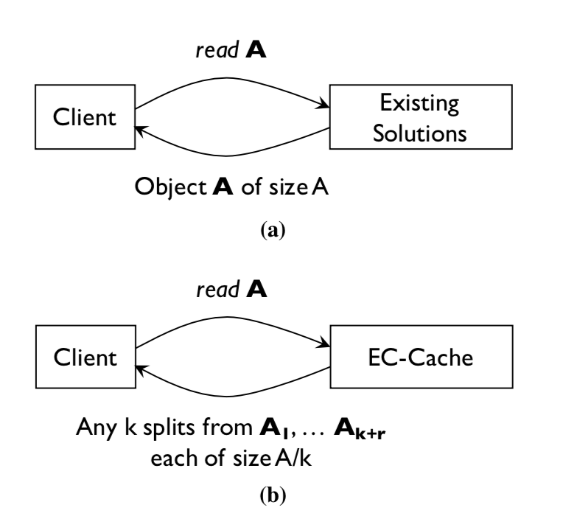
Key Idea
Not a great image but gets the idea across
Instead of returning one giant “A” blob, the client can request any k of the object and reconstruct the object locally
The client does decoding/encoding of the EC

Slide 7
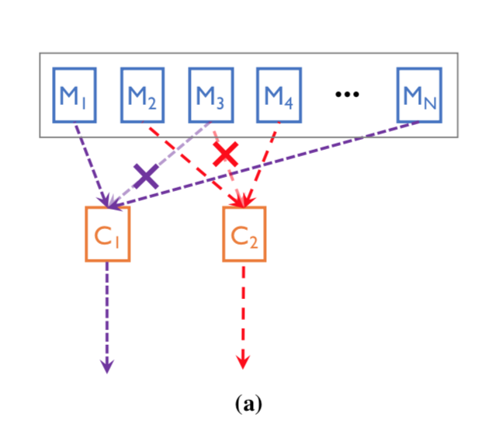
Key Idea
Reads are late binding
K + delta reads are done
Deals with the straggler problem

Slide 8
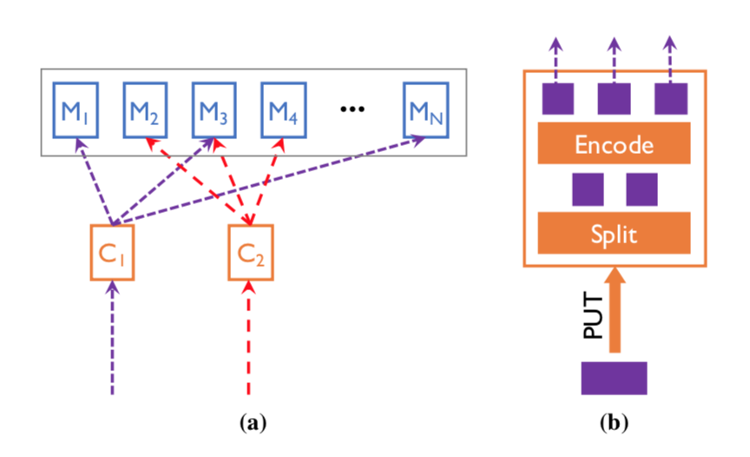
Key Idea
Writes are essentially the same, but backwards

Slide 9
Key Challenges
Dealing with popularity skew
Zipf request distribution
Dealt with via the division into k+r splits, which are uniformly distributed across servers
Dealing with load imbalance
Also dealt with via the k+r splitting model, which are uniformly distributed across servers
Dealing with machine failures
Failure recovery is dealt with via online erasure coding

Slide 10
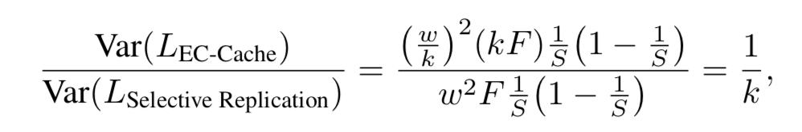
Key Result (Evaluation - Theoretical)
Proof that the system rebalances the load correctly
Each server has some number of splits, with Load L on any given server (L is a random variable)
Variance of a binomial random variable = np(1-p)
P= 1/S in both cases, since there are S servers and F objects, w is the popularity
The proof is trivial from here, the only difference is # objects (kF vs F) and popularity
Intuitive if you think about it

Slide 11
Key Result (Evaluation - Theoretical)
Latency impacts
Stragglers are an issue in naïve EC-Cache since there is a higher chance and individual read is a straggler (tail latency problem)
Solved by doing extra reads + late binding (this is when we do k + delta reads and stop once we have enough)

Slide 12
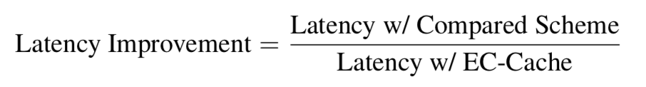
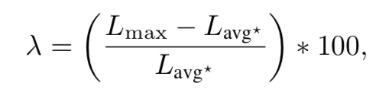
Key Result (Evaluation)
Experiments on EC2 + Evaluation of FB datacenter traces
Evaluations focused on high skew, but EC-Cache still provides latency benefits even in low skew systems
High skew = Zipf –like distribution on object popularity
Two new metrics for perf. Evaluation
Lambda = percent imbalance, L = load

Slide 13
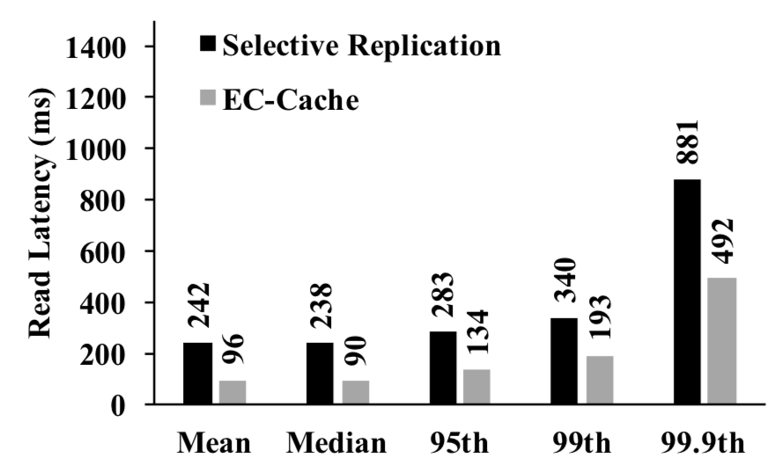
Key Result (Evaluation)
EC-Cache is strictly better for all reads
Median improvement = 2.64x, Mean improvement = 2.52x
This trend holds true for reads/w background traffic + failures

Slide 14
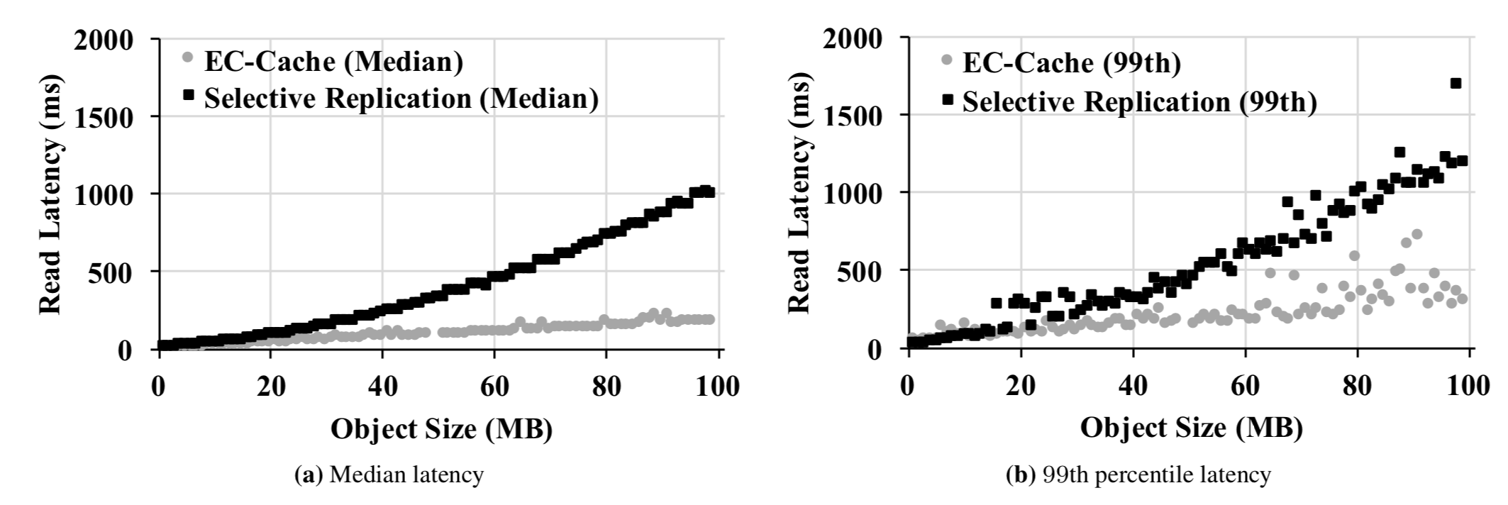
Key Result (Evaluation)
EC-Cache doesn’t have as big of an impact on reads for small objects latency-wise, but significant impact on larger objects
Seems to be more or less the same for objects <=1MB in size

Slide 15
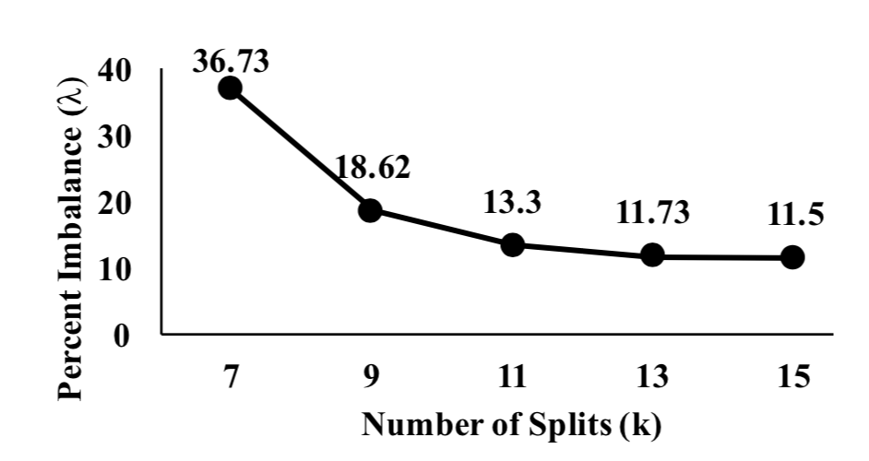
Key Result (Evaluation)
We can see that there are diminishing returns for splitting objects in respect to load balancing

Slide 16
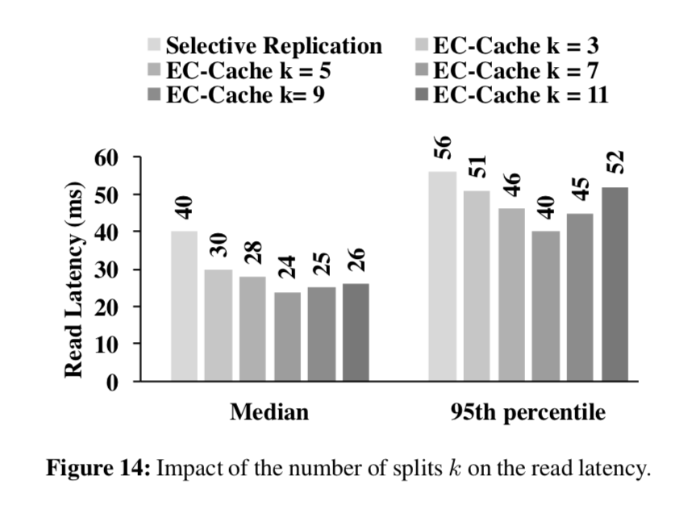
Key Result (Evaluation)
More splits helps with read latencies (makes sense – it mitigates the straggler issue)

Slide 17
Key Result (Evaluation)
More splits helps with read latencies (makes sense – it mitigates the straggler issue)

Slide 18
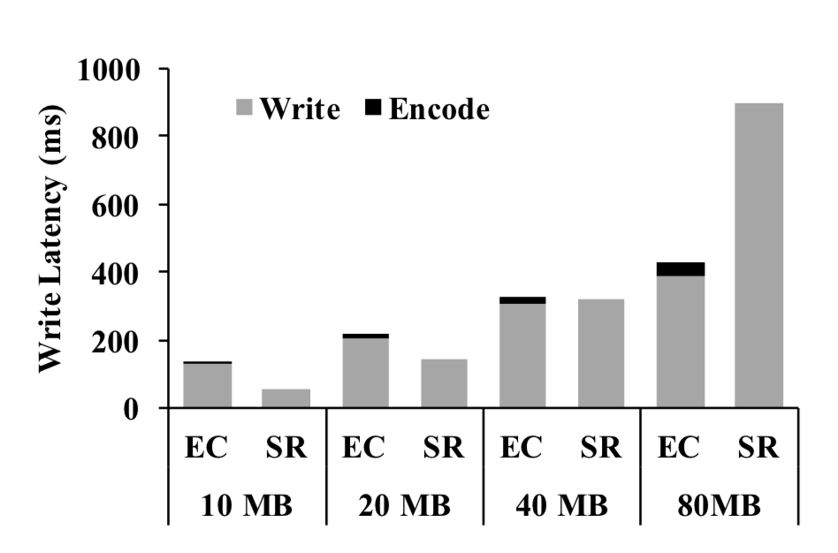
Key Result (Evaluation)
Writes are more complicated
Erasure codes aren’t strictly better until somewhere between 40MB and 80MB

Slide 19
Impact
Recent paper from 2016
Already has at least 43 citations? (Inspired future work)
If the evaluation is correct (which it seems to be), it is likely that the system has been copied in industry by now at big tech companies (FB/Google/MSFT/Amazon) but that’s just a guess

Slide 20
Technical Details

Slide 21
Implementation
Clients handle all encoding/decoding of the online erasure codes, as well as all splitting/recovery
Based on Alluxio, which appears to be based on an academic paper called “Tachyon”
The high level architecture is essentially that Alluxio/Tachyon is essentially a distributed in-memory filesystem designed to get high read/write throughput

Slide 22
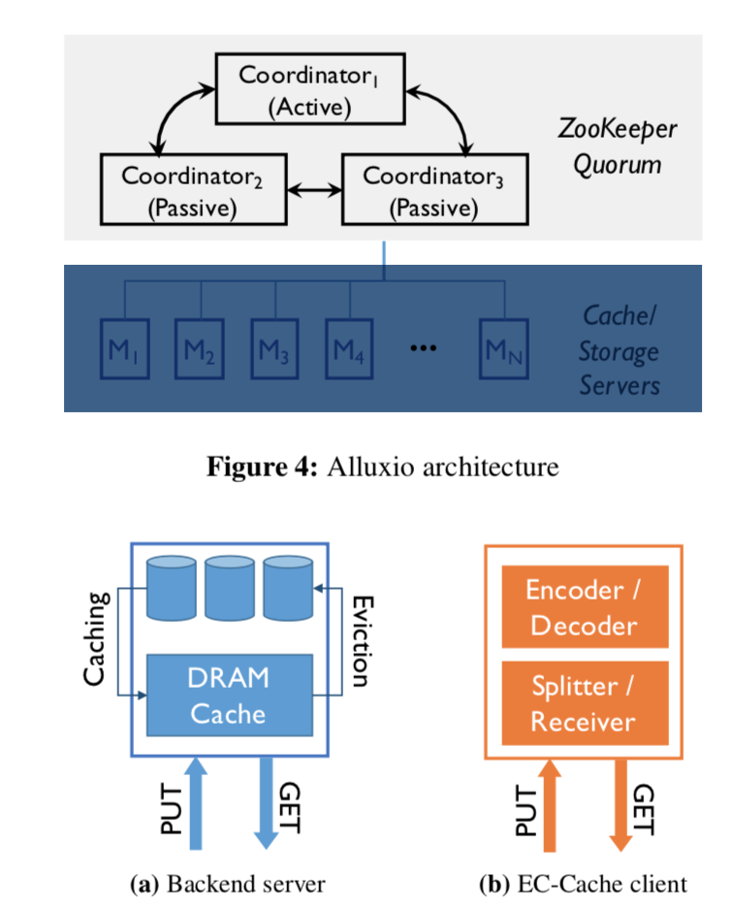
Implementation
Graphic from the paper
Probably not enough time to go over tachyon itself, but from a brief skim through it is interesting on its own

