Slide 1
Student Presentation Erasure Coding in
Windows Azure Storage
COS 518: Advanced Computer Systems
Alejandro Newell
4/2/19

Slide 2

Problem Statement / Motivation
Backing up and reliably storing data is important.
No one wants to be responsible for a headline like this:

Slide 3
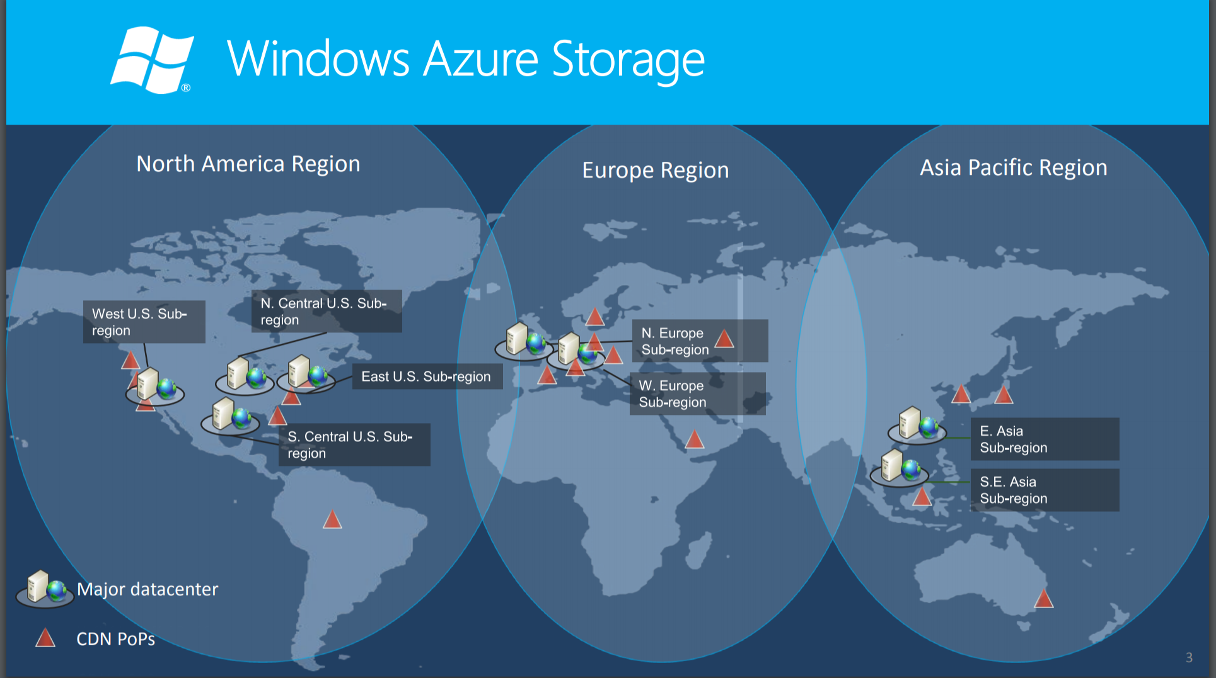
Problem Statement / Motivation
With Windows Azure, Microsoft is responsible for a lot of data...

Slide 4
Problem Statement / Motivation
At that scale, any improvements to storage overhead will save lots of $$$.
The question is how to provide sufficient reliability while minimizing additional storage requirements?
(while also thinking about latency, I/O, bandwidth, etc….)

Slide 5
Previous Solutions
Most straightforward option: replicate
Not a very good use of storage...

Slide 6
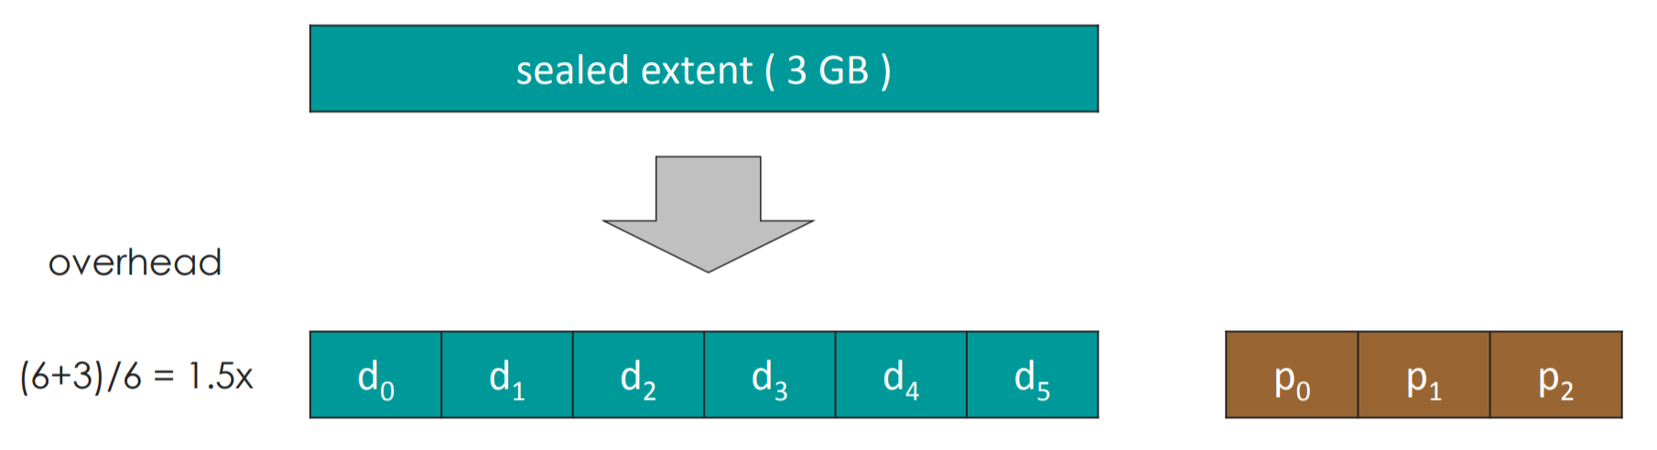
Previous Solutions
A better option: erasure coding
Standard approach is to use Reed-Solomon codes (used by Facebook and Google for example)

Slide 7
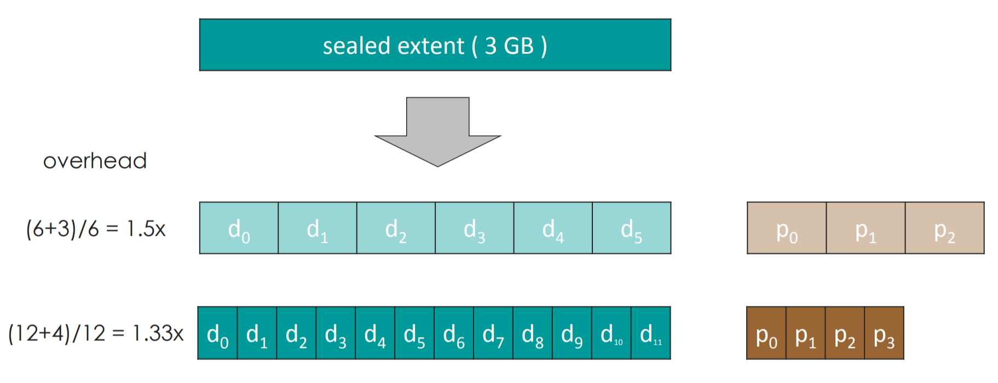
Previous Solutions
Trade offs can be made to reduce cost further with more fragments,
but now reconstruction is more expensive.

Slide 8
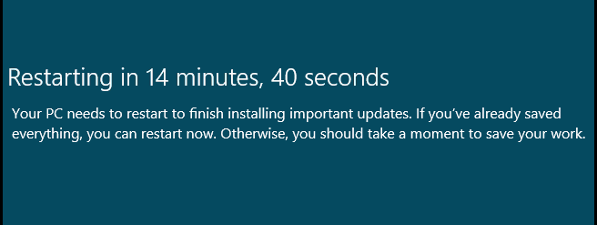
Motivation
Why do we care about reconstruction cost?
Data may be unavailable for many reasons, one of the main reasons cited in this work is OS updates….

Slide 9
Motivation
If data is unavailable, it is critical to provide a reconstruction as fast as possible.
Can also help out with hot nodes by serving reads with reconstructions!

Slide 10
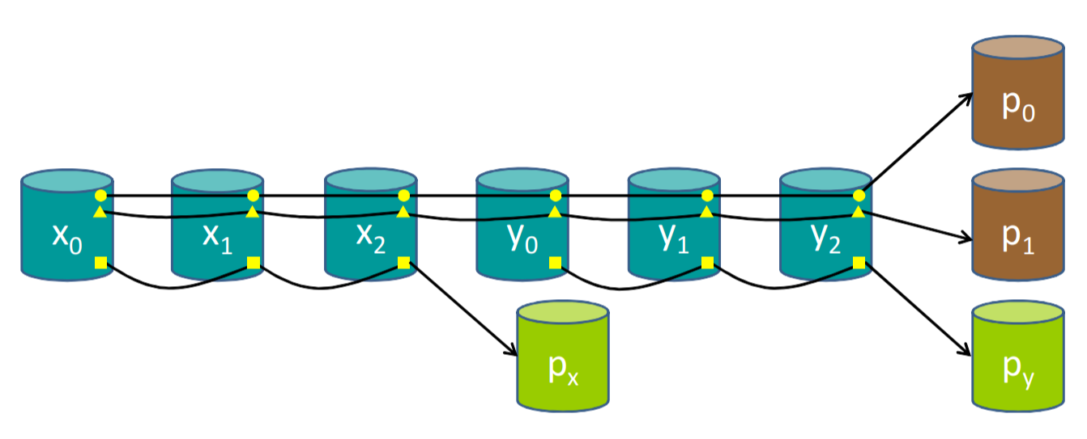
Key Idea
To reduce the fragments needed for reconstruction, use:
Local Reconstruction Codes (LRC)
Split data into groups
Provide local parity for each group

Slide 11
Key Idea
Define (k, l, r):
k - number of data fragments
l - number of groups
r - number of global parities
This example is (6,2,2)

Slide 12
Key Idea
Storage overhead will be: 1 + (l + r) / k
Can guarantee recovery from r + 1 failures, while also handling some cases up to r + l failures.
Only need k / l fragments to recover from single failure.

Slide 13
Key Idea
With more failures, need to compare global parity

Slide 14
Key Idea
LRC 2,2 parity is between the fault tolerance of RS 3 and RS 4
Main focus is to handle single failure cases well because more than that is super rare in this setting.

Slide 15
Key Challenges
Some loss in fault tolerance compared to RS with the same number of parity bits. For example, LRC (12,2,2) recovers from 86% of failures of 4 fragments.
Need to pay attention to where fragments are placed to avoid correlated domains (where failures would affect multiple fragments)

Slide 16
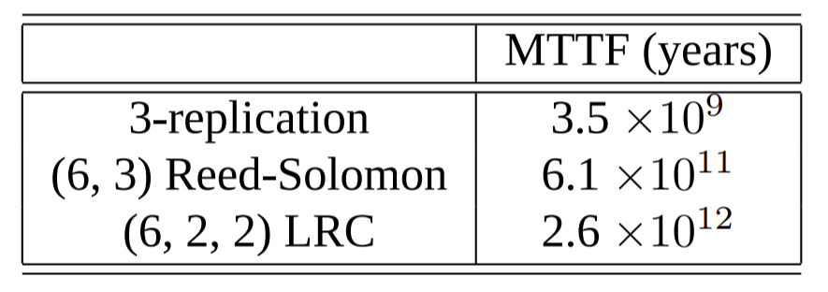
Key Result (Evaluation)
Want to think about tradeoffs in:
cost
performance
reliability
To simplify things, only consider cases that meet minimum threshold for reliability (3-replication)

Slide 17
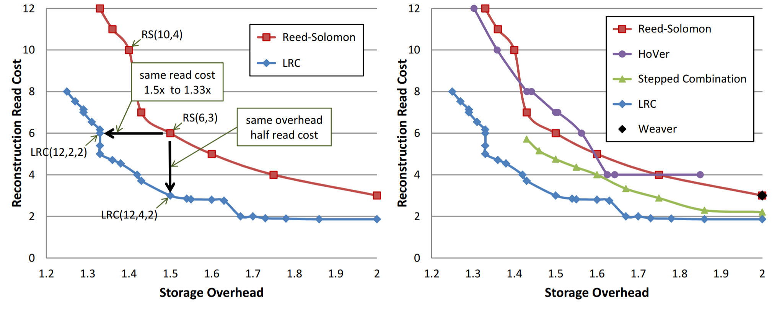
Key Result (Evaluation)
Compare number of reads required for reconstruction vs storage overhead:

Slide 18
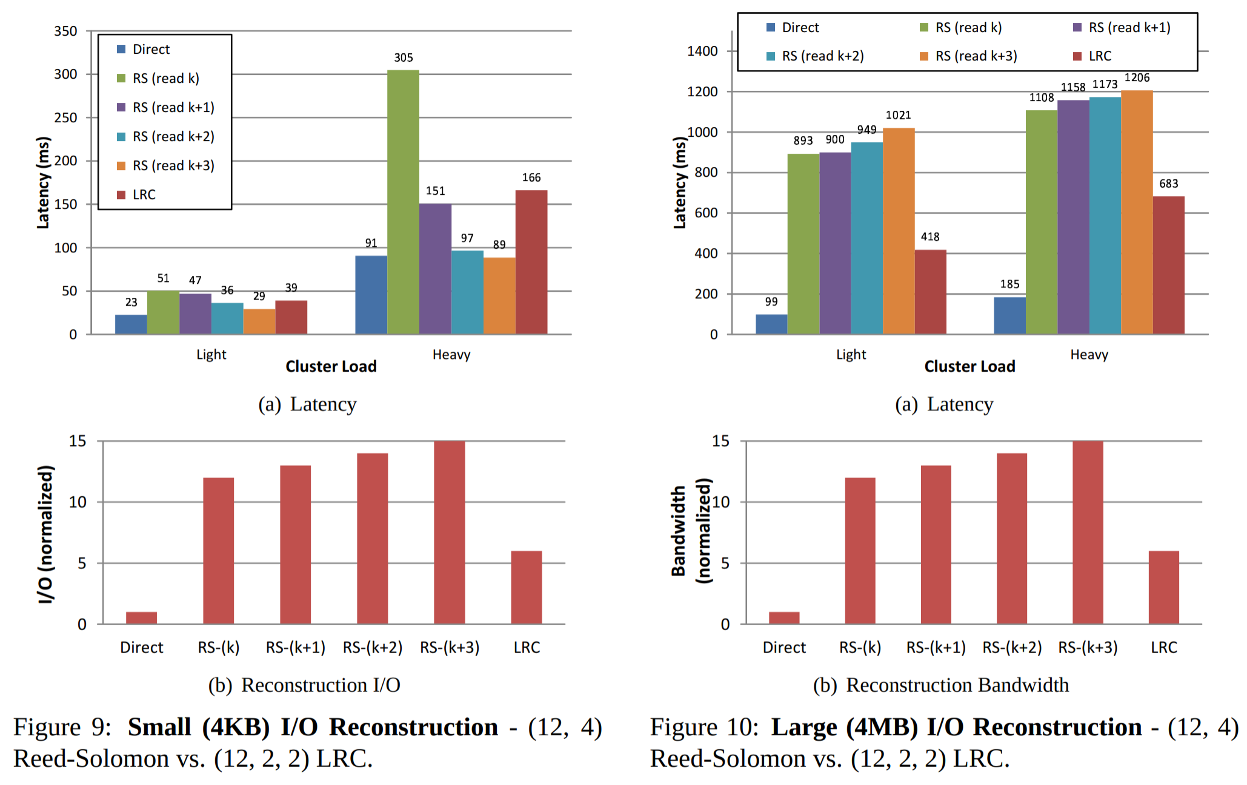
Key Result (Evaluation)
Comparing latency and I/O: (with large I/Os, bandwidth becomes bottleneck)

Slide 19
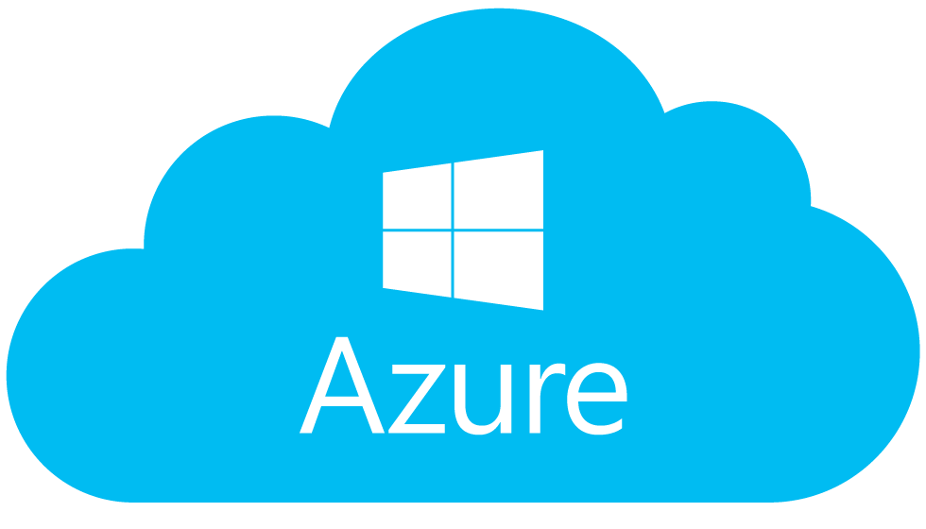
Impact
Best paper, lots of citations, etc
Part of Windows Azure

Slide 20
Technical Details

Slide 21
Key Idea: Stream Layer
Data (called extents) initially managed in stream layer:
append-only filesystem
all extents are 3-replicated
at a certain size, extents are sealed (with no further changes, they are a great candidate for erasure coding)

Slide 22
Key Idea: Stream Layer
Erasure coding process details:
Stream manager scans sealed extents and schedules them to be erasure coded
Fragment boundaries are set by blocks, so reading a block does not cross multiple fragments
Once coded, the full replicas of the extent can be deleted

Slide 23
Key Idea: Fragment Placement
Two correlated domains:
fault domain: sets of nodes that may fail together due to hardware (eg nodes that share a rack)
upgrade domain: group of nodes that are taken offline and updated at same time
Limited number of upgrade domains, so can be careful about placement by assigning fragments from different local groups to same domain.

