Slide 1
Content Distribution Networks + P2P File Sharing
COS 518: Advanced Computer Systems
Lecture 16
Mike Freedman

Slide 2
Single Server, Poor Performance
Single server
Single point of failure
Easily overloaded
Far from most clients
Popular content
Popular site
“Flash crowd”
Denial of Service attack

Slide 3
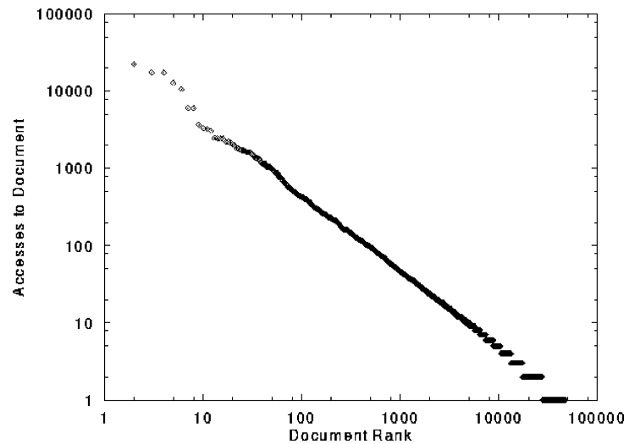
Skewed Popularity of Web Traffic
“Zipf” or “power-law” distribution
Characteristics of WWW Client-based Traces
Carlos R. Cunha, Azer Bestavros, Mark E. Crovella, BU-CS-95-01

Slide 4
Web Caching

Slide 5

Proxy Caches
5
origin
server
Proxy
server
HTTP request
HTTP request
client
HTTP response
HTTP response
HTTP request
HTTP response
client

Slide 6
Forward Proxy
Cache “close” to the client
Under administrative control
of client-side AS
Explicit proxy
Requires configuring browser
Implicit proxy
Service provider deploys an “on path” proxy
… that intercepts and handles Web requests
Proxy
server
HTTP request
client
HTTP response
HTTP request
HTTP response
client

Slide 7
Reverse Proxy
origin
server
Cache “close” to server
Either by proxy run by server or in third-party CDNs
Directing clients to the proxy
Map the site name to the IP address of the proxy
Proxy
server
HTTP request
HTTP response
HTTP request
HTTP response
origin
server

Slide 8

Google Design
. .
.
Servers
Data Centers
Servers
Router
Router
Private Backbone
Reverse Proxy
Reverse Proxy
Internet
Requests
Client
Client
Client

Slide 9
Proxy Caches
(A) Forward (B) Reverse (C) Both (D) Neither
Reactively replicates popular content
Reduces origin server costs
Reduces client ISP costs
Intelligent load balancing between origin servers
Offload form submissions (POSTs) and user auth
Content reassembly or transcoding on behalf of origin
Smaller round-trip times to clients
Maintain persistent connections to avoid TCP setup delay (handshake, slow start)

Slide 10
Proxy Caches
(A) Forward (B) Reverse (C) Both (D) Neither
Reactively replicates popular content (C)
Reduces origin server costs (C)
Reduces client ISP costs (A)
Intelligent load balancing between origin servers (B)
Offload form submissions (POSTs) and user auth (D)
Content reassembly, transcoding on behalf of origin (C)
Smaller round-trip times to clients (C)
Maintain persistent connections to avoid TCP setup delay (handshake, slow start) (C)

Slide 11
Limitations of Web Caching
Much content is not cacheable
Dynamic data: stock prices, scores, web cams
CGI scripts: results depend on parameters
Cookies: results may depend on passed data
SSL: encrypted data is not cacheable
Analytics: owner wants to measure hits
Stale data
Or, overhead of refreshing the cached data

Slide 12
Modern HTTP Video-on-Demand
Download “content manifest” from origin server
List of video segments belonging to video
Each segment 1-2 seconds in length
Client can know time offset associated with each
Standard naming for different video resolutions and formats: e.g., 320dpi, 720dpi, 1040dpi, …
Client downloads video segment (at certain resolution) using standard HTTP request.
HTTP request can be satisfied by cache: it’s a static object
Client observes download time vs. segment duration, increases/decreases resolution if appropriate

Slide 13
What about large files?

Slide 14

Peer-to-Peer Networks: BitTorrent
BitTorrent history
2002: B. Cohen debuted BitTorrent
Emphasis on efficient fetching, not searching
Distribute same file to many peers
Single publisher, many downloaders
Preventing free-loading
Incentives for peers to contribute

Slide 15
BitTorrent: Simultaneous Downloads
Divide file into many chunks (e.g., 256 KB)
Replicate different chunks on different peers
Peers can trade chunks with other peers
Peer can (hopefully) assemble the entire file
Allows simultaneous downloading
Retrieving different chunks from different peers
And uploading chunks to peers
Important for very large files

Slide 16
BitTorrent: Tracker
Infrastructure node
Keeps track of peers participating in the torrent
Peers registers with the tracker when it arrives
Tracker selects peers for downloading
Returns a random set of peer IP addresses
So the new peer knows who to contact for data
Can have “trackerless” system
Using distributed hash tables (DHTs)

Slide 17
BitTorrent: Overall Architecture
Web Server
Tracker
Web page
with link
to .torrent
.torrent
C
A
Peer
[Seed]
Peer
[Leech]
Downloader
“US”
B
Peer
[Leech]

Slide 18
BitTorrent: Overall Architecture
Web Server
Tracker
Web page
with link
to .torrent
Get-announce
C
A
Peer
[Seed]
Peer
[Leech]
Downloader
“US”
B
Peer
[Leech]

Slide 19
BitTorrent: Overall Architecture
Web Server
Tracker
Web page
with link
to .torrent
Response-peer list
C
A
Peer
[Seed]
Peer
[Leech]
Downloader
“US”
B
Peer
[Leech]

Slide 20
BitTorrent: Overall Architecture
Web Server
Tracker
Web page
with link
to .torrent
Shake-hand
C
A
Peer
[Seed]
Peer
[Leech]
Downloader
“US”
Shake-hand
B
Peer
[Leech]

Slide 21
BitTorrent: Overall Architecture
Web Server
Tracker
Web page
with link
to .torrent
pieces
C
A
pieces
Peer
[Seed]
Peer
[Leech]
Downloader
“US”
B
Peer
[Leech]

Slide 22
BitTorrent: Overall Architecture
Web Server
Tracker
Web page
with link
to .torrent
pieces
C
A
pieces
Peer
[Seed]
Peer
[Leech]
Downloader
“US”
pieces
B
Peer
[Leech]

Slide 23
BitTorrent: Overall Architecture
Web Server
Tracker
Web page
with link
to .torrent
Get-announce
Response-peer list
pieces
C
A
pieces
Peer
[Seed]
Peer
[Leech]
Downloader
“US”
pieces
B
Peer
[Leech]

Slide 24
BitTorrent: Chunk Request Order
Which chunks to request?
Could download in order
Like an HTTP client does
Problem: many peers have the early chunks
Peers have little to share with each other
Limiting the scalability of the system
Problem: eventually nobody has rare chunks
E.g., the chunks need the end of the file
Limiting the ability to complete a download
Solutions: random selection and rarest first

Slide 25
BitTorrent: Rarest Chunk First
Which chunks to request first?
Chunk with fewest available copies (i.e., rarest chunk)
Benefits to the peer
Avoid starvation when some peers depart
Benefits to the system
Avoid starvation across all peers wanting a file
Balance load by equalizing # of copies of chunks

Slide 26
Free-Riding in P2P Networks
Vast majority of users are free-riders
Most share no files and answer no queries
Others limit # of connections or upload speed
A few “peers” essentially act as servers
A few individuals contributing to the public good
Making them hubs that basically act as a server
BitTorrent prevent free riding
Allow the fastest peers to download from you
Occasionally let some free loaders download

Slide 27
Bit-Torrent: Preventing Free-Riding
Peer has limited upload bandwidth
And must share it among multiple peers
Tit-for-tat: favor neighbors uploading at highest rate
Rewarding the top four neighbors
Measure download bit rates from each neighbor
Reciprocate by sending to the top four peers
Optimistic unchoking
Randomly try a new neighbor every 30 seconds
So new neighbor has a chance to be a better partner

Slide 28
Conclusion
Content distribution is hard
Many, diverse, changing objects
Clients distributed all over the world
Reducing latency is king
Contribution distribution solutions
Reactive caching, proactive CDNs
BitTorrent
Distributed download of large files
Anti-free-riding techniques
Great example of how change can happen quickly in application-level protocols

