Slide 1
Content Distribution Networks
COS 518: Advanced Computer Systems
Lecture 17
Mike Freedman

Slide 2
Content Distribution Network
origin server
in North America
Proactive content replication
Content provider (e.g., CNN) contracts with a CDN
CDN replicates the content
On many servers spread throughout the Internet
Updating the replicas
Updates pushed to replicas when the content changes
CDN distribution node
CDN server
in S. America
CDN server
in Asia
CDN server
in Europe

Slide 3
Server Selection Policy
Live server
For availability
Lowest load
To balance load across the servers
Closest
Nearest geographically, or in round-trip time
Best performance
Throughput, latency, …
Cheapest bandwidth, electricity, …
Requires continuous monitoring of liveness, load, and performance

Slide 4
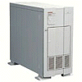

Server Selection Mechanism
Application
HTTP redirection
Advantages
Fine-grain control
Selection based on client IP address
Disadvantages
Extra round-trips for TCP connection to server
Overhead on the server
GET
Redirect
GET
OK

Slide 5
Server Selection Mechanism
Advantages
No extra round trips
Route to nearby server
Disadvantages
Does not consider network or server load
Different packets may go to different servers
Used only for simple request-response apps
Routing
Anycast routing
1.2.3.0/24
1.2.3.0/24

Slide 6
Server Selection Mechanism
Naming
DNS-based server selection
1.2.3.4
DNS
query
1.2.3.5
local DNS server

Slide 7



A DNS lookup traverses DNS hierarchy
. (root) authority 198.41.0.4
edu.: NS 192.5.6.30
com.: NS 158.38.8.133
io.: NS 156.154.100.3
www.princeton.edu?
edu. authority 192.5.6.30
princeton.edu.: NS 66.28.0.14
pedantic.edu.: NS 19.31.1.1
Contact 192.5.6.30 for edu.
Client
www.princeton.edu?
Contact 66.28.0.14 for princeton.edu.
www.princeton.edu?
www.princeton.edu?
www.princeton.edu A 140.180.223.42
Local nameserver
. (root): NS 198.41.0.4
princeton.edu. authority 66.28.0.14
www.princeton.edu.: A 140.180.223.42
edu.: NS 192.5.6.30
princeton.edu.: NS 66.28.0.14
www.princeton.edu.: A 140.180.223.42
Notes:
Client is doing a lookup for www.princeton.edu
SEGUE: Finally, the local nameserver replies to the client with an answer.

Slide 8
DNS caching
Performing all these queries takes time
And all this before actual communication takes place
Caching can greatly reduce overhead
Top-level servers very rarely change, popular sites visited often
Local DNS server often has information cached
How DNS caching works
All DNS servers cache responses to queries
Responses include a time-to-live (TTL) field, akin to cache expiry
Notes:
>>> SEGUE: And these TTL fields play a key role in how CDNs like Akamai function.

Slide 9
Server Selection Mechanism
Advantages
Avoid TCP set-up delay
DNS caching reduces overhead
Relatively fine control
Disadvantage
Based on IP address of local DNS server
“Hidden load” effect
DNS TTL limits adaptation
Naming
DNS-based server selection
1.2.3.4
DNS
query
1.2.3.5
local DNS server

Slide 10
How Akamai Works

Slide 11
How Akamai Uses DNS
11
cnn.com (content provider)
HTTP
DNS root server
GET index.html
Akamai
cluster
Akamai global
DNS server
1
2
HTTP
http://cache.cnn.com/foo.jpg
Akamai regional
DNS server
Nearby Akamai
cluster
end user

Slide 12
How Akamai Uses DNS
12
cnn.com (content provider)
HTTP
DNS TLD server
DNS lookup
cache.cnn.com
Akamai
cluster
Akamai global
DNS server
1
2
3
ALIAS:
g.akamai.net
4
Akamai regional
DNS server
Nearby Akamai
cluster
end user

Slide 13
How Akamai Uses DNS
13
cnn.com (content provider)
HTTP
DNS TLD server
DNS lookup
g.akamai.net
Akamai
cluster
Akamai global
DNS server
5
1
2
3
4
6
Akamai regional
DNS server
ALIAS
a73.g.akamai.net
Nearby Akamai
cluster
end user

Slide 14
How Akamai Uses DNS
14
cnn.com (content provider)
HTTP
DNS TLD server
Akamai
cluster
Akamai global
DNS server
5
1
2
3
4
6
Akamai regional
DNS server
7
DNS a73.g.akamai.net
8
Address
1.2.3.4
Nearby Akamai
cluster
end user

Slide 15
How Akamai Uses DNS
15
cnn.com (content provider)
HTTP
DNS TLD server
Akamai
cluster
Akamai global
DNS server
5
1
2
3
4
6
Akamai regional
DNS server
7
8
9
Nearby Akamai
cluster
end user
GET /foo.jpg
Host: cache.cnn.com

Slide 16

How Akamai Uses DNS
16
cnn.com (content provider)
HTTP
DNS TLD server
GET foo.jpg
11
12
Akamai
cluster
Akamai global
DNS server
5
1
2
3
4
6
Akamai regional
DNS server
7
8
9
Nearby Akamai
cluster
end user
GET /foo.jpg
Host: cache.cnn.com

Slide 17
How Akamai Uses DNS
17
cnn.com (content provider)
HTTP
DNS TLD server
11
12
Akamai
cluster
Akamai global
DNS server
5
1
2
3
4
6
Akamai regional
DNS server
7
8
9
Nearby Akamai
cluster
end user
10

Slide 18
How Akamai Works: Cache Hit
18
cnn.com (content provider)
HTTP
DNS TLD server
Akamai
cluster
Akamai global
DNS server
1
2
Akamai regional
DNS server
3
4
5
Nearby Akamai
cluster
end user
6

Slide 19
Mapping System
Equivalence classes of IP addresses
IP addresses experiencing similar performance
Quantify how well they connect to each other
Collect and combine measurements
Ping, traceroute, BGP routes, server logs
E.g., over 100 TB of logs per days
Network latency, loss, and connectivity

Slide 20
Mapping System
Map each IP class to a preferred server cluster
Based on performance, cluster health, etc.
Updated roughly every minute
Map client request to a server in the cluster
Load balancer selects a specific server
E.g., to maximize the cache hit rate

Slide 21
Adapting to Failures
Failing hard drive on a server
Suspends after finishing “in progress” requests
Failed server
Another server takes over for the IP address
Low-level map updated quickly
Failed cluster
High-level map updated quickly
Failed path to customer’s origin server
Route packets through an intermediate node

Slide 22
How standards adapt…
Growth of non-ISP DNS servers
Google’s 8.8.8.8, Level 3’s 1.2.3.4, Cloudflare’s 1.1.1.1
Only one IP address? Use IP anycast. Many servers worldwide announce, your DNS packets get routed to the closest anycasted server. Automated failover.
Problem: There aren’t enough anycasted DNS
Using 8.8.8.8 (because it’s a “faster DNS”), laptop in Princeton might use DNS server in Washington DC…
… using that DNS nameserver, Akamai will now assign you webserver in DC rather than one in Philly/NYC
… which results in Public DNS making CDNs much slower!

Slide 23
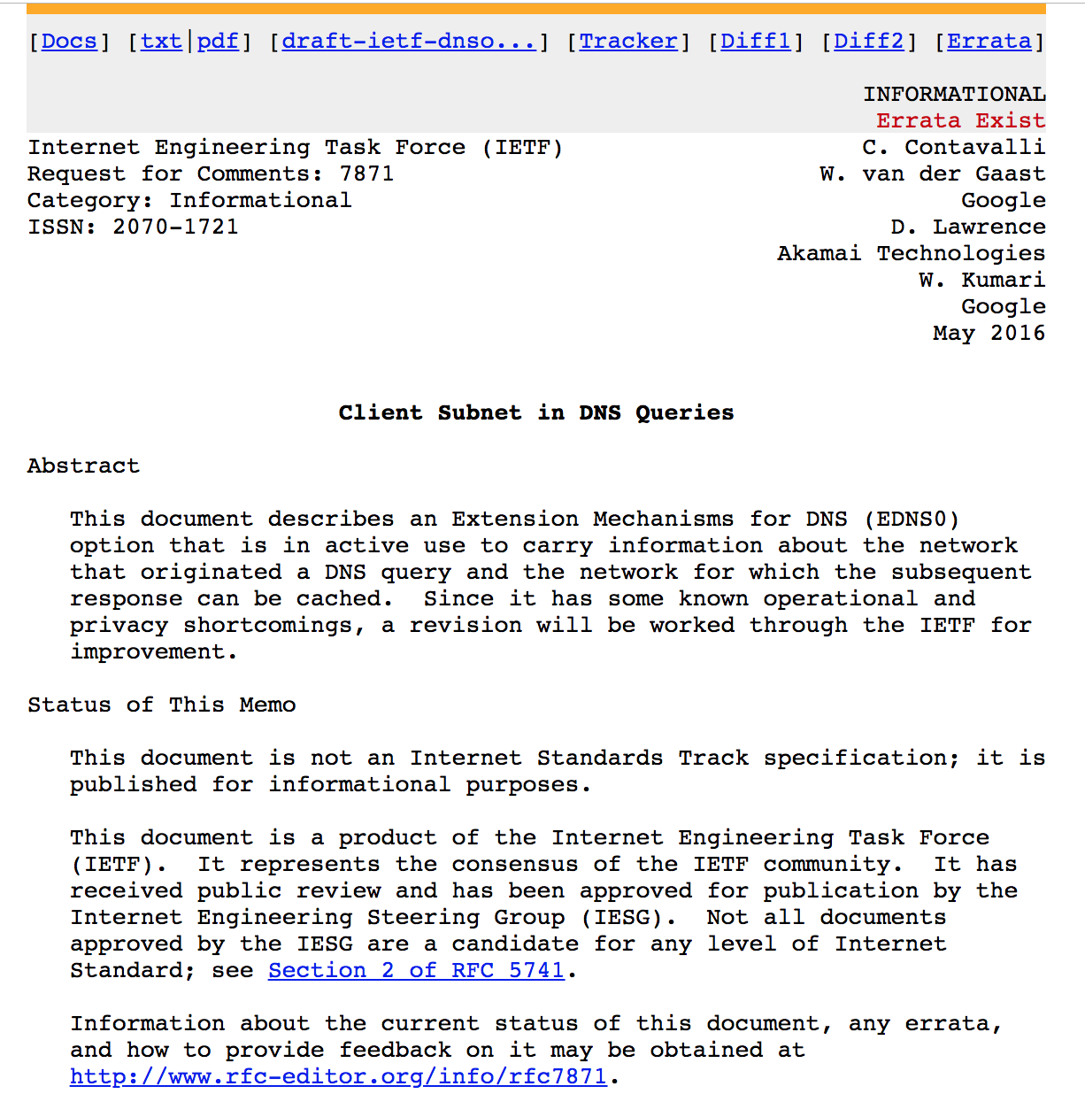
Needed: Better identification of clients

Slide 24
Conclusion
Content distribution is hard
Many, diverse, changing objects
Clients distributed all over the world
Reducing latency is king
Contribution distribution solutions
Reactive caching
Proactive content distribution networks

