Slide 1
Student Presentation Flashield : a Key-value Cache that Minimizes Writes to Flash
COS 518: Advanced Computer Systems
Ashwini Raina
03/11/2019

Slide 2
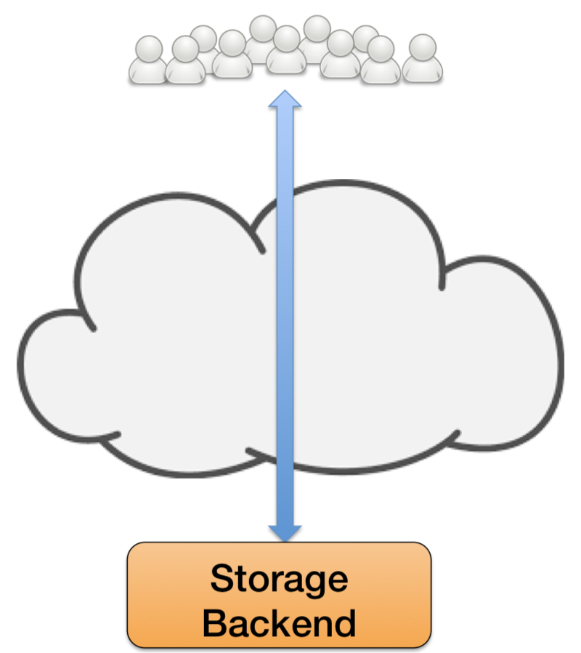



Problem Statement / Motivation
Clients
Why use Flash?
Client access times in order of hundreds of microseconds to milliseconds
Flash is 10X cheaper than DRAM
Why is it not used?
Cache workloads wear out flash quickly
Device-Level Write Amplification (DLWA)
Reducing DLWA creates Cache Level Write Amplification (CLWA)
Next-gen QLC SSDs support 30X fewer writes compared to TLC
Typically use DRAM

Slide 3
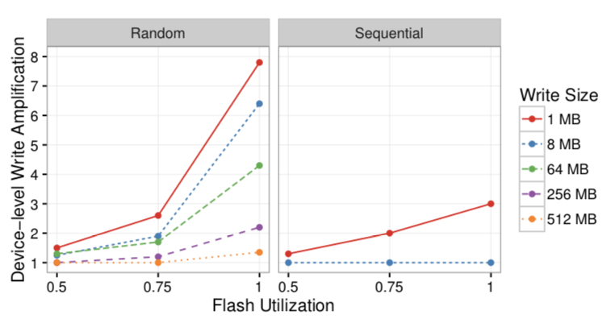
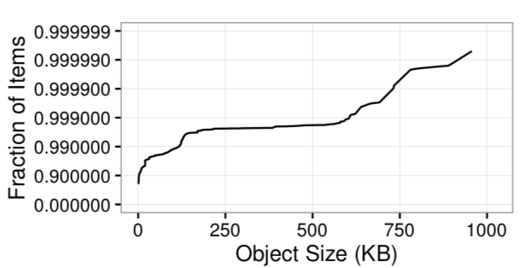
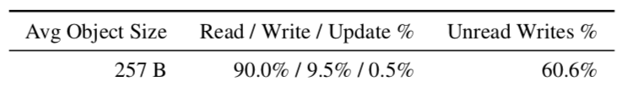
Problem Statement / Motivation
257 bytes
Large % of objects smaller than 1KB
Large sequential writes reduce DLWA

Slide 4
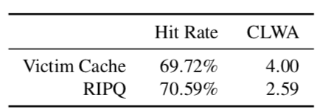
Previous Solutions
Victim Cache - every object evicted from DRAM is written into flash.
suffers from high DLWA due to small writes to flash
RIPQ – objects with similar read frequencies are written to flash in the same segment.
no admission policy; all incoming objects written to flash
If object read frequency changes in future, object needs to be re-written

Slide 5
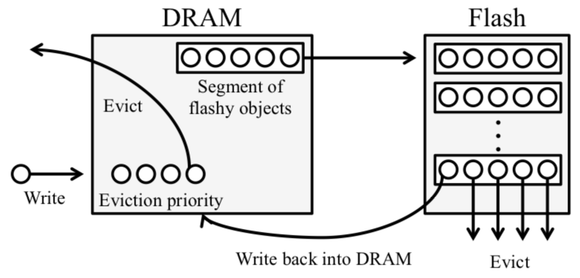
Flashield Design

Slide 6
Key Idea
Use DRAM as a filter to predict flash worthiness of objects
It will be accessed n times in the near future
It will be immutable in the near future
Use Machine Learning to predict flash worthiness
Classifier predicts whether an object will be accessed at least n times in the future without being updated.
Use DRAM as an index for flash
In-memory look up index 4bytes compared to 22bytes in RIPQ
Multiple choice hash table without chains
Bloom filter for each segment
16 predefined hash functions to map object location within a segment
Priority is implemented as approximated LRU (CLOCK algorithm)

Slide 7
Key Challenges
Efficient look-up index in DRAM
Frequently accessed objects can result in oversampling biases in classifier training
Single sample for each object chosen uniformly over all its accesses.
Evictions for objects stored on flash
Ghost bit serves as a hint to flash cleaning service

Slide 8
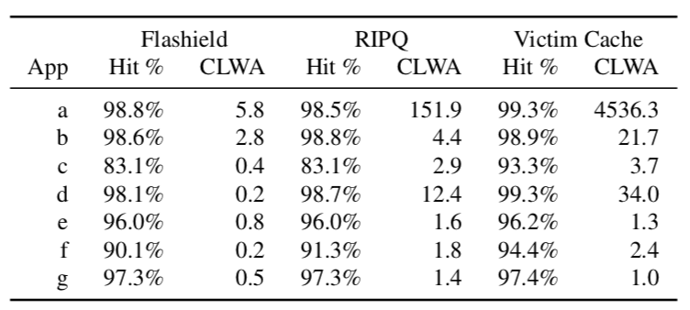
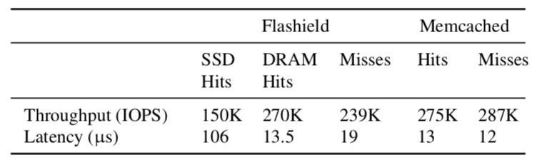
Key Result (Evaluation)

Slide 9
Impact
Paper published at NSDI in February 2019

Slide 10
Technical Details

Slide 11
Key Idea: DRAM-as-a-filter

Slide 12
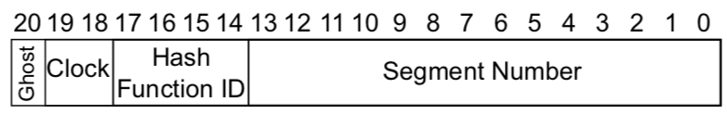
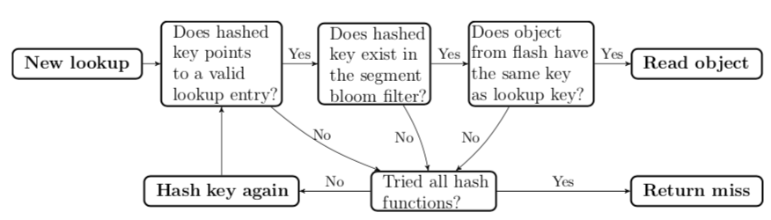
Key Idea: DRAM as an index for flash
Identities of keys not stored in index
Uses a set of hash functions to look up key segment entry
Each segment has a bloom filter
16 pre-defined hash functions used to map the location of key within the segment

Slide 13
Key Idea: Predict object “flashiness”
Classification using Support Vector Machine.
Features used:
number of past reads
number of past updates
Classifier predicts whether an object will be accessed at least n times in the future without being updated.
Achieves 75% to 90% accuracy on seven applications

