Slide 1
Student Presentation Beehive: O(1) Lookup Performance for Power-Law Query Distributions in Peer-to-Peer Overlays
COS 518: Advanced Computer Systems
Yue Tan
04/08/2019

Slide 2
Problem Statement / Motivation
N5
N10
N110
K19
N20
N99
N32
Lookup(K19)
Circular 7-bit
ID space
N80
N60
Notes:
A quick recap of Chord.

Slide 3
log(N) is slow for DNS
For a million nodes, it’s 20 hops
If each hop takes 50ms, lookups take a second
If each hop has 10% chance of failure, it’s a couple of timeouts
So in practice log(n) is better than O(n) but not great for DNS
Notes:
SEGUE: So we’ll come back to this point when we discuss Chord’s impact at the end.

Slide 4
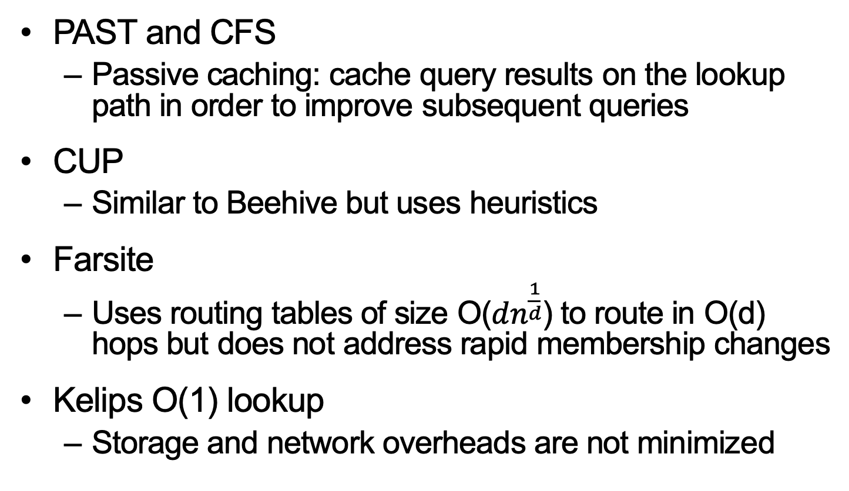
Previous Solutions
PAST and CFS
Passive caching: cache query results on the lookup path in order to improve subsequent queries
CUP
Similar to Beehive but uses heuristics
Farsite
Uses routing tables of size O($dn^{\frac{1}{d}}$) to route in O(d) hops but does not address rapid membership changes
Kelips O(1) lookup
Storage and network overheads are not minimized

Slide 5
Key Idea
Replicating an object at all nodes k hops prior to its home node reduces the length of query paths by k hops.

Slide 6
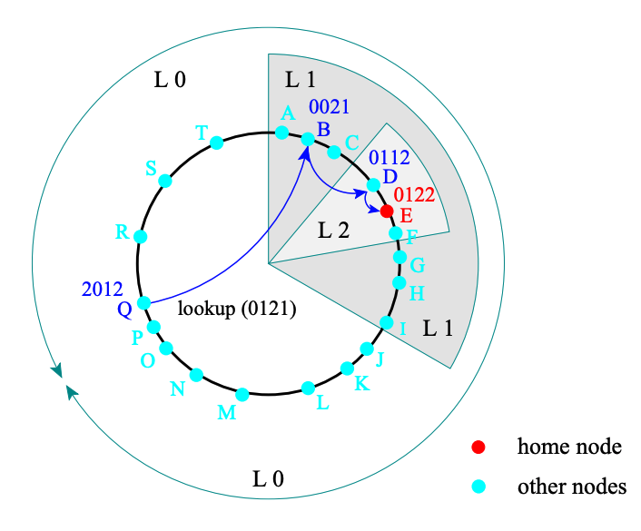
Key Idea
Prefix-based routing, each step in routing takes the query to a node that has one more matching prefix than the previous node
In this example, for key 0121, the query path is 2012 -> 0021 -> 0112 -> 0122
Notes:
Before we go to replication level, let’s first take a look at the DHT structure Beehive assumes, which deviates a bit from Chord DHT.

Slide 7
Key Idea
An object replicated at level $i$ means queries to it incur at most $i$ hops

Slide 8
Key Idea
Replicating an object at all nodes k hops prior to its home node reduces the length of query paths by k hops.
Assuming Zipfian query distributions, Beehive controls the extent of replication based on objects’ relative popularity to achieve O(1) average lookup latency

Slide 9
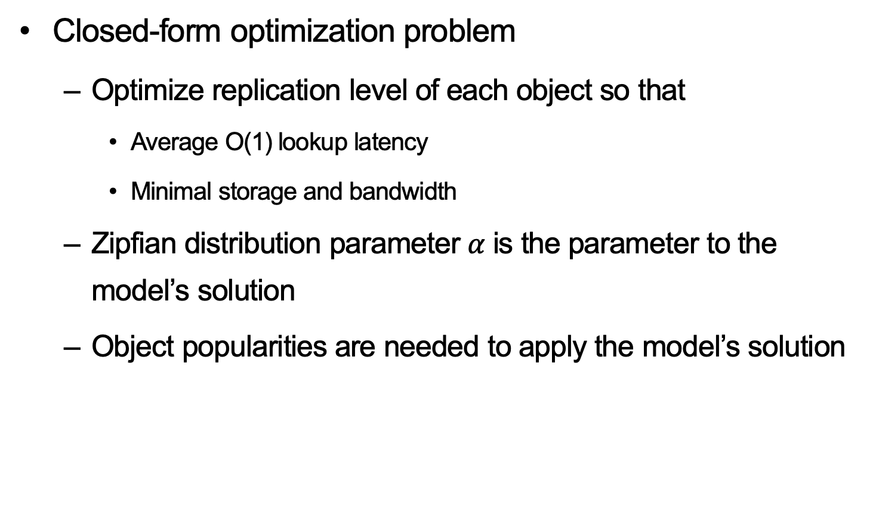
Key Challenges – Analytical Model
Closed-form optimization problem
Optimize replication level of each object so that
Average O(1) lookup latency
Minimal storage and bandwidth
Zipfian distribution parameter $α$ is the parameter to the model’s solution
Object popularities are needed to apply the model’s solution

Slide 10
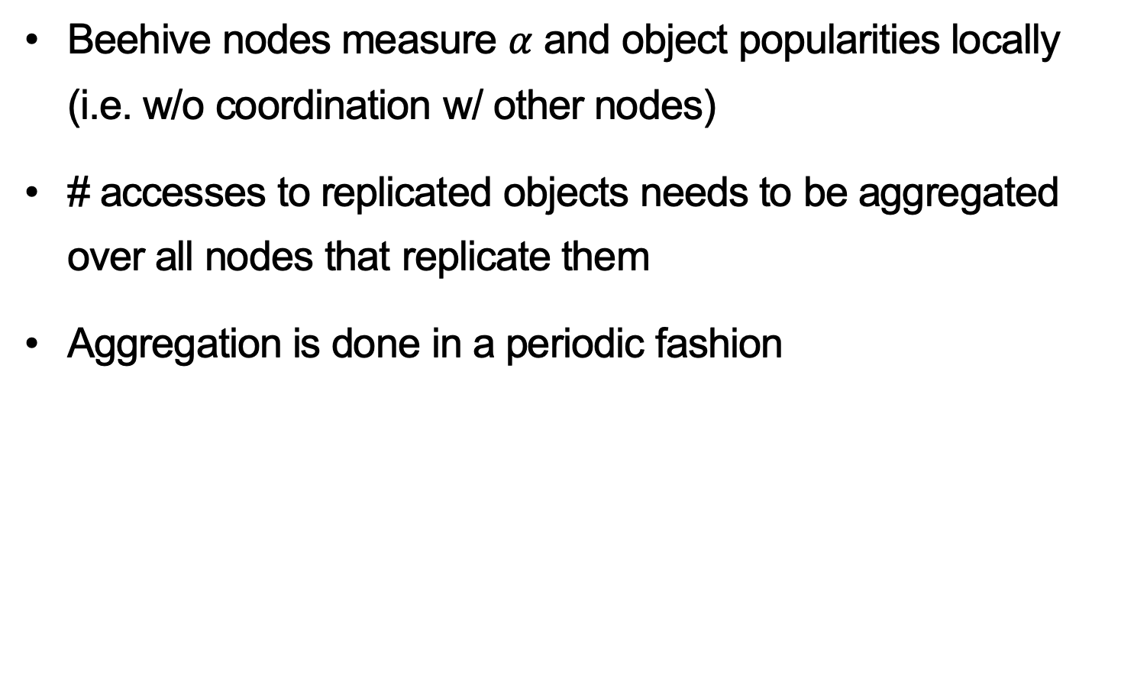
Key Challenges – Aggregation Protocol
Beehive nodes measure $α$ and object popularities locally (i.e. w/o coordination w/ other nodes)
# accesses to replicated objects needs to be aggregated over all nodes that replicate them
Aggregation is done in a periodic fashion

Slide 11
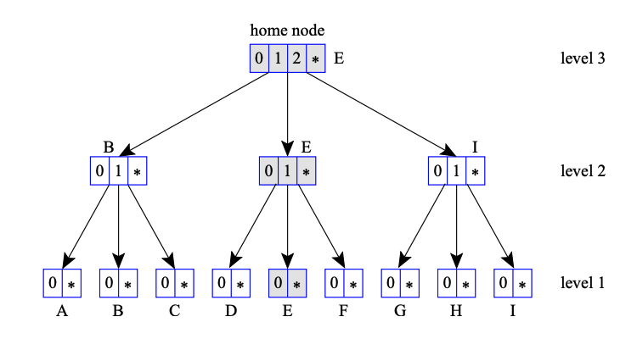


Key Challenges – Aggregation Protocol
Local measured values are aggregated and propagated towards the home node (red arrows)
And the home node disseminates updated values downwards to the leaf nodes (black arrows)

Slide 12

Key Challenges – Aggregation Protocol
Each node using linear regression estimates $α$
During the aggregation and dissemination of # accesses to an object, nodes also exchange their local $α$, and take an average across all received $α$

Slide 13
Key Challenges – Replication Protocol
Consists of two phases: Analysis and Replicate. Both are done periodically
Analysis phase calculates the solution of the analytical model, changing the fraction of objects replicated at each level and each object’s replication level.
Replicate phase enforces replication or deletion of objects based on their popularity change, i.e. manipulating object replicas

Slide 14
Evaluation Setup
Regular Pastry
Prefix-based DHT offering O(log N) lookup performance
Passive-caching Pastry
Beehive
Aggregation interval = replication interval = 48 min
Analysis interval = 480 min
Target latency is set to 1 hop

Slide 15
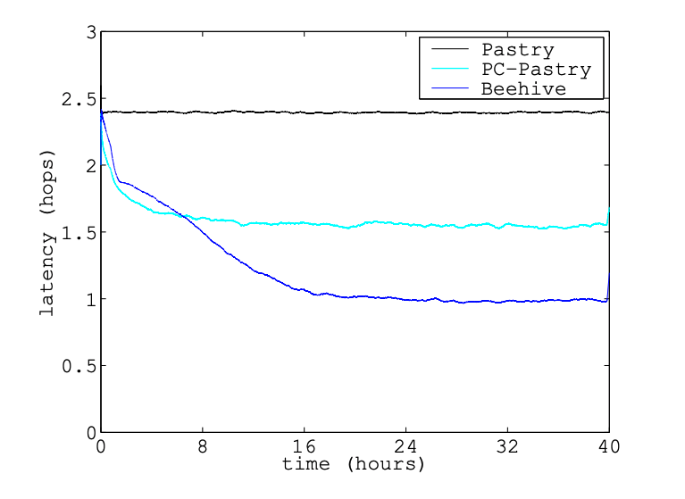
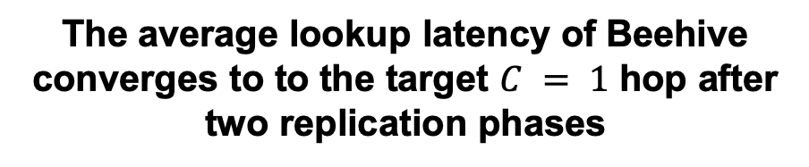
Key Result (Evaluation)
The average lookup latency of Beehive converges to to the target $C = 1$ hop after two replication phases

Slide 16
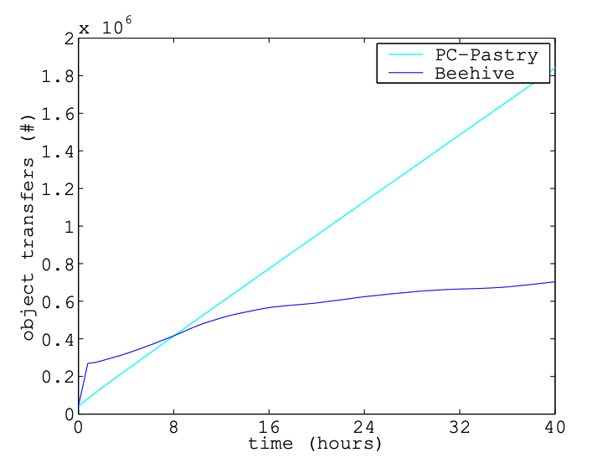
Key Result (Evaluation)
Beehive generates significantly lower background traffic due to object transfers compared to passive caching.

Slide 17
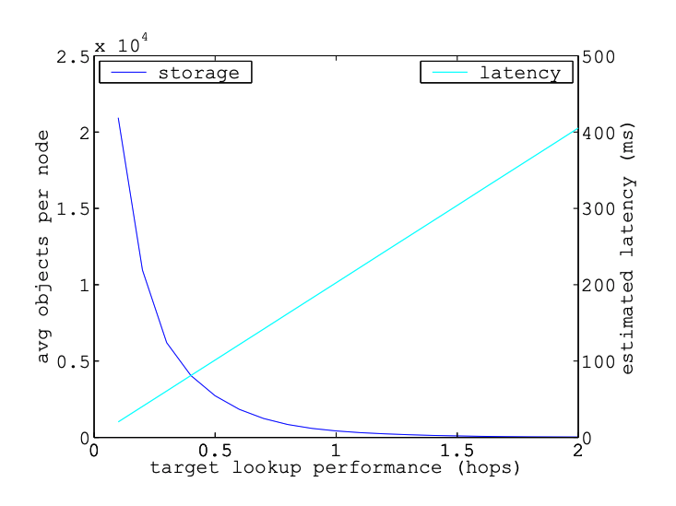
Key Result (Evaluation)
This plot captures the trade off between storage overhead incurred by replication and target lookup latency

Slide 18
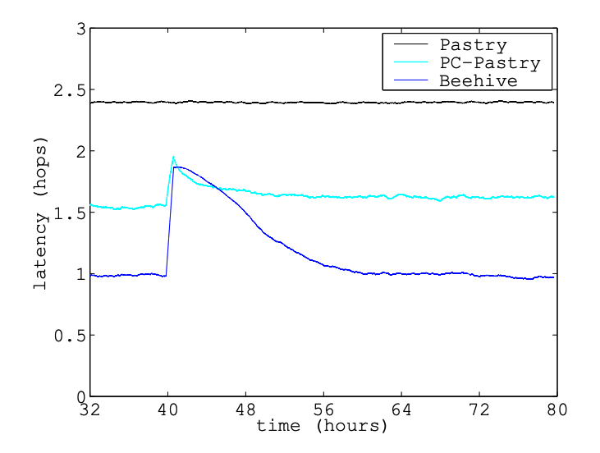
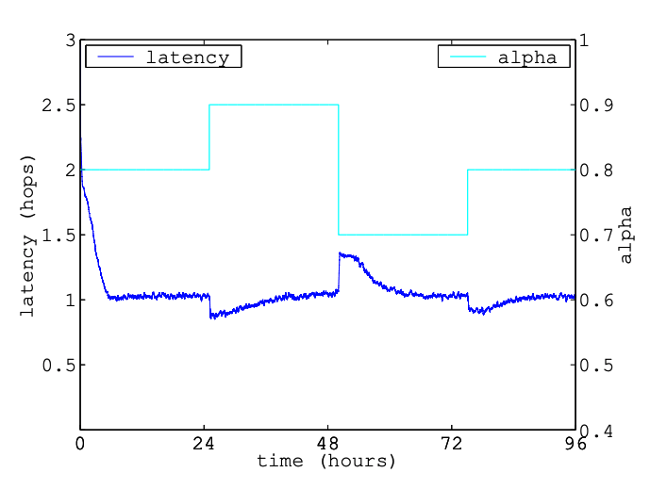
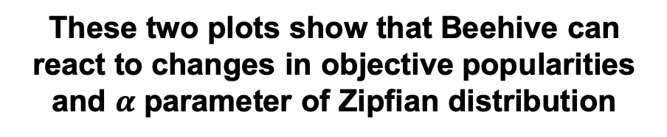
Key Result (Evaluation)
These two plots show that Beehive can react to changes in objective popularities and $α$ parameter of Zipfian distribution

Slide 19
Impact
The same lab built three systems using Beehive
CoDoNS: Cooperative Domain Name Service
CobWeb: Content Distribution Network
CorONA: A high performance publish-subscribe system for disseminating micronews, a replacement of RSS

Slide 20
Technical Details

Slide 21
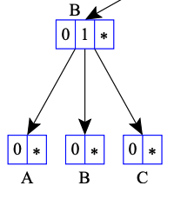
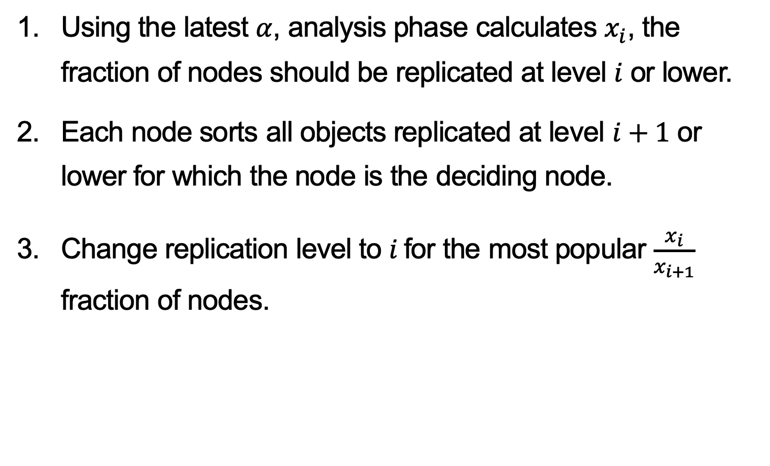
Analysis Phase
Using the latest $α$, analysis phase calculates $x_{i}$, the fraction of nodes should be replicated at level $i$ or lower.
Each node sorts all objects replicated at level $i+1$ or lower for which the node is the deciding node.
Change replication level to $i$for the most popular $\frac{x_{i}}{x_{i+1}}$ fraction of nodes.
Deciding node

Slide 22

Replicate Phase
Node A sends ids of all objects at level $i$to the deciding node B.
Node B replies to A a list of ids of objects that are unlisted by A’s msg and a list ids of objects no longer replicated at level $i$.
Deciding node

Slide 23
Integrate aggregate/replicate phases
To reduce load on the network and improve the efficiency of replication
When A sends an aggregation msg to B, the msg contains ids of all objects replicated from B;
When B sends back an replication msg to A, the msg contains updated # accesses to objects.

Slide 24
Mutable Objects
Beehive associates a version number with each object to identify modified objects
Modifying an object is done by inserting a fresh copy of the object with a higher version number at the home node.
The home node proactively propagates the update to all the replicas.

