Slide 1
Student Presentation Do incentives build robustness in BitTorrent?
COS 518: Advanced Computer Systems
Sam Ginzburg
4/10/2019

Slide 2
Problem Statement / Motivation
Free Ride problem in previous P2P systems (Kazaa, MojoNation, AudioGalaxy)
BitTorrent introduced the TFT (tit-for-tat) strategy
Authors decided to see if this strategy really works, since everyone claimed “incentives build robustness in BitTorrent”

Slide 3
Previous Solutions (What other P2P Systems Did)
This is an attack paper, so I’ll discuss previous attacks
Gnutella
70% of Gnutella users didn’t share
50% of queries answered by 1% of hosts
Mojonation / AudioGalaxy
Didn’t get adopted
Kazaa
Reputation based system (couldn’t find much info)

Slide 4
Previous Solutions
Modeling and Performance Analysis of BitTorrent-Like Peer-to-Peer Networks
Showed that Bittorent reached a nash equilibrium after convergence (reality: not for real workloads)
BitTyrant exploits this failure
Sybil Attacks (several)
Upload garbage data, ignoring rate limits
Easy to patch
Sociological Explanation
All the swarms with malicious actors die out, leaving the “majority good” swarms alive

Slide 5
Key Idea
BitTorrent is already unfair
Optimizes for low capacity peers! (average case)
High capacity peers pay out more than their fair share
We can game the system as a result
In each TFT round, we want to pick the peers that maximize the Download / Upload ratio

Slide 6
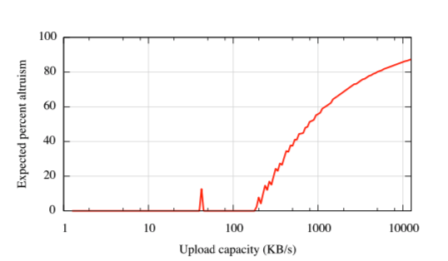
Key Idea
Remember: majority of peers have very little upload capacity

Slide 7
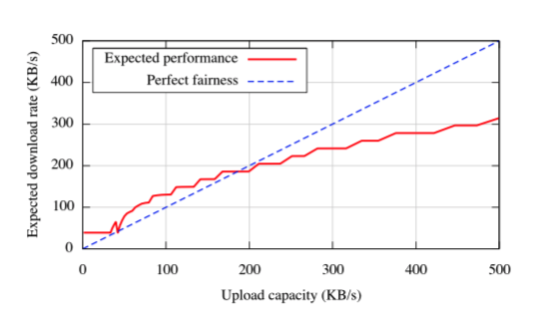
Key Idea
Downloads are optimized for low capacity peers

Slide 8
Key Idea
3 key strategies
Reciprocate as much as we possibly can on a per connection basis
Some people will offer more than we offer them in return
Maximize the number of peers that are contributing
Saturate our connection
Vary upload speeds depending on Download / Upload ratio (no equal split)
Goes with strategy 1

Slide 9
Key Idea
Unchoking in BitTyrant
Given an array of ratios, pick the top k ratios, s.t. the sum <= max capacity
For each unchoked peer:
If the peer doesn’t unchoke us
Increase how much we let them upload from us
If they unchoke us: do nothing
If the’ve unchoked us several times
reduce how much we let them upload

Slide 10
Key Challenges
Estimating the upload rate for peers
Has to be estimated via the formula in the previous slide
Binary search doesn’t work since this value changes often
Estimating reciprocation bandwidth
Measure how often peers announce blocks, computes from there, makes an assumption about the set size
Super useful: finding the top ~2% of peers can double the download throughput
Maximizing the set size

Slide 11
Key Challenges
Maximizing the set size
Ask the tracker(s) as often as we can
Azureus extension gossips about extra peers
Peers can willingly do so, but BitTyrant can’t make them

Slide 12
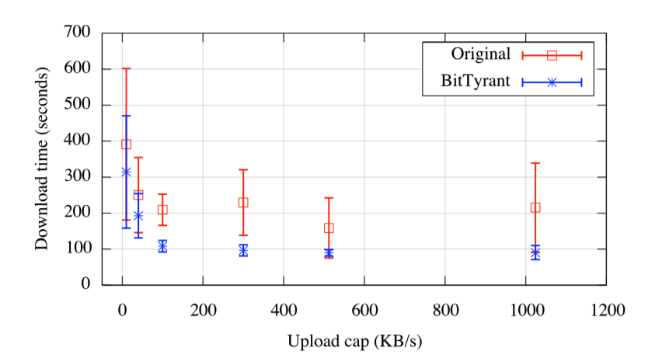
Key Result (Evaluation)
Files are downloaded faster
BitTyrant is not only faster, but more consistent (less variance)

Slide 13
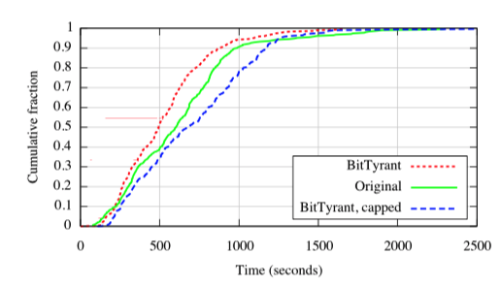
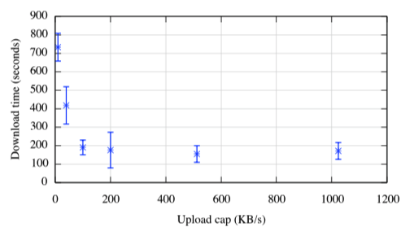
Key Result (Evaluation)
Immediate followup question: What if everyone cheats with BitTyrant?
(everyone has the same DL speed in the right hand side figure)

Slide 14
Impact
BitTorrent supports client blacklisting (not that effective)
From what I can remember from downloading Linux ISOs, I never really saw it around much personally
Found a bunch of posts from ~2007 on old-looking websites talking about it’s announcement, but not much after that

Slide 15
Technical Details

Slide 16
Technical Details
Based on Azureus, another BitTorrent client that was popular for a while
Not too many details in the paper

Slide 17
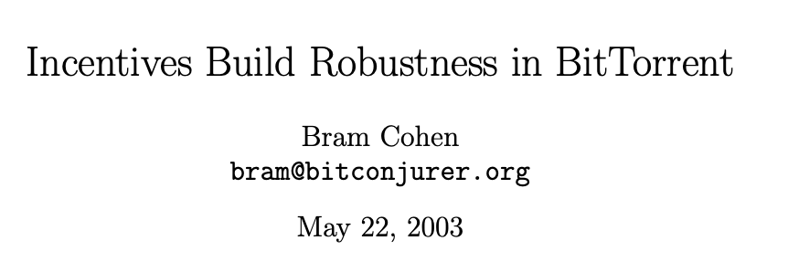
The Danger of Making Formal Security Claims

