Slide 1
Student Presentation Kademlia: A P2P Information System Based on the XOR Metric
COS 518: Advanced Computer Systems
Jennifer Lam
4/8/2019

Slide 2



Problem Statement / Motivation
Efficient routing in P2P systems / DHT.
Novel implementation of Distributed Hash Table (DHT) using XOR metric of closeness.
Minimizing necessary rounds to find target key.

Slide 3
Previous Solutions
Chord (2001)
Pastry (2001)
Kademlia (2002)
Tapestry (2004)
Plaxton (2008)

Slide 4
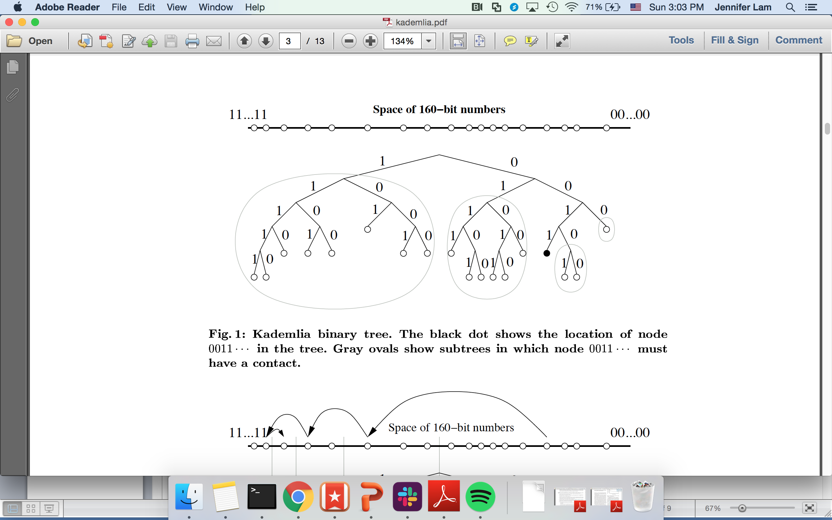
Key Idea
XOR expresses “closeness” or “distance” between two node ID’s.
Represents key space as a trie.
Tree height = distance = path length (or hops) to target.
Finds target in O(log n), n= system nodes.

Slide 5
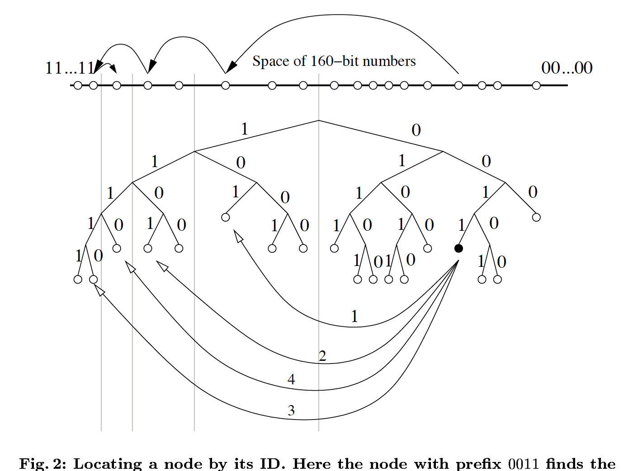
Key Idea

Slide 6
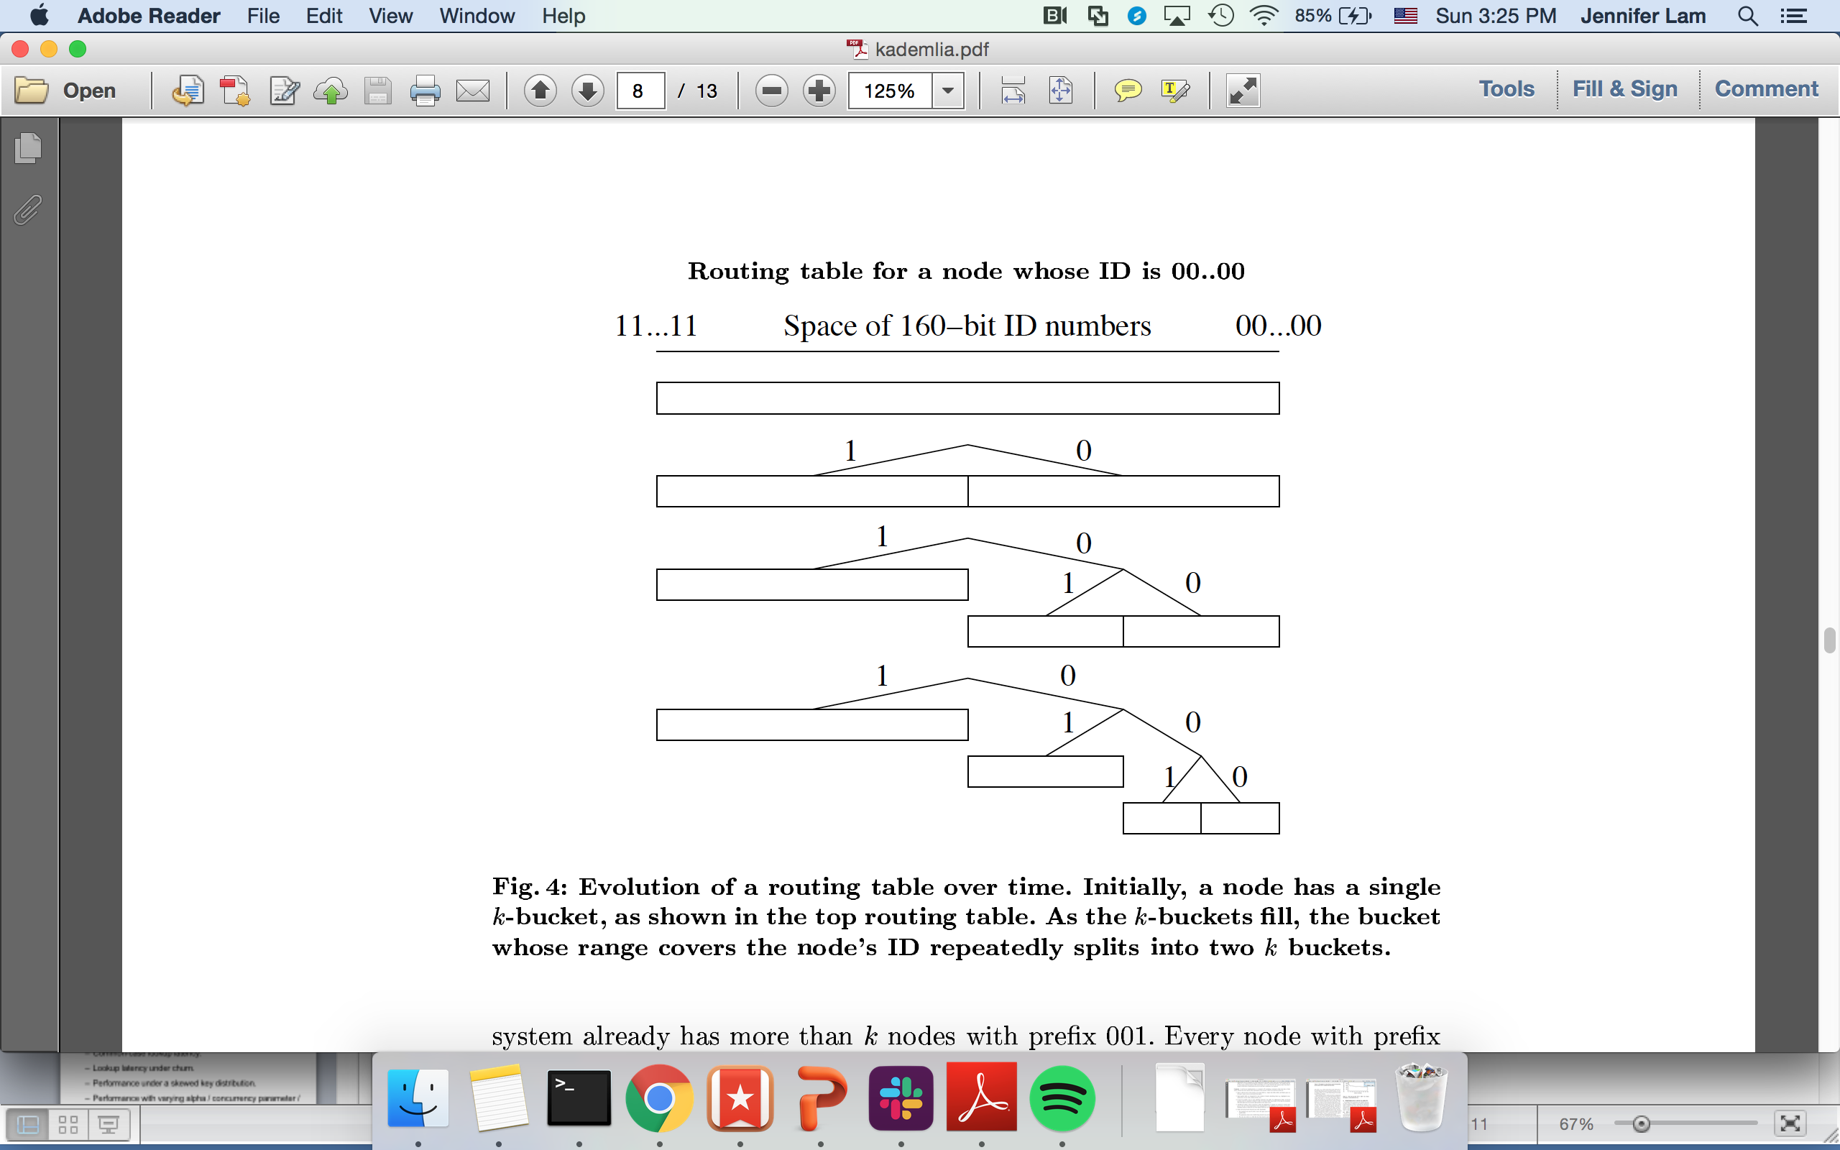
Key Idea
xor

Slide 7
Key Idea
xor

Slide 8
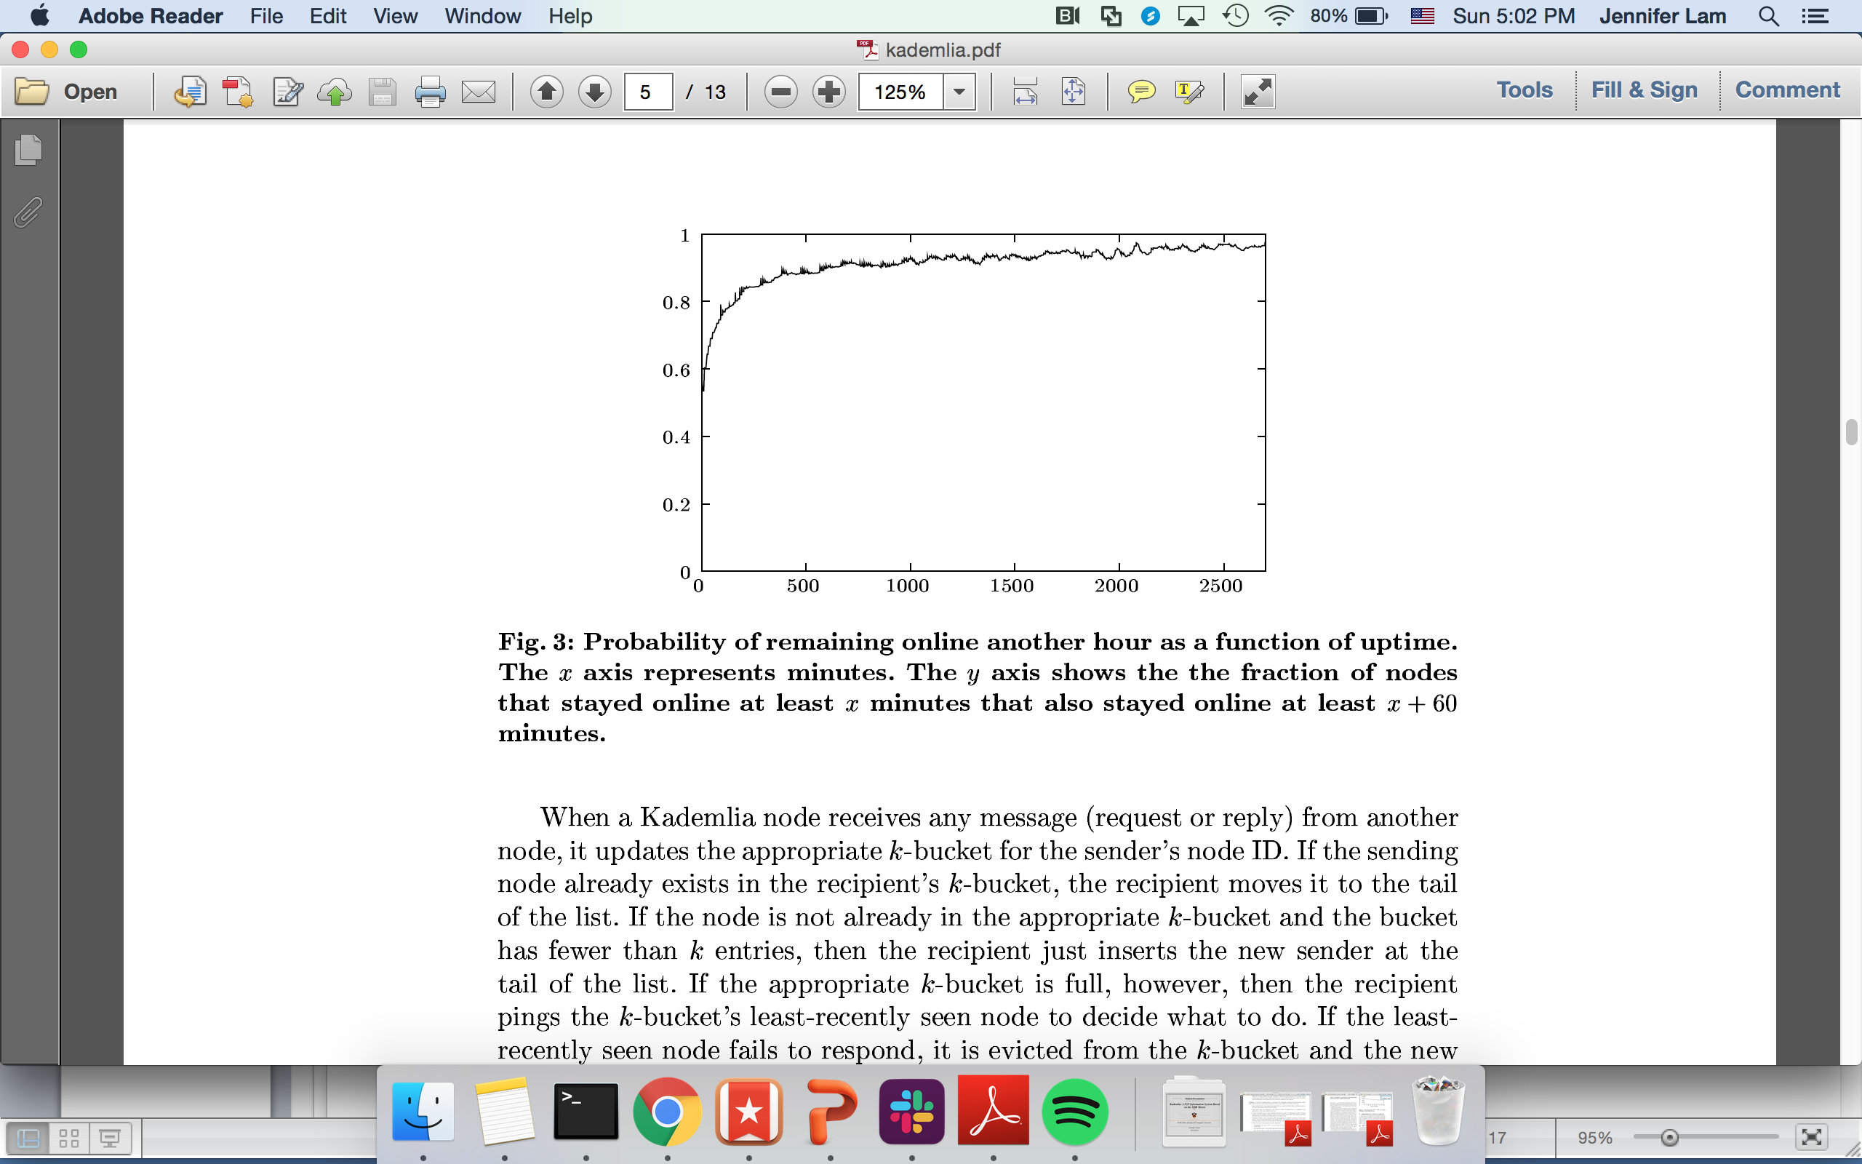
Key Challenges
Eviction policy: LRU
Probability
(Percentage of Nodes)
Minutes alive

Slide 9
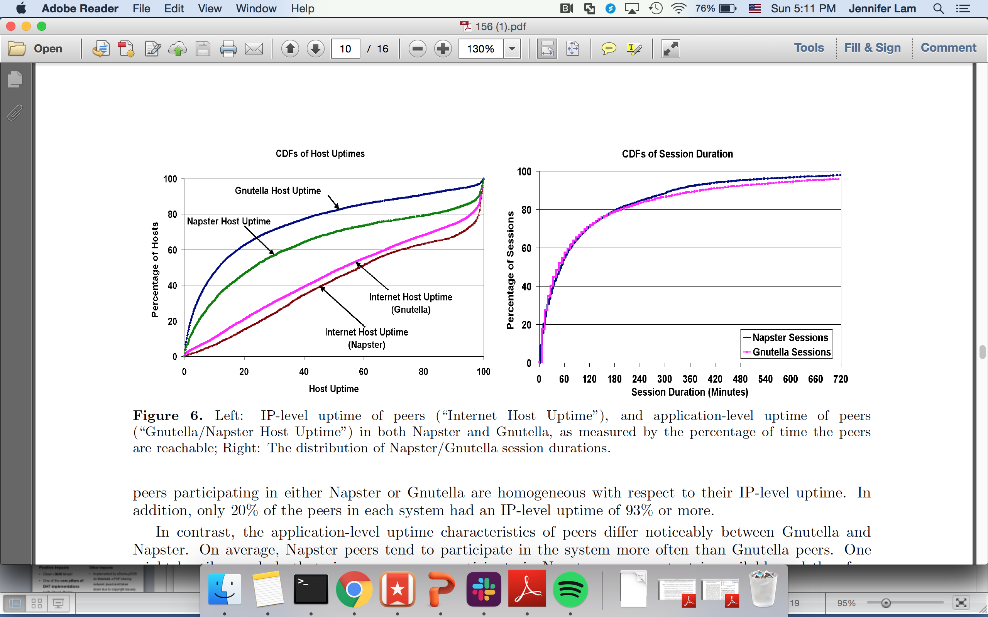
Key Challenges
Diving into the data source…
??

Slide 10
Key Challenges
Highly Unbalanced Trees

Slide 11
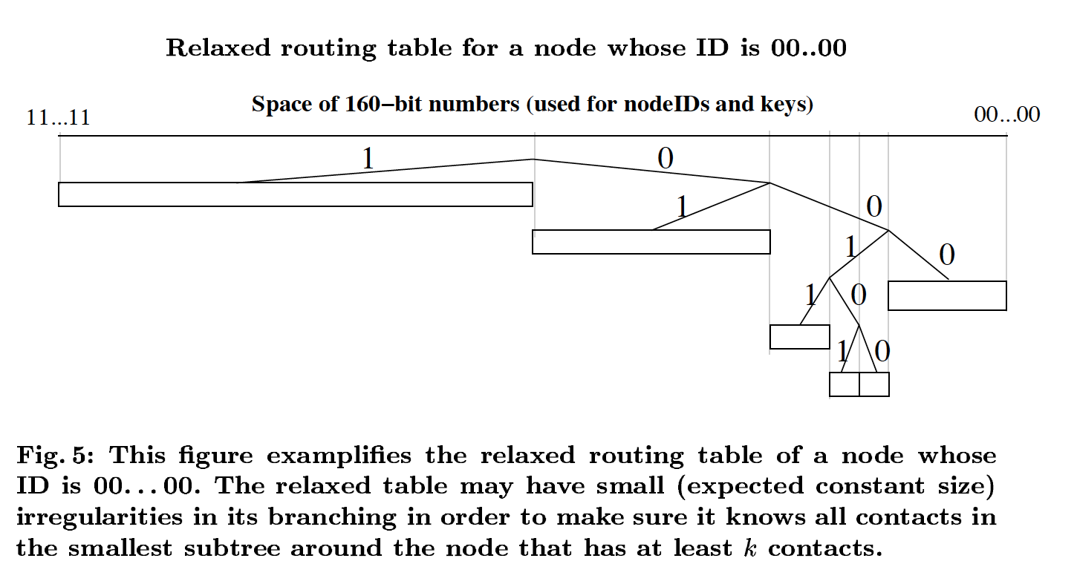
Key Challenges

Slide 12
Key Result (Evaluation)
There is no evaluation of their implementation. Instead, there is a proof. ☺
Potential metrics (later papers actually perform these analyses):
Common-case lookup latency.
Lookup latency under churn.
Performance under a skewed key distribution.
Performance with varying alpha / concurrency parameter / number of peers in system.
Effect of low network bandwidth.

Slide 13
Impact
Positive Impacts
Other Impacts
Cited ~3600 times!
One of the core pillars of DHT implementations (with Chord, Pastry, Plaxton)
An interesting example of handling churn.
BitTorrent, IPFS, Kad, Overnet, Gnutella.
Implemented by eDonkey2000 as Overnet, a P2P sharing network (sued and taken down due to copyright issues).
Storm botnet (Trojan horse run on Overnet), which infected 1-50 million Windows at its peak in 2007.

Slide 14
Technical Details

Slide 15
Key Idea: Kademlia API
PING(160 bit node_id)
STORE(key, value)
FIND_NODE(160 bit key / node_id) => k closest nodes
FIND_VALUE(key) => value, if it exists

Slide 16
Key Idea: Terminology
k: replication factor.
alpha: concurrency factor (size of fanout).
k-bucket: leaves in the xor-tree, holds at most k nodes.

Slide 17
Key Idea: Full Lookup Protocol
Chalkboard.

Slide 18
Last Thoughts
Load balancing when key distribution is skewed?
Determining when topology is highly unbalanced?
LRU policy—liveness vs. access?

