Slide 1
Concurrency Control II (OCC, MVCC)
COS 418: Distributed Systems
Lecture 18
Michael Freedman

Slide 2
Serializability Execution of a set of transactions over multiple items is equivalent to some serial execution of txns

Slide 3
Lock-based concurrency control
Big Global Lock: Results in a serial transaction schedule at the cost of performance
Two-phase locking with finer-grain locks:
Growing phase when txn acquires locks
Shrinking phase when txn releases locks (typically commit)
Allows txn to execute concurrently, improvoing performance
Notes:
So that motivates the 2PL algorithm.

Slide 4
Q: What if access patterns rarely, if ever, conflict?

Slide 5
Be optimistic!
Goal: Low overhead for non-conflicting txns
Assume success!
Process transaction as if would succeed
Check for serializability only at commit time
If fails, abort transaction
Optimistic Concurrency Control (OCC)
Higher performance when few conflicts vs. locking
Lower performance when many conflicts vs. locking

Slide 6
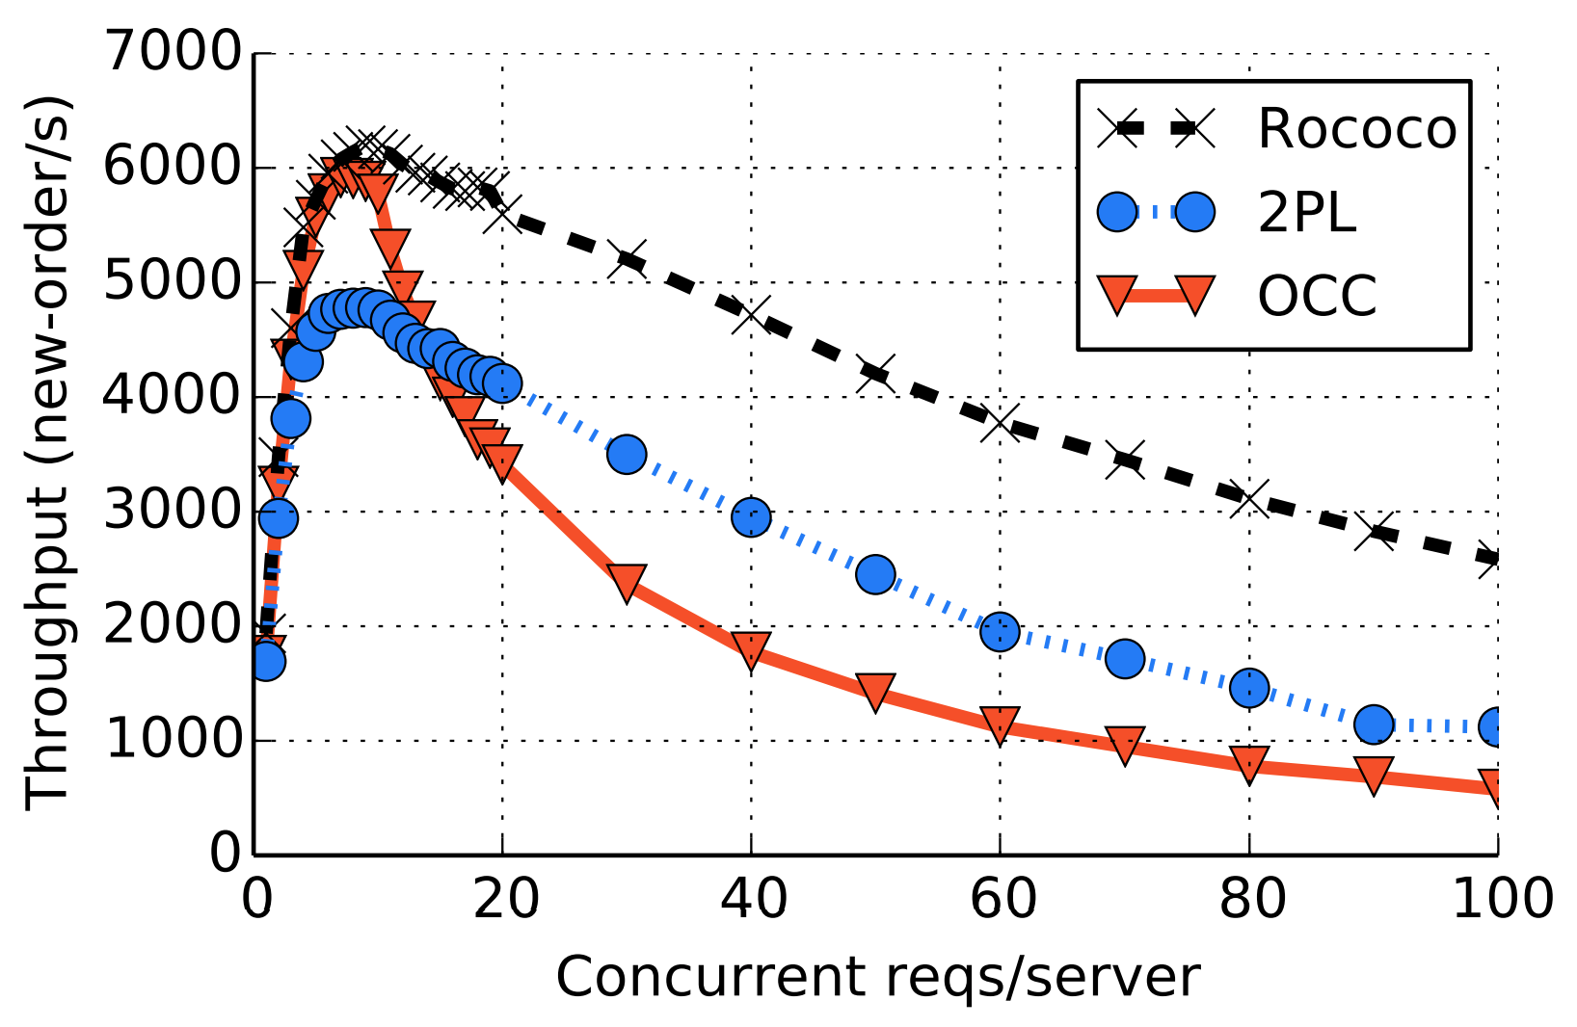
2PL vs OCC
From ”Rococo” paper in OSDI 2014. Focus on 2PL vs. OCC.
Observe OCC better when write rate lower (fewer conflicts), worse than 2PL with write rate higher (more conflicts)

Slide 7
OCC: Three-phase approach
Begin: Record timestamp marking the transaction’s beginning
Modify phase:
Txn can read values of committed data items
Updates only to local copies (versions) of items (in db cache)
Validate phase
Commit phase
If validates, transaction’s updates applied to DB
Otherwise, transaction restarted
Care must be taken to avoid “TOCTTOU” issues
Notes:
Time to check t Time to use

Slide 8
OCC: Why validation is necessary
New txn creates shadow copies of P and Q
P and Q’s copies at inconsistent state
txn coord
O
P
txn coord
When commits txn updates,
create new versions at some timestamp t
Q

Slide 9
OCC: Validate Phase
Transaction is about to commit. System must ensure:
Initial consistency: Versions of accessed objects at start consistent
No conflicting concurrency: No other txn has committed an operation at object that conflicts with one of this txn’s invocations
Consider transaction 1. For all other txns N either committed or in validation phase, one of the following holds:
N completes commit before 1 starts modify
1 starts commit after N completes commit, and ReadSet 1 and WriteSet N are disjoint
Both ReadSet 1 and WriteSet 1 are disjoint from WriteSet N, and N completes modify phase.
When validating 1, first check (A), then (B), then (C). If all fail, validation fails and 1 aborted.

Slide 10
OCC: Validate Phase
1
O
P
N
Q
N completes commit before 1 starts modify
Remember that modify includes both read & write. So this just says N finishes before 1 actually starts any read/write → no conflict
1 starts commit after N completes commit, and ReadSet 1 and WriteSet N are disjoint
Nothing 1 has recently read depends on what N has written, and 1’s writes will all be serialized after N’s (even though may overwrite N’s values)
Both ReadSet 1 and WriteSet 1 are disjoint from WriteSet N, and N completes modify phase.
If N has already finished reads (during modify), so it’s reads won’t depend on WriteSet 1, and similarly, 1’s reads don’t depend on N’s writes.

Slide 11
2PL & OCC = strict serialization
Provides semantics as if only one transaction was running on DB at time, in serial order
+ Real-time guarantees
2PL: Pessimistically get all the locks first
OCC: Optimistically create copies, but then recheck all read + written items before commit

Slide 12
Multi-version concurrency control
Generalize use of multiple versions of objects

Slide 13
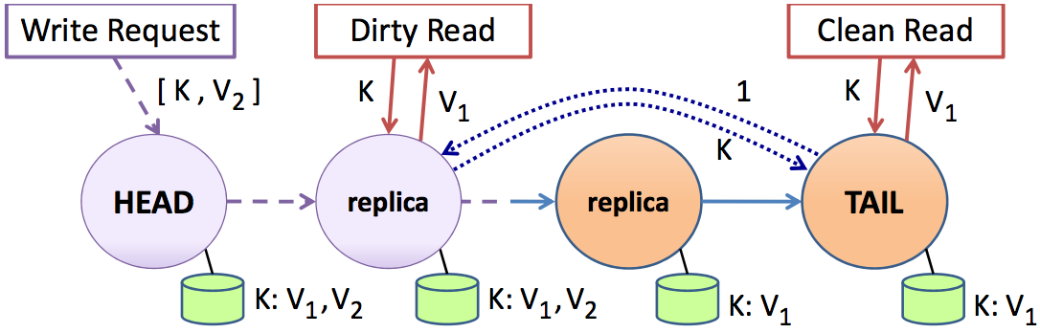
Multi-version concurrency control
Maintain multiple versions of objects, each with own timestamp. Allocate correct version to reads.
Prior example of MVCC:

Slide 14
Multi-version concurrency control
Maintain multiple versions of objects, each with own timestamp. Allocate correct version to reads.
Unlike 2PL/OCC, reads never rejected
Occasionally run garbage collection to clean up

Slide 15
MVCC Intuition
Split transaction into read set and write set
All reads execute as if one “snapshot”
All writes execute as if one later “snapshot”
Yields snapshot isolation < serializability

Slide 16
Serializability vs. Snapshot isolation
Intuition: Bag of marbles: ½ white, ½ black
Transactions:
T1: Change all white marbles to black marbles
T2: Change all black marbles to white marbles
Serializability (2PL, OCC)
T1 → T2 or T2 → T1
In either case, bag is either ALL white or ALL black
Snapshot isolation (MVCC)
T1 → T2 or T2 → T1 or T1 || T2
Bag is ALL white, ALL black, or ½ white ½ black

Slide 17
Timestamps in MVCC
Transactions are assigned timestamps, which may get assigned to objects those txns read/write
Every object version O_{V} has both read and write TS
ReadTS: Largest timestamp of txn that reads O_{V}
WriteTS: Timestamp of txn that wrote O_{V}

Slide 18
Executing transaction T in MVCC
Find version of object O to read:
# Determine the last version written before read snapshot time
Find O_{V} s.t. max { WriteTS(O_{V}) | WriteTS(O_{V}) <= TS(T) }
ReadTS(O_{V}) = max(TS(T), ReadTS(O_{V}))
Return O_{V} to T
Perform write of object O or abort if conflicting:
Find O_{V} s.t. max { WriteTS(O_{V}) | WriteTS(O_{V}) <= TS(T) }
# Abort if another T’ exists and has read O after T
If ReadTS(O_{V}) > TS(T)
Abort and roll-back T
Else
Create new version O_{W}
Set ReadTS(O_{W}) = WriteTS(O_{W}) = TS(T)

Slide 19
Digging deeper
Notation
W(1) = 3: Write creates version 1
with WriteTS = 3
R(1) = 3: Read of version 1
returns timestamp 3
txn
txn
txn
TS = 3
TS = 4
TS = 5
write(O)
by TS=3
O

Slide 20
Digging deeper
Notation
W(1) = 3: Write creates version 1
with WriteTS = 3
R(1) = 3: Read of version 1
returns timestamp 3
txn
txn
txn
TS = 3
TS = 4
TS = 5
W(1) = 3
R(1) = 3
write(O)
by TS=5
O

Slide 21
Digging deeper
Notation
W(1) = 3: Write creates version 1
with WriteTS = 3
R(1) = 3: Read of version 1
returns timestamp 3
txn
txn
txn
TS = 3
TS = 4
TS = 5
W(1) = 3
R(1) = 3
W(2) = 5
R(2) = 5
O
Find v such that max WriteTS(v) <= (TS = 4)
v = 1 has (WriteTS = 3) <= 4
If ReadTS(1) > 4, abort
3 > 4: false
Otherwise, write object
write(O)
by TS = 4
Notes:
Write O by txn T, find serializable write or abort:
Find OV s.t. max { WriteTS(OV) | WriteTS(OV) <= TS(T) }
If ReadTS(OV) > TS(T)
Abort and roll-back T
Else
Create new version OW
ReadTS(Ow) = WriteTS(Ow) = TS(T)

Slide 22
Digging deeper
Notation
W(1) = 3: Write creates version 1
with WriteTS = 3
R(1) = 3: Read of version 1
returns timestamp 3
txn
txn
txn
TS = 3
TS = 4
TS = 5
W(1) = 3
R(1) = 3
W(3) = 4
R(3) = 4
W(2) = 5
R(2) = 5
O
Find v such that max WriteTS(v) <= (TS = 4)
v = 1 has (WriteTS = 3) <= 4
If ReadTS(1) > 4, abort
3 > 4: false
Otherwise, write object

Slide 23
Digging deeper
Notation
W(1) = 3: Write creates version 1
with WriteTS = 3
R(1) = 3: Read of version 1
returns timestamp 3
txn
txn
txn
TS = 3
TS = 4
TS = 5
W(1) = 3
R(1) = 3
R(1) = 5
O
BEGIN Transaction
tmp = READ(O)
WRITE (O, tmp + 1)
END Transaction
Find v such that max WriteTS(v) <= (TS = 5)
v = 1 has (WriteTS = 3) <= 5
Set R(1) = max(5, R(1)) = 5
Notes:
Read O by txn T, find version to read (never rejected):
Find O_{V} s.t. max { WriteTS(O_{V}) | WriteTS(O_{V}) <= TS(T) }
ReadTS(O_{V}) = max(TS(T), ReadTS(O_{V}))
Return O_{V} to T

Slide 24
Digging deeper
Notation
W(1) = 3: Write creates version 1
with WriteTS = 3
R(1) = 3: Read of version 1
returns timestamp 3
txn
txn
txn
TS = 3
TS = 4
TS = 5
W(1) = 3
R(1) = 3
W(2) = 5
R(2) = 5
R(1) = 5
O
Find v such that max WriteTS(v) <= (TS = 5)
v = 1 has (WriteTS = 3) <= 5
If ReadTS(1) > 5, abort
5 > 5: false
Otherwise, write object
BEGIN Transaction
tmp = READ(O)
WRITE (O, tmp + 1)
END Transaction
Notes:
Read O by txn T, find version to read (never rejected):
Find O_{V} s.t. max { WriteTS(O_{V}) | WriteTS(O_{V}) <= TS(T) }
ReadTS(O_{V}) = max(TS(T), ReadTS(O_{V}))
Return O_{V} to T

Slide 25
Digging deeper
Notation
W(1) = 3: Write creates version 1
with WriteTS = 3
R(1) = 3: Read of version 1
returns timestamp 3
txn
txn
txn
TS = 3
TS = 4
TS = 5
W(1) = 3
R(1) = 3
W(2) = 5
R(2) = 5
R(1) = 5
O
Find v such that max WriteTS(v) <= (TS = 4)
v = 1 has (WriteTS = 3) <= 4
If ReadTS(1) > 4, abort
5 > 4: true
write(O)
by TS = 4
Notes:
Read O by txn T, find version to read (never rejected):
Find O_{V} s.t. max { WriteTS(O_{V}) | WriteTS(O_{V}) <= TS(T) }
ReadTS(O_{V}) = max(TS(T), ReadTS(O_{V}))
Return O_{V} to T

Slide 26
Digging deeper
Notation
W(1) = 3: Write creates version 1
with WriteTS = 3
R(1) = 3: Read of version 1
returns timestamp 3
txn
txn
txn
TS = 3
TS = 4
TS = 5
W(1) = 3
R(1) = 3
W(2) = 5
R(2) = 5
R(1) = 5
R(1) = 5
O
Find v such that max WriteTS(v) <= (TS = 4)
v = 1 has (WriteTS = 3) <= 4
Set R(1) = max(4, R(1)) = 5
BEGIN Transaction
tmp = READ(O)
WRITE (P, tmp + 1)
END Transaction
Then write on P succeeds as well
Notes:
Read O by txn T, find version to read (never rejected):
Find O_{V} s.t. max { WriteTS(O_{V}) | WriteTS(O_{V}) <= TS(T) }
ReadTS(O_{V}) = max(TS(T), ReadTS(O_{V}))
Return O_{V} to T

Slide 27
No class Wednesday! 🦃
Monday lecture
Distributed Transactions
+ Google Spanner

