Slide 1
Hyperdex
A Distributed, Searchable Key-value Store
Robert Escriva, Bernard Wong, and Emin Gun Sirer
Presented By: Oluwatosin V. Adewale

Slide 2


What is Hyperdex?

Slide 3
Hyperdex
Hyperdex is a:
Distributed key-value store
That is Searchable.
i.e. Enables queries on secondary attributes, not just keys.
has strong consistency
maintains availability and is fault-tolerant
Notes:
Other key value stores have have API’s that limits object retrieval, because a key can only be retrieved by the primary and only key through which it was inserted.

Slide 4
Key Ideas
Hyperspace Hashing (main idea)
Enables search queries on secondary attributes
Data partitioning into subspaces
Each subspace is divided into regions
Value Dependent Chaining
Guarantees strong consistency
And includes fault-tolerance via replication within regions
Centralized Coordinator for managing global state which includes:
Mapping between hyperspace servers and regions
Information about server failures
Table Abstraction for data with different schema
Notes:
Coordinator only manages state of system and it is a replicated state machine….. Mention this. So its not a central point of failure
Say why each of this is good.

Slide 5
Hyperspace Hashing
Each table is an independent multidimensional space (low-dimensional)
Each object has a coordinate in this space based on hash of attribute values
This mapping is deterministic
Hyperspace is tessellated into grid of non-overlapping regions
Each server responsible for a specific region
Multi-dimensional hash bucket, mapping each object to a unique server
Coordinator generates mapping. Servers and Clients aware of mapping.
Insertion, delete and search are easy. No need for server-to-server routing.
Notes:
Axes of the dimensional space are the attributes.
Not sure but I think 2 regions per subspace.

Slide 6
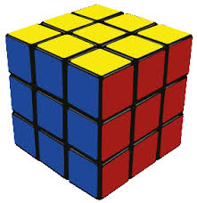
A hyperspace with regions

Slide 7
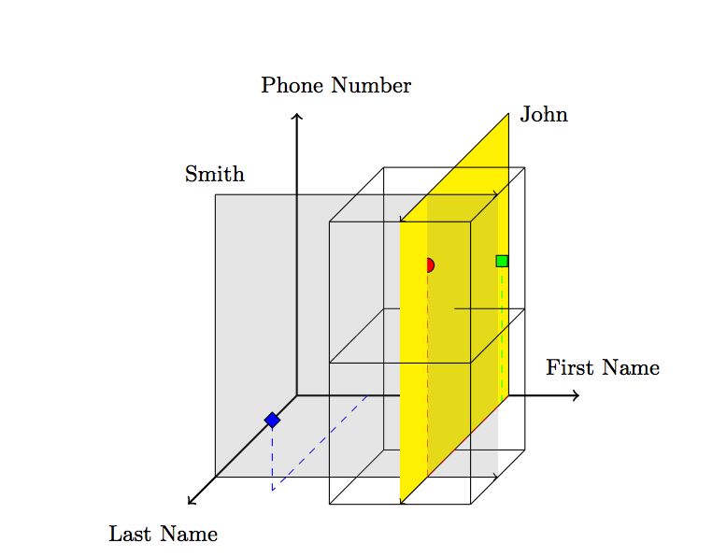
KEY IDEA: Hyperspace Hashing and Search
Notes:
Search by other attribute is key in paper,
Maps objects and servers into same hyperspace,
it is not necessary to contact a server whose region does not intersect the search hyperplane.
Set of servers to be contacted is drastically reduced!!!!!!
Range queries posisble, but hash should preserve relative orders for an attribute.

Slide 8
Data Partitioning
“Curse of dimensionality”
Dimensionality of hyperspace depends on the number of searchable attributes.
MOAR dimensions means O(2^{MOAR}) regions/servers . Volume grows exponentially with number of dimensions.
Think of size of truth table as number of Boolean variables increases
This is bad, you need exponentially more servers as attributes increase
Also means search and operations are less efficient on average
Solution: Partition tables with many attributes into lower-dimensional subspaces
Notes:
Assuming 2 regions per dimension or so.
So for 9 secondary attributes you need 2^9 regions or more to support efficient searches.

Slide 9
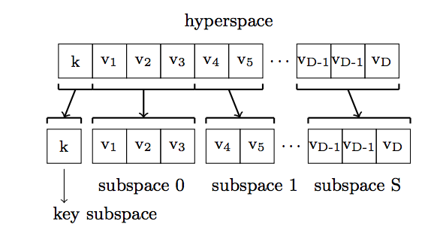
Data Partitioning
Partition hyperspace into subspaces
Key subspace to make retrieval by key remain fast
Each subspace has a copy of every object with subset of attributes as the dimensional axes.
PROS:
Search more efficient as it reduces dimensionality of underlying hyperspace.
Makes contacting fewer servers more likely.
Can create corresponding subspaces
CONS:
Consistency across subspaces needs to be addressed
Notes:
could use another normalized scheme that reduces storage per server but makes searches and operation more expensive.

Slide 10
Consistency And Replication
Challenge of maintaining consistent view of objects across servers and subspaces
Updates mean object might need to change servers
Updates need to be propagated across subspaces
What happens if the server in charge of a region fails?
How do we provide strong consistency and fault-tolerance?

Slide 11
Value Dependent Chaining
Goals are consistency and fault-tolerance
Location of objects determined by contents. Servers change as objects updated
Can’t just send updates to all servers involved as provides no strong guarantees
So HyperDex orders updates by arranging object’s replicas into a value-dependent chain chosen based on object’s coordinates
Head of the chain is the point leader and chosen from the key subspace.
Subsequent servers determined by hashing attribute values for each of the remaining subspaces
This allows efficient deterministic propagation of updates.
Provides strong consistency and linearizeability between operations.
Notes:
Linearizeability, if you put something all other gets would return that value.

Slide 12
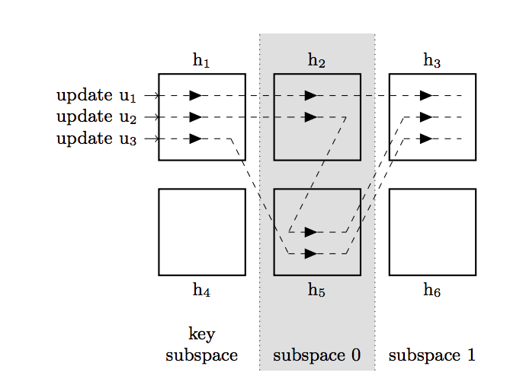
Value Dependent Chaining
Update flow through the chain and are pending till acknowledgement of update received from next server through the chain.
Tail sends acknowledgment back through chain after receiving update.
Client notified when operation is complete by point leader.
For updates servers holding old object within subspace precede servers that would hold new objects within subspace
Data therefore never disappears from data store. Objects only removed after acknowledgement
Like CRAQ
Operations dependent on destructive operations blocked

Slide 13
Value Dependent Chaining with fault tolerance
Fault tolerance is provided by f + 1 replicas.
Each replica appears in value-dependent chain. Trade off between fault-tolerance and latency.
If server fails for a region, then replica would replace failed server
If point leader fails, then another server takes over. Client detects failure and notifies application to provide at most once semantics.
Notes:
Imagine adding h1’ to h6’ at enf of every region

Slide 14
Coordinator
Tessellation of the hyperspace into regions (hyperspace mapping) and assignment to servers done by coordinator
Maintains mapping and disseminates to servers and clients. Maintains mapping as servers fail and new servers are introduced into the system.
Messages have state that servers can use to check if request was from old mapping etc.
instance ids, the regions of the hyperspace and indices into the chain for both the sender and recipient.
Configurations changed in all or nothing fashion.

Slide 15
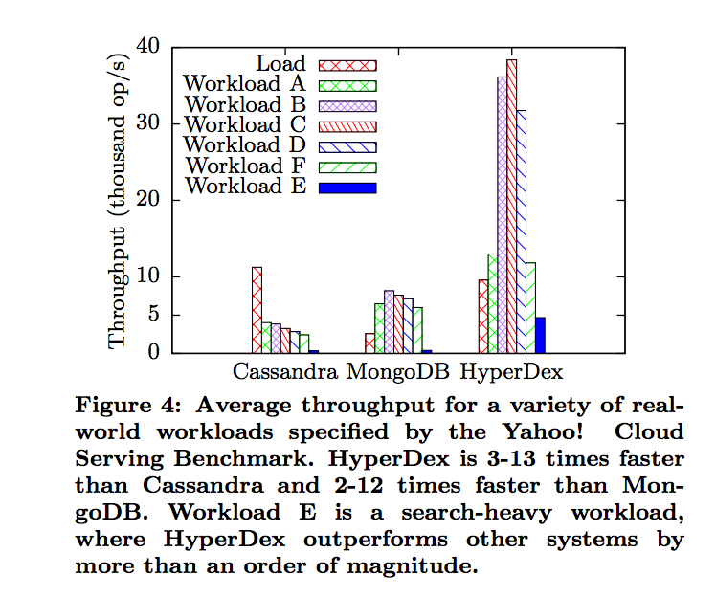
Evaluation and Results

Slide 16
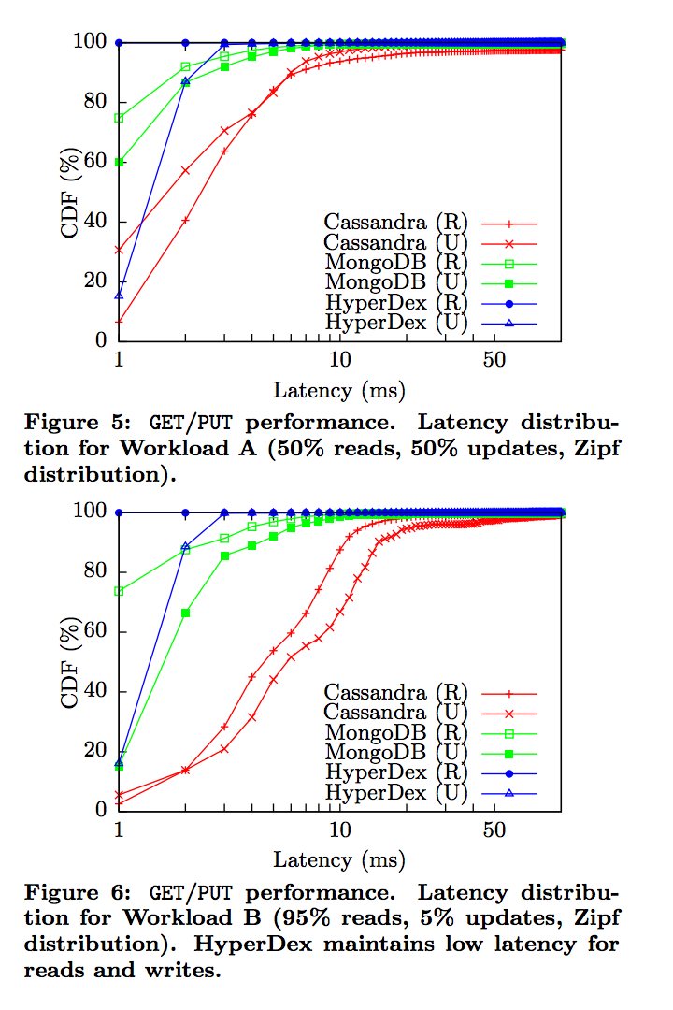
Evaluation and Results

Slide 17
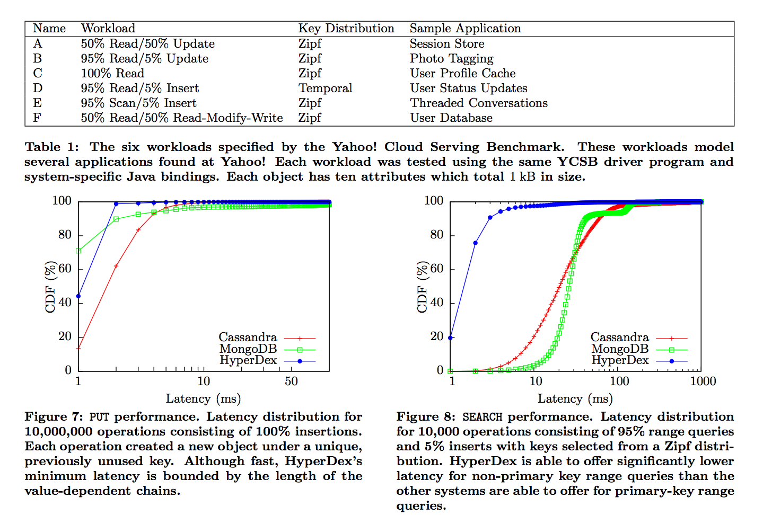
Evaluation and Results

Slide 18
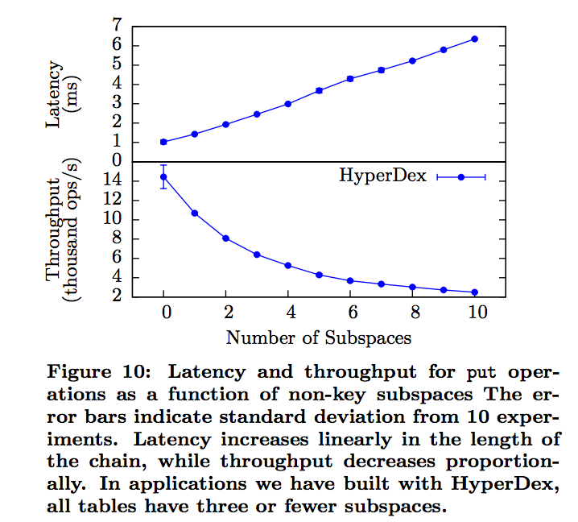
Evaluation and Results

Slide 19
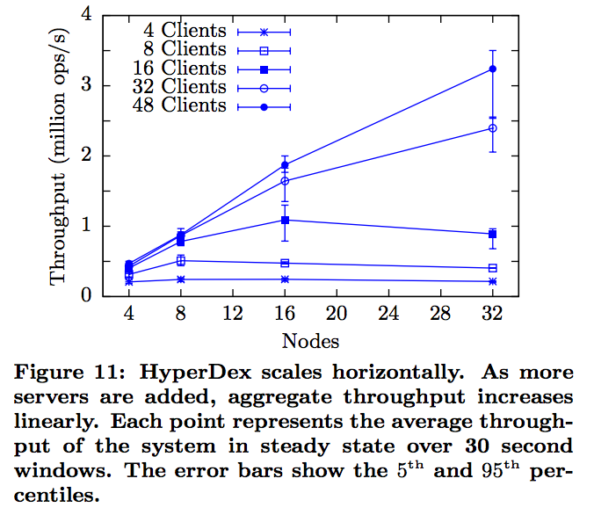
Evaluation and Results

Slide 20
Conclusion and Remarks
Notes:
Project declared inactive and consus

