Slide 1
SUNDR Secure Untrusted Data Repository
Jinyuan Li, Maxwell Krohn, David Mazières, and Dennis Shasha NYU

Slide 2
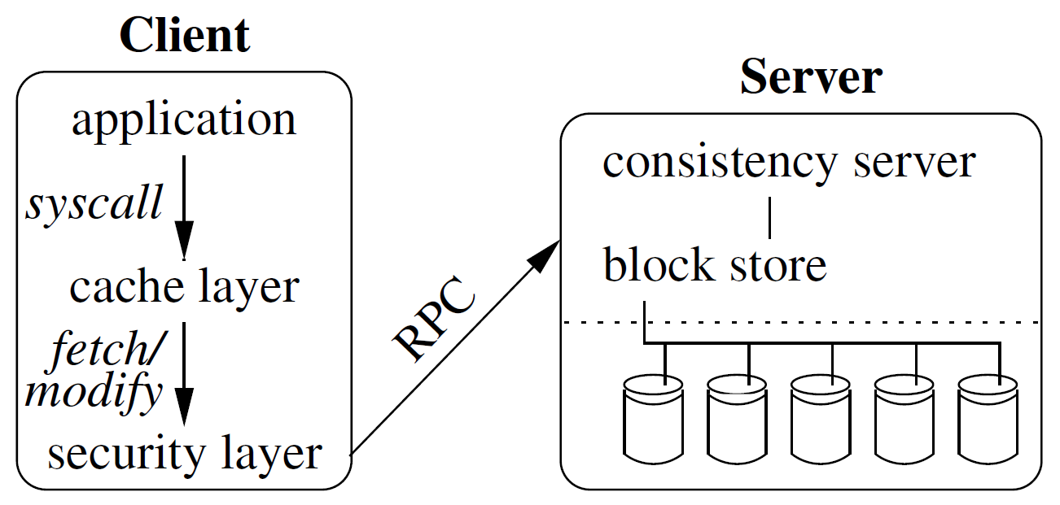
Motivation
How can we protect data integrity on untrusted or compromised servers?
SUNDR is a network file system that reduces the need to trust servers
Users can detect any unauthorized changes to their files
Users will eventually notice if the server drops operations
Notes:
Traditionally: trust the system admins, restrict user access, disable unneeded software…
> Doesn’t protect against malicious intrusions

Slide 3
SUNDR
Interface like NFS, with fetch and modify operations
SUNDR filesystem requires:
Superuser public/private signature key pair for root access – give public key to server admin
Server never needs private key!
User public/private signature key pair – give public key to superuser
Must remember private key and their last operation
User groups to give multiple users permissions to access the same files
Notes:
Fetch – retrieve file contents
Modify – change a file, and make it visible to other users
One file server can hold multiple SUNDR filesystems – completely isolated from each other

Slide 4
Security Model
Fetch-modify consistency: a fetch reflects exactly the authorized modifications that happened before it
Impossible without online trusted parties – server can just drop operations
Fork consistency: a malicious server can cause a fetch by A to miss a modify by B, but either will detect the attack upon seeing a subsequent operation by the other
Provided by SUNDR
Notes:
Fork consistency: can’t introduce gaps in history or forge operations

Slide 5
Strawman Filesystem
File server stores complete history of operations
Users sign every operation and the entire operation history preceding it
Invariant: users will only append to the history if they can validate all preceding history
To fetch or modify, a client must:
Acquire the global lock
Download the entire filesystem history
Validate each user’s most recent signature
Check that their last operation is in the downloaded history
Reconstruct the filesystem from its history, append their new modification, then sign it
But: no concurrency (global lock), computationally expensive

Slide 6
Serialized SUNDR
Ship digests of filesystem state using hash trees, instead of the whole history
i-handle: the root of a user/group hash tree, aggregating all of their files into a single hash
Version vector: ties together the latest versions of all i-handles
Notes:
(or Merkle trees)

Slide 7
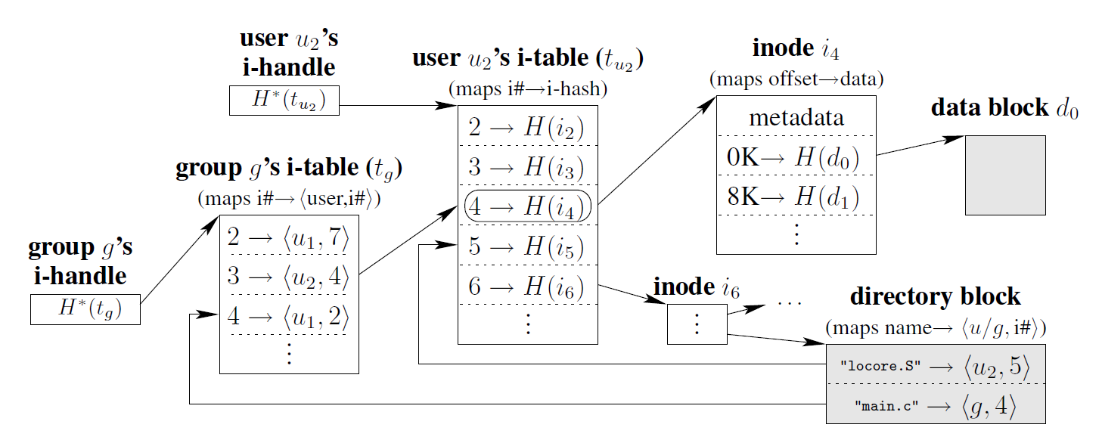
Serialized SUNDR
Notes:
[i-handles]
Data blocks are indexed by their SHA-1 hash, stored on block server
inodes store hashes of data blocks (and indirect blocks)
Files are identified by <user, i-number> (directory entries map file names onto them)
A user’s i-table maps i-numbers to a hash of the inode (or i-hash)
i-tables are stored as B+ trees, where nodes store hashes of their children
i-handle is the hash of a user’s i-table root
Given an i-handle, user can fetch any block of any file by recursively requesting intermediate blocks.

Slide 8
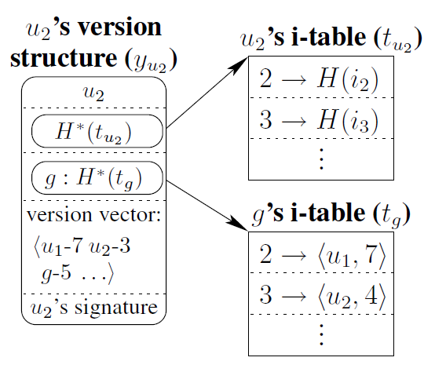
Serialized SUNDR
Notes:
[Version structures]
Version vector is the last known version number for every user and group in the system
Version structure contains the user’s i-handle, any group i-handles, and a version vector, and is signed by the user
Version structure list (VSL) contains latest version structure for every user and group

Slide 9
Serialized SUNDR
File server stores version structure list (VSL)
To fetch or modify, a client must:
Acquire the global lock
Download the VSL
Update their version structure
Perform modifications, recompute i-handles, increment version numbers, …
Check VSL consistency
Is their old version structure is in VSL?
Is there a total ordering? (all old version numbers <= new version numbers)
Sign their new version structure

Slide 10
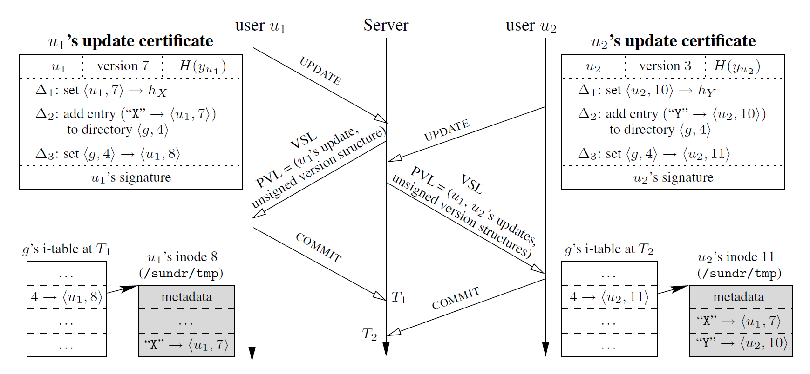
Concurrent SUNDR
Users pre-declare operations in signed update certificates (no global lock)
Gets complicated…

Slide 11
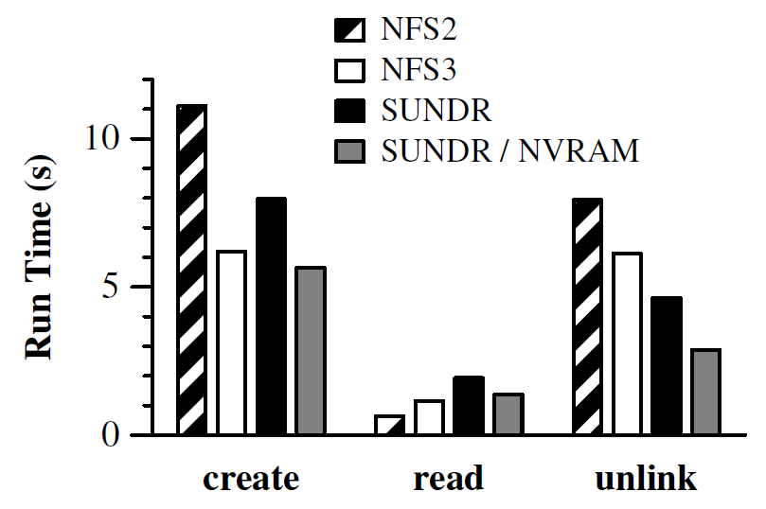
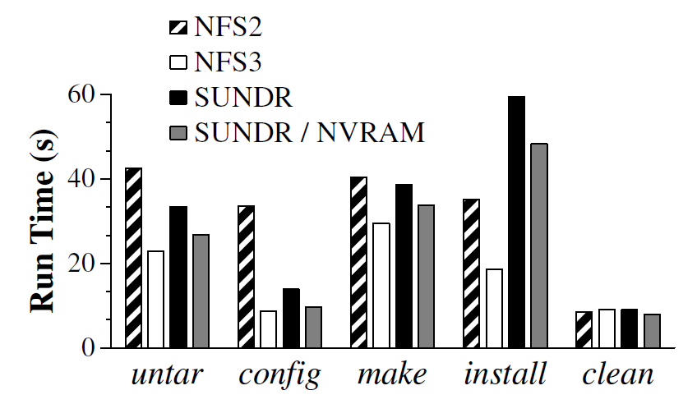
Evaluation
Single-client LFS Small File Benchmark
Installing Emacs
Notes:
Testing against NFS – usually comparable performance (NVRAM to store update certificates)
Creates 1000 1KB files, reads them back, then deletes them
Real workload
High bar is an “implementation artifact”

