Slide 1
Security
COS 518: Advanced Computer Systems
Lecture 17
Michael Freedman

Slide 2
Basic security properties
Confidentiality: Concealment of information or resources
Authenticity: Identification and assurance of origin of info
Integrity: Trustworthiness of data or resources in terms of preventing improper and unauthorized changes
Availability: Ability to use desired info or resource
Non-repudiation: Offer of evidence that a party indeed is sender or a receiver of certain information
Access control: Facilities to determine and enforce who is allowed access to what resources (host, software, network)

Slide 3
Intro to crypto in 15 minutes

Slide 4
What is Cryptography?
From Greek, meaning “secret writing”
Confidentiality: encrypt data to hide content
Include “signature” or “message authentication code”
Integrity: Message has not been modified
Authentication: Identify source of message
Modern encryption:
Algorithm public, key secret and provides security
Symmetric (shared secret) or asymmetric (public-private key)
encryption
decryption
plaintext
ciphertext
plaintext

Slide 5
Symmetric (Secret Key) Crypto
Sender and recipient share common key
Main challenge: How to distribute the key?
Provides dual use:
Confidentiality (encryption)
Message authentication + integrity (MAC)
1000x more computationally efficient than asymmetric

Slide 6
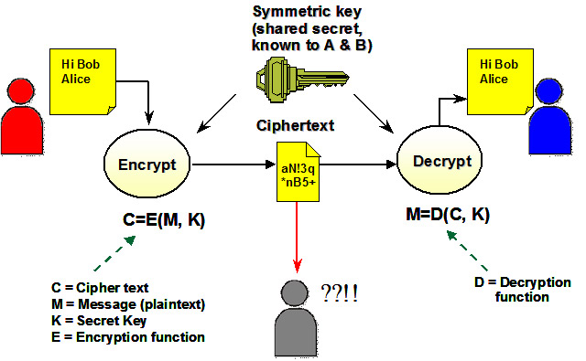
Symmetric Cipher Model

Slide 7
Public-Key Cryptography
Each party has (public key, private key)
Alice’s public key PK
Known by anybody
Bob uses PK to encrypt messages to Alice
Bob uses PK to verify signatures from Alice
Alice’s private/secret key: sk
Known only by Alice
Alice uses sk to decrypt ciphertexts sent to her
Alice uses sk to generate new signatures on messages

Slide 8
Public-Key Cryptography
(PK, sk) = generateKey(keysize)
Encryption API
ciphertext = encrypt (message, PK)
message = decrypt (ciphertext, sk)
Digital signatures API
Signature = sign (message, sk)
isValid = verify (signature, message, PK)

Slide 9
(Simple) RSA Algorithm
Generating a key:
Generate composite n = p * q, where p and q are secret primes
Pick public exponent e
Solve for secret exponent d in d⋅e ≡ 1 (mod (p -1) (q – 1))
Public key = (e, n), private key = d
Encrypting message m: c = m^{e} mod n
Decrypting ciphertext c: m = c^{d} mod n
Security due to cost of factoring large numbers
Finding (p,q) given n takes O(e ^{log n log log n}) operations
n chosen to be 2048 or 4096 bits long

Slide 10
Cryptographic hash function
( and using them in systems )

Slide 11
Cryptography Hash Functions I
Take message m of arbitrary length and produces fixed-size (short) number H(m)
One-way function
Efficient: Easy to compute H(m)
Hiding property: Hard to find an m, given H(m)
Assumes “m” has sufficient entropy, not just {“heads”, “tails”}
Random: Often assumes for output to “look” random
Notes:
Balls and bins analogy: weak collision is finding a collision on a SPECIFIC bin (the "m"), strong collision is finding a collision on ANY bin.

Slide 12
Cryptography Hash Functions II
Collisions exist: | possible inputs | >> | possible outputs | … but hard to find
Collision resistance:
Strong resistance: Find any m != m’ such that H(m) == H(m’)
Weak resistance: Given m, find m’ such that H(m) == H(m’)
For 160-bit hash (SHA-1)
Finding any collision is birthday paradox: 2^{160/2} = 2^80
Finding specific collision requires 2^160
Notes:
Balls and bins analogy: weak collision is finding a collision on a SPECIFIC bin (the "m"), strong collision is finding a collision on ANY bin.

Slide 13
Hash Pointers
h = H( )
(data)

Slide 14
Self-certifying names
F_{name} = H( )
(data)
P2P file sharing software (e.g., Limewire)
File named by F_{name} = H (data)
Participants verify that H (downloaded) == F_{name}

Slide 15
Self-certifying names
C_{name} = H( )
H( )
H( )
H( )
H( )
chunk
chunk
chunk
chunk
chunk
BitTorrent
Large file split into smaller chunks (~256KB each)
Torrent file specifies the name/hash of each chunk
Participants verify that H (downloaded) == C_{name}
Security relies on getting torrent file from trustworthy source

Slide 16
Hash chains
H( )
prev: H( )
prev: H( )
prev: H( )
data
data
data
Creates a “tamper-evident” log of data

Slide 17
Hash chains
H( )
prev: H( )
prev: H( )
prev: H( )
data
data
data
If data changes, all subsequent hash pointers change
Otherwise, found a hash collision!

Slide 18
Security more broadly

Slide 19
Fortune favors the attacker
Cost asymmetry
Defense must protect everything
Offense must find just one hole
“Security” is a negative goal: hard to achieve
Policy: desired goal
Threat model: assumptions about what can go wrong

Slide 20
Ways to attack grades.txt
Change permissions on grades.txt to get access
Access disk blocks directly
Access grades.txt via www.cs.princeton.edu
Reuse memory after Mike’s text editor exits, read data
Read backup copy of grades.txt from Mike’s text editor
Intercept network packets to file server storing grades.txt
Send Mike a trojaned text editor that emails out the file
Steal disk from file server storing grades.txt
Get discarded printout of grades.txt from the trash
Call sysadmin, pretend to be Mike, reset his password
...
Example from MIT 6.033

Slide 21
paymaxx.com (2005)
https://my.paymaxx.com/
Requires username and password
If you authenticate, provides menu of options
One option is to get a PDF of your W2 tax form
https://my.paymaxx.com/get-w2.cgi?id=1234
Gets a PDF of W2 tax form for ID 1234
get-w2.cgi forgot to check authorization
Attacker manually constructs URLs to fetch all data
Example from MIT 6.033

Slide 22
Thinking about threat models…

Slide 23
Example: Passwords
Can’t store passwords in a file that could be read
Concerned with insider attacks / break-ins
Must compare typed passwords to stored passwords
Does H (input) == H (password) ?
Memory cheap: build table of all likely password hashes?
Notes:
A salt is random data that is used as an additional input to a one-way function that hashes a password or passphrase. The primary function of salts is to defend against dictionary attacks and pre-computed rainbow table attacks.
A new salt is randomly generated for each password. In a typical setting, the salt and the password are concatenated and processed with a cryptographic hash function, and the resulting output (but not the original password) is stored with the salt in a database. Hashing allows for later authentication while defending against compromise of the plaintext password in the event that the database is somehow compromised.

Slide 24
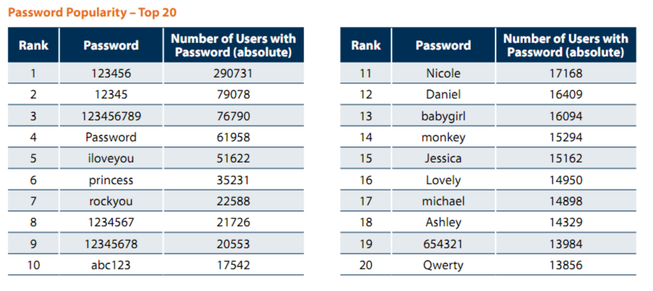
Password stats (leaked 32M passwords, 2009)
5,000 unique passwords account for 20% users (6.4M)
Similar statistics in Gawker breakin, 2010

Slide 25
Example: Passwords
Can’t store passwords in a file that could be read
Concerned with insider attacks / break-ins
Must compare typed passwords to stored passwords
Does H (input) == H (password) ?
Memory cheap: build table of all likely password hashes?
Use “salt” to compute h = H (password || salt)
Store salt as plaintext in password file, not a secret
Then check whether H (input, salt) == h
Notes:
A salt is random data that is used as an additional input to a one-way function that hashes a password or passphrase. The primary function of salts is to defend against dictionary attacks and pre-computed rainbow table attacks.
A new salt is randomly generated for each password. In a typical setting, the salt and the password are concatenated and processed with a cryptographic hash function, and the resulting output (but not the original password) is stored with the salt in a database. Hashing allows for later authentication while defending against compromise of the plaintext password in the event that the database is somehow compromised.

Slide 26
Attacking specific accounts
“Tar pit” connections
Failed logins take 2-3 seconds to respond
...but can just retry within 100s of ms
...or launch attack from many bots concurrently
Max number of failed connections
“Lock” account and require additional information
Two-factor auth
“What you have” + “what you know”

Slide 27
HTTP Security

Slide 28
“Securing” HTTP
Threat model
Eavesdropper listening on conversation (confidentiality)
Man-in-the-middle modifying content (integrity)
Adversary impersonating desired website (authentication, and confidentiality)
Enter HTTP-S
HTTP sits on top of secure channel (SSL/TLS)
All (HTTP) bytes written to secure channel are encrypted and authenticated
Problem: What is actually authenticated to prevent impersonation? Which keys used for crypto protocols?

Slide 29
Learning a valid public key
What is that lock?
Securely binds domain name to public key (PK)
Believable only if you trust the attesting body
Bootstrapping problem: Who to trust, and how to tell if this message is actually from them?
If PK is authenticated, then any message signed by PK cannot be forged by non-authorized party

Slide 30
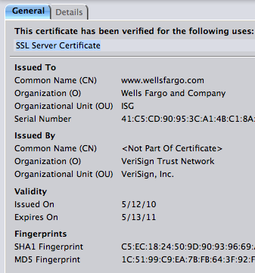
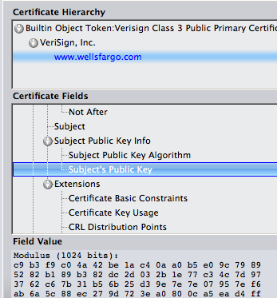
How to authenticate PK

Slide 31
Transport Layer Security (TLS) (Enhances/Replaces SSL)
Send new random value, list of supported ciphers
Send pre-secret, encrypted under PK
Create shared secret key from pre-secret and random
Switch to new symmetric-key cipher using shared key
Send new random value, digital certificate with PK
Create shared secret key from pre-secret and random
Switch to new symmetric-key cipher using shared key

Slide 32
Comments on HTTPS
Note that HTTPS authenticates server, not content
Switch to symmetric-key crypto after public-key ops
Symmetric-key crypto much faster (100-1000x)
PK crypto can encrypt message only approx. as large as key (2048 bits – this is a simplification) – afterwards uses hybrid
HTTPS on top of TCP, so reliable byte stream
Can leverage fact that transmission is reliable to ensure: each data segment received exactly once
Adversary can’t successfully drop or replay packets

Slide 33
The trouble with CAs
Browse/OS vendors pick which CAs to trust
Sometimes they revoke this trust – e.g. DigiNotar.
No notion of CAs having authority over only given TLD
Trust the {Iranian, Chinese, US} national authorities?
What standards does Apple use to pick root certs? Google? MSFT?
There’s a restraint-of-trade issue here. Can’t enter the CA business without vendor support…

Slide 34
DNS Security

Slide 35
Hierarchical naming in DNS
unnamed root
com
edu
org
ac
uk
zw
arpa
generic domains
country domains
bar
ac
in-
addr
west
east
cam
12
foo
my
usr
34
my.east.bar.edu
usr.cam.ac.uk
56
12.34.56.0/24

Slide 36
DNS Integrity: Trust the TLD operators?
If domain name doesn’t exist, DNS should return NXDOMAIN (non-existant domain) msg
Verisign instead creates wildcard DNS record for all .com and .net domain names not yet registered
September 15 – October 4, 2003
Redirection for these domain names to Verisign web portal: “to help you search”
and serve you ads…and get “sponsored” search
Verisign and online advertising companies make money…

Slide 37
DNS Integrity: Answer from authoritative server?
DNS cache poisoning
Client asks for www.evil.com
Nameserver authoritative for www.evil.com returns additional section for (www.cnn.com, 1.2.3.4, A)
Thanks! I won’t bother check what I asked for

Slide 38
DNS Integrity: Answer from authoritative server?
To prevent cache poisoning, client remembers domain and 16-bit request ID (used to demux UDP response)
But…DNS hijacking attack:
16 bits: 65K possible IDs
What rate to enumerate all in 1 sec? 64B/packet
64*65536*8 / 1024 / 1024 = 32 Mbps
Prevention: Also randomize the DNS source port
Windows DNS alloc’s 2500 DNS ports: ~164M possible IDs
Would require 80 Gbps
Kaminsky attack: this source port…wasn’t random after all

Slide 39
Let’s strongly believe the answer! Enter DNSSEC
DNSSEC protects against data spoofing and corruption
DNSSEC also provides mechanisms to authenticate servers and requests
DNSSEC provides mechanisms to establish authenticity and integrity

Slide 40
PK-DNSSEC (Public Key)
The DNS servers sign the hash of resource record set with its private (signature) keys
Public keys can be used to verify the SIGs
Leverages hierarchy:
Authenticity of nameserver’s public keys is established by a signature over the keys by the parent’s private key
In ideal case, only roots’ public keys need to be distributed out-of-band

Slide 41
Verifying the tree
Question: www.cnn.com ?
. (root)
dns.cs.princeton.edu
www.cnn.com A ?
src.cs.princeton.edu
ask .com server
SIG (ip addr and PK of .com server)
resolver
stub
resolver
www.cnn.com A ?
xxx.xxx.xxx.xxx
www.cnn.com A ?
.com
transaction
signatures
ask cnn.com server
SIG (ip addr and PK of cnn.com server)
add to cache
www.cnn.com A ?
slave servers
SIG (xxx.xxx.xxx.xxx)
transaction
signatures
cnn.com

