Slide 1
Student Presentation SLAQ: Quality-Driven Scheduling for Distributed Machine Learning
COS 518: Advanced Computer Systems
Jinzheng Tu
04/01/2019

Slide 2
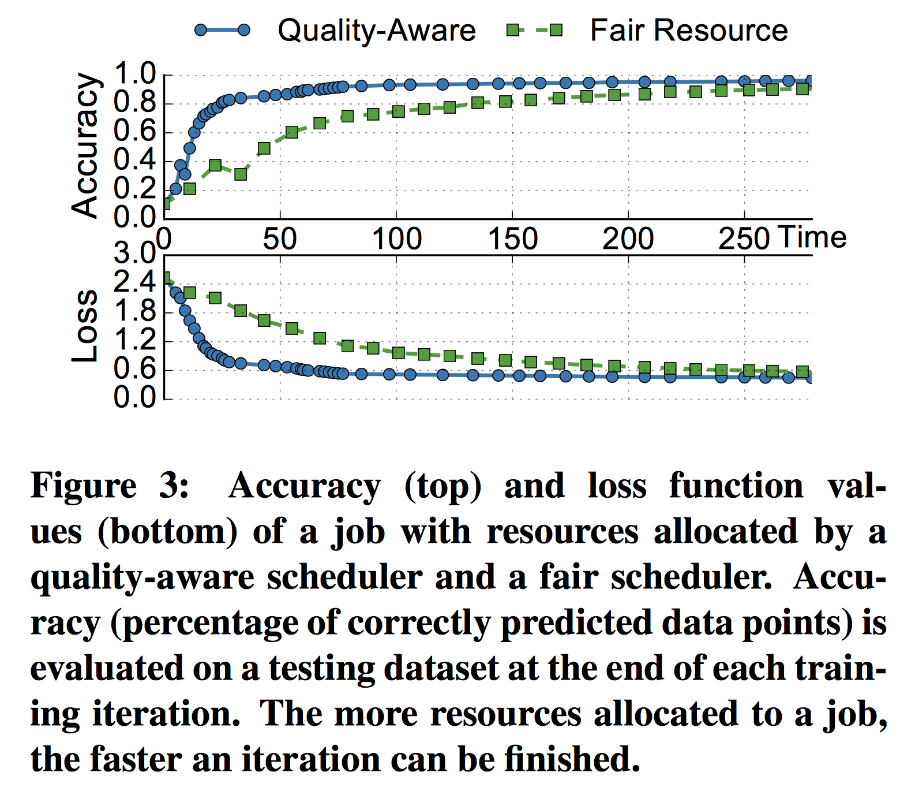
Problem Statement / Motivation
Machine learning jobs are drastically different from "traditional" ones:
Traditional:
1x res., 1x perf.
10x res., 10x perf.
ML-like:
1x res., 80% perf.
10x res., 90% perf.

Slide 3
Previous Solutions
Fairness-based algorithms are widely used in all cluster env:
Apache Hadoop YARN
DRF
Quincy
None of them consider the nature of performance saturation

Slide 4
Key Idea
SLAQ:
Divide an ML job into many tasks
Each has ~100x iterations
Estimate task runtime & perf. yield
Naïve "strawman"
Weighted curve fitting
Schedule tasks by estimated perf.
Maximize total yield
Maximize minimum yield

Slide 5
Key Challenges
ML algorithms are heterogeneous
There isn't one single criteria for performance yield
Different loss functions need to be normalized
Online prediction for task runtime and quality
Curve-fitting
Exponential weight decay

Slide 6
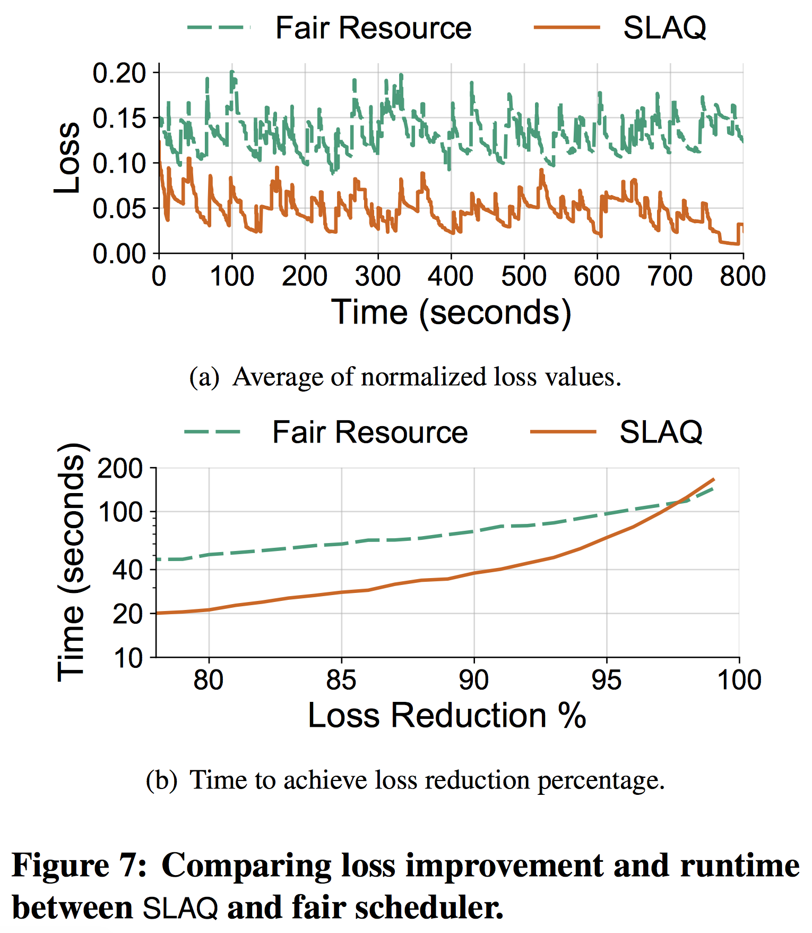
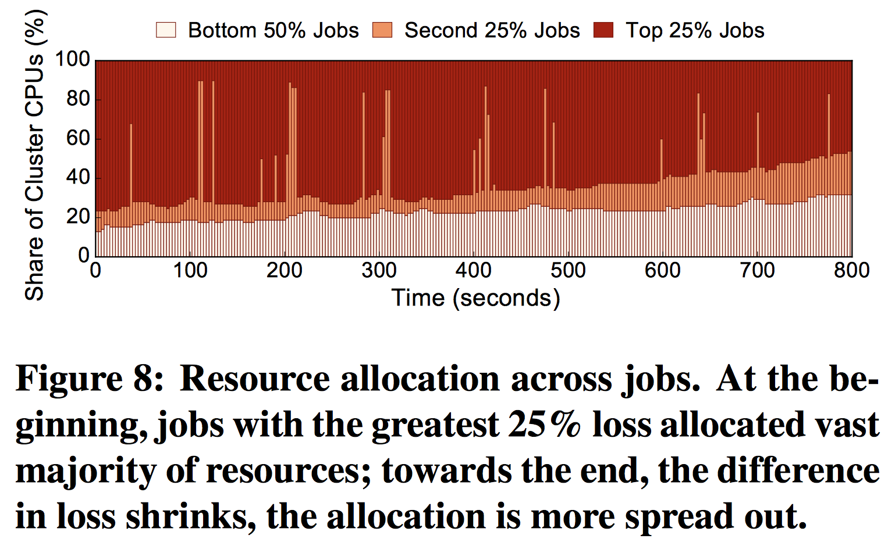
Key Result (Evaluation)
A higher total performance gain is observed
Also, newly-submitted jobs are given much more resources, reducing the time to achieve a (lower) loss reduction.

Slide 7
Impact
This is a fairly recent paper so...

Slide 8
Technical Details

Slide 9
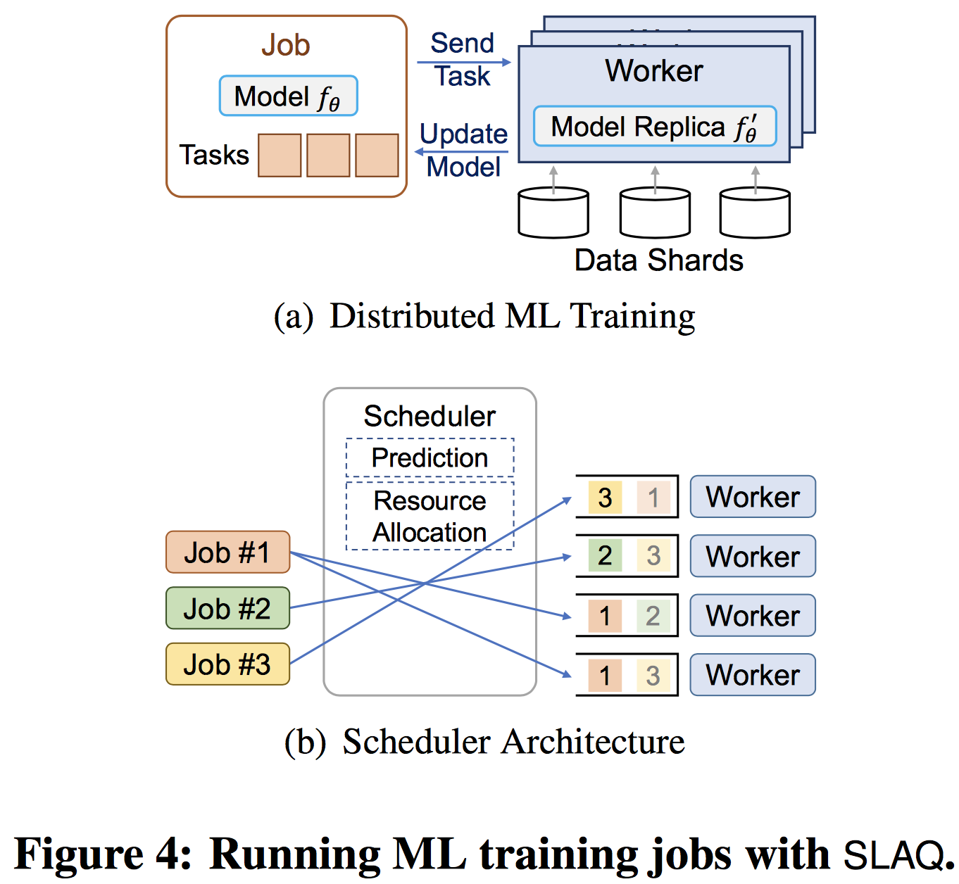
Key Idea: Granularity
An ML-job is divided into many tasks
Each task is composed of several iterations
Each task runs just some seconds

Slide 10
Key Idea: Estimating task runtime
Runtime should be
Proportional to number of iterations
Proportional to fraction of dataset
Inversely proportional to number of processors

Slide 11

Key Idea: Estimating task performance
Normalize the loss function w.r.t. the largest change we have ever seen for this job
Choose an extrapolation model:
One-step linear: "strawman"
Inversely quadratic:
Sub-linear convergency algorithms
Exponential:
Linear, supra-linear convergency algorithms
Weight the observations exponentially

