Slide 1
Cluster Scheduling
COS 518: Advanced Computer Systems
Lecture 13
Michael Freedman
[Heavily based on content from Ion Stoica]

Slide 2
Key aspects of cloud computing
Illusion of infinite computing resources available on demand, eliminating need for up-front provisioning
The elimination of an up-front commitment
The ability to pay for use of computing resources on a short-term basis
From “Above the Clouds: A Berkeley View of Cloud Computing”

Slide 3

Two main sources of resource demand
“Services”
External demand, scale supply to match demand
“Data analysis”
Tradeoff scale & completion time
E.g., use 1 server for 10 hours vs. 10 servers for 1 hour
Source of demand elasticity!
Type of contract | Price (m4.xlarge)
Spot - 1 hr duration | $0.139 / hour
Spot– 6 hr duration | $0.176 / hour
On-demand | $0.215 / hour

Slide 4
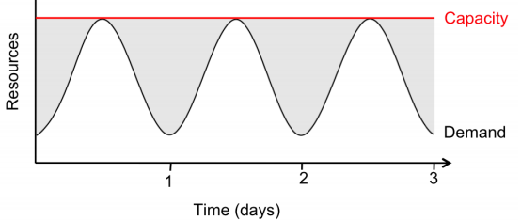
Towards fuller utilization
Source of variable demand?
Search, social networks, e-commerce, usage have diurnal patterns
Apocryphal story: AWS exists because Amazon needed to provision for holiday shopping season, wanted to monetize spare capacity
But…if provision for peak, what around remaining time?
Fill-in with non-time-sensitive usage, e.g., various data crunching
E.g., Netflix using AWS at night for video transcoding

Slide 5
Today’s lecture
Metrics / goals for scheduling resources
System architecture for big-data scheduling

Slide 6
Scheduling: An old problem
CPU allocation
Multiple processors want to execute, OS selects one to run for some amount of time
Bandwidth allocation
Packets from multiple incoming queue want to be transmitted out some link, switch chooses one

Slide 7
What do we want from a scheduler?
Isolation
Have some sort of guarantee that misbehaved processes cannot affect me “too much”
Efficient resource usage
Resource is not idle while there is process whose demand is not fully satisfied
“Work conservation” -- not achieved by hard allocations
Flexibility
Can express some sort of priorities, e.g., strict or time based

Slide 8
Single Resource: Fair Sharing
CPU
100%
33%
n users want to share a resource (e.g. CPU)
Solution: give each 1/n of the shared resource
Generalized by max-min fairness
Handles if a user wants less than its fair share
E.g. user 1 wants no more than 20%
Work conserving or work preserving
No unused capacity if there’s demand.
Generalized by weighted max-min fairness
Give weights to users according to importance
User 1 gets weight 1, user 2 weight 2
50%
33%
33%
0%
100%
20%
40%
50%
40%
0%
100%
33%
50%
66%
0%
Notes:
Less than its fair share

Slide 9
Max-Min Fairness is Powerful
Weighted Fair Sharing / Proportional Shares
User u1 gets weight 2, u2 weight 1
Priorities: Give u1 weight 1000, u2 weight 1
Reservations
Ensure u1 gets 10%: Give u1 weight 10, sum weights ≤ 100
Deadline-based scheduling
Given a job’s demand and deadline, compute user’s reservation / weight
Isolation: Users cannot affect others beyond their share

Slide 10
Max-min Fairness via Fair Queuing
Fair queuing explained in a fluid flow system: reduces to bit-by-bit round robin among flows
Each flow receives min( r_{i}, f ), where
r_{i} – flow arrival rate
f – link fair rate (see next slide)
Weighted Fair Queuing (WFQ)
Associate a weight with each flow

Slide 11
Fair Rate Computation
If link congested, compute f such that
f = 4:
min(8, 4) = 4
min(6, 4) = 4
min(2, 4) = 2
8
10
4
6
4
2
2

Slide 12
Fair Rate Computation
Associate a weight w_{i} with each flow i
If link congested, compute f such that
f = 2:
min(8, 2*3) = 6
min(6, 2*1) = 2
min(2, 2*1) = 2
(w₁ = 3)
8
10
6
(w₂ = 1)
6
2
(w₃ = 1)
2
2

Slide 13
Theoretical Properties of Max-Min Fairness
Share guarantee
Each user gets at least 1/n of the resource
But will get less if her demand is less
Strategy-proof
Users are not better off by asking for more than they need
Users have no reason to lie

Slide 14

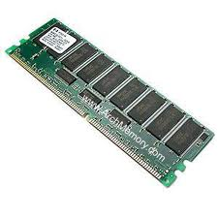

Why is Max-Min Fairness Not Enough?
Job scheduling is not only about a single resource
Tasks consume CPU, memory, network and disk I/O
What are task demands today?

Slide 15
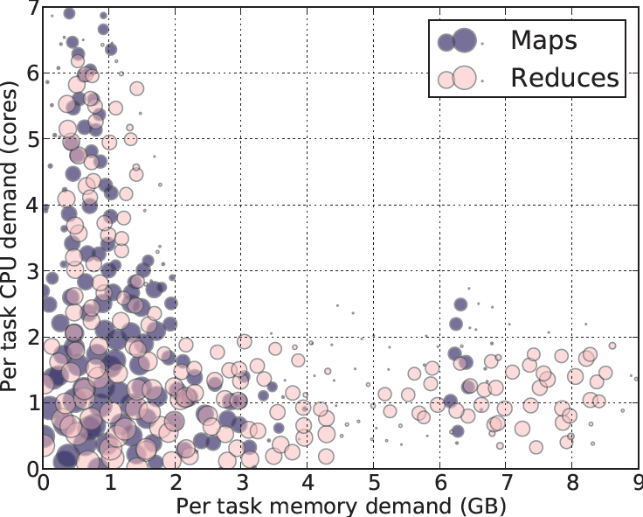
Heterogeneous Resource Demands
Some tasks are CPU-intensive
Most task need ~
<2 CPU, 2 GB RAM>
Some tasks are memory-intensive
2000-node Hadoop Cluster at Facebook (Oct 2010)
Notes:
Put fb in title

Slide 16
How to allocate?
2 resources: CPUs & memory
User 1 wants <1 CPU, 4 GB> per task
User 2 wants <3 CPU, 1 GB> per task
What’s a fair allocation?
100%
? ?
50%
0%
CPU
mem

Slide 17
A Natural Policy
Asset Fairness: Equalize each user’s sum of resource shares
Cluster with 28 CPUs, 56 GB RAM
U₁ needs <1 CPU, 2 GB RAM> per task, or <3.6% CPUs, 3.6% RAM> per task
U₂ needs <1 CPU, 4 GB RAM> per task, or <3.6% CPUs, 7.2% RAM> per task
Asset fairness yields
U₁: 12 tasks: <43% CPUs, 43% RAM> (∑=86%)
U₂: 8 tasks: <28% CPUs, 57% RAM> (∑=86%)
100%
43%
43%
50%
57%
28%
0%
CPU
RAM
User 1
User 2
Notes:
Say whats the prob

Slide 18
Strawman for asset fairness
Approach: Equalize each user’s sum of resource shares
Cluster with 28 CPUs, 56 GB RAM
U₁ needs <1 CPU, 2 GB RAM> per task, or <3.6% CPUs, 3.6% RAM> per task
U₂ needs <1 CPU, 4 GB RAM> per task, or <3.6% CPUs, 7.2% RAM> per task
Asset fairness yields
U₁: 12 tasks: <43% CPUs, 43% RAM> (∑=86%)
U₂: 8 tasks: <28% CPUs, 57% RAM> (∑=86%)
100%
43%
43%
50%
Problem: violates share guarantee
User 1 has < 50% of both CPUs and RAM
Better off in separate cluster with half the resources
57%
28%
0%
CPU
RAM
User 1
User 2
Notes:
Say whats the prob

Slide 19
Cheating the Scheduler
Users willing to game the system to get more resources
Real-life examples
A cloud provider had quotas on map and reduce slots Some users found out that the map-quota was low. Users implemented maps in the reduce slots!
A search company provided dedicated machines to users that could ensure certain level of utilization (e.g. 80%). Users used busy-loops to inflate utilization.
How achieve share guarantee + strategy proofness for sharing?
Generalize max-min fairness to multiple resources/

Slide 20
Dominant Resource Fairness (DRF)
A user’s dominant resource is resource user has biggest share of
Example:
Total resources:
User 1’s allocation:
Dominant resource of User 1 is CPU (as 25% > 20%)
A user’s dominant share: fraction of dominant resource allocated
User 1’s dominant share is 25%
8 CPU
2 CPU
5 GB
1 GB
25% CPUs
20% RAM
Dominant Resource Fairness: Fair Allocation of Multiple Resource Types
Ali Ghodsi, Matei Zaharia, Benjamin Hindman, Andy Konwinski, Scott Shenker, Ion Stoica, NSDI’11

Slide 21
Dominant Resource Fairness (DRF)
Apply max-min fairness to dominant shares
Equalize the dominant share of the users. Example:
Total resources: <9 CPU, 18 GB>
User 1 demand: <1 CPU, 4 GB>; dom res: mem (1/9 < 4/18)
User 2 demand: <3 CPU, 1 GB>; dom res: CPU (3/9 > 1/18)
100%
User 1
3 CPUs
12 GB
66%
User 2
50%
66%
6 CPUs
2 GB
0%
CPU
(9 total)
mem
(18 total)

Slide 22
Online DRF Scheduler
Whenever available resources and tasks to run:
Schedule task to user with smallest dominant share

Slide 23
Today’s lecture
Metrics / goals for scheduling resources
System architecture for big-data scheduling

Slide 24
Many Competing Frameworks
Many different “Big Data” frameworks
Hadoop | Spark
Storm | Spark Streaming | Flink
GraphLab
MPI
Heterogeneity will rule
No single framework optimal for all applications
So…each framework runs on dedicated cluster?

Slide 25
One Framework Per Cluster Challenges
Inefficient resource usage
E.g., Hadoop cannot use underutilized resources from Spark
Not work conserving
Hard to share data
Copy or access remotely, expensive
Hard to cooperate
E.g., Not easy for Spark to use graphs generated by Hadoop

Slide 26

Common resource sharing layer ?
Abstracts (“virtualizes”) resources to frameworks
Enable diverse frameworks to share cluster
Make it easier to develop and deploy new frameworks
Hadoop
Spark
Hadoop
Spark
Resource Management System
Uniprograming
Multiprograming

Slide 27
Abstraction hierarchy 101
In a cluster:
… a framework (e.g., Hadoop, Spark) manages 1+ jobs
… a job consists of 1+ tasks
… a task (e.g., map, reduce) involves 1+ processes executing on single machine
Executor
(e.g., Task
Tracker)
Executor
(e.g., Task
Traker)
Job 1: tasks 1, 2, 3, 4
Job 2: tasks 5, 6, 7
task 1
task 2
task 5
task 6
Framework
Scheduler
(e.g., Job Tracker)
Executor
(e.g., Task
Tracker)
Executor
(e.g., Task
Tracker)
task 3
task 7
task 4

Slide 28
Abstraction hierarchy 101
In a cluster:
… a framework (e.g., Hadoop, Spark) manages 1+ jobs
… a job consists of 1+ tasks
… a task (e.g., map, reduce) involves 1+ processes executing on single machine
Seek fine-grained resource sharing
Tasks typically short: median ~= 10 sec – minutes
Better data locality / failure-recovery if tasks fine-grained

Slide 29
Approach #1: Global scheduler
Global scheduler takes input, outputs task schedule
Organization policies
Resource Availability
Estimates: Task durations, input sizes, xfer sizes, …
Job requirements: Latency, throughput, availability…
Job execution plan: Task DAG, inputs/outups
Advantages: “Optimal”
Disadvantages
More complex, harder to scale (yet Google: 10,000s servers/scheduler)
Anticipate future requirements, refactor existing

Slide 30
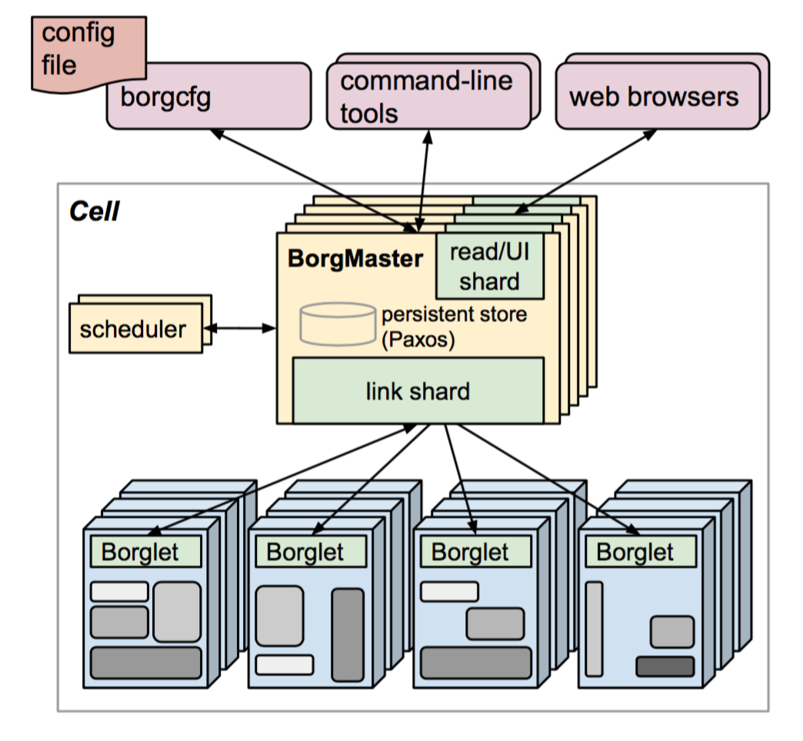
Google’s Borg
Centralized Borgmaster + Localized Borglet (manage/monitor tasks)
Goal: Find machines for a given job
job hello = {
runtime = { cell = “ic” }
binary = ‘../hello_webserver’
args = { port = ‘%port%’ }
requirements = {
RAM = 100M
disk = 100M
CPU = 0.1
}
replicas = 10000
}
Large-scale cluster management at Google with Borg
A. Verma, L. Pedrosa, M. Korupolu, D. Oppenheimer, E. Tune, J. Wilkes, EuroSys 15

Slide 31
Google’s Borg
Centralized Borgmaster + Localized Borglet (manage/monitor tasks)
Goal: Find machines for a given job
Used across all Google services
Services: Gmail, web search, GFS
Analytics: MapReduce, streaming
Framework controller sends master allocation request to Borg for full job

Slide 32
Google’s Borg
Centralized Borgmaster + Localized Borglet (manage/monitor tasks)
Goal: Find machines for a given job
Allocation
Minimize # / priority preempted tasks
Pick machines already having copy of the task’s packages
Spread over power/failure domains
Mix high/low priority tasks

Slide 33
Approach #2: Offers, not schedule
Unit of allocation: resource offer
Vector of available resources on a node
E.g., node1: <1CPU, 1GB>, node2: <4CPU, 16GB>
Master sends resource offers to frameworks
Frameworks:
Select which offers to accept
Perform task scheduling
Unlike global scheduler, requires another level of support
Mesos: A Platform for Fine-Grained Resource Sharing in the Data Center
Benjamin Hindman, Andy Konwinski, Matei Zaharia, Ali Ghodsi, Anthony D. Joseph, Randy Katz, Scott Shenker, Ion Stoica, NSDI’11

Slide 34
How to allocate resources? DRF!
 | CPU | Memory
Cluster Supply | 10 | 20
A’s Demand | 4 (40%) | 2 (10%)
B’s Demand | 1 (10%) | 5 (25%)
Cluster: Remaining | Cluster: Offer | A’s Allocation | B’s Allocation
( 10cpu, 20gb ) | (2cpu, 2gb) to A | ✔ (2cpu, 2gb, 20%) | (0cpu, 0gb, 0%)
Cluster: Remaining | Cluster: Offer | A’s Allocation | B’s Allocation
( 10cpu, 20gb ) | (2cpu, 2gb) to A | ✔ (2cpu, 2gb, 20%) | (0cpu, 0gb, 0%)
( 8cpu, 18gb ) | (1cpu, 2gb) to B | (2cpu, 2gb, 20%) | ✔ (1cpu, 2gb, 10%)
Cluster: Remaining | Cluster: Offer | A’s Allocation | B’s Allocation
( 10cpu, 20gb ) | (2cpu, 2gb) to A | ✔ (2cpu, 2gb, 20%) | (0cpu, 0gb, 0%)
( 8cpu, 18gb ) | (1cpu, 2gb) to B | (2cpu, 2gb, 20%) | ✔ (1cpu, 2gb, 10%)
( 7cpu, 16gb ) | (1cpu, 3gb) to B | (2cpu, 2gb, 20%) | ✔ (2cpu, 5gb, 25%)
Cluster: Remaining | Cluster: Offer | A’s Allocation | B’s Allocation
( 10cpu, 20gb ) | (2cpu, 2gb) to A | ✔ (2cpu, 2gb, 20%) | (0cpu, 0gb, 0%)
( 8cpu, 18gb ) | (1cpu, 2gb) to B | (2cpu, 2gb, 20%) | ✔ (1cpu, 2gb, 10%)
( 7cpu, 16gb ) | (1cpu, 3gb) to B | (2cpu, 2gb, 20%) | ✔ (2cpu, 5gb, 25%)
( 6cpu, 13gb ) | (1cpu, 6gb) to A | ✘ (2cpu, 2gb, 20%) | (2cpu, 5gb, 25%)
Cluster: Remaining | Cluster: Offer | A’s Allocation | B’s Allocation
( 10cpu, 20gb ) | (2cpu, 2gb) to A | ✔ (2cpu, 2gb, 20%) | (0cpu, 0gb, 0%)
( 8cpu, 18gb ) | (1cpu, 2gb) to B | (2cpu, 2gb, 20%) | ✔ (1cpu, 2gb, 10%)
( 7cpu, 16gb ) | (1cpu, 3gb) to B | (2cpu, 2gb, 20%) | ✔ (2cpu, 5gb, 25%)
( 6cpu, 13gb ) | (1cpu, 6gb) to A | ✘ (2cpu, 2gb, 20%) | (2cpu, 5gb, 25%)
( 6cpu, 13gb ) | (1cpu, 6gb) to B | (2cpu, 2gb, 20%) | ✔ (3cpu, 11gb, 55%)
Cluster: Remaining | Cluster: Offer | A’s Allocation | B’s Allocation
( 10cpu, 20gb ) | (2cpu, 2gb) to A | ✔ (2cpu, 2gb, 20%) | (0cpu, 0gb, 0%)
( 8cpu, 18gb ) | (1cpu, 2gb) to B | (2cpu, 2gb, 20%) | ✔ (1cpu, 2gb, 10%)
( 7cpu, 16gb ) | (1cpu, 3gb) to B | (2cpu, 2gb, 20%) | ✔ (2cpu, 5gb, 25%)
( 6cpu, 13gb ) | (1cpu, 6gb) to A | ✘ (2cpu, 2gb, 20%) | (2cpu, 5gb, 25%)
( 6cpu, 13gb ) | (1cpu, 6gb) to B | (2cpu, 2gb, 20%) | ✔ (3cpu, 11gb, 55%)
( 5cpu, 7gb ) | (3cpu, 2gb) to B | ✔ (5cpu, 4gb, 50%) | (3cpu, 11gb, 55%)

Slide 35
Today’s lecture
Metrics / goals for scheduling resources
Max-min fairness, weighted-fair queuing, DRF
System architecture for big-data scheduling
Central allocator (Borg), two-level resource offers (Mesos)

