Slide 1
Student Presentation Bigtable: A Distributed Storage System for Structured Data
COS 518: Advanced Computer Systems
Josh Zhang
March 6, 2019

Slide 2
Problem Statement / Motivation
Lots of (semi-)structured data at Google
URLs:
Web contents, crawl metadata, links, anchors, ...
Per-user data:
User preference settings, recent search results, …
Geographic locations:
Physical entities (shops, restaurants, etc.), roads, …
Scale is large
Billions of URLs, many versions, …
Hundreds of millions of users, thousands of q/sec
Across thousands of machines

Slide 3
Previous Solutions
Use commercial DB - but there are problems
Scale is too large for most commercial DB
Cost would be very high
Building internally means system can be applied across many projects for low cost
Cannot do low-level storage optimization
Low-level storage optimizations help performance
Much harder to do when running on top of a database layer
Notes:
Different projects can use Bigtable as a building block
Can do low-level optimization in storage and network if we start from the bottom to higher layer

Slide 4
Key Ideas
An interesting data model
distributed multi-level map
A better relationship between memory and disk (GFS)
how to make read/write fast
Tb of in-memory data + Pb of disk data
Scalability
Thousands of servers
Self-managing
Reliability
Fault-tolerant, persistent
Notes:
Data changes over time: E.g. contents of a webpage over multiple crawls
Efficient join of large one-to-one and one-to-many datasets

Slide 5
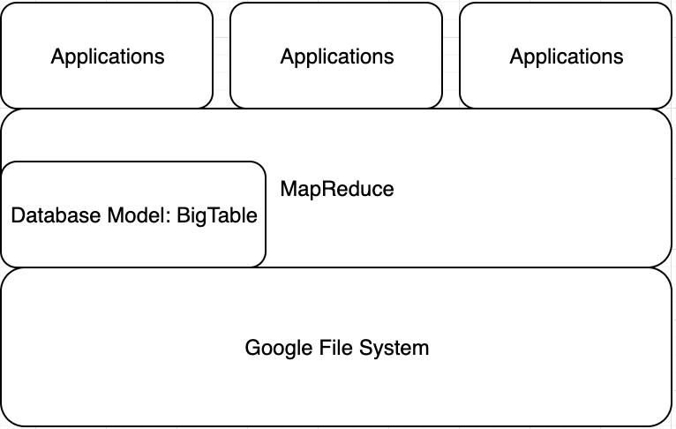
Building Blocks for BigTable
BigTable:
Client library
Master server
Tablet servers
Google File System (GFS): Raw storage
Scheduler: schedules jobs onto machines
Chubby(distributed lock manager): master election, bootstrap location of Bigtable data
Notes:
GFS: stores persistent state
Scheduler: schedules jobs involved in BigTable service
Lock service: master election, location boostrapping
MapReduce: clients’ way of reading/writing BigTable data

Slide 6
Data Model
A sparse, distributed, multi-dimensional sorted map
Indexed by row key, column key, and a timestamp
Sorted in lexicographic order by the key

Slide 7
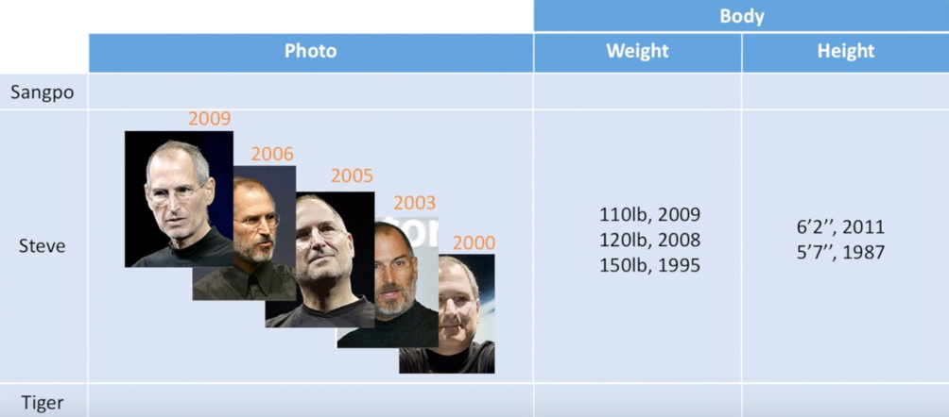
Data Model – Logic View of Table
source: bittiger.io

Slide 8
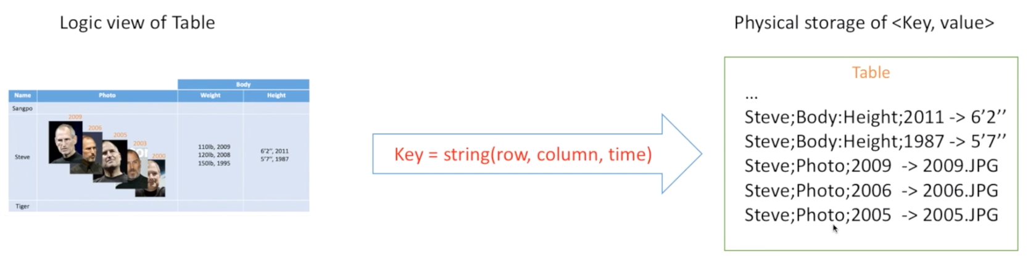
Data Model – Physical View of Table
(row:string, column:string, time:int64) -> string
Keys are sorted in lexicographical order – good locality
A table can be stored as key-value pairs

Slide 9
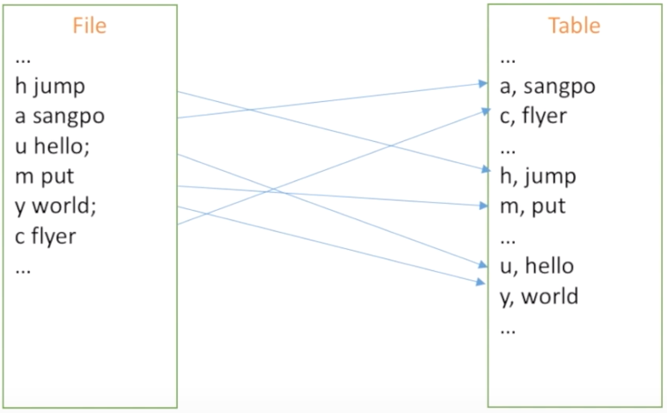
How to fast search in a file?
Table: a list of sorted <key, value>
source: bittiger.io

Slide 10
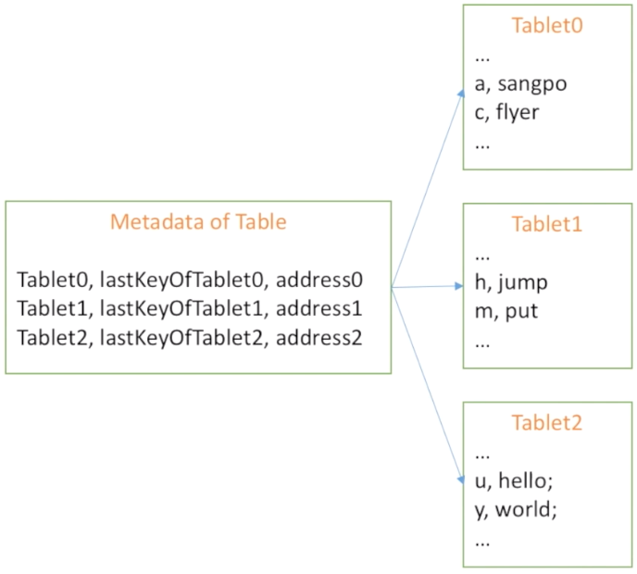
How to store a big table?
Metadata Table: a list of tablets
Tablet: a list of <key, value>

Slide 11
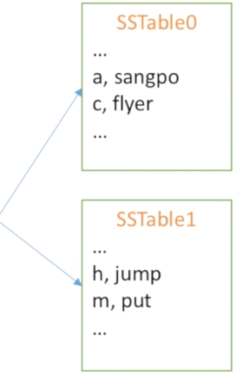
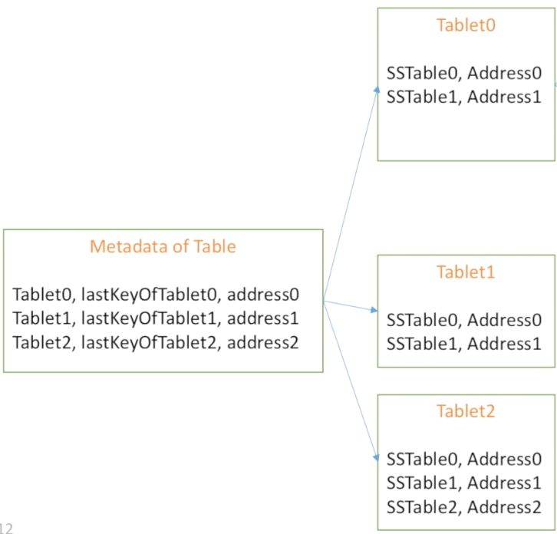
How to store a super super big table?
Metadata Table: a list of tablets
Tablet: a list of SSTable
SSTable: a list of sorted <key, value>

Slide 12
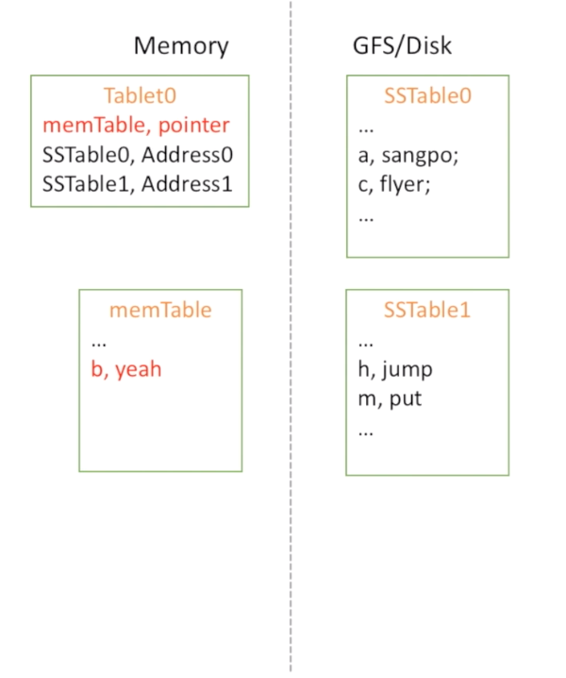
How to write data to the table?
Key point: memTable
New data <b, yeah>
Write to a memTable
What if the memTable is full?

Slide 13
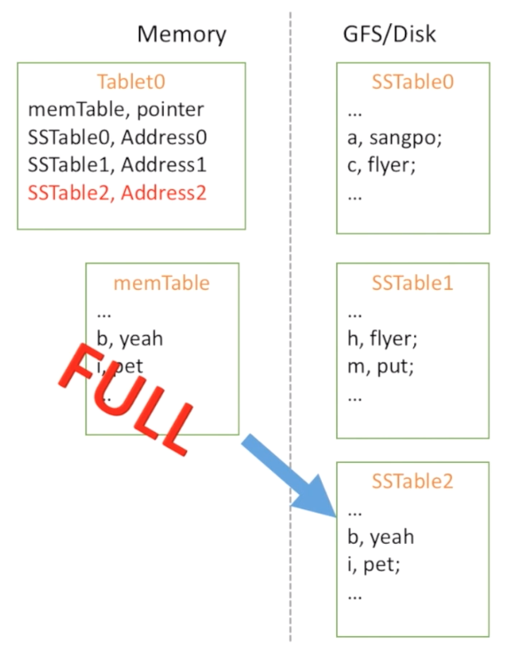
memTable is Full?
Key point: write to disk
When memTable is full, move to disk, create new SSTable
What if the server dies?

Slide 14
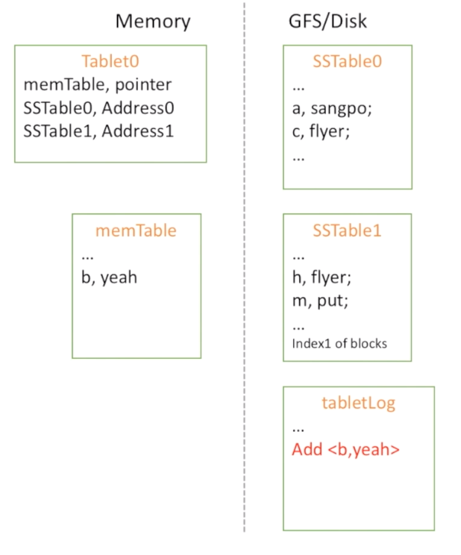
What if server dies when writing to disk?
Key point: logs
A tablet:
memTable
a list of SSTables
log file

Slide 15
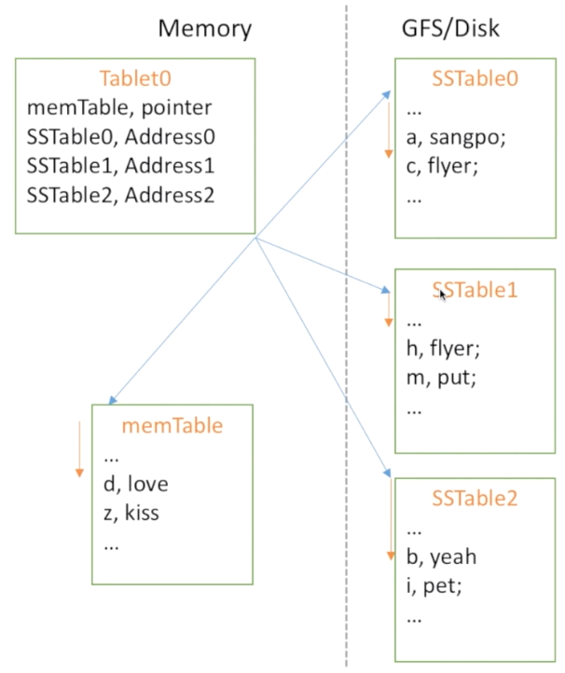
How to read data?
Data in SSTable is sorted
Data between SSTable is not sorted
Slow to read data
How to speed up?

Slide 16
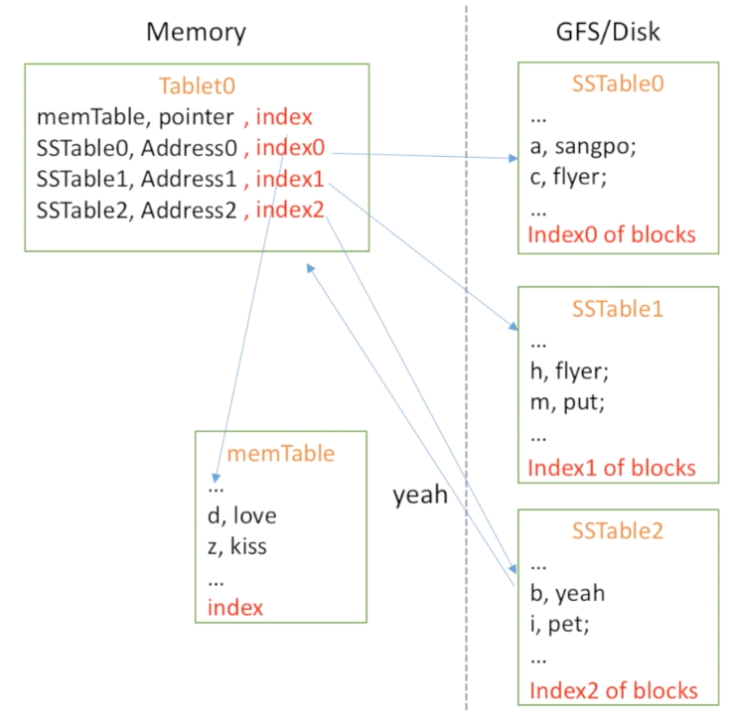
How to fast read data?
Key point: index
Store index for memTable and SSTable
Indexes will be pushed into memory

Slide 17
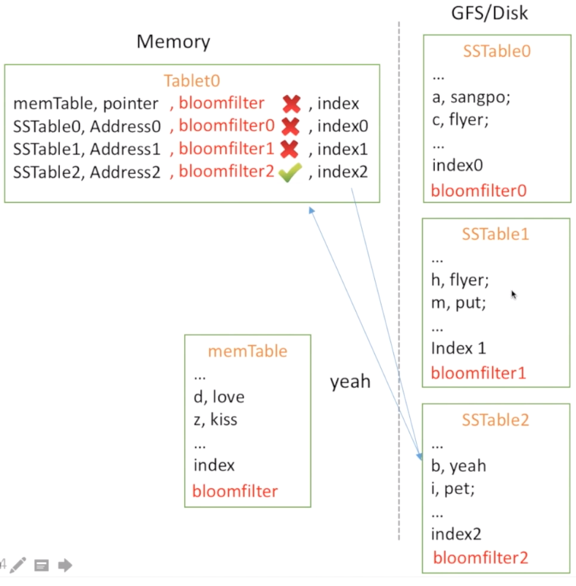
Can we make read even faster?
Key point: bloomfilter
Can ask bloomfilter if an SSTable might contain any data
Bloomfilter: hash + check bits

Slide 18
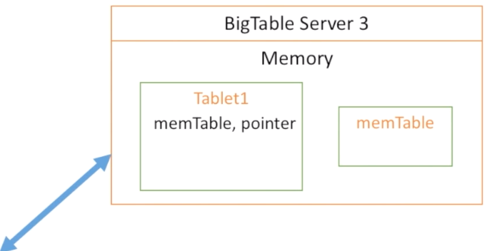
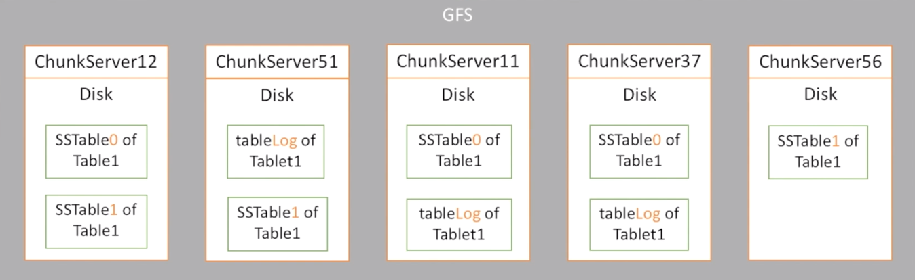
BigTable with GFS
Memory: Tablet, memTable
Disk: SSTable + Log
Disk: replicated 3 times

Slide 19
Master and Tablet servers
Master
Assigns tablets to tablet servers
Detects addition and deletion of tablet servers
Balances load
Tablet Server
Handles read/write requests
Split tablets
Speak to GFS

Slide 20
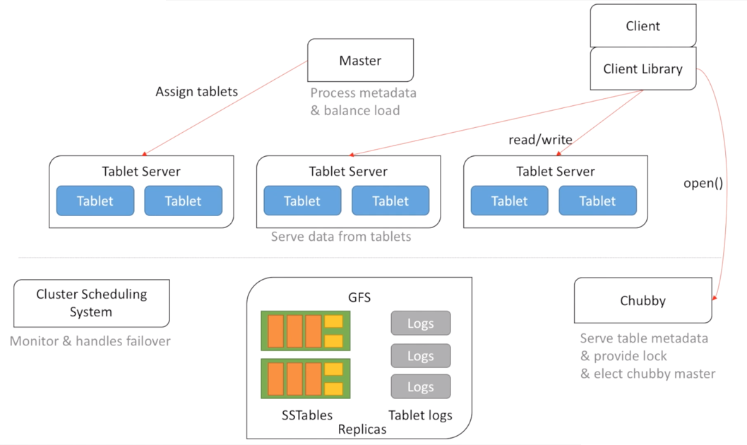
Putting everything together
source: bittiger.io
Notes:
Lock service: master election, location boostrapping

Slide 21
Conclusion
Many applications are based on BigTable
MapReduce, Web indexing, Google Maps, Google Earth, YouTube
Lead to development of other systems like MegaStore, Google Spanner
BigTable and GFS happily live together…

