Slide 1
Student Presentation Column-Stores vs. Row-Stores: How Different Are They Really?
COS 518: Advanced Computer Systems
Jace Lu
03/04/2019

Slide 2
Types of database workloads (Review)
OLTP = OnLine Transaction Processing
Write-heavy
Transactions
Row store > Column store
OLAP = OnLine Analytical Processing
Read-heavy
Analytical scans or “rollups” along column
SELECT AVG(latency) FROM system WHERE time > now() – interval(“1h”)
Column store > Row store

Slide 3
Comparison of disk layouts (Review)
Row-oriented layout
Id BIGINT | Name CHAR(32) | Age INT | Gender SMALLINT | Birthday DATE
Id BIGINT | Name CHAR(32) | Age INT | Gender SMALLINT | Birthday DATE
Column-oriented layout
Id BIGINT | Id BIGINT | Id BIGINT | Id BIGINT | Id BIGINT | Id BIGINT
Name CHAR(32) | Name CHAR(32) | Name CHAR(32) | Name CHAR(32) | Name CHAR(32) | Name CHAR(32)
Age INT | Age INT | Age INT | Age INT | Age INT | Age INT
Particularly good for compression, especially for long runs of identical numbers or small deltas

Slide 4
Problem Statement / Motivation
Column-stores outperforms row-stores for read-only queries
Can one can obtain the performance benefits of a column-store using a row-store?
Analyze performance impact of a variety of column-oriented query execution techniques (e.g. vectorized query processing, compression and join algorithm)

Slide 5
Previous Solutions
MonetDB and C-Store
Outperform row-store system on read-intensive analytical processing workloads (TPC-H), such as those encountered in data warehouses
Benchmark against row-store system without exploring alternate physical designs
Harizopoulos et al.
Column-store and row-store with simple plans
Vertically partitioned variant of Shore vs row-based Shore
No advanced techniques for improving performance

Slide 6
Key Idea
Emulate the physical structure of a column-store inside a row store and compare query processing performance
Vertically partitioning the tables in the system into a collection of two-column tables consisting of table key and attribute pairs
Using (B+ Tree) index-only plans: indices that cover all the columns used in a query (rid-value pairs for all predicates)
Using materialized views: there is a view with exactly the columns needed to answer every query in the benchmark

Slide 7
Key Idea
Decompose C-Store optimizations to survey which are most responsible for column-store performance gain
Late materialization
Block iteration
Column-specific compression techniques
Invisible join (proposed in the paper)

Slide 8
Key Challenges
Comparison of attempts to emulate a column store in a row-store with baseline performance of C-Store
Is it possible for an unmodified row-store to obtain the benefits of column oriented design
Effect of different optimization technique in column-store

Slide 9
Technical Details

Slide 10
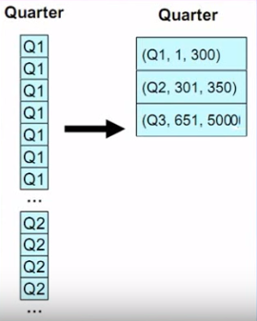
Compression
If data sorted on one column, that column will be super-compressible in a row store
Run length encoding

Slide 11
Later Materialization
Delay tuple construction
Tuple construction: data from multiple columns must be combined together into ‘rows’ of information about an entity
Might avoid constructing it altogether
Intermediate position lists might need to be constructed
e.g: SELECT R.a FROM R WHERE R.c = 5 AND R.b = 10
Output of each predicate is a bit string
Perform bitwise AND
Use final position list to extract R.a
Advantage:
Unnecessary construction of tuple is avoided
Direct operation on compressed data

Slide 12
Block Iteration
Operators operate on blocks of tuples at once
Iterate over blocks rather than tuples
Like batch processing
If column is fixed width, it can be operated as an array
Minimizes per-tuple overhead

Slide 13
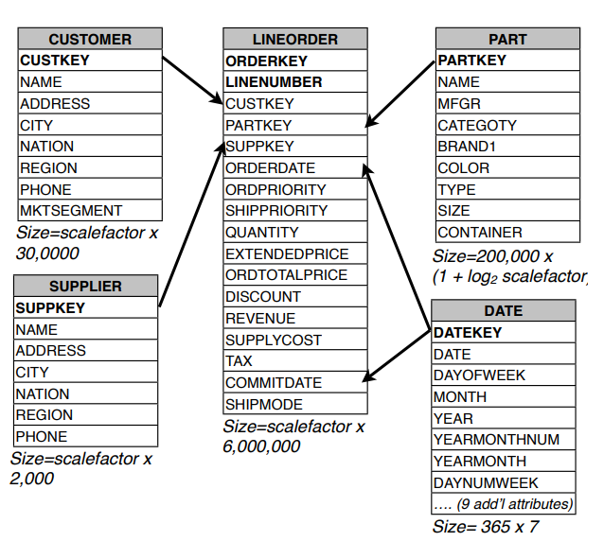
Star Schema Benchmark
SSBM is a data ware housing benchmark derived from TPC-H
Consist of a single fact table LINE-ORDER
Four dimension table
CUSTOMER
PART
SUPPLIER
DATE

Slide 14
Invisible Join
Queries over data warehouse (particularly modeled with star schema) often have following structure
Restrict set of tuple in the fact table using selection predicates on dimension table
Perform some aggregation on the restricted fact table
Often grouping by other dimension table attribute

Slide 15
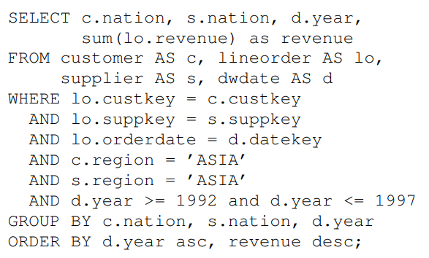
Invisible Join
Below query finds the total revenue from Asian customers who purchase a product supplied by an Asian supplier between 1992 and 1997 grouped by nation of the customer, supplier and year of transaction

Slide 16
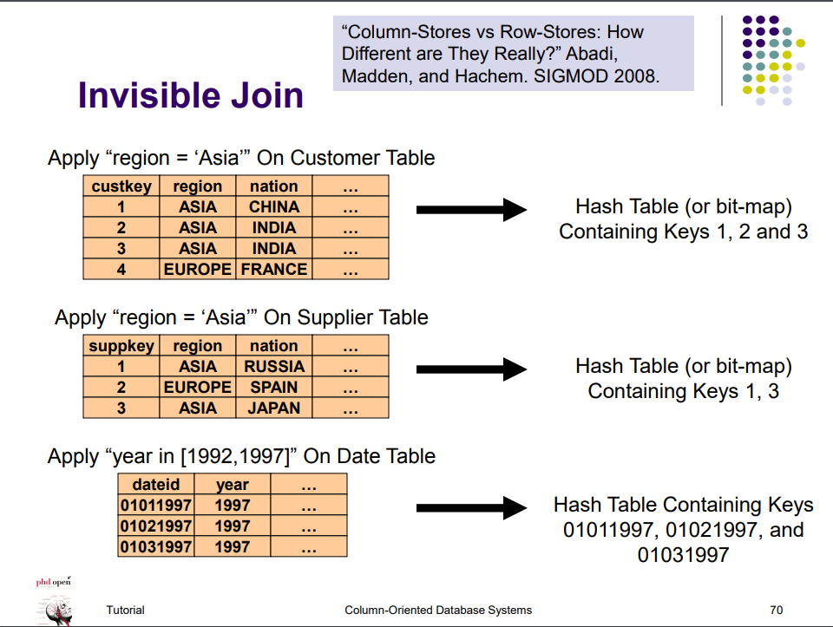
Invisible Join

Slide 17
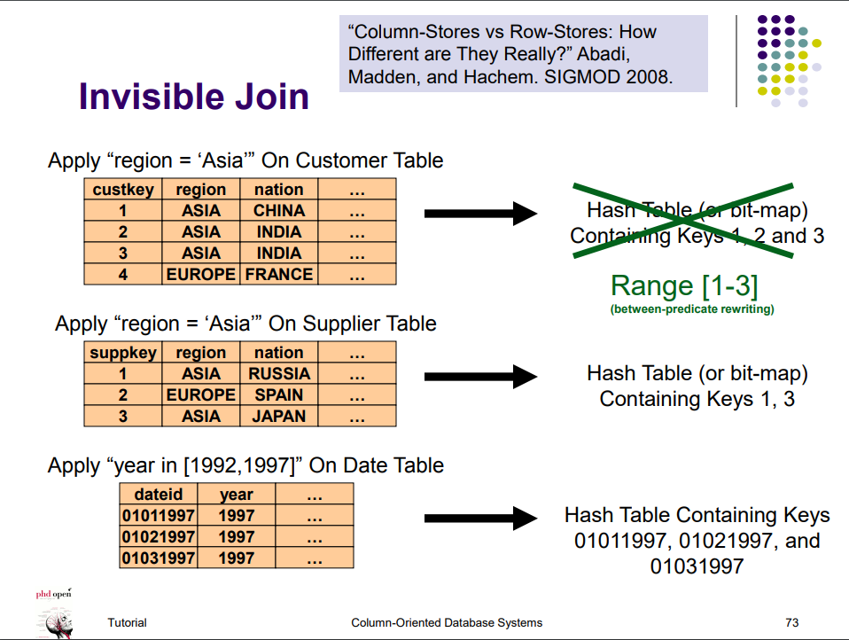

Slide 18
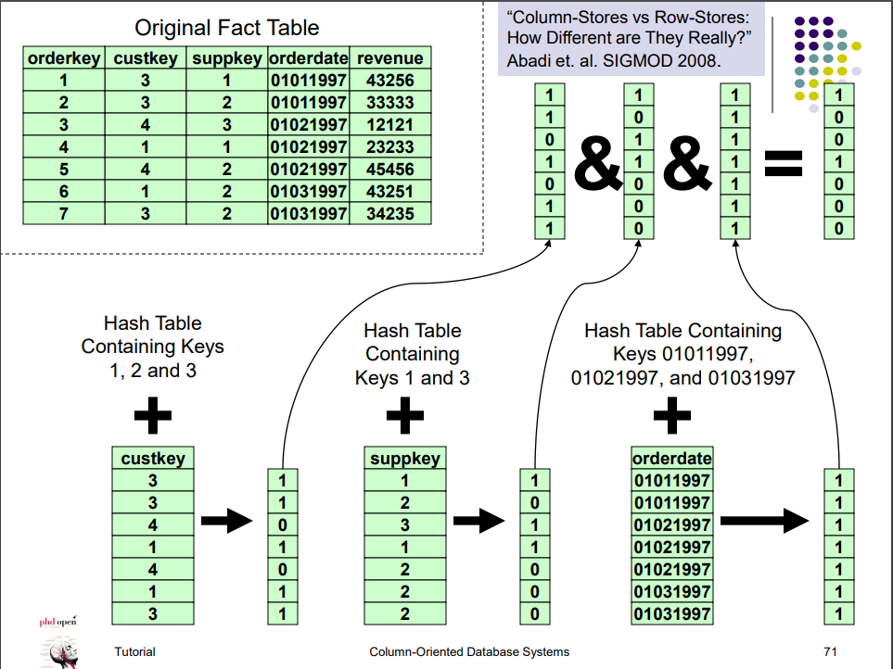

Slide 19
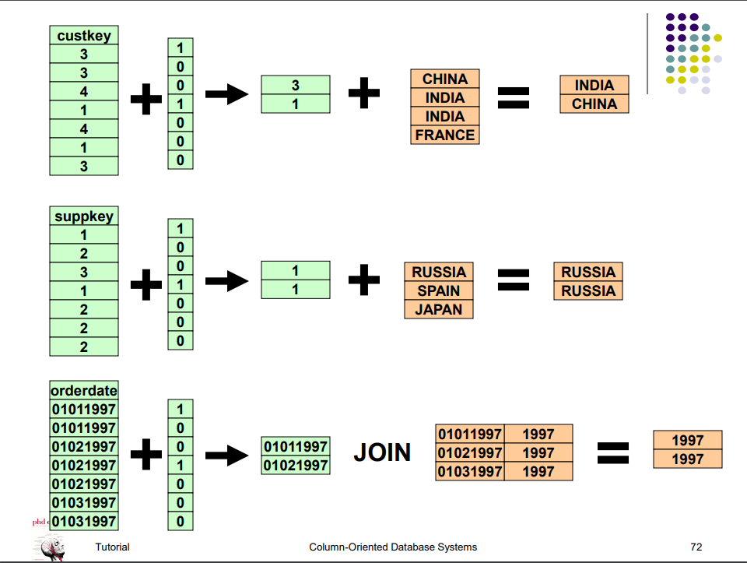

Slide 20
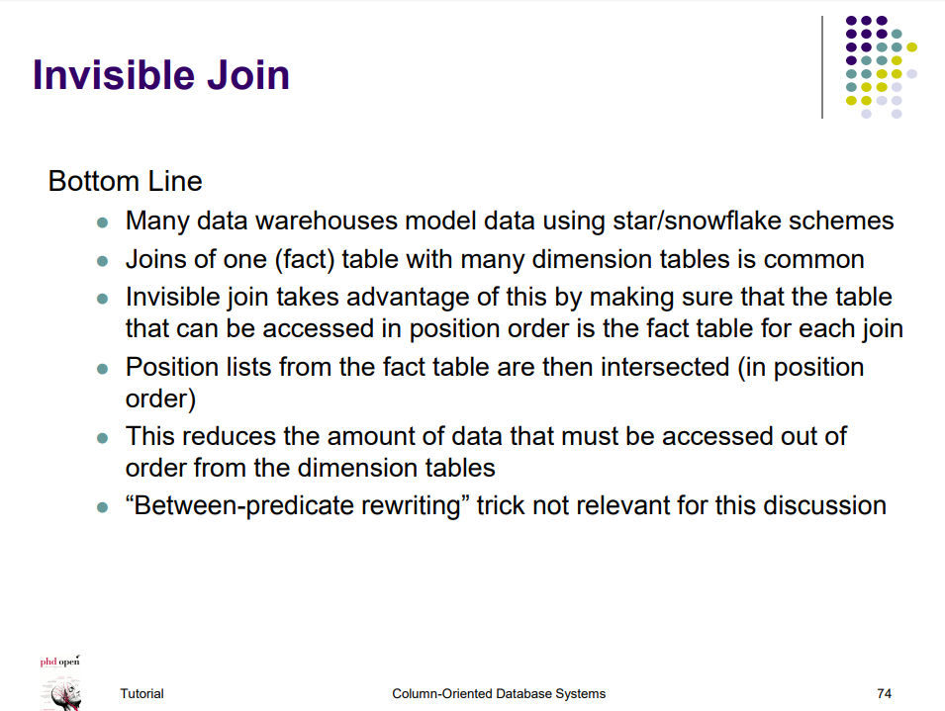

Slide 21
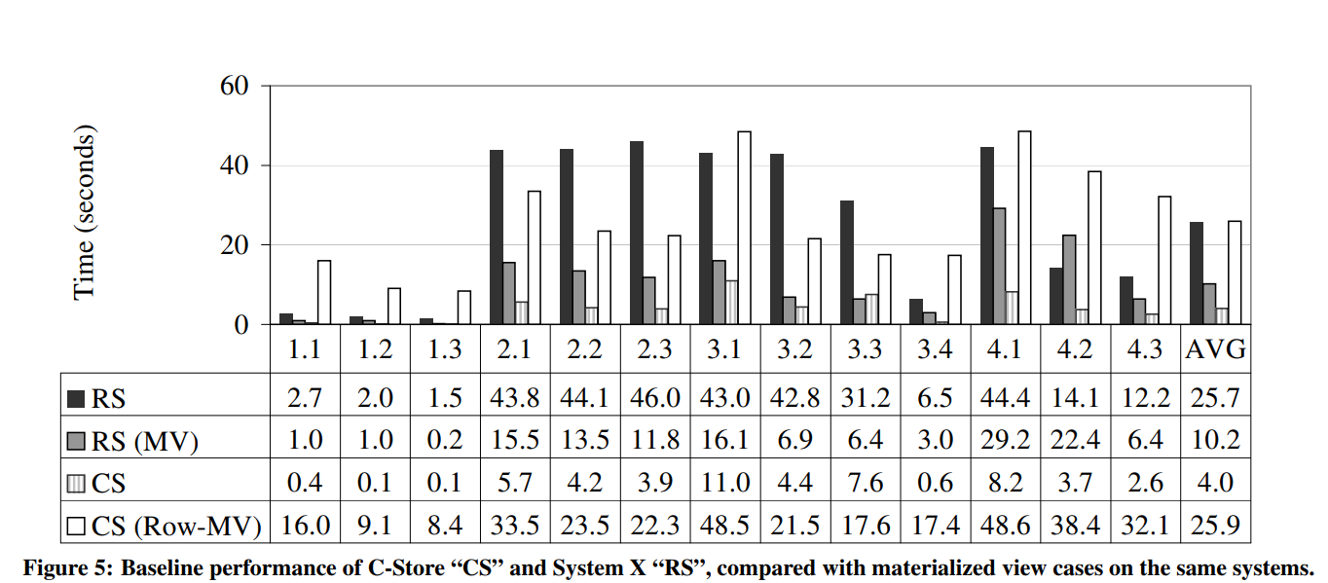
Key Result (Evaluation)
C-Store out performs System X by a
Factor of 6 in the base case
Factor of 3 when System x use materialized view

Slide 22
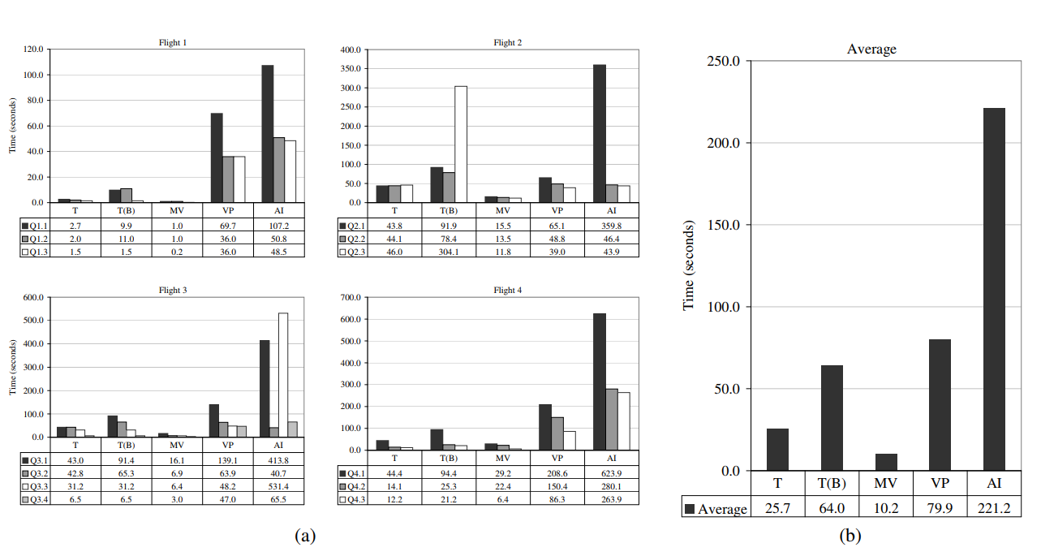
Key Result (Evaluation)
T – Traditional
T(B) – Traditional(bitmap)
MV – Materialized views
VP – Vertical partitioning
AI – All indexes

Slide 23
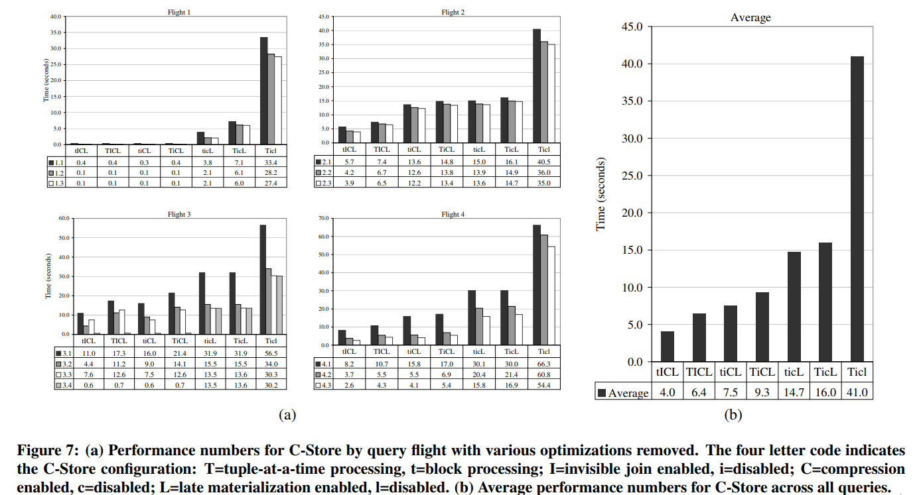
Key Result (Evaluation)
Compression and late materialization are the most significant two optimizations
Once all optimizations are removed, the column store acts like a row-store
Column store performs better than the best case of row store

Slide 24
Conclusion
Row Store | Column Store
Store record id explicitly | Don’t explicitly store the record id
Headers are stored with each column | Headers are stored in separate column
Merge join needs to be sorted | Use merge join
Tuple construction and tuple overhead is costly
Compression and later materialization for C-Store
Changes must be made to both the storage layer and query executor to fully obtain the benefits of column-oriented approach

Slide 25
Reference
https://homepages.cwi.nl/~boncz/mimuw/boncz_mimuw.pdf
http://www.cs.umd.edu/~abadi/papers/abadi-sigmod08.pdf

