Slide 1
Caching 50.5* + Apache Kafka
COS 518: Advanced Computer Systems
Lecture 10
Michael Freedman
* Half of 101

Slide 2
Basic caching rule
Tradeoff
Fast: Costly, small, close
Slow: Cheap, large, far
Based on two assumptions
Temporal location: Will be accessed again soon
Spatial location: Nearby data will be accessed soon

Slide 3
Multi-level caching in hardware
https://en.wikipedia.org/wiki/Cache_memory

Slide 4
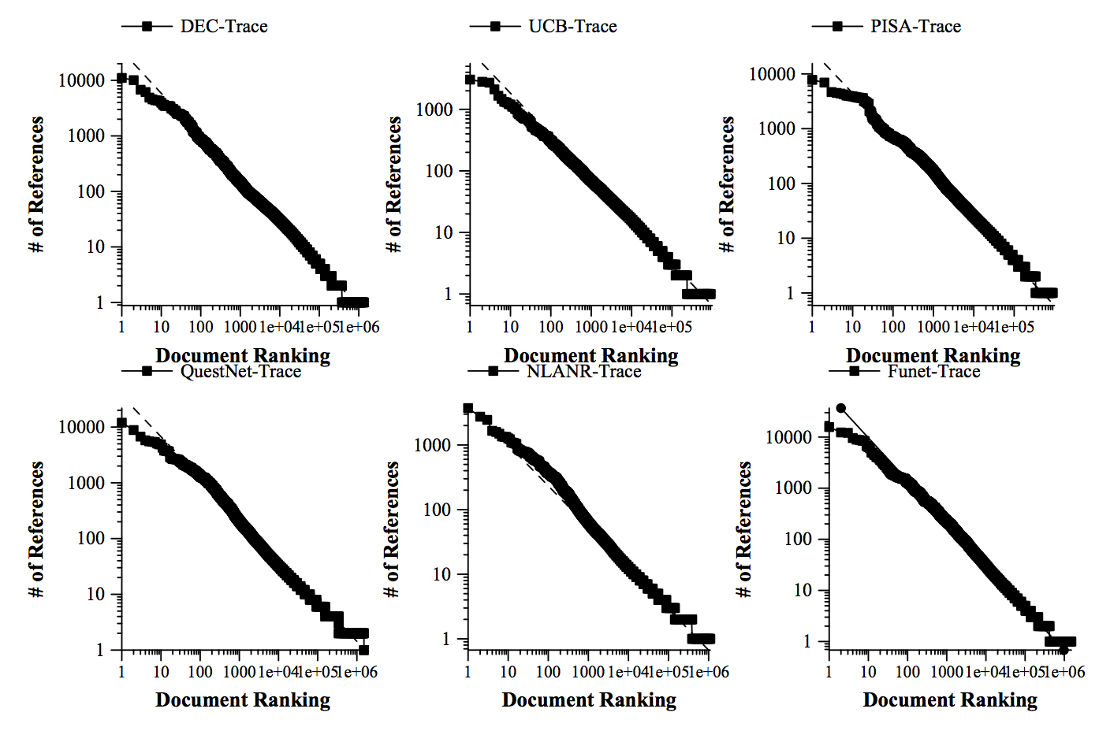
Caching in distributed systems
Web Caching and Zipf-like Distributions: Evidence and Implications
Lee Breslau, Pei Cao, Li Fan, Graham Phillips, Scott Shenker

Slide 5
Caching common in distributed systems
Web
Web proxies at edge of enterprise networks
“Server surrogates” in CDNs downstream of origin
DNS
Caching popular NS, A records
File sharing
Gnutella & flooding-based p2p networks

Slide 6
Caching within datacenter systems
load
balancers
front-end
web servers
DB / backend
identical
identical
partitioned

Slide 7
Caching within datacenter systems
load
balancers
front-end
web servers
DB / backend
identical
identical
partitioned
cache

Slide 8
Caching within datacenter systems
load
balancers
front-end
web servers
look-through
cache
DB / backend
identical
identical
partitioned
partitioned

Slide 9
Caching within datacenter systems
look-aside
cache
load
balancers
front-end
web servers
DB / backend
identical
identical
partitioned
partitioned

Slide 10
Cache management
Write-through
Data written simultaneously to cache and storage
Write-back
Data updated only in cache
On cache eviction, written “back” to storage

Slide 11
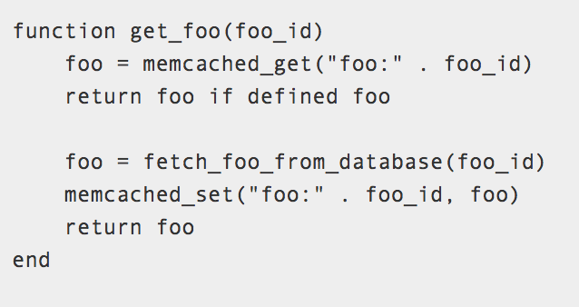

Caching within datacenter systems
look-aside
cache
load
balancers
front-end
web servers
DB / backend
identical
identical
partitioned
partitioned

Slide 12
New system / hardware architectures:
New opportunities for caching

Slide 13



Be Fast, Cheap and in Control
with SwitchKV
Xiaozhou Li
Raghav Sethi
Michael Kaminsky
David G. Andersen
Michael J. Freedman
NSDI 2016

Slide 14
Traditional architectures: High-overhead for skewed/dynamic workloads
clients
clients
miss
failure point
miss
backends
cache
backends
cache (load balancer)
Look-aside
Look-through
Cache must process all queries and handle misses
In our case, cache is small and hit ratio could be low
Throughput is bounded by the cache I/O
High latency for queries for uncached keys

Slide 15
SwitchKV: content-aware routing
clients
controller
OpenFlow Switches
cache
backends
Switches route requests directly to the appropriate nodes
Latency can be minimized for all queries
Throughput can scale out with # of backends
Availability would not be affected by cache node failures

Slide 16
Exploit SDN and switch hardware
Clients encode key information in packet headers
Encode key hash in MAC for read queries
Encode destination backend ID in IP for all queries
Switches maintain forwarding rules and route query packets
L2 table
hit
Packet In
exact match rule per cached key
Packet Out
to the cache
miss
TCAM table
match rule per physical machine
Packet Out

Slide 17
Keep cache and switch rules updated
New challenges for cache updates
Only cache the hottest O(nlogn) items
Limited switch rule update rate
Goal: react quickly to workload changes with minimal updates
switch rule update
top-k <key, load> list
(periodic)
cache
fetch <key, value>
backend
controller
bursty hot <key, value>
(instant)

Slide 18
Distributed Queues & Apache Kafka

Slide 19
What is pub sub ?
Producer
publish(topic, msg)
subscribe
Consumer
Topic 1
msg
Topic 2
Topic 3
Publish subscribe
system
Consumer
Producer
msg
Notes:
Multiple subscribers, decoupling
Some examples : email notification on adding connection etc

Slide 20
Automatic load balancing
Producer
Producer
Parties
Producers write data to brokers
Consumers read data from brokers
Data stored in topics
Topics split into partitions
Partitions are replicated for failure recovery
Broker
Broker
Consumer
Consumer

Slide 21
Topics
Topic: name to which messages are published
Kafka prunes “head” based on age or max size or “key”
Producer A1
Kafka topic
Producer A2
…
…
new
Producer An
Older msgs
Newer msgs
Producers always append to “tail”
(think: append to a file)
Broker(s)

Slide 22
Topics
Consumer group C1
Consumers use an “offset pointer” to
track/control their read progress
(and decide the pace of consumption)
Consumer group C2
Producer A1
Kafka topic
Producer A2
…
…
new
Producer An
Older msgs
Newer msgs
Producers always append to “tail”
(think: append to a file)
Broker(s)

Slide 23
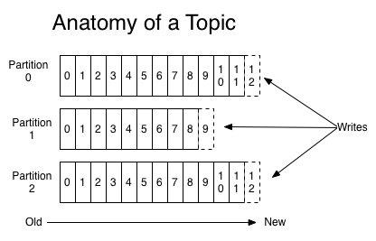
Partitions
A topic consists of partitions.
Partition: ordered + immutable sequence of msgs, continually appended to
Number of partitions determines max consumer parallelism

Slide 24
Partition offsets
Offset: messages in partitions are each assigned a unique (per partition) and sequential id called the offset
Consumers track their pointers via (offset, partition, topic) tuples
Consumer group C1

Slide 25
Wednesday:
Welcome to BIG DATA

