Slide 1
Content Distribution Networks
COS 518: Advanced Computer Systems
Lecture 16
Mike Freedman

Slide 2
Single Server, Poor Performance
Single server
Single point of failure
Easily overloaded
Far from most clients
Popular content
Popular site
“Flash crowd”
Denial of Service attack

Slide 3
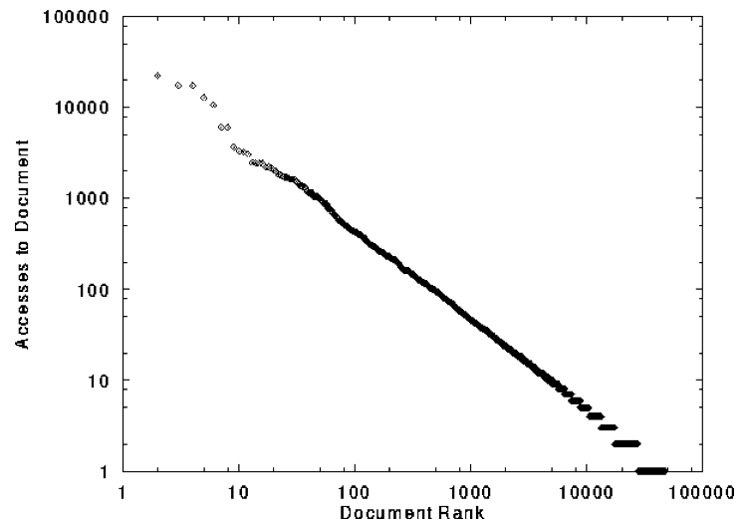
Skewed Popularity of Web Traffic
“Zipf” or “power-law” distribution
Characteristics of WWW Client-based Traces
Carlos R. Cunha, Azer Bestavros, Mark E. Crovella, BU-CS-95-01

Slide 4
Web Caching

Slide 5

Proxy Caches
5
origin
server
Proxy
server
HTTP request
HTTP request
client
HTTP response
HTTP response
HTTP request
HTTP response
client

Slide 6
Forward Proxy
Cache “close” to the client
Under administrative control
of client-side AS
Explicit proxy
Requires configuring browser
Implicit proxy
Service provider deploys an “on path” proxy
… that intercepts and handles Web requests
Proxy
server
HTTP request
client
HTTP response
HTTP request
HTTP response
client

Slide 7
Reverse Proxy
origin
server
Cache “close” to server
Either by proxy run by server or in third-party CDNs
Directing clients to the proxy
Map the site name to the IP address of the proxy
Proxy
server
HTTP request
HTTP response
HTTP request
HTTP response
origin
server

Slide 8

Google Design
. .
.
Servers
Data Centers
Servers
Router
Router
Private Backbone
Reverse Proxy
Reverse Proxy
Internet
Requests
Client
Client
Client

Slide 9
Proxy Caches
(A) Forward (B) Reverse (C) Both (D) Neither
Reactively replicates popular content
Reduces origin server costs
Reduces client ISP costs
Intelligent load balancing between origin servers
Offload form submissions (POSTs) and user auth
Content reassembly or transcoding on behalf of origin
Smaller round-trip times to clients
Maintain persistent connections to avoid TCP setup delay (handshake, slow start)

Slide 10
Proxy Caches
(A) Forward (B) Reverse (C) Both (D) Neither
Reactively replicates popular content (C)
Reduces origin server costs (C)
Reduces client ISP costs (A)
Intelligent load balancing between origin servers (B)
Offload form submissions (POSTs) and user auth (D)
Content reassembly, transcoding on behalf of origin (C)
Smaller round-trip times to clients (C)
Maintain persistent connections to avoid TCP setup delay (handshake, slow start) (C)

Slide 11
Limitations of Web Caching
Much content is not cacheable
Dynamic data: stock prices, scores, web cams
CGI scripts: results depend on parameters
Cookies: results may depend on passed data
SSL: encrypted data is not cacheable
Analytics: owner wants to measure hits
Stale data
Or, overhead of refreshing the cached data

Slide 12
Modern HTTP Video-on-Demand
Download “content manifest” from origin server
List of video segments belonging to video
Each segment 1-2 seconds in length
Client can know time offset associated with each
Standard naming for different video resolutions and formats: e.g., 320dpi, 720dpi, 1040dpi, …
Client downloads video segment (at certain resolution) using standard HTTP request.
HTTP request can be satisfied by cache: it’s a static object
Client observes download time vs. segment duration, increases/decreases resolution if appropriate

Slide 13
Content Distribution Networks

Slide 14
Content Distribution Network
origin server
in North America
Proactive content replication
Content provider (e.g., CNN) contracts with a CDN
CDN replicates the content
On many servers spread throughout the Internet
Updating the replicas
Updates pushed to replicas when the content changes
CDN distribution node
CDN server
in S. America
CDN server
in Asia
CDN server
in Europe

Slide 15
Server Selection Policy
Live server
For availability
Lowest load
To balance load across the servers
Closest
Nearest geographically, or in round-trip time
Best performance
Throughput, latency, …
Cheapest bandwidth, electricity, …
Requires continuous monitoring of liveness, load, and performance

Slide 16
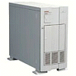

Server Selection Mechanism
Application
HTTP redirection
Advantages
Fine-grain control
Selection based on client IP address
Disadvantages
Extra round-trips for TCP connection to server
Overhead on the server
GET
Redirect
GET
OK

Slide 17
Server Selection Mechanism
Advantages
No extra round trips
Route to nearby server
Disadvantages
Does not consider network or server load
Different packets may go to different servers
Used only for simple request-response apps
Routing
Anycast routing
1.2.3.0/24
1.2.3.0/24

Slide 18
Server Selection Mechanism
Naming
DNS-based server selection
1.2.3.4
DNS
query
1.2.3.5
local DNS server

Slide 19



A DNS lookup traverses DNS hierarchy
. (root) authority 198.41.0.4
edu.: NS 192.5.6.30
com.: NS 158.38.8.133
io.: NS 156.154.100.3
www.princeton.edu?
edu. authority 192.5.6.30
princeton.edu.: NS 66.28.0.14
pedantic.edu.: NS 19.31.1.1
Contact 192.5.6.30 for edu.
Client
www.princeton.edu?
Contact 66.28.0.14 for princeton.edu.
www.princeton.edu?
www.princeton.edu?
www.princeton.edu A 140.180.223.42
Local nameserver
. (root): NS 198.41.0.4
princeton.edu. authority 66.28.0.14
www.princeton.edu.: A 140.180.223.42
edu.: NS 192.5.6.30
princeton.edu.: NS 66.28.0.14
www.princeton.edu.: A 140.180.223.42
Notes:
Client is doing a lookup for www.princeton.edu
SEGUE: Finally, the local nameserver replies to the client with an answer.

Slide 20
DNS caching
Performing all these queries takes time
And all this before actual communication takes place
Caching can greatly reduce overhead
Top-level servers very rarely change, popular sites visited often
Local DNS server often has information cached
How DNS caching works
All DNS servers cache responses to queries
Responses include a time-to-live (TTL) field, akin to cache expiry
Notes:
>>> SEGUE: And these TTL fields play a key role in how CDNs like Akamai function.

Slide 21
Server Selection Mechanism
Advantages
Avoid TCP set-up delay
DNS caching reduces overhead
Relatively fine control
Disadvantage
Based on IP address of local DNS server
“Hidden load” effect
DNS TTL limits adaptation
Naming
DNS-based server selection
1.2.3.4
DNS
query
1.2.3.5
local DNS server

Slide 22
How Akamai Works

Slide 23
How Akamai Uses DNS
23
cnn.com (content provider)
HTTP
DNS root server
GET index.html
Akamai
cluster
Akamai global
DNS server
1
2
HTTP
http://cache.cnn.com/foo.jpg
Akamai regional
DNS server
Nearby Akamai
cluster
end user

Slide 24
How Akamai Uses DNS
24
cnn.com (content provider)
HTTP
DNS TLD server
DNS lookup
cache.cnn.com
Akamai
cluster
Akamai global
DNS server
1
2
3
ALIAS:
g.akamai.net
4
Akamai regional
DNS server
Nearby Akamai
cluster
end user

Slide 25
How Akamai Uses DNS
25
cnn.com (content provider)
HTTP
DNS TLD server
DNS lookup
g.akamai.net
Akamai
cluster
Akamai global
DNS server
5
1
2
3
4
6
Akamai regional
DNS server
ALIAS
a73.g.akamai.net
Nearby Akamai
cluster
end user

Slide 26
How Akamai Uses DNS
26
cnn.com (content provider)
HTTP
DNS TLD server
Akamai
cluster
Akamai global
DNS server
5
1
2
3
4
6
Akamai regional
DNS server
7
DNS a73.g.akamai.net
8
Address
1.2.3.4
Nearby Akamai
cluster
end user

Slide 27
How Akamai Uses DNS
27
cnn.com (content provider)
HTTP
DNS TLD server
Akamai
cluster
Akamai global
DNS server
5
1
2
3
4
6
Akamai regional
DNS server
7
8
9
Nearby Akamai
cluster
end user
GET /foo.jpg
Host: cache.cnn.com

Slide 28

How Akamai Uses DNS
28
cnn.com (content provider)
HTTP
DNS TLD server
GET foo.jpg
11
12
Akamai
cluster
Akamai global
DNS server
5
1
2
3
4
6
Akamai regional
DNS server
7
8
9
Nearby Akamai
cluster
end user
GET /foo.jpg
Host: cache.cnn.com

Slide 29
How Akamai Uses DNS
29
cnn.com (content provider)
HTTP
DNS TLD server
11
12
Akamai
cluster
Akamai global
DNS server
5
1
2
3
4
6
Akamai regional
DNS server
7
8
9
Nearby Akamai
cluster
end user
10

Slide 30
How Akamai Works: Cache Hit
30
cnn.com (content provider)
HTTP
DNS TLD server
Akamai
cluster
Akamai global
DNS server
1
2
Akamai regional
DNS server
3
4
5
Nearby Akamai
cluster
end user
6

Slide 31
Mapping System
Equivalence classes of IP addresses
IP addresses experiencing similar performance
Quantify how well they connect to each other
Collect and combine measurements
Ping, traceroute, BGP routes, server logs
E.g., over 100 TB of logs per days
Network latency, loss, and connectivity

Slide 32
Mapping System
Map each IP class to a preferred server cluster
Based on performance, cluster health, etc.
Updated roughly every minute
Map client request to a server in the cluster
Load balancer selects a specific server
E.g., to maximize the cache hit rate

Slide 33
Adapting to Failures
Failing hard drive on a server
Suspends after finishing “in progress” requests
Failed server
Another server takes over for the IP address
Low-level map updated quickly
Failed cluster
High-level map updated quickly
Failed path to customer’s origin server
Route packets through an intermediate node

Slide 34
Conclusion
Content distribution is hard
Many, diverse, changing objects
Clients distributed all over the world
Reducing latency is king
Contribution distribution solutions
Reactive caching
Proactive content distribution networks

