Slide 1
Practical Byzantine Fault Tolerance
COS 518: Advanced Computer Systems
Andrew Spencer, Avthar Sewrathan, Felix Madutsa
March 28 2018

Slide 2
Problem Overview
Implement practical BFT Protocol
Motivation:
Lack of Open Source Practical BFTs Libraries
PBFT Motive:
Increase in malicious actors
Increase in software errors
Notes:
Lack of Open source PBFT Libraries: Upright not ready for deployment
Malicious: profit
Software is complex: failures
Zillica guys -- finding libraries for crypto consensus

Slide 3
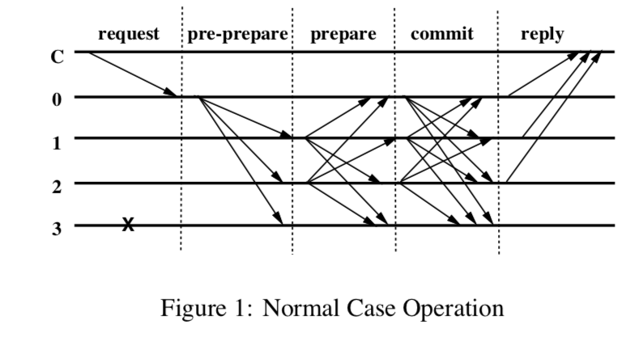
Technical Solution
State machine replication
Asynchronous network communication
Undelivered, duplicated,delayed, out of order messages
Key detail for Practical BFT
3F+1 nodes needed
F = Max number of failures tolerated
Independent node failures
Crypto signatures to verify identity of nodes
Not accept messages from malicious actors
Practical optimizations
Notes:
Async: Part 2
Independent Failure:

Slide 4
Implementation Plan
MVP
Just replication library in Golang
Reproducing tests in paper
Micro-benchmarking
Stretch
Byzantine File System
NFS that can handle Byzantine failures
Additional testing with byzantine failures
Andrew benchmarking

Slide 5
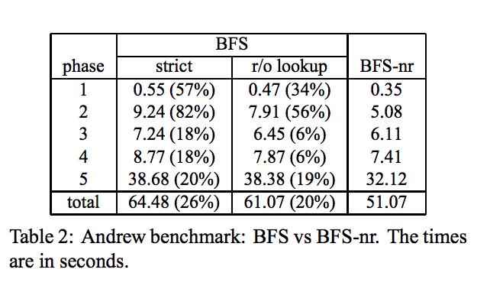
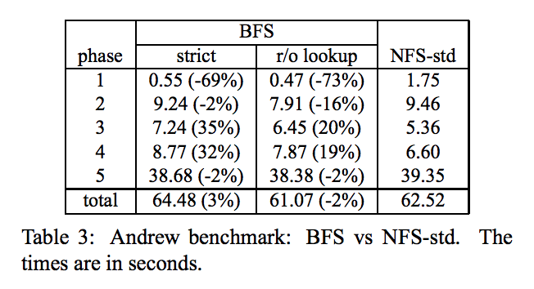
Evaluation Plan
One client with two relay processes and four replicas
Test with NFS, BFS in stretch goal
Attempt to reproduce results under Andrew Benchmark
Notes:
The Andrew benchmark emulates a software development workload.

