Slide 1
Rossplex
Where There’s a Wilkinson, There’s a Way

Slide 2
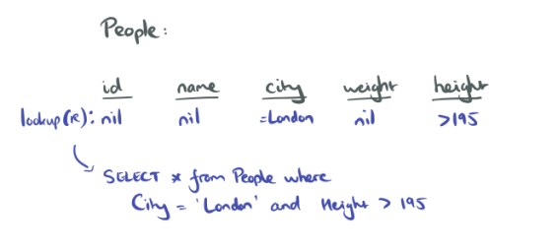
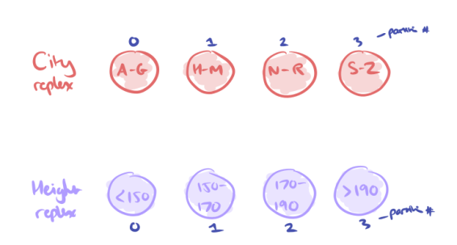
Problem Overview
Large databases
Query data by multiple keys
Common solution:
Multiple replicas, each indexed on a different key
Complete backup for each replica
Solution: Replexes and Hybrids!
https://blog.acolyer.org/2016/10/27/replex-a-scalable-highly-available-multi-index-data-store/

Slide 3
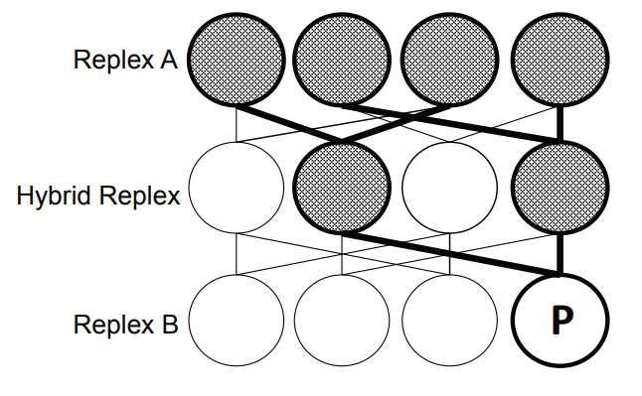
Technical Solution
Each Replex is a replica of the data indexed on a different key
The hybrid replex solves the issue of failure amplification.
Notes:
Who is talkiing!!!! Why can’t we hop back and forth?

Slide 4
Implementation Plan
Build Replex following their implementation
Modify Hyperdex to replace subspaces with replexes
Implement basic replexes and failure handling
Implement hybrid replexes
Stretch
Generalize to support hybrids shared between r replexes
Notes:
Requires adding a consensus phase, because some ops invalid on some eplexess

Slide 5
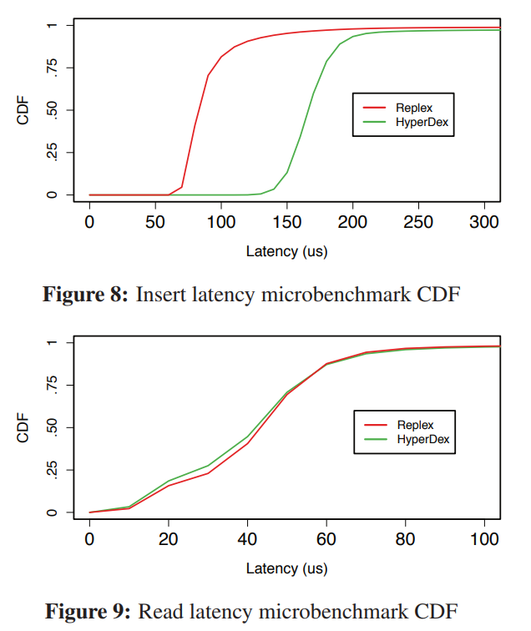
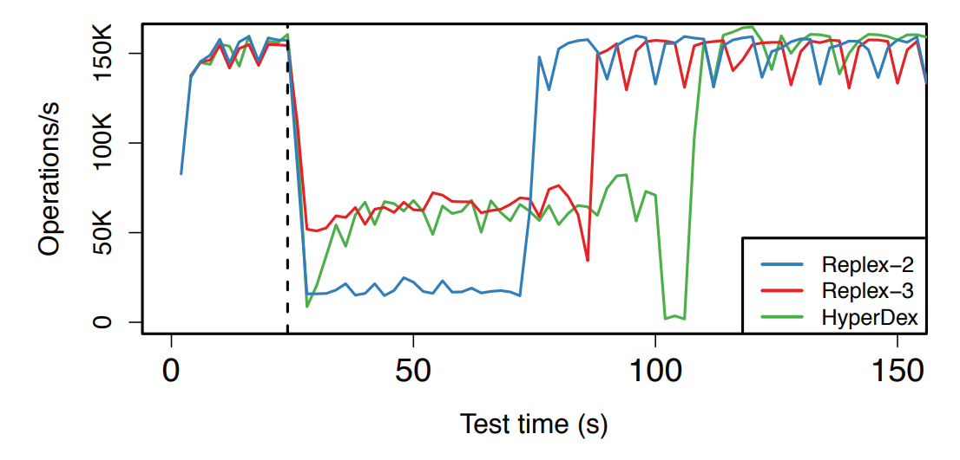
Evaluation Plan
Mimic their evaluation setup as closely as possible
Evaluate the insert and read latency of Replex and HyperDex
Evaluation the recovery time and recovery throughput of Replex and HyperDex
Goal: Validate the comparative performance of Replex and HyperDex
Notes:
Mention they only used about 20 comps and that we just use the YCSP. Also who is talking?

