Slide 1
Caching 50.5*
COS 518: Advanced Computer Systems
Lecture 9
Michael Freedman
* Half of 101

Slide 2
Basic caching rule
Tradeoff
Fast: Costly, small, close
Slow: Cheap, large, far
Based on two assumptions
Temporal location: Will be accessed again soon
Spatial location: Nearby data will be accessed soon

Slide 3
Multi-level caching in hardware
https://en.wikipedia.org/wiki/Cache_memory

Slide 4
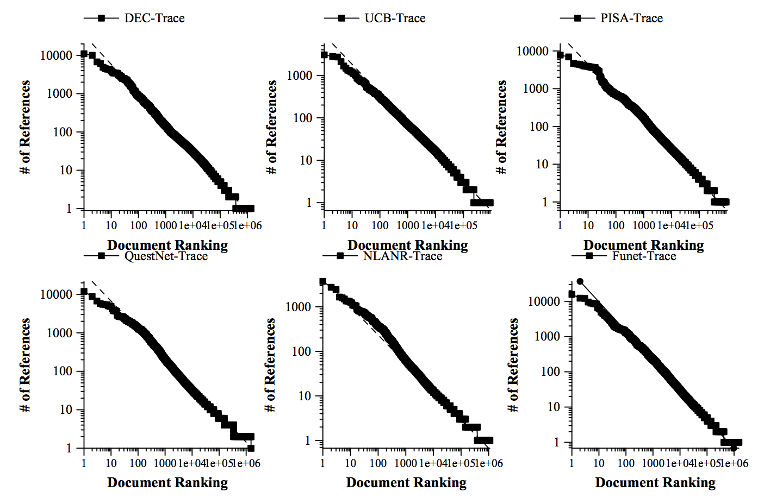
Caching in distributed systems
Web Caching and Zipf-like Distributions: Evidence and Implications
Lee Breslau, Pei Cao, Li Fan, Graham Phillips, Scott Shenker

Slide 5
Caching common in distributed systems
Web
Web proxies at edge of enterprise networks
“Server surrogates” in CDNs downstream of origin
DNS
Caching popular NS, A records
File sharing
Gnutella & flooding-based p2p networks

Slide 6
Caching within datacenter systems
load
balancers
front-end
web servers
DB / backend
identical
identical
partitioned

Slide 7
Caching within datacenter systems
load
balancers
front-end
web servers
DB / backend
identical
identical
partitioned
cache

Slide 8
Caching within datacenter systems
load
balancers
front-end
web servers
look-through
cache
DB / backend
identical
identical
partitioned
partitioned

Slide 9
Caching within datacenter systems
look-aside
cache
load
balancers
front-end
web servers
DB / backend
identical
identical
partitioned
partitioned

Slide 10
Caching within datacenter systems
look-aside
cache
load
balancers
front-end
web servers
DB / backend
identical
identical
partitioned
partitioned

Slide 11
Caching within datacenter systems
look-aside
cache
load
balancers
front-end
web servers
DB / backend
identical
identical
partitioned
partitioned

Slide 12
Cache management
Write-through
Data written simultaneously to cache and storage
Write-back
Data updated only in cache
On cache eviction, written “back” to storage

Slide 13
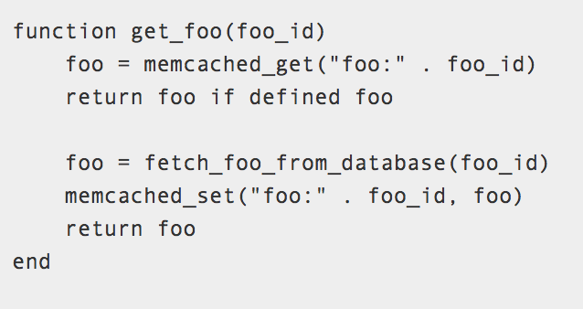

Caching within datacenter systems
look-aside
cache
load
balancers
front-end
web servers
DB / backend
identical
identical
partitioned
partitioned

