Slide 1
Student Presentation Improving MapReduce Performance in Heterogenous Environments
COS 518: Advanced Computer Systems
Jeffrey Helt
March 25, 2019

Slide 2
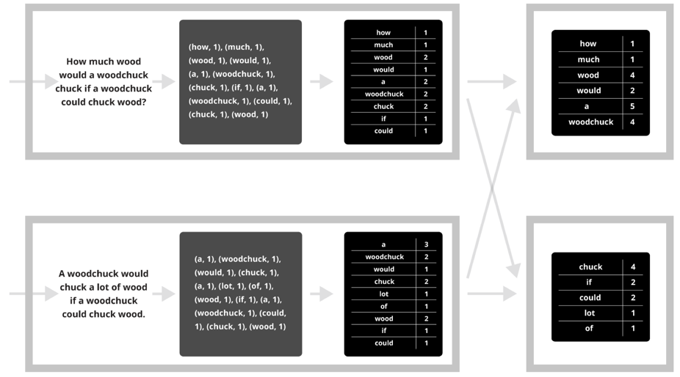
MapReduce/Hadoop Jobs
map
combine
partition
reduce

Slide 3
Synchronization Barrier

Slide 4
Problem Statement / Motivation
Paper focuses on improving speculative execution scheduling for straggler mitigation
Hadoop’s speculative execution scheduler assumes server’s are homogenous
Unlikely to be true:
Data center machine upgrades and replacement
Virtualized data centers (e.g., EC2)

Slide 5
Variable I/O Performance in EC2
Load Level | VMs | Write Perf (MB/s) | Std. Deviation
1 VM/host | 202 | 61.8 | 4.9
2 VMs/host | 264 | 56.5 | 10.0
3 VMs/host | 201 | 53.6 | 11.2
4 VMs/host | 140 | 46.4 | 11.9
5 VMs/host | 45 | 34.2 | 7.9
6 VMs/host | 12 | 25.4 | 2.5
7 VMs/host | 7 | 24.8 | 0.9
VM write performance significantly affected by co-located VMs!

Slide 6
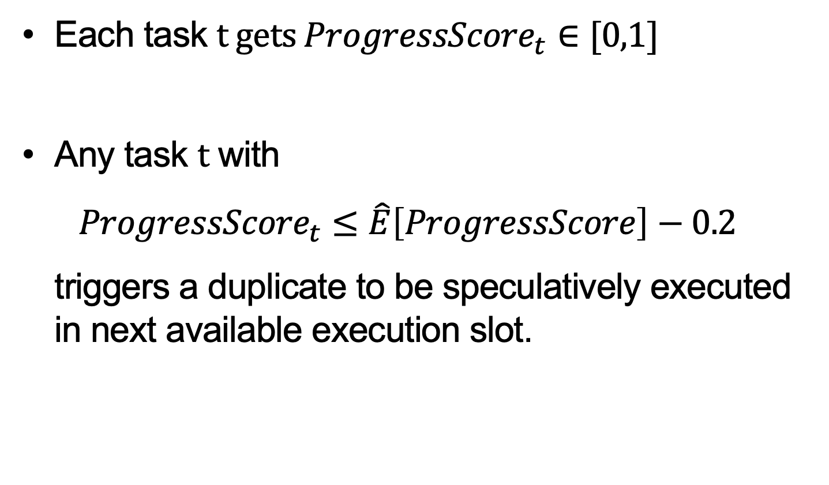
Background: Hadoop’s Speculative Execution
Each task t gets ${ProgressScore}_{t}∈[0,1]$
Any task t with ${ProgressScore}_{t}≤\hat{E}\left[ProgressScore\right]−0.2$ triggers a duplicate to be speculatively executed in next available execution slot.
Notes:
Progress for map tasks is percentage of input read
Progress for reduce tasks estimated from sum of three equally-weighted components: copy phase, sort phase, and reduce phase. Score is percentage of data processed.

Slide 7
Key Insight 1: Time to completion
Insight: Tasks who finish last directly affect job response time
Idea: Prioritize tasks that will finish last for speculative execution
Challenge: How can we perform online estimate time to completion for each task?

Slide 8
Key Insight 2: Better job placement
Insight: Slow servers are bad candidates for speculative execution
Idea: Speculatively execute tasks only on the fastest servers
Challenge: How to perform online estimation of server performance and use it to inform placement?

Slide 9
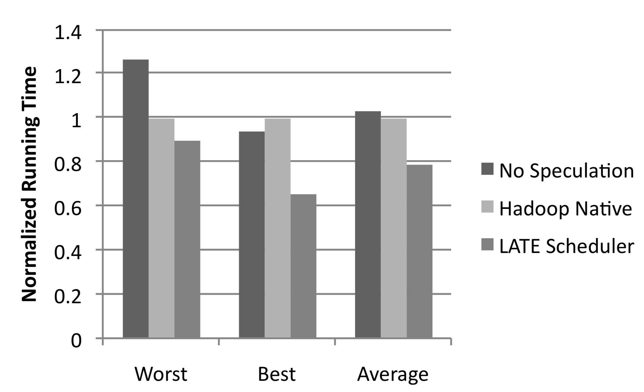
LATE Improves Response Times
Without stragglers

Slide 10
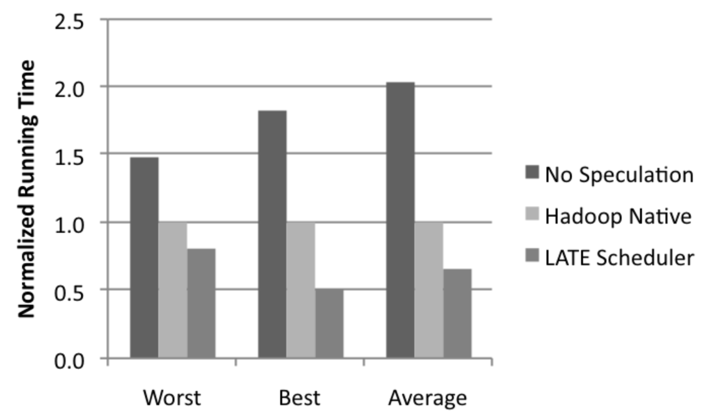
LATE Improves Response Times
Without stragglers
With stragglers

Slide 11
Impact
Informed design of Mesos, a cluster scheduler used by many organizations in production (by some of the same authors).
Notes:
Mesos’s scheduling abstraction, resource offers, can be used to implement policies similar to those presented in this paper.

Slide 12
Technical Details

Slide 13
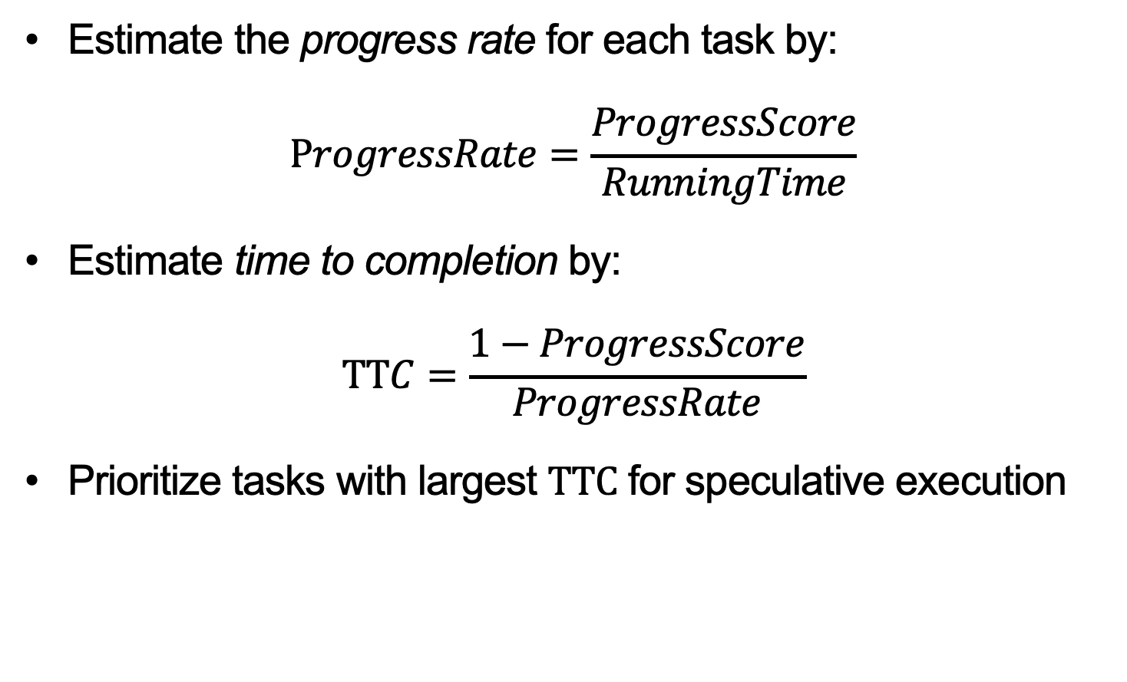
Key Idea: Prioritize tasks by time to completion
Estimate the progress rate for each task by: $ProgressRate=\frac{ProgressScore}{RunningTime}$
Estimate time to completion by: $TTC=\frac{1−ProgressScore}{ProgressRate}$
Prioritize tasks with largest TTC for speculative execution

Slide 14
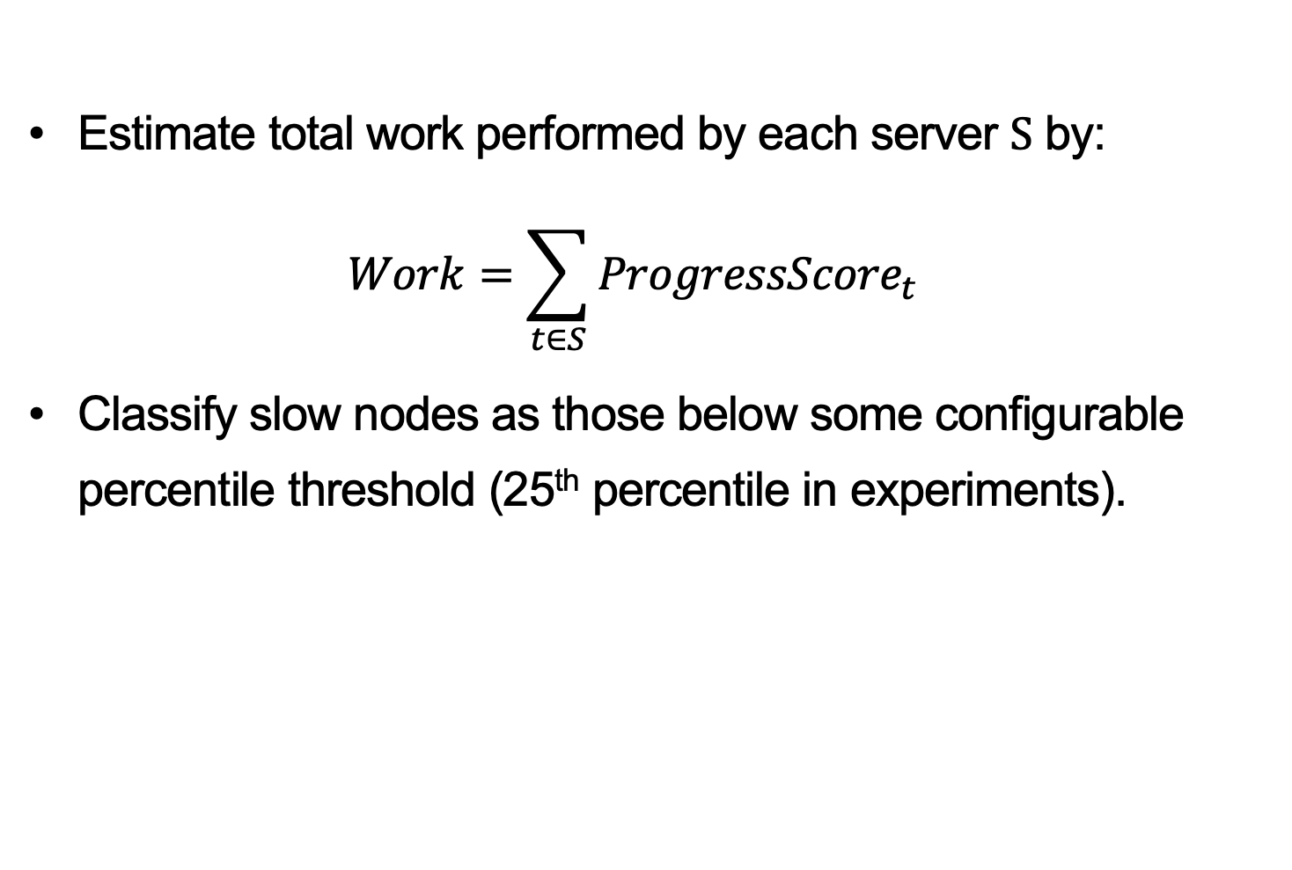
Key Idea: Place speculative tasks only on fast servers
Estimate total work performed by each server S by: $Work=\sum_{t∈S}{{ProgressScore}_{t}}$
Classify slow nodes as those below some configurable percentile threshold (25th percentile in experiments).

Slide 15
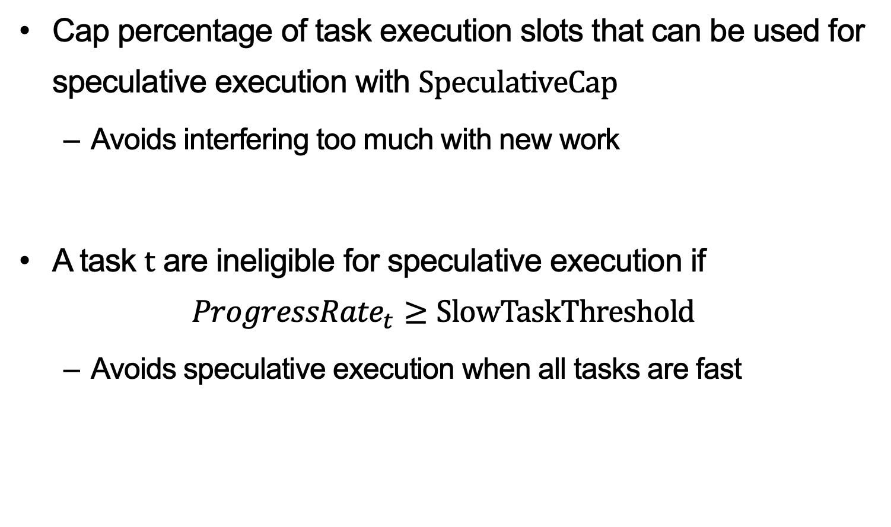
Key Idea: Avoid unnecessary speculative execution
Cap percentage of task execution slots that can be used for speculative execution with SpeculativeCap
Avoids interfering too much with new work
A task t are ineligible for speculative execution if ${ProgressRate}_{t}≥SlowTaskThreshold$
Avoids speculative execution when all tasks are fast

Slide 16
Questions?

