Slide 1
Student Presentation Resilient Distributed Datasets
COS 518: Advanced Computer Systems
Yue Tan
03/25/2019

Slide 2
Motivation
MapReduce & Dryad handle iterative algorithms and interactive data mining inefficiently
Intermediate results have to be written to disks
MapReduce Job 1
MapReduce Job 2
mapper
reducer
mapper
reducer
Disk I/O
Notes:
These two classes of applications reuse intermediate results across multiple computations.

Slide 3
Previous Solutions
Pregel & HaLoop
Keep intermediate data in memory
But only support specific computation patterns
Pregel is a system for iterative graph computations
HaLoop offers iterative MapReduce interface
Data sharing is implicitly done by the systems. Applications have no control over how data are shared.
Notes:
Before Spark/RDD, Pregel and HaLoop already managed to keep intermediate data in memory.
But the problems with the two are that they only support specific computation patterns
...
...
and that data sharing is implicitly performed. Applications have no control.

Slide 4
Key Idea
What is missing is a data sharing abstraction
Resilient Distributed Dataset (RDD)
A read-only, partitioned collection of records
that provides fault-tolerance
and lets users explicitly
persist intermediate results in memory,
control their partitioning,
and manipulate them using a rich set of operations
Notes:
The key idea of RDD is that what is missing is a data sharing abstraction.
RDD is proposed.
Formally, an RDD is a read-only,....

Slide 5
Key Challenges
Efficient fault tolerance
Reconstructing lost data using its lineage
Reconstruction from lineage is efficient because
Transformations on RDDs are coarse-grained: the same operation (e.g. map, filter, join) on many data items
A new RDDs can only be created by deterministic operations on
Data in stable storage
Other RDDs

Slide 6
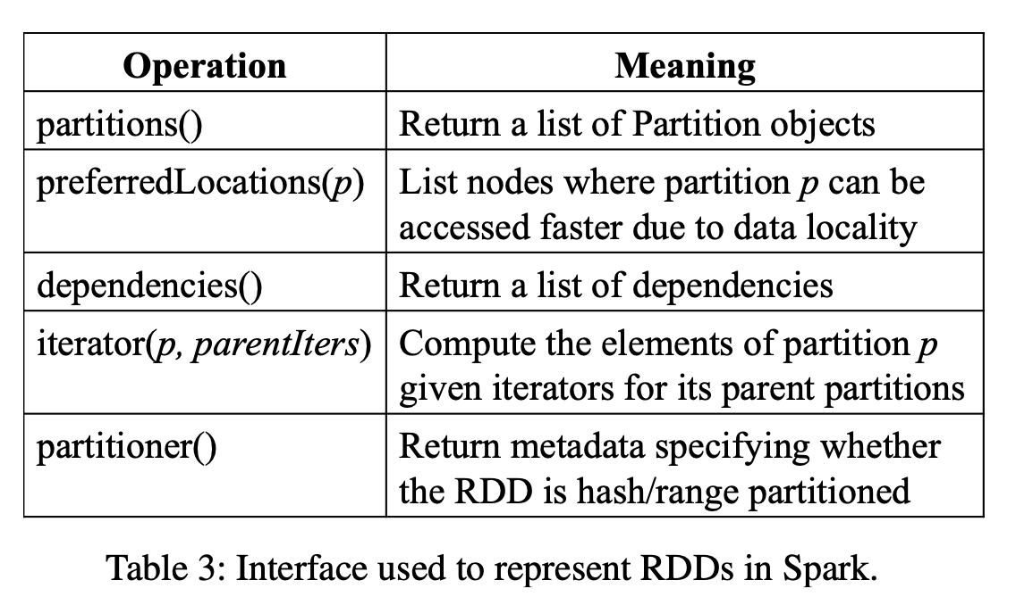
Key Challenges
Need a representation that can track lineage across a wide range of transformations
A block in an HDFS file
The block’s location
Partition the file by blocks
Notes:
Partitions: the atomic pieces of the dataset
dependencies
Function to compute partition p from its parent
Partitioning scheme & data placement

Slide 7
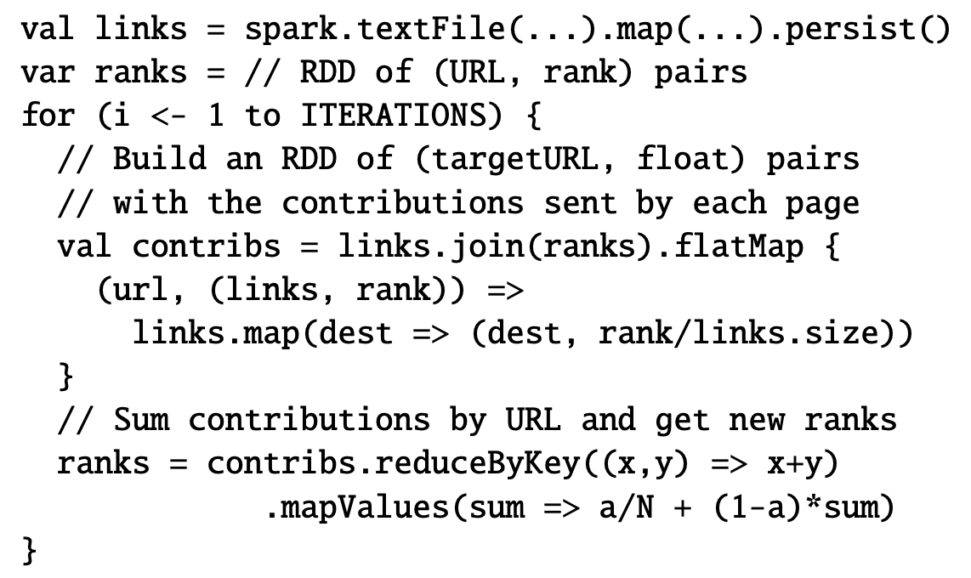
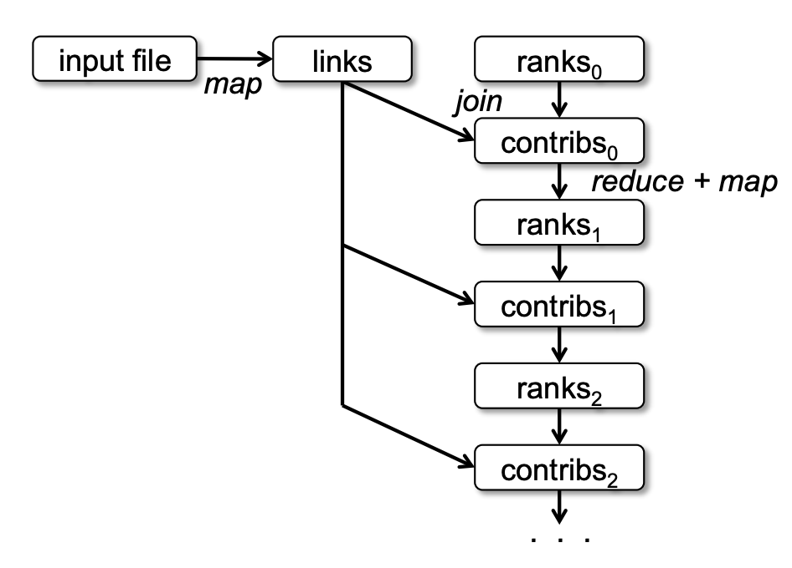
EX: PageRank in Spark

Slide 8
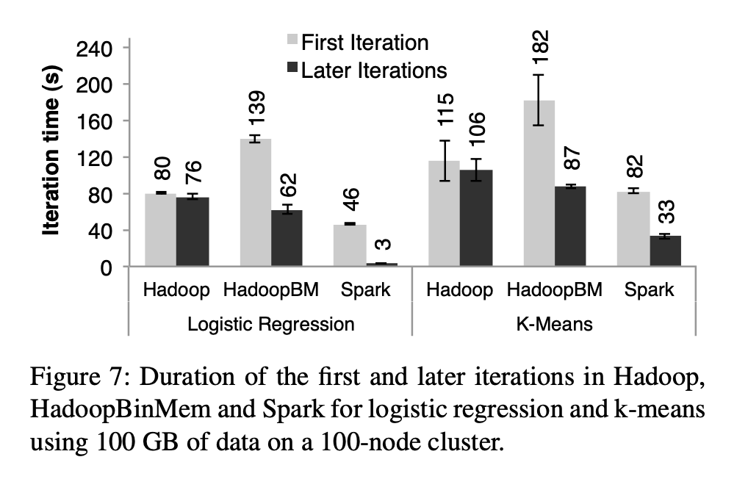
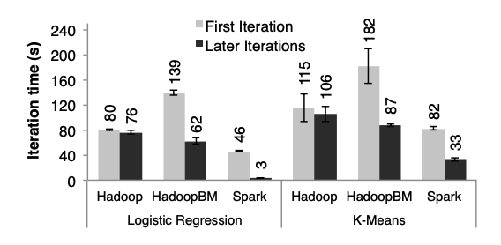
Key Result (Evaluation)
Spark’s performance is significantly better than Hadoop and HadoopBM
Notes:
HadoopBM: a Hadoop deployment that converts the input data into a low-overhead binary format in the first iteration to eliminate text parsing in later iterations and store it in an in-memory HDFS instance.
In the first iteration, all three read text input from HDFS

Slide 9
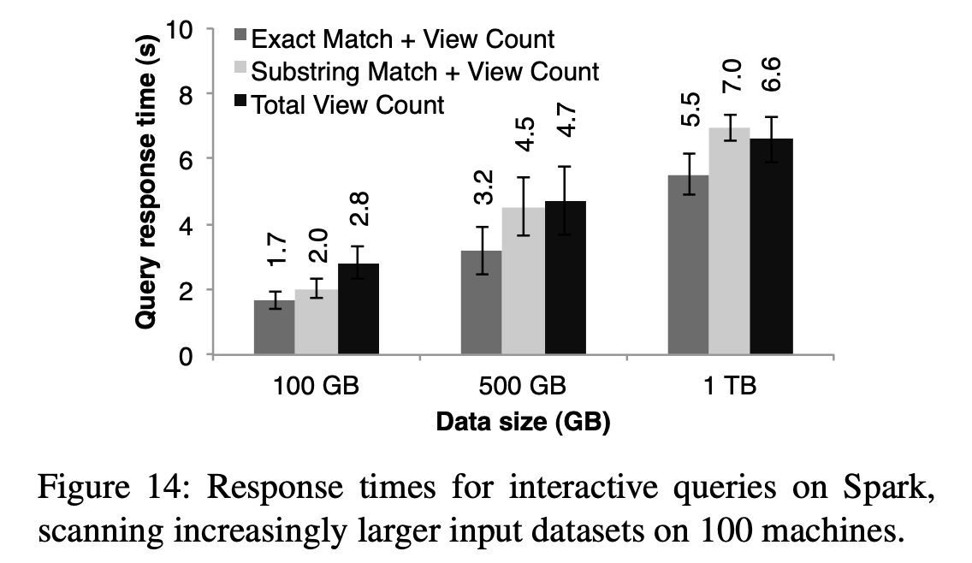
Key Result (Evaluation)
The whole dataset is 1 TB of Wikipedia page view logs.
Querying the 1 TB file from disk took 170s.
Notes:
Demonstrate Spark’s ability to interactively query big datasets
100 EC2 instances each of which has 8 cores and 68 GB RAM

Slide 10
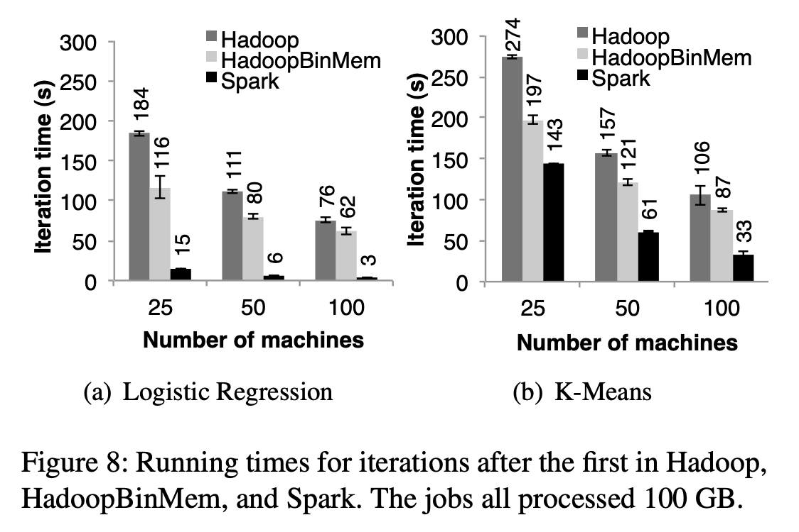
Key Result (Evaluation)
Roughly speaking, for logistic regression and k-means, spark scales linearly
Notes:
Roughly speaking, for logistic regression and k-means, spark scales linearly

Slide 11
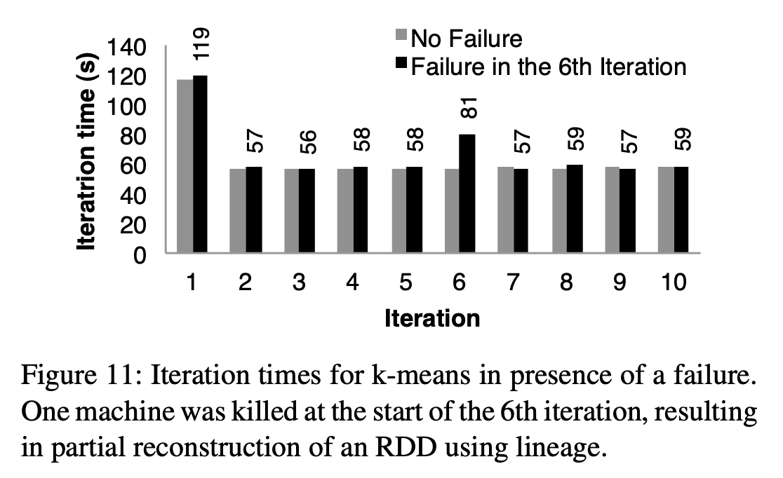
Key Result (Evaluation)
This plot shows effective fault tolerance.

Slide 12
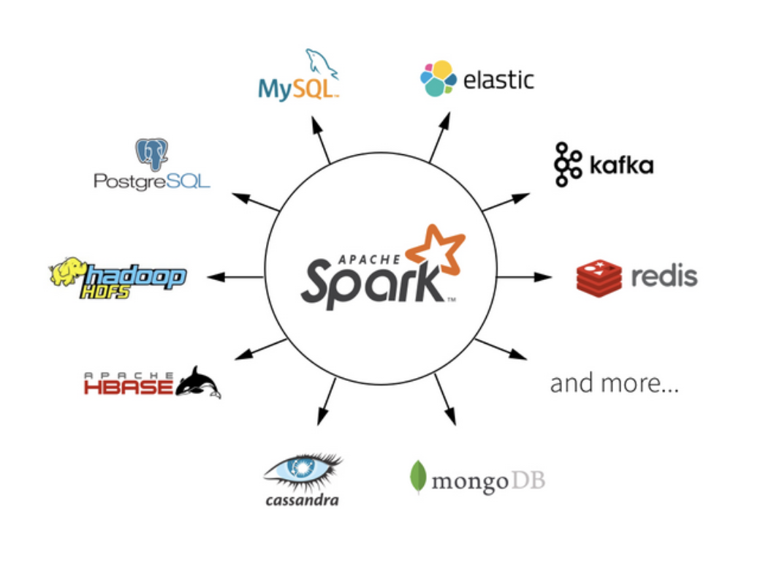
Impact
The RDD paper is cited by 3512 papers
Apache Spark is the largest open source community in big data, with over 1k contributors from 250+ organizations
Apache Spark is widely deployed by enterprises across a wide range of industries.
Spark works with many other systems

Slide 13
Technical Details

Slide 14
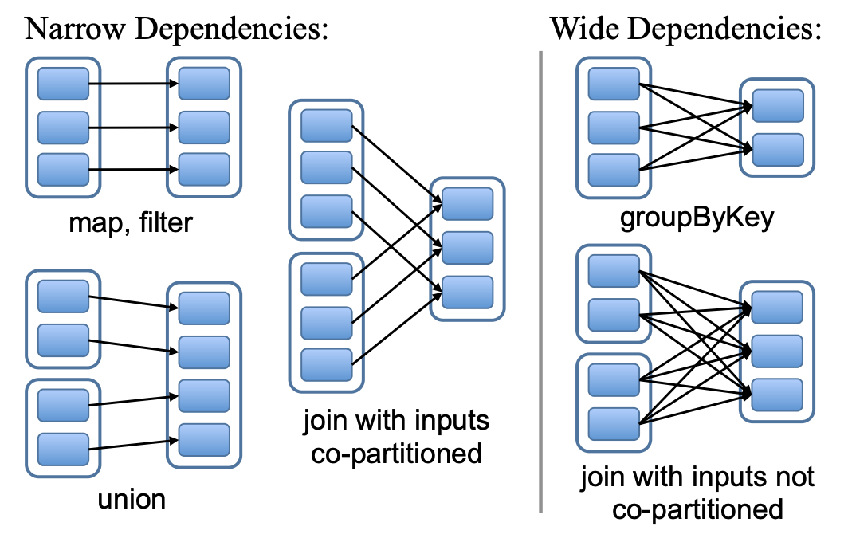
Key Idea: pipelining
Narrow dependencies: each parent partition is used by at most one child partition
Wide dependencies: multiple child partitions may depend on one parent partition

Slide 15
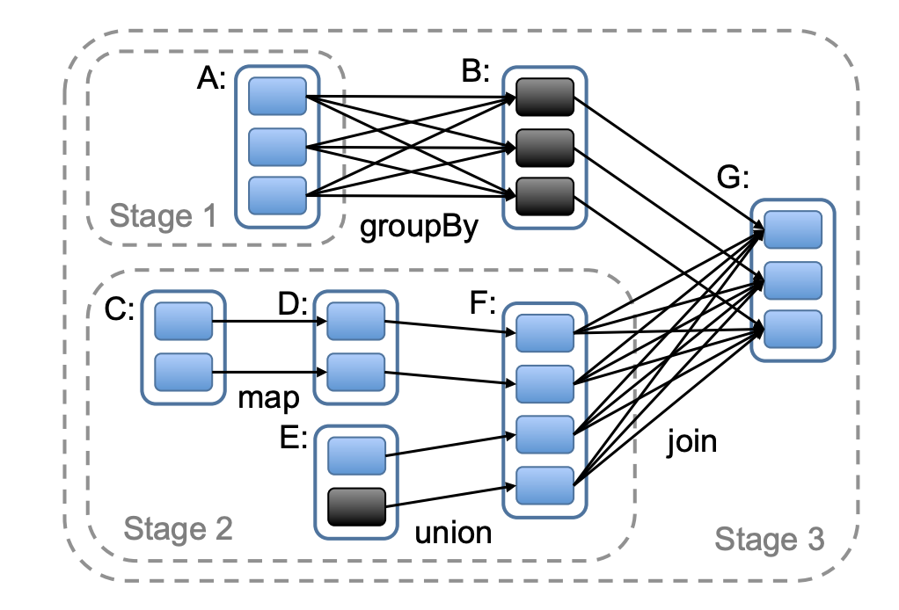
Key Idea: pipelining
Partitions are shaded rectangles, in black if they are in memory
C->D->F are pipelined so C and D need not to be materialized
E->F and C->D->F are parallelized

Slide 16
Key Idea: memory management
Three options for storage of persistent RDDs:
In-memory storage as deserialized Java objects
In-memory storage as serialized data
On-disk storage
LRU eviction policy at the level of RDDs

