Slide 1
Mesos: A Platform for Fine-grained Resource Sharing
Written By: some folks at UC-Berkely. Including the electrifying Ion Stoica!!
Presented by: Oluwatosin V. Adewale

Slide 2



Problem and goals
Multiple diverse frameworks per clusters
At moment in time using different framework impossible or would mean needed to create new cluster for framework
Enable various frameworks to efficiently share clusters
Resource sharing across frameworks. Need common interface.
Fine-grained resource sharing
Allows tasks to have data locality
Fast re-allocation of resources
Minimal, scalable, efficient and resilient core enabling resource sharing

Slide 3
Approach
Decentralized scheduler. Deals with complexity of framework requirements.
Delegates control, scheduling and execution to frameworks
Resource offers (bundle of resources; used for framework tasks)
Use of organizational policy to allocate resources.
*Led to development of spark!
Notes:
Centralized would need expressive api and should accommodate unforseen frameowkrs.

Slide 4

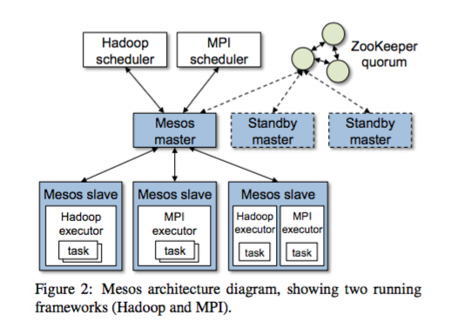

Architecture
Master Process managing slave daemons
Frameworks
Scheduler
Executor
Notes:
Zookeeper quorom used

Slide 5
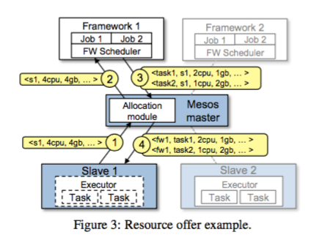
Architecture
Report from slave
Offer to framework
Accepted offer
Task execution
Repeat
Notes:
Master decides how many resources to offer each framework according to organizational policy
Mesos allows organization define policies via pluggable allocation module.
Master determines how many resources to offer framework. Framework decides which of the offered resources it wants to use.
When accepts, passes description of tasks it wants run on offered resources to mesos

Slide 6
Now tell me what you want, what you really really want
How do frameworks get the offers they want?
Accept/Reject Filters
Notes:
Can reject offers they don’t want.
But means framework can wait a very long time.
Mesos allows frameworks to set Filters. Boolean predicates specifying that it would always reject certain resources. Whitelist of nodes it can run on.
Mesos does not offer reosurce that are filetered out
This is a performance optimization. Still will specify what to accept or reject. Still performs “surprisingly well” in the absence of filters.
Only offers two types of filters…. As of paper written. We currently support two types of filters: “only offer nodes from list L” and “only offer nodes with at least R resources free”.

Slide 7
This is your last offer. More on offers
Offers
Mesos does not offer filtered out resources
Offer is counted as part of you allocation. Better respond fast
Too slow!
Rescinds offers and re-offers if framework is too slow

Slide 8
(Accepting)To Infinity and Beyond?
Nope.
Mesos can kill/revoke tasks. Gives framework grace period to cleanup task.
Mesos doesn’t just kill any task.
Kills tasks belonging to frameworks that have exceeded their guranteed allocation.
Notes:
Normally tasks are short and resources reallocated when tasks are finished.
We leave it up to the allocation module to select the policy for revoking tasks, but describe two related mech- anisms here.
Allocation modules are responsible for ensuring that the guaranteed allocations they provide can all be met concurrently. For now, we have kept the semantics of guaranteed alloca- tions simple: if a framework is below its guaranteed al- location, none of its tasks should be killed, and if it is above, any of its tasks may be killed.

Slide 9
Fault Tolerance
Master
Soft state. Internal state can be reconstructed from slaves and frameworks.
ZooKeeper used for leader election of standby masters. Gets state from buddies.
Slaves
Mesos reports node and executor failures to relevant schedulers.
Schedulers
Multiple schedulers. They deal with how they share their own state.
Notes:
In particular, the master’s only state is the list of active slaves, active frameworks, and running tasks. This information is sufficient to compute how many re- sources each framework is using and run the allocation policy.

Slide 10
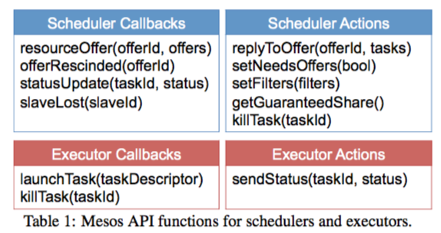
API
Call backs implemented
Actions can be invoked

Slide 11
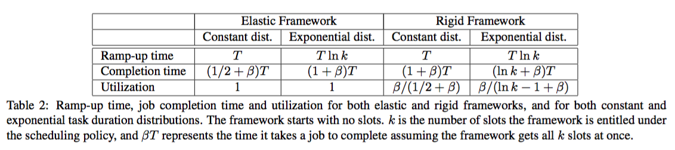
Behavior with Homogenous Tasks
Notes:
Ramp up, how long it takes to getallocation
Completion, how long it takes to complete
Utilization how much is used
Homogenous task distribution where mean task duration is T.

Slide 12
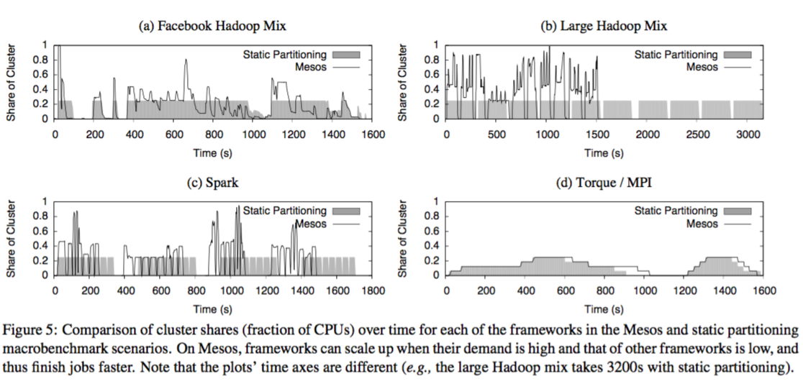
More Evaluation

Slide 13
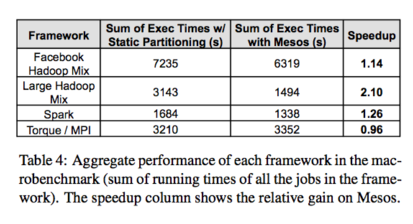
Even More Evaluation

Slide 14
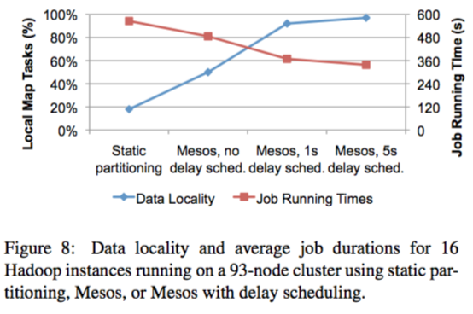
Need I say It?

Slide 15
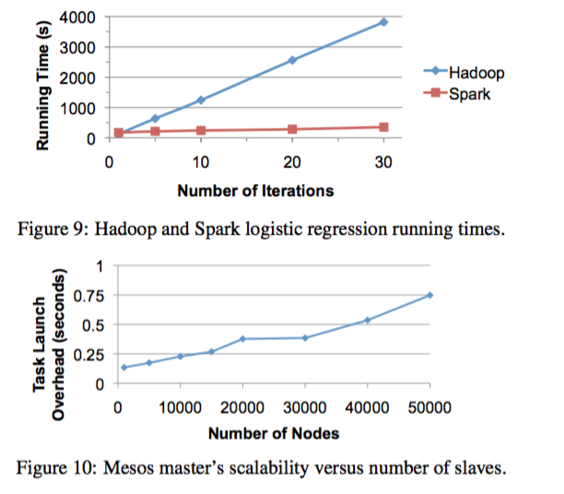
You Know the Drill
Notes:
This allowed us to calculate the extra delay incurred over 10s due to having to register with the master, wait for a resource offer, accept it, wait for the master to process the response and launch the task on a slave, and wait for Mesos to report the task as finished.

Slide 16

Conclusions

