Slide 1
Distributed Machine Learning
COS 518: Advanced Computer Systems
Lecture 13
Michael Freedman
(Slides heavily based on Daniel Suo)

Slide 2
Outline
What is machine learning?
Why is machine learning hard in parallel / distributed systems?
A brief history of what people have done

Slide 3
Some definitions
Give computers the ability to act without being explicitly programmed
Program that learns from experience to perform some task better
More practical: predictive models that have some parameters that are informed by data

Slide 4
Three broad classes
Primarily classified by the ‘feedback’
Supervised: use example inputs with corresponding ‘answers’ (labels) -> learn mapping
Unsupervised: find structure in data without labels (but is anything ever really unsupervised?)
Reinforcement: learn policy of behavior in a dynamic environment from rewards / punishments

Slide 5
Example: Linear regressions
Could be thought of as a machine learning algorithm
Want to make predictions
Determine parameters from data

Slide 6

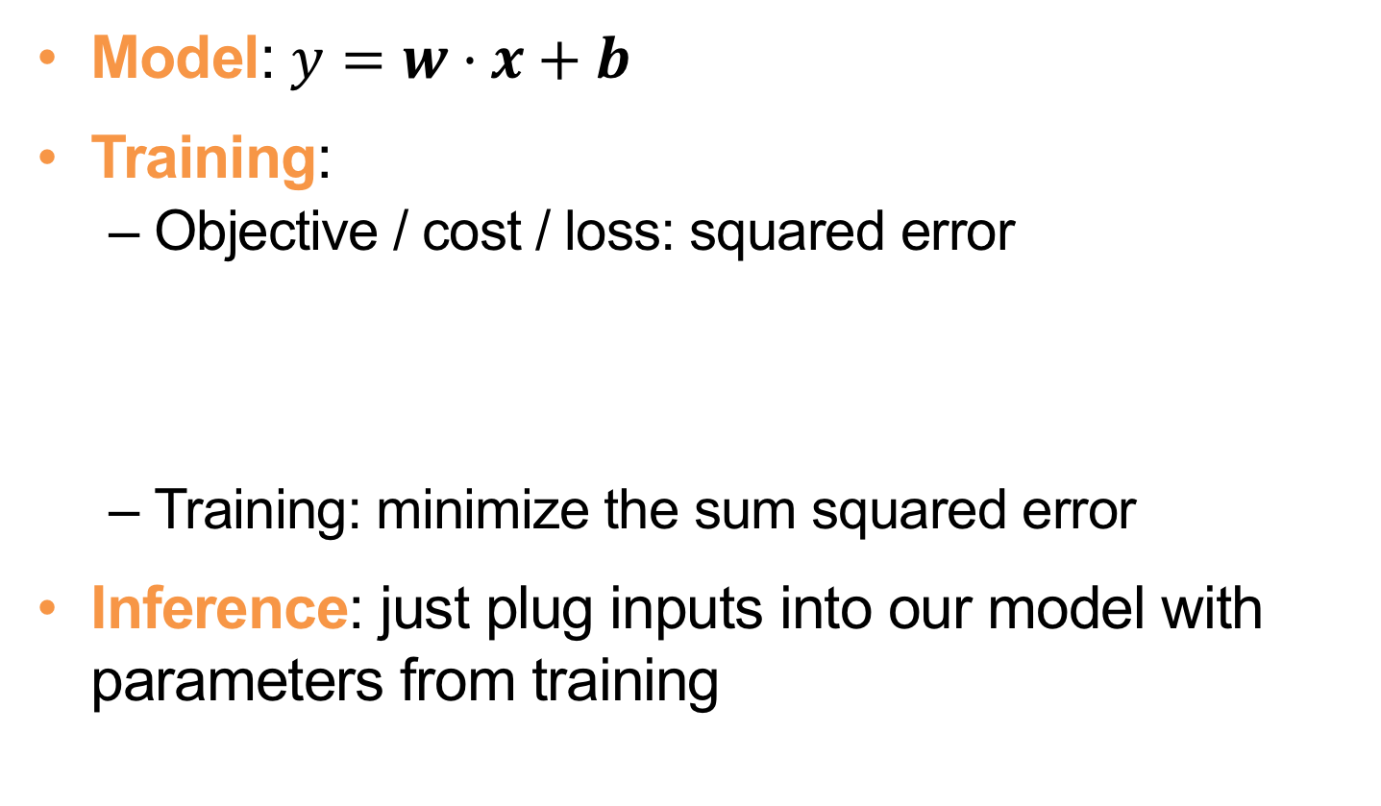
Example: Linear regressions
Model: $y=w·x+b$
Training:
Objective / cost / loss: squared error
Training: minimize the sum squared error
Inference: just plug inputs into our model with parameters from training

Slide 7
But isn’t this statistics?
Lots of overlap, but some notable differences
Partly interest
Statistics: survey design, sampling, industrial statistics
ML: what is learning, what can be learned
Partly cultural
Statistics: complicated models we can explain but don’t work
ML: whatever improves prediction performance goes

Slide 8
Representation learning
What if we don’t have data collected and organized into a bunch of features?
What if features are hard / impossible to define?
Quick example: k-means clustering
Initialize centroids
Cluster
Re-compute centroid
Repeat
We can create hierarchies of representations
Deep learning!

Slide 9
Why is distributed ML hard?
Iterative
Many algorithms use some kind of optimization to find a model that fits data well
Functions are often complex, but even simple ones can be approximated with iterative approach
Stateful
Algorithms often store and update model parameters between iterations
Dependent
Often can’t run jobs independently / needs lots of synchronization

Slide 10
Typical distributed approaches?
Dataflow
Graph
Parameter server
MPI / “All reduce”

Slide 11
So what do people typically do?
Use a beefy workstation instead of a cluster
A single GPU can sometimes outperform a cluster
Use clusters for simple / highly parallelizable algorithms
Use data parallelism (as opposed to model parallelism) when possible
Even at large companies!

Slide 12
Wednesday: Project Presentations
Five minutes presentation per group
Four slides
Problem overview
Technical solution
Implementation Plan: Minimal Viable Project” and “Stretch” goals
Evaluation Plan: Most important graph?

