Slide 1
Multiple Non-profits and Health and Wellness Platform Requirements
GROUP C Sydney Fang - Project lead
Mitch Hussuck - Client liaison
Ansul Dhariwal - Technical lead
Paul Gray - Quality assurance lead

Slide 2
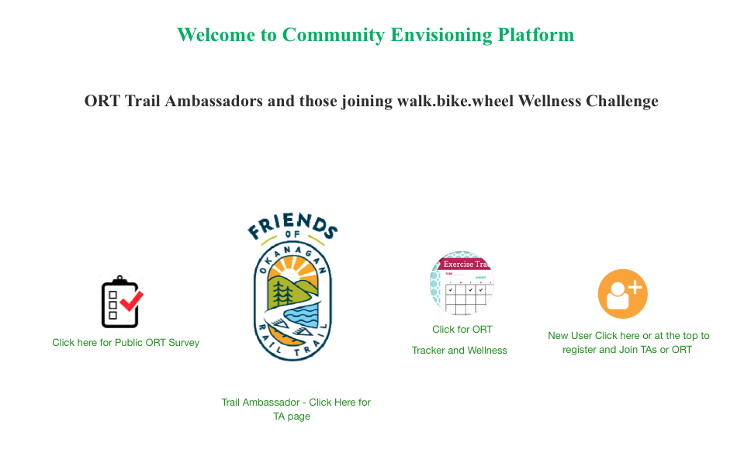
About the Project
Web platform
Connects the Okanagan Rail Trail with the Okanagan community
Allow vendors and organizations to fundraise and create events
Allows the community to participate in events and challenges
Allow healthcare professionals to interact with the community
Notes:
Sydney

Slide 3
Technical aspect
Architecture
FastAPI
DJango CMS
MariaDB
Virtual machine
Compute Canada
Developmental tools
TerraForm
RedHat
Docker
Programming language
Python, HTML, CSS, ReactJS, Javascript
Charting tools - google chart, D3js
Testing
PyTest
Continuous testing
Test throughout development
Database testing
Accessibility testing
Notes:
Sydney

Slide 4

User Groups
All Users
Visitors with/without account, patients, professional healthcare workers, and trail ambassadors
Professional Users
From medical/health organizations
Set goals for patients
Monitor data entered by patients
Provide health recommendations
Patient Users
Participate in a challenge
Better themselves physically
Monitor activity for health professionals.
Trail Ambassadors
Organize events
Monitor recommendation from Health Professionals
Educate the users on Okanagan Rail Trail and nearby trails
Notes:
Sydney - cut it down
Current time 1:11
//Slide 1-4 2:30

Slide 5
User Requirements
All users will login and have access to certain features based on their role
All Users
basic user, professional, and trail ambassador accounts
join groups to partake in weekly challenges and compare goals with others
access to interactive map of the Okanagan Rail Trail
contribute to a discussion board
Professional Users
access the Professional View tab where they can monitor patient progress and provide feedback
Patient Users
access their Patient Dashboard where they can view progress charts and feedback
log data into an exercise, health, nutrition and lifestyle tracker
Trail Ambassadors
access the Trail Ambassador View tab where they can view contact information and events and schedule new events on a communal calendar
Notes:
Paul - 1:20
1 MINUTE
//Slide 1-5 3:30

Slide 6

Functional Requirements
Multiple health and wellness trackers :
Available for users to log their progress
Will display the user’s past and present data
Charts and graphics:
Available for users to input and monitor their activity
Will be able to view feedback from professionals
Health care professionals:
Will have a dashboard with special access to assigned patient’s information
Notes:
Mitch - Timed at 31 seconds
For functional requirements, there will be multiple health and wellness trackers that will be available for users to log their progress that will display the user’s past and present data. Charts and graphics will be available for users to input and monitor their activity, which professionals can view and give feedback on. The health care professionals will have a dashboard with special access to assigned patient’s information.

Slide 7
Non-functional Requirements
Non-Functional Requirement List
Name | Description
Maintainability | Website architecture must allow for easy long-term maintenance for when it is left to the community.
Security | The website should have mandatory login to use features. Different levels of access should be given based on login credentials. Secure SSL encrypted, web-based software and secure VPN encryption for data transfer.
Usability | The website should be easy for anyone to use, with simple methods to track/measure activity and visualize progress. Should cover all different user flows to be successful.
Compatibility | The website should work on desktop browsers as well as mobile devices so users can log their progress anywhere on any device.
Privacy | Individuals should provide their full identity to mentors, experts, and researchers, but should stay anonymous or aggregated to event volunteers and analytics. All data should be held within a password protected research warehouse.
Notes:
Mitch
1:20
//Slide 6-7 1:12
//Total 4:42
Non-functional requirements will consist of 5 things: maintainability, security, usability, compatibility, and privacy. Maintainability will allow for easy long-term maintenance. For security, the website will have a mandatory login to use features. Different levels of access will be given based on login credentials which will be SSL encrypted, as well it will have web-based software and secure VPN encryption for data transfer. Usability will consist of the ease of use of the website. It will be easy to track and measure activity and visualize progress. The website will also be compatible with desktop as well as mobile devices. And last but not least, individual data will stay completely private from people that don’t include their mentors, experts, and researchers that they give permission to view.

Slide 8
Milestones
Prototype video demo I - November 18
Users will login to access certain features based on role
Professional users will have professional dashboard
Patient users will have a patient dashboard
Able to join groups to partake in weekly challenges
Peer testing report I - December 2
Trail ambassadors will have access to a events calendar
Users will have access to walkthrough of the Okanagan rail trail
Patient users will have access to resources for homeless people
Users will be able to contribute to discussion boards
Peer testing report II - March 11
Log health measures into health and wellness trackers:
Exercise duration, distance, steps
Blood pressure, heart rate, weight and height
Diet, water intake, meals
Sleep, smoking and other habits
Prototype video demo II - April 28
Trail ambassadors will be able to view previous transactions.
All users will be able to transact donations in a securely and timely manner
Trail ambassadors will be able to create and advertise events
Notes:
Anshul
1:10
All Users account will have corresponding access
User will be able to join events
Trail ambassadors will have access to a calendar
Access to walkthrough of Okanagan Rail Trail
Resources for homeless people
log their exercise in a tracker
Log health measures into health and wellness trackers:
Exercise duration ,heart rate, water intake and other habits
TAs will be able to view previous transactions.
All users will be able to donate securely
Tas will be able to create events, and advertise them to the users
//Slide 8 1:51
//Total 6:32

Slide 9
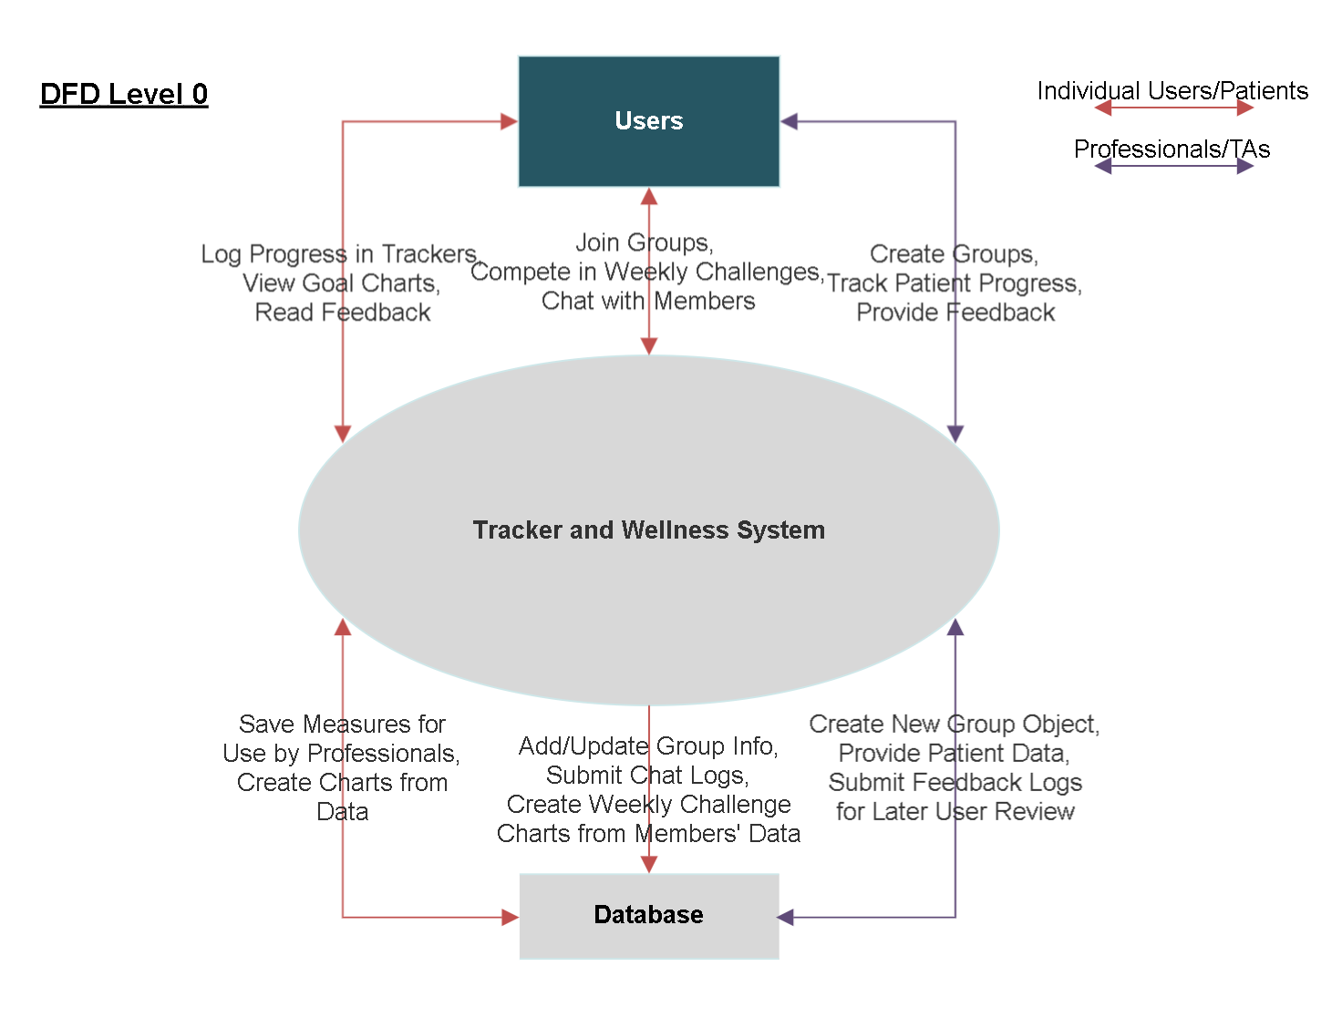
Notes:
Anshul
30 seconds
//Slide 9 1 min

Slide 10
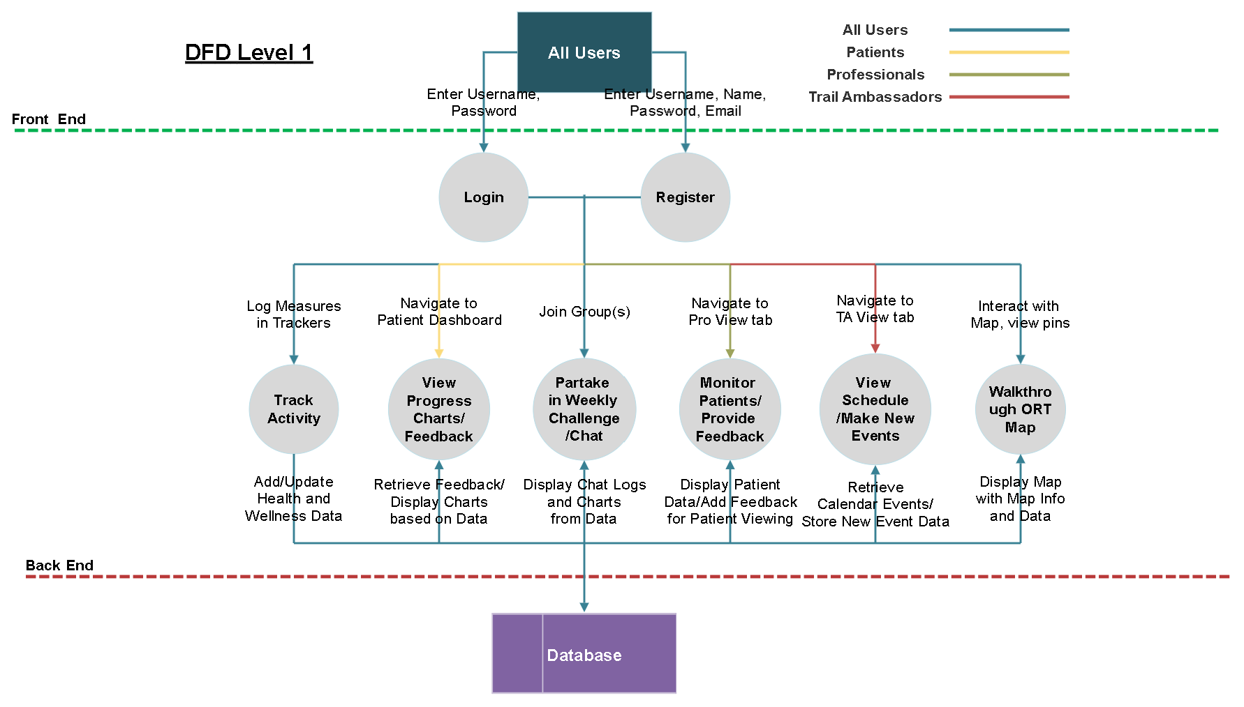
Notes:
Paul
20 seconds
10 seconds left over for buffer
//Slide 10 10 sec

