Slide 1


Slide 2
Introduction to Multivariable Calculus
Understanding Multivariable Calculus in Depth

Slide 3
What is Multivariable Calculus?
Multivariable Calculus is the branch of calculus that studies functions of more than one variable and their manipulation.
It extends principles of single variable calculus such as derivatives and integrals to multiple variables.

Slide 4
text1
text2

Slide 5
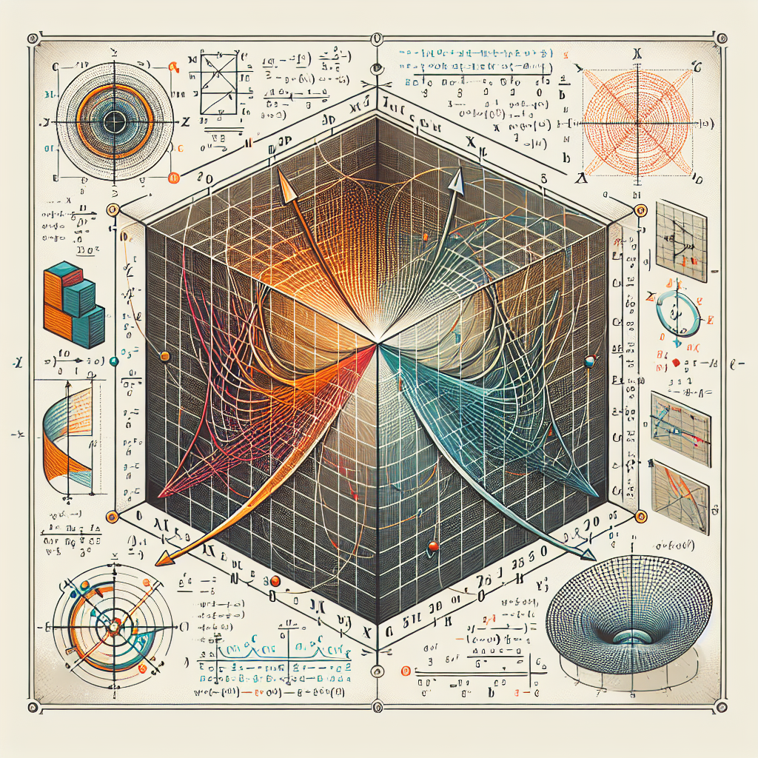
Vector-Valued Functions
Vector-Valued Functions provide a way to parameterize equations with more than one unknown variable.
A vector-valued function r(t) = [f(t), g(t), h(t)] is a function of one variable—the parameter t—that output a vector in three-dimensional space.
Vector-Valued Functions

Slide 6
Partial Derivatives & Gradients
In multivariable calculus, the derivative becomes the partial derivatives, which measure the rate of change of a function of several variables with respect to one of those variables.
The gradient is a vector operation which operates on a scalar function to produce a vector whose magnitude is the maximum rate of change of the function.
It points in the direction of the greatest rate of increase of the function, and its magnitude is the rate of that increase.

Slide 7
Multiple Integrals
Double and triple integrals extend the idea of a definite integral to functions of more than one variable.
Double integrals can be used to compute areas and volumes, while triple integrals can be used to compute volumes and mass.
Instead of integrating over an interval, one integrates over a region in the plane or in space.

Slide 8
Applications of Multivariable Calculus
Multivariable calculus is widely employed in the physical sciences and engineering.
In physics, it underpins a wide range of theories such as electromagnetism and fluid dynamics.
It is also crucial in the realm of machine learning and optimization theory in computer science.

Slide 9

Conclusion
In conclusion, Multivariable calculus plays a vital role in higher dimensions of Mathematics.
It has led to a deeper understanding of the nature of physical, mathematical, and even societal systems.
As our world becomes increasingly quantitative and data-focused, multivariable calculus will continue to be an important tool to model, understand, and optimize our solutions.
Multivariable Calculus

Slide 10
References
1. Stewart, J. (2015). Multivariable calculus. Cengage Learning.
2. Rogawski, J., & Adams, C. (2016). Calculus: Multivariable. WH Freeman.
3. Larson, R., & Edwards, B. H. (2010). Calculus. Cengage Learning.

Slide 11
Thank You
Thank you for your attention!
Any questions?

