Slide 1
Convolutional Neural Networks
An Introduction to CNNs and Their Applications

Slide 2
What are Convolutional Neural Networks?
Convolutional Neural Networks (CNNs) are a class of deep neural networks most commonly applied to analyzing visual imagery
They are specifically designed to process pixel data and are used in image recognition and classification challenges
CNNs use a series of convolutional layers to filter inputs for useful information

Slide 3
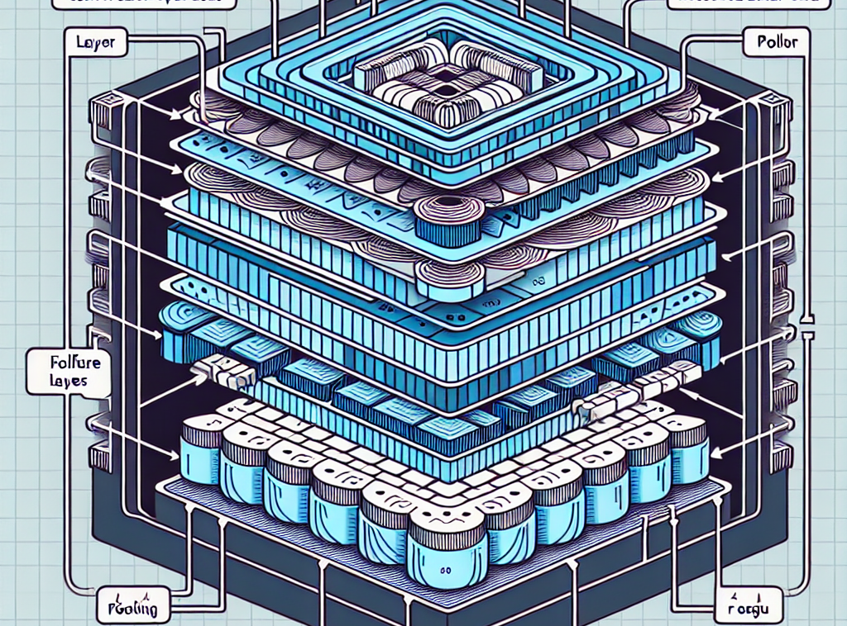
Architecture of CNNs
The architecture of a CNN includes layers like convolutional layers, pooling layers, and fully connected layers
Each layer performs distinct operations on the input data to capture and represent the features effectively

Slide 4
Convolutional Layers
Convolutional masks use filters to perform convolution operations
This operation extracts high-level features such as edges from the input image
Filters are adjusted during the learning process to capture the most relevant features

Slide 5
Pooling Layers
Pooling layers reduce the spatial size of the representation to reduce the number of parameters and computation in the network
The most common type of pooling is max pooling, which selects the maximum value from each sub-region of the feature map

Slide 6
Fully Connected Layers
After several convolutional and pooling layers, the high-level reasoning in the neural network is done via fully connected layers
Neurons in a fully connected layer have full connections to all activations in the previous layer

Slide 7
Applications of CNNs
CNNs are widely used in image and video recognition, image classification, medical image analysis, and natural language processing
They also play a crucial role in the development of autonomous vehicles by enabling them to recognize obstacles

Slide 8
Advancements in CNNs
Research in CNN architectures has led to the development of deeper and more complex networks capable of achieving state-of-the-art performance on various tasks
New advancements focus on making CNNs more efficient, requiring less computational power and data

Slide 9
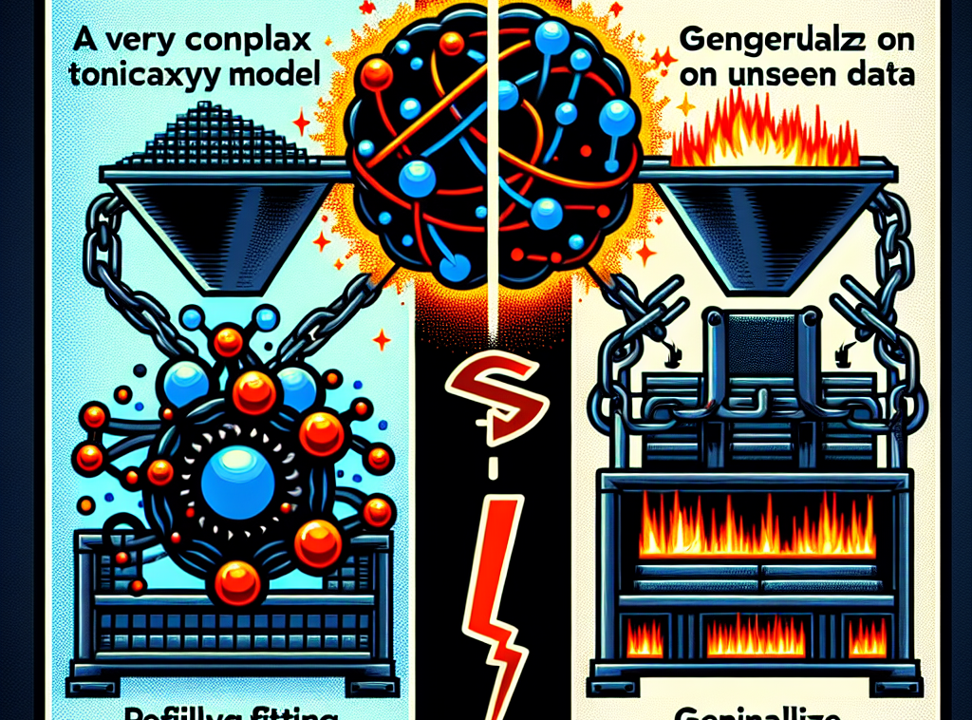
Challenges in CNN Development
Despite their success, CNNs face challenges such as overfitting to training data
They also require significant computational resources, which can be a barrier to entry for smaller organizations

Slide 10
Conclusion
CNNs have revolutionized the field of image recognition and continue to push the boundaries of what is possible in machine learning and artificial intelligence
Ongoing research and development promise to further expand their capabilities and applications

