Slide 1
Introduction to Multivariable Calculus
Exploring Functions of Multiple Variables

Slide 2
What is Multivariable Calculus?
Multivariable calculus, also known as vector calculus, is a branch of mathematics that deals with functions of multiple variables.
It extends the concepts and techniques of calculus to functions that depend on more than one independent variable.
This branch of calculus is essential for understanding and analyzing complex phenomena in various fields such as physics, engineering, and economics.

Slide 3
Why Study Multivariable Calculus?
Multivariable calculus provides a powerful framework for modeling and solving real-world problems that involve multiple variables.
It allows us to analyze and optimize functions in multiple dimensions, which is essential for understanding the behavior of complex systems.
By studying multivariable calculus, we can gain insights into diverse phenomena and make informed decisions in various fields.

Slide 4
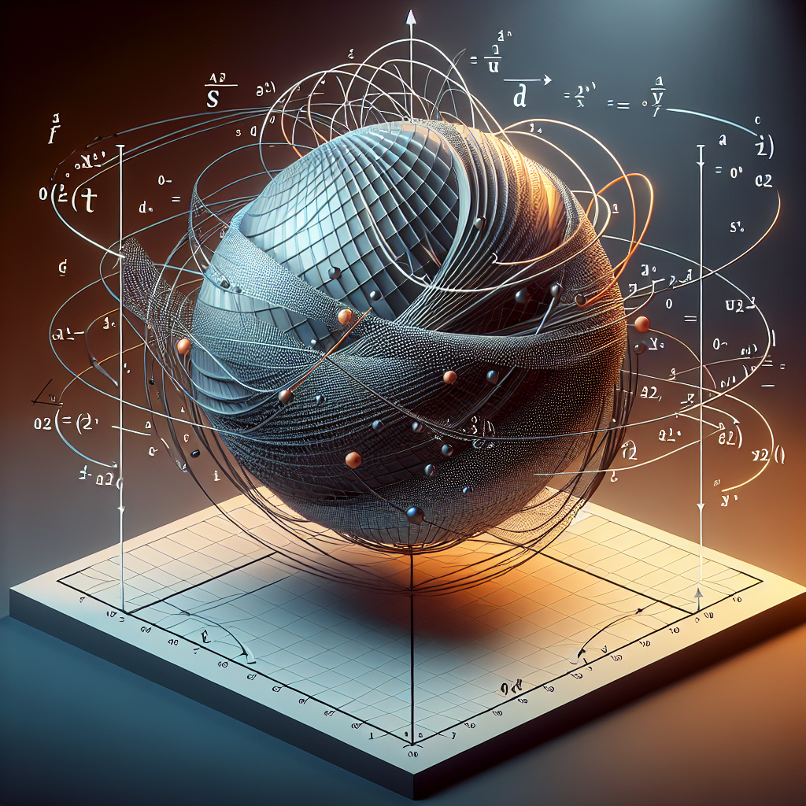
Partial Derivatives and Gradients
Partial derivatives are a fundamental concept in multivariable calculus.
They allow us to measure how a function changes with respect to each of its variables while holding the other variables constant.
Gradients, which are vectors of partial derivatives, provide valuable information about the direction and rate of change of a function at a given point.
Partial Derivatives

Slide 5
Multiple Integrals
Multiple integrals are extensions of single-variable integrals to functions of multiple variables.
They allow us to compute volumes, areas, and other quantities in higher dimensions.
By understanding multiple integrals, we can solve problems involving mass, probability, and other physical quantities in complex systems.

Slide 6
Vector Fields and Line Integrals
Vector fields associate a vector with each point in a region of space.
Line integrals allow us to compute the work done by a force field along a curve.
By studying vector fields and line integrals, we can analyze fluid flow, electromagnetic fields, and other vector phenomena.

Slide 7
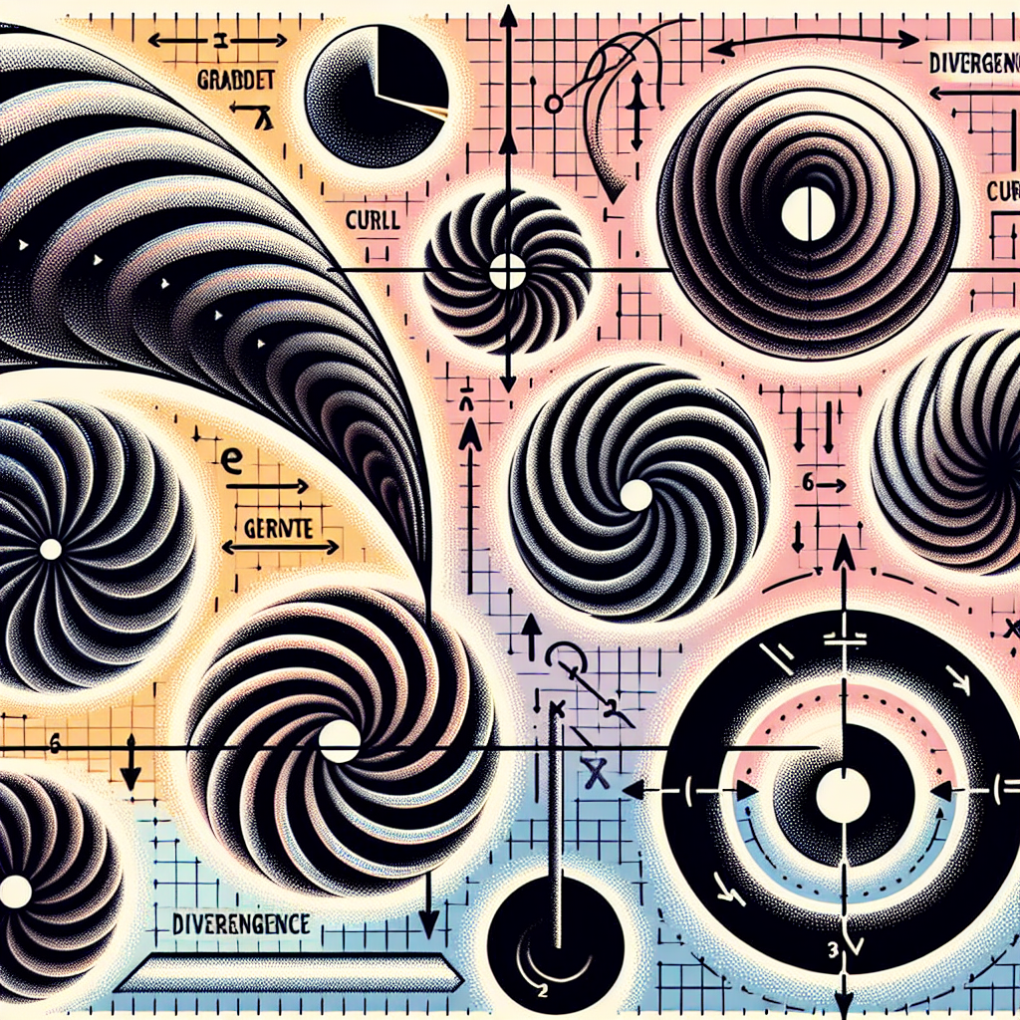
Gradient, Curl, and Divergence
Gradient, curl, and divergence are fundamental operators in vector calculus.
They provide insights into the properties of vector fields and are essential for understanding the behavior of physical systems.
By applying these operators, we can analyze fluid flow, electromagnetism, and other phenomena in the natural world.
Vector Calculus

Slide 8
Applications of Multivariable Calculus
The concepts and techniques of multivariable calculus have wide-ranging applications in various fields.
Some examples include optimization problems in economics, fluid dynamics in engineering, and image processing in computer science.
By leveraging multivariable calculus, we can analyze and solve complex problems that arise in different disciplines.

Slide 9
Challenges and Limitations
While multivariable calculus is a powerful tool, it also poses challenges and limitations.
Some challenges include visualizing functions in higher dimensions, dealing with complex equations, and solving optimization problems with multiple constraints.
However, with practice and a deep understanding of the concepts, these challenges can be overcome.

Slide 10
Future Directions
The future of multivariable calculus holds exciting possibilities.
As technology advances, new applications and techniques will continue to emerge.
Researchers and mathematicians are actively exploring interdisciplinary approaches to tackle complex problems using multivariable calculus.

Slide 11
Conclusion
In conclusion, multivariable calculus plays a critical role in understanding and analyzing functions of multiple variables.
It provides the mathematical foundations for solving complex problems and has widespread applications in diverse fields.
By studying multivariable calculus, we can unlock new insights and make significant contributions to various disciplines.

Slide 12
References
1. James Stewart. Calculus: Early Transcendentals. Cengage Learning.
2. Michael Spivak. Calculus. Publish or Perish.
3. Peter D. Lax. Multivariable Calculus with Applications. Springer.

Slide 13
Thank You
Thank you for your attention!
Any questions?

