Slide 1
Cows
An Introduction to Cows

Slide 2
What are Cows?
Cows are large domesticated mammals that are commonly raised as livestock for their meat and milk.
They are herbivorous animals and belong to the Bovidae family, which also includes other animals such as bison, buffalo, and antelopes.
Cows are known for their distinctive appearance, with a large body, horns (in some breeds), and a spotted or solid-colored coat.

Slide 3
Uses of Cows
Cows have been domesticated for thousands of years and have various uses in human society.
They are primarily raised for their meat, which is a significant part of many cuisines worldwide.
Cows also provide milk, which is a valuable source of nutrition and is used to make dairy products such as cheese, butter, and yogurt.

Slide 4
Breeds of Cows
There are numerous breeds of cows, each with its own characteristics and purposes.
Some popular breeds include Holstein, Angus, Hereford, Jersey, and Brahman.
These breeds have been selectively bred over generations to enhance specific traits such as milk production, meat quality, or adaptability to different climates.

Slide 5
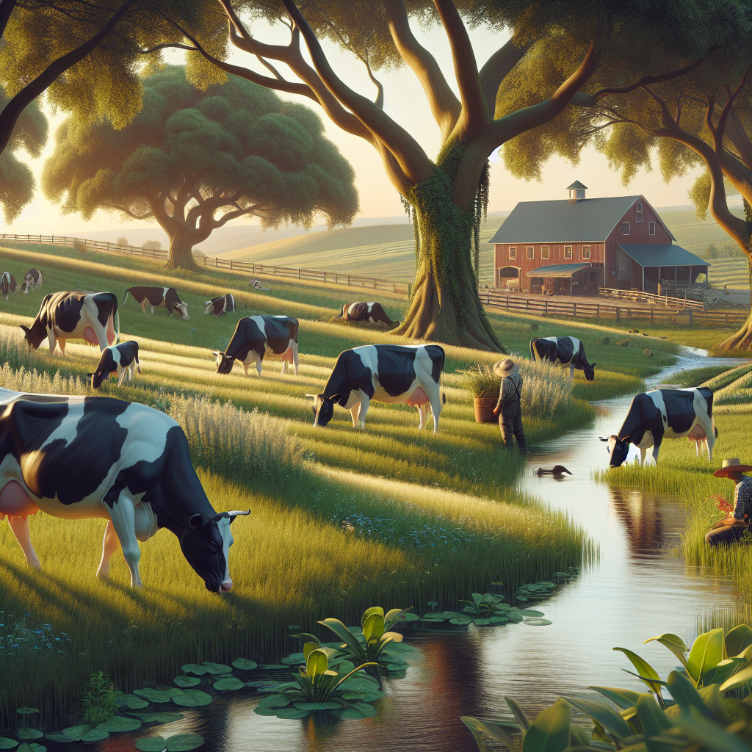
Cows in Agriculture
Cows play a crucial role in agriculture, particularly in the livestock industry.
They contribute to the production of meat, milk, and other dairy products that are consumed by people worldwide.
In addition, cows also have an important impact on soil fertility through their grazing and waste deposition, which helps maintain healthy ecosystems in agricultural areas.
Cows in a Field

Slide 6
Caring for Cows
Proper care and management are essential for the health and well-being of cows.
They require a nutritious diet, access to clean water, and suitable shelter to protect them from extreme weather conditions.
Regular veterinary care, including vaccinations and disease prevention measures, is also important to ensure their overall health.

Slide 7
Interesting Facts about Cows
Here are some interesting facts about cows:
- Cows have a unique digestive system with four compartments in their stomach, allowing them to efficiently extract nutrients from plant-based diets.
- They have a highly developed sense of smell and can detect scents from up to six miles away.

Slide 8
Conclusion
In conclusion, cows are domesticated mammals that have been an important part of human society for centuries.
They provide us with meat and milk, contribute to agriculture, and have unique characteristics that make them fascinating creatures.
Understanding and caring for cows is crucial for sustainable farming practices and ensuring the well-being of these animals.

Slide 9
References
1. Smith, A. B. (2020). The Complete Guide to Cows: How to Choose the Best Breeds, Raise, and Take Care of Them. Simon & Schuster.
2. Brown, M. (2018). Cows: An Illustrated Guide to the Breeds of the World. Storey Publishing.
3. Johnson, R. L. (2019). Caring for Cows: A Comprehensive Guide to Dairy Management. Wiley.

Slide 10
Thank You
Thank you for your attention!
Any questions?

