Slide 1
Cows
An Introduction to Cows

Slide 2
What are Cows?
Cows are large domesticated animals that are commonly raised for their milk, meat, and leather.
They are herbivores and have a complex digestive system that allows them to efficiently extract nutrients from grass and other plant material.
Cows are social animals that form strong bonds with their herd members and communicate through vocalizations and body language.

Slide 3
Different Breeds of Cows
There are numerous breeds of cows, each with its own unique characteristics and purposes.
Some popular cattle breeds include Holstein, Angus, Hereford, Jersey, and Brahman.
These breeds vary in size, color, milk production, and adaptability to different climates.

Slide 4
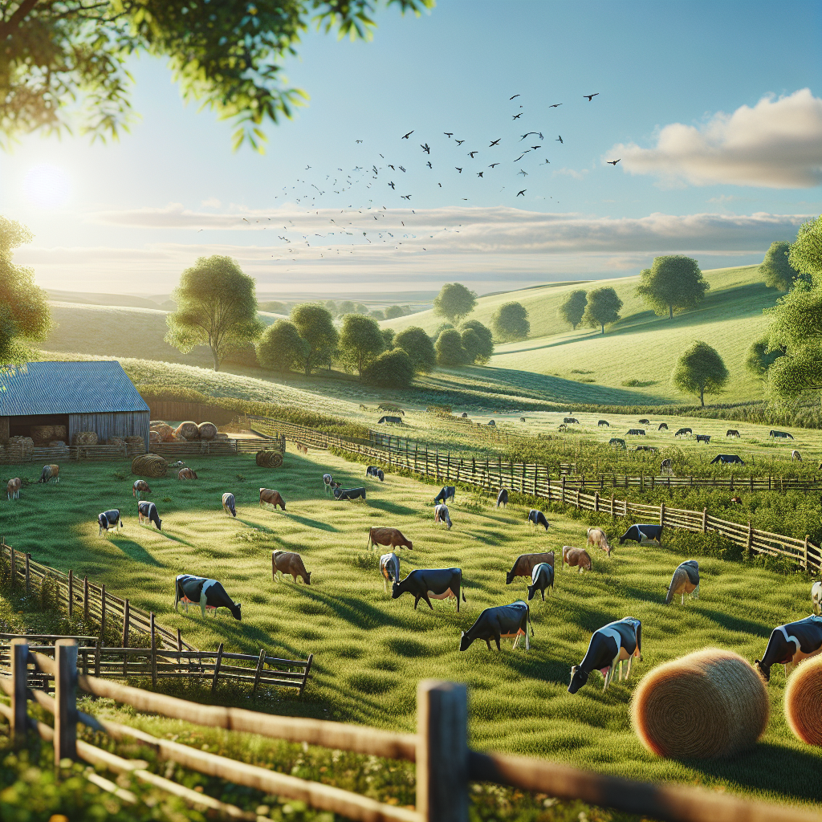
Cattle Farming
Cattle farming, also known as ranching or beef production, plays a significant role in the agricultural industry.
Cows are raised on farms for various purposes, including milk production, meat production, and breeding.
Cattle farmers employ different management practices to ensure the health and welfare of their cows and to maximize productivity.
Cattle Farm

