Slide 1
Introduction to Cows
Understanding Cows and Their Importance

Slide 2
Characteristics of Cows
Cows are large domesticated mammals known for their significance in agriculture and food production.
They are herbivores, commonly found in farms and grasslands, and are usually reared for dairy products, meat, and leather.
Cows are known for their gentle nature and are highly social animals that form strong bonds within their herds.

Slide 3
Cattle Breeds
There are numerous breeds of cows, each with its own distinct characteristics and purposes.
Some popular cattle breeds include Holstein, Angus, Hereford, Jersey, and Brahman.
These breeds are selectively bred for specific traits such as milk production, meat quality, and adaptability to different environments.

Slide 4
Importance of Cows in Agriculture
Cows play a vital role in agriculture and food production.
They are a primary source of milk, which is a nutritious and essential part of the human diet.
Cows also contribute to the production of meat, leather, fertilizers, and other by-products that are used in various industries.

Slide 5
Cattle Farming Practices
Cattle farming involves various practices to ensure the well-being and productivity of cows.
These practices include proper nutrition, vaccination, regular health check-ups, and maintaining suitable living conditions.
Cattle farmers also implement breeding programs to improve desirable traits in their herds and maximize productivity.

Slide 6
Environmental Impact of Cows
Cows have both positive and negative environmental impacts.
On the positive side, they contribute to nutrient cycling and soil fertility through manure deposition.
However, methane emissions from cow digestion are a significant contributor to greenhouse gas emissions, contributing to climate change.

Slide 7
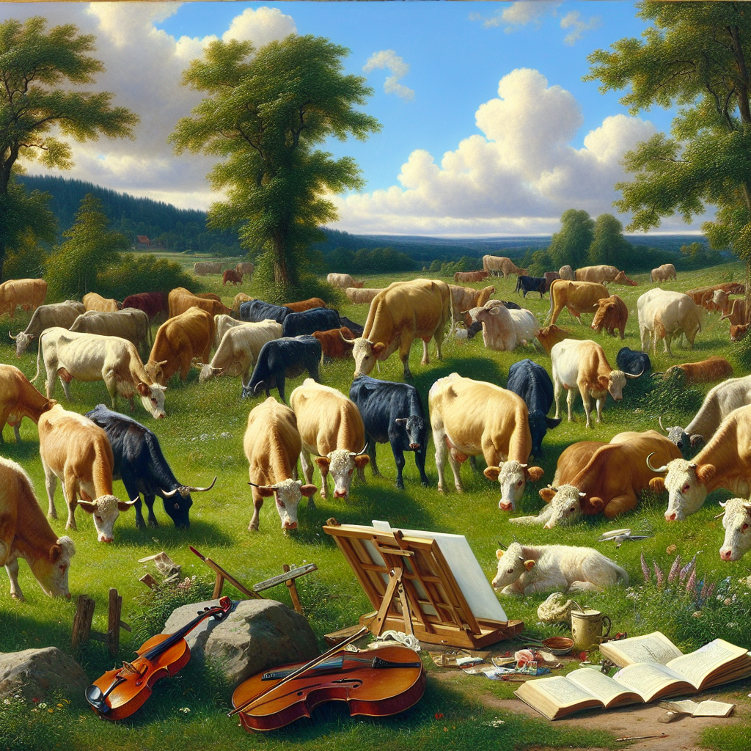
Cows in Art and Culture
Cows have also been depicted in various forms of art and have cultural significance in different societies.
They are often associated with pastoral life, fertility, and abundance.
Artists have captured the beauty and grace of cows in paintings, sculptures, and other art forms.
Cows in Art

Slide 8
Interesting Facts about Cows
Here are some interesting facts about cows:
1. Cows have a unique digestive system with four compartments in their stomach.
2. They can see color and have panoramic vision, allowing them to have a wide field of view.

Slide 9
Cows in Literature and Mythology
Cows have been mentioned in various literary works and mythologies throughout history.
In Hindu mythology, cows are considered sacred and symbolize wealth, abundance, and purity.
They have also been featured in folklore and children's stories, portraying their importance in different cultures.

Slide 10
The Future of Cattle Farming
The future of cattle farming involves sustainable practices and technological advancements.
Efforts are being made to reduce the environmental impact of cow farming, improve animal welfare, and optimize productivity.
Innovations such as precision farming and genetic engineering may play a significant role in shaping the future of cattle farming.

Slide 11
Conclusion
In conclusion, cows are remarkable animals that have been integral to human civilization for centuries.
From providing essential resources to their cultural significance, cows have a profound impact on various aspects of our lives.
It is essential to ensure their welfare, promote sustainable farming practices, and appreciate their contributions.

Slide 12
References
1. Murray, M., & Murray, C. (2006). Cows! Strange and Wonderful. Peachtree Publishing Company.
2. Field, S. J. G. (2014). Cattle: A Handbook to the Breeds of the World. Ivy Press.
3. Langlois, B. (2017). Sacred Cows: The Truth About Divorce and Marriage. Sweetgrass Publishing.

Slide 13
Thank You
Thank you for your attention!
Any questions?

