Slide 1
Introduction to Cows
Understanding the Basics of Cows

Slide 2
Types of Cows
Cows are generally classified into different types based on their purpose and characteristics.
Some popular types of cows include dairy cows, beef cows, and dual-purpose cows.
Dairy cows are specifically bred and raised for milk production, while beef cows are raised for meat production. Dual-purpose cows can be used for both milk and meat production.

Slide 3
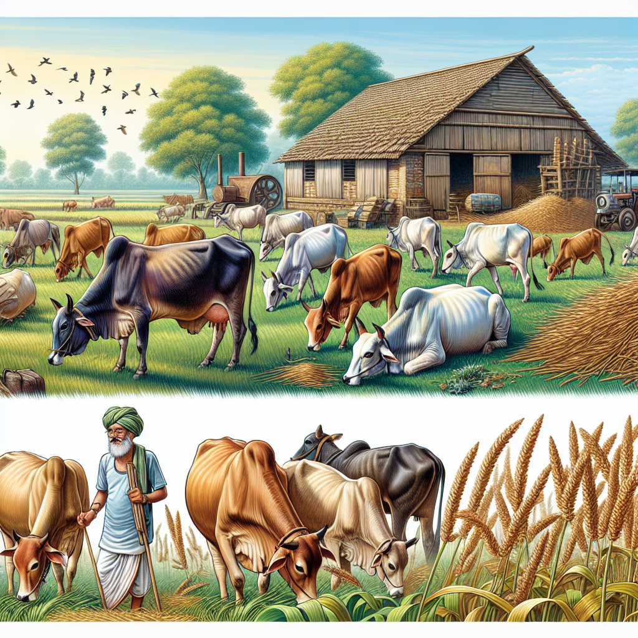
Caring for Cows
Caring for cows involves providing them with proper nutrition, shelter, and healthcare.
They should have access to fresh and clean water, as well as a balanced diet consisting of grass, hay, and other feed.
Regular veterinary care, vaccinations, and deworming are essential for maintaining the health and well-being of cows.
Cows in a Farm

