Slide 1
Introduction to the Roman Empire
A Historical Overview of Ancient Rome

Slide 2
What was the Roman Empire?
The Roman Empire was one of the largest and most powerful empires in history.
It emerged from the Roman Republic and expanded its territory through military conquests and strategic alliances.
At its height, the Roman Empire encompassed vast regions in Europe, Africa, and Asia.

Slide 3
Founding of Rome
According to legend, Rome was founded by Romulus and Remus, twin brothers who were raised by a she-wolf.
They established the city on the banks of the Tiber River in 753 BC.
Over time, Rome grew from a small settlement into a powerful city-state.

Slide 4
Government and Leadership
The Roman Empire was governed by a combination of elected officials, including senators and consuls.
The emperor, who held supreme power, was often chosen from the ruling family or appointed by the military.
Notable emperors include Augustus, Julius Caesar, and Marcus Aurelius.

Slide 5
Roman Society and Culture
Roman society was divided into classes, with the upper class known as the patricians and the lower class as the plebeians.
The Romans were known for their engineering feats, such as the construction of aqueducts, roads, and bridges.
They also had a rich culture, including art, literature, and architecture.

Slide 6
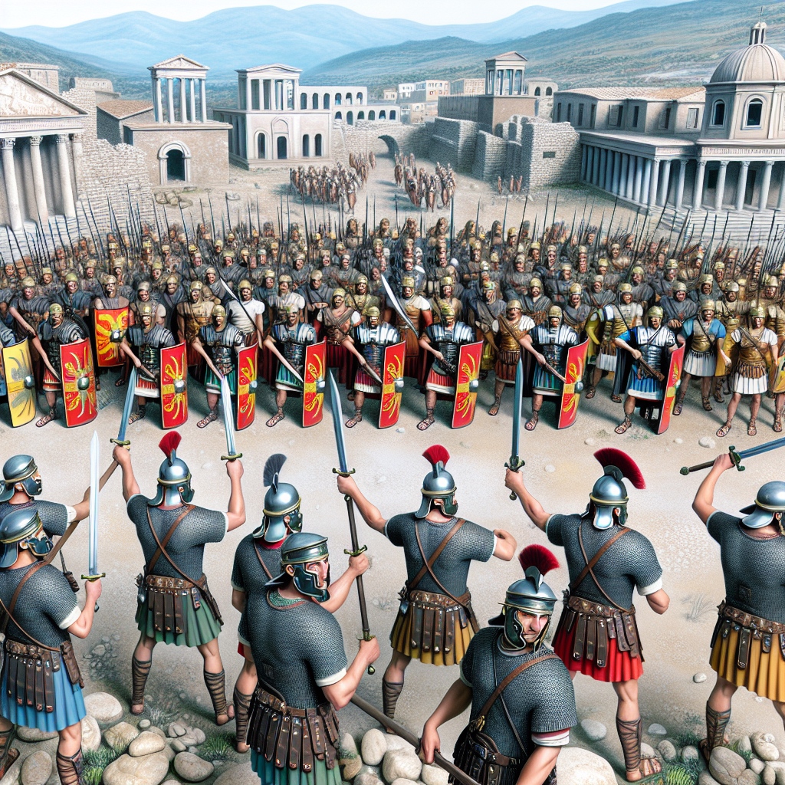
Roman Military
The Roman military was instrumental in expanding and defending the empire.
It was organized into legions, each consisting of around 5,000 soldiers.
The Roman army utilized advanced military tactics and engineering skills to achieve victories.
Roman Legionaries

Slide 7
Roman Architecture
Roman architecture is known for its grandeur and innovation.
They built structures such as the Colosseum, aqueducts, and the Pantheon.
Roman architecture continues to inspire and influence modern design.

Slide 8
Roman Religion
The Romans had a polytheistic religion, with various gods and goddesses.
They worshipped deities such as Jupiter, Mars, and Venus.
Religion played a significant role in Roman society, with religious ceremonies and rituals being an integral part of daily life.

Slide 9
Decline and Fall of the Roman Empire
The decline of the Roman Empire was a gradual process influenced by various factors.
These factors included internal conflict, economic instability, and invasions by barbarian tribes.
The Western Roman Empire ultimately fell in 476 AD, while the Eastern Roman Empire, known as the Byzantine Empire, continued to exist for centuries.

Slide 10
Legacy of the Roman Empire
The Roman Empire left a lasting legacy on the world.
Their legal system, known as Roman law, influenced modern legal systems.
Roman art, architecture, and literature continue to be admired and studied today.

Slide 11
References
1. Beard, M. (2015). SPQR: A History of Ancient Rome. Liveright Publishing.
2. Gibbon, E. (1776). The History of the Decline and Fall of the Roman Empire. Strahan & Cadell.
3. Ward-Perkins, B. (2006). The Fall of Rome: And the End of Civilization. Oxford University Press.

Slide 12
Conclusion
In conclusion, the Roman Empire was a remarkable civilization that left a significant impact on world history.
From its humble beginnings to its grand empire, Rome influenced politics, culture, and governance.
By understanding the history of the Roman Empire, we can gain insights into the foundations of modern society and appreciate the achievements of this ancient civilization.

Slide 13
Thank You
Thank you for your attention!
Any questions?

