Slide 1
Introduction to Calculus
Understanding the Fundamentals of Calculus

Slide 2
What is Calculus?
Calculus is a branch of mathematics that deals with the study of change and motion.
It provides powerful tools and techniques for analyzing the behavior of functions and solving problems involving rates of change and accumulation.

Slide 3
Why is Calculus Important?
Calculus is widely used in various fields such as physics, engineering, economics, and biology.
It helps in understanding and modeling complex phenomena, optimizing processes, and making accurate predictions.
Calculus plays a crucial role in the advancement of science and technology.

Slide 4
Basic Concepts of Calculus
Calculus is based on two fundamental concepts: differentiation and integration.
Differentiation focuses on finding the rate at which a function changes at a particular point, while integration deals with finding the accumulated effect of a rate of change over an interval.

Slide 5
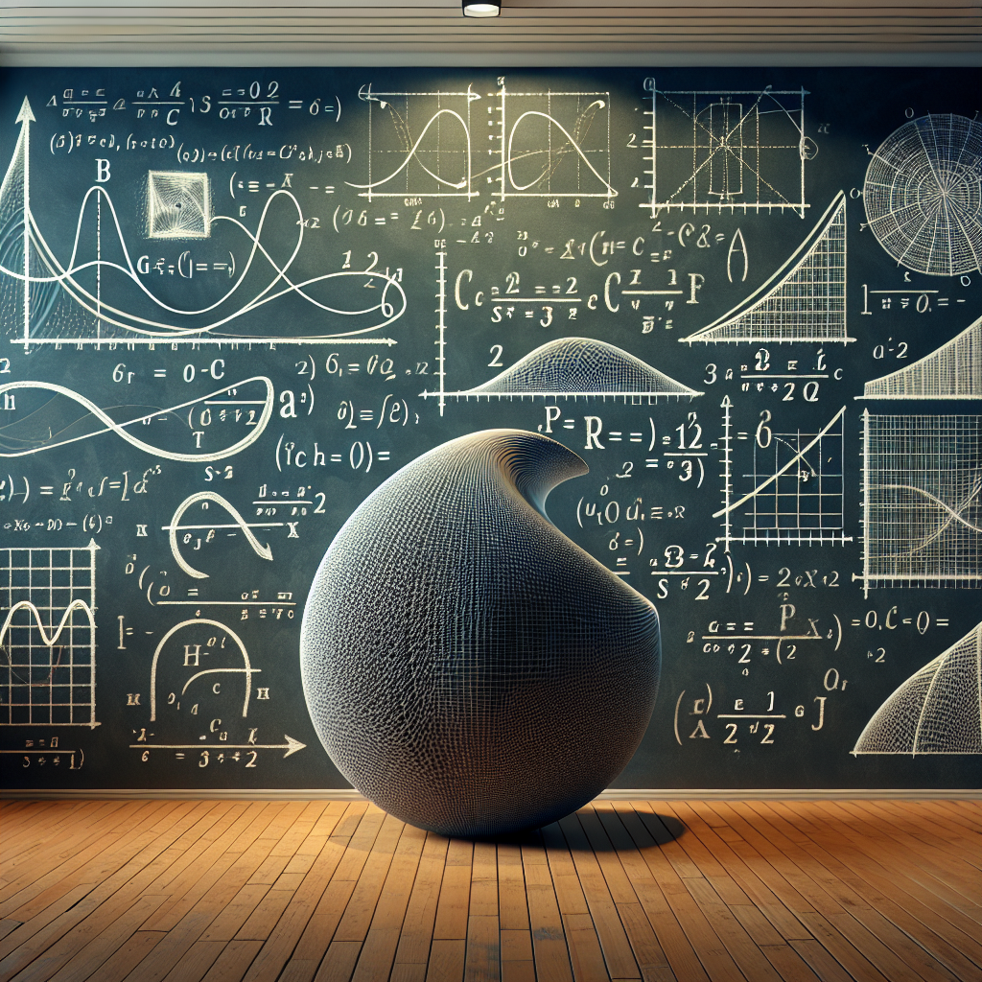
Derivatives and Differentiation
Derivatives are the central concept in differentiation.
They represent the rate of change of a function at any given point.
Derivatives have numerous applications in physics, economics, and optimization problems.
Derivatives

Slide 6
Rules of Differentiation
There are various rules and techniques for finding derivatives of different types of functions.
Some common differentiation rules include the power rule, product rule, chain rule, and quotient rule.
These rules enable us to find the derivatives of more complex functions.

Slide 7
Applications of Differentiation
Differentiation is essential in modeling real-world phenomena and solving optimization problems.
Some applications of differentiation include finding maximum and minimum values, determining rates of change, and analyzing the behavior of functions.

Slide 8
Integrals and Integration
Integrals are the fundamental concept in integration.
They represent the accumulated effect of a rate of change over an interval.
Integration has various applications in physics, economics, and calculating areas and volumes.

Slide 9
Techniques of Integration
There are several techniques for finding integrals of different types of functions.
Some common integration techniques include substitution, integration by parts, and partial fractions.
These techniques help us solve a wide range of integrals.

Slide 10
Applications of Integration
Integration is essential in calculating areas, volumes, and solving problems involving accumulated change.
Some applications of integration include finding areas under curves, calculating volumes of 3D shapes, and solving differential equations.

Slide 11
Limits and Continuity
Limits are an important concept in calculus that describes the behavior of a function as it approaches a certain point.
Continuity refers to the smoothness and connectivity of a function's graph without any jumps or breaks.
Limits and continuity form the basis for understanding differentiation and integration.

Slide 12
Applications of Calculus
Calculus has numerous applications in various fields.
Some examples of applications of calculus include optimization problems, physics and engineering laws, economic analysis, and predicting population growth.
Calculus plays a vital role in solving real-world problems and understanding the natural world.

Slide 13
Challenges and Limitations
While calculus is a powerful tool, it also poses challenges and limitations.
Some challenges include dealing with indeterminate forms, complex functions, and non-integrable functions.
Additionally, calculus requires a solid understanding of mathematical concepts and problem-solving skills.

Slide 14
Future Directions
The future of calculus holds possibilities for further advancements and applications.
Areas of future research include the development of new techniques for solving complex problems, applications in emerging fields such as machine learning, and exploring connections with other branches of mathematics.
Calculus will continue to be a cornerstone of mathematics and its applications in the future.

Slide 15

Conclusion
In conclusion, calculus is a powerful branch of mathematics that provides tools for understanding change, modeling real-world phenomena, and solving complex problems.
By studying calculus, we can gain insights into the behavior of functions, rates of change, and the accumulation of quantities.
As we continue to explore calculus and push its boundaries, we unlock new possibilities for scientific and technological advancements.
Calculus

Slide 16
References
1. Stewart, J. (2015). Calculus: Early Transcendentals. Cengage Learning.
2. Smith, A. (2019). Calculus: A Complete Introduction. Teach Yourself.
3. Larson, R., & Edwards, B. (2014). Calculus. Cengage Learning.

Slide 17
Thank You
Thank you for your attention!
Any questions?

