Slide 1
Introduction to the Roman Empire
A Brief Overview of the Roman Empire

Slide 2
The Rise of the Roman Empire
The Roman Empire was one of the most powerful and enduring civilizations in history.
It began as a small city-state in Italy and gradually expanded its territory through conquest and diplomacy.
Under the leadership of ambitious emperors, such as Julius Caesar and Augustus, Rome became a dominant force in the ancient world.

Slide 3
Government and Administration
The Roman Empire had a complex system of government and administration.
At its height, the empire was divided into provinces, each ruled by a governor appointed by the emperor.
The emperor held absolute power, but he relied on a vast bureaucracy to govern and enforce his policies.

Slide 4
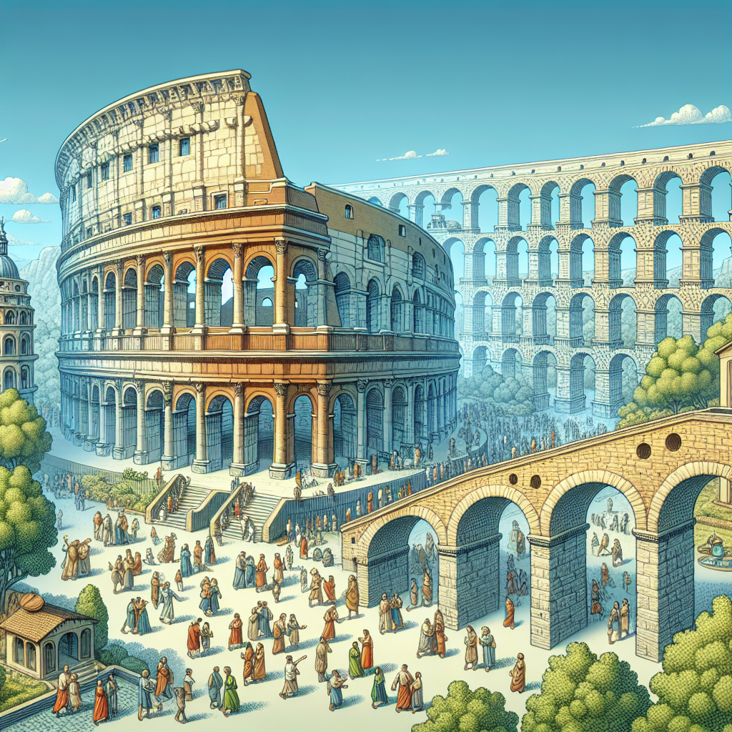
Roman Architecture and Engineering
Roman architecture was known for its grandeur and innovation.
The Romans built impressive structures, such as the Colosseum and aqueducts, that still awe us today.
Their engineering skills allowed them to construct vast networks of roads, bridges, and buildings.
Colosseum

Slide 5
Daily Life in Ancient Rome
Life in ancient Rome was busy and vibrant.
The city was filled with markets, theaters, and bathhouses, where people socialized and conducted business.
Slavery was widespread, and the economy was based on agriculture, trade, and mining.

Slide 6
Culture and Society
Roman culture and society were greatly influenced by the Greeks.
They adopted Greek art, literature, and philosophy, and made significant contributions to these fields.
The Romans also valued education, with wealthy families hiring private tutors for their children.

Slide 7
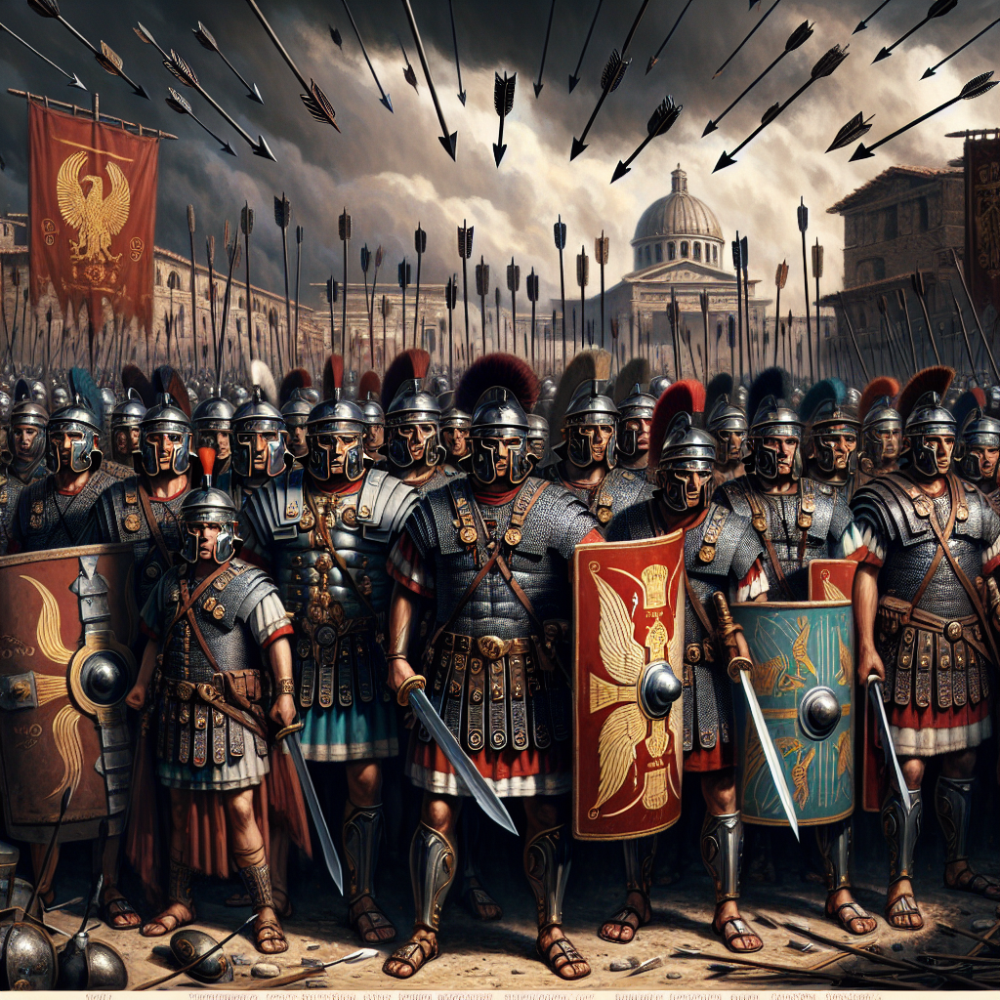
Military Power
The Roman military was a dominant force in the ancient world.
They had highly disciplined armies, with well-trained soldiers called legionaries.
Their military campaigns resulted in the conquest of vast territories across Europe, North Africa, and the Middle East.
Roman Legionaries

Slide 8
Decline and Fall of the Roman Empire
Despite its power and achievements, the Roman Empire eventually faced significant challenges.
External threats, such as invasions by barbarian tribes, and internal problems, such as political instability and economic decline, contributed to its downfall.
The empire split into two, and the Western Roman Empire collapsed in 476 CE.

Slide 9
Legacy of the Roman Empire
The Roman Empire left a lasting legacy on Western civilization.
Roman law, government structures, and architecture influenced future societies.
The Latin language, from which many Romance languages evolved, traces its roots to ancient Rome.

Slide 10
References
1. Beard, M. (2016). SPQR: A History of Ancient Rome. Liveright Publishing.
2. Grant, M. (1978). The History of Rome. Faber & Faber.
3. Ward-Perkins, B. (2005). The Fall of Rome and the End of Civilization. Oxford University Press.

Slide 11
Thank You
Thank you for your attention!
Any questions?

