Slide 1
Introduction to Calculus
Understanding the Fundamental Concepts of Calculus

Slide 2
What is Calculus?
Calculus is a branch of mathematics that focuses on the study of change and motion.
Its goal is to understand and analyze continuous processes through the concepts of differentiation and integration.

Slide 3
Limits and Continuity
Limits are used to describe the behavior of functions as they approach a certain value.
In calculus, the concept of continuity is closely related to limits, as it determines whether a function is smooth and uninterrupted.

Slide 4
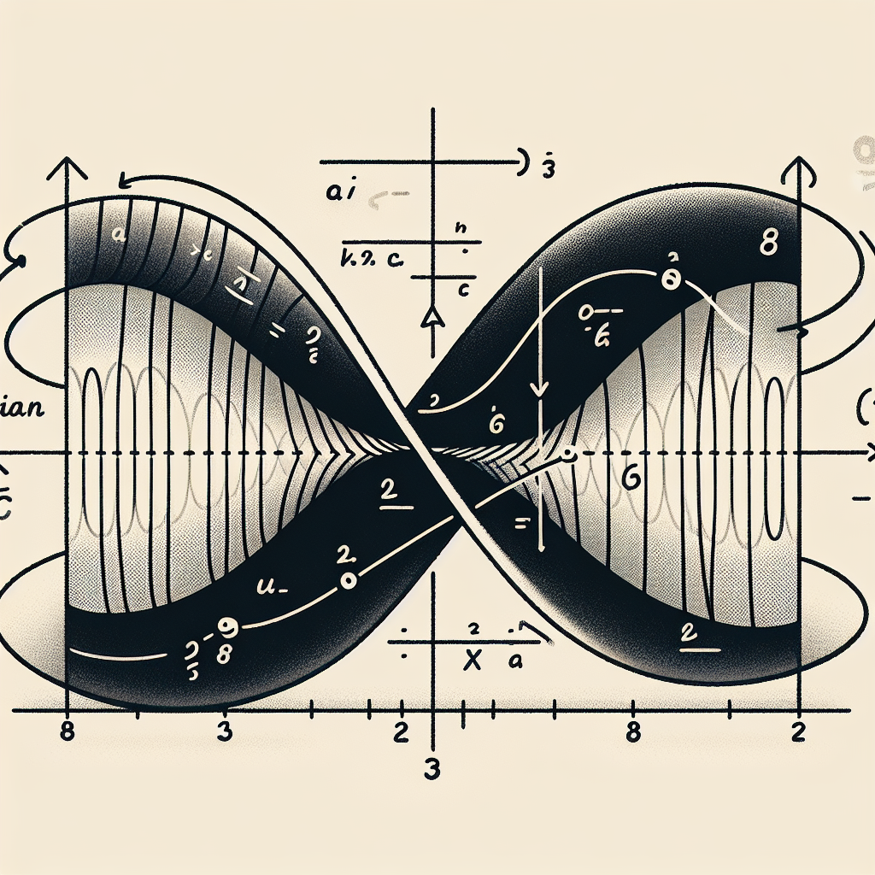
Derivatives
Derivatives measure the rate of change of a function at a specific point.
They can be interpreted geometrically as the slope of the tangent line to a curve at a given point.
Derivatives have applications in various fields such as physics, economics, and engineering.
Tangent Line

Slide 5
Differentiation Rules
Differentiation rules provide a systematic way to find the derivatives of different types of functions.
Some common rules include the power rule, product rule, and chain rule.
These rules allow us to calculate derivatives efficiently and accurately.

Slide 6
Applications of Derivatives
Derivatives have a wide range of applications in various fields.
They can be used to analyze the behavior of functions, optimize functions, and solve real-world problems.
Some examples include finding maximum and minimum values, determining rates of change, and modeling physical phenomena.

Slide 7
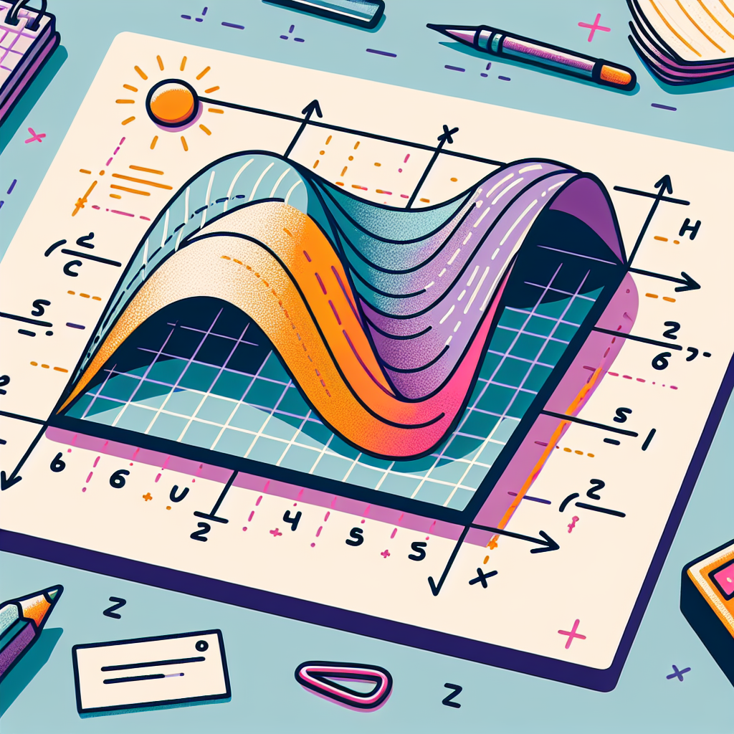
Integration
Integration is the reverse process of differentiation.
It involves finding the area under a curve or calculating the accumulated change of a function.
Integration has numerous applications in physics, economics, statistics, and engineering.
Area Under Curve

Slide 8
Techniques of Integration
There are various techniques for evaluating integrals.
Some common methods include substitution, integration by parts, and trigonometric substitutions.
These techniques provide tools to solve a wide range of integrals.

Slide 9
Applications of Integration
Integration has numerous applications in different fields.
It can be used to calculate areas, volumes, work, and displacement.
Some examples include calculating the area between curves, finding the volume of solids, and solving problems in physics and economics.

Slide 10
Differential Equations
Differential equations involve the study of functions and their derivatives.
They are used to model and describe various phenomena in physics, engineering, and biology.
Solving differential equations requires applying integration and differentiation techniques.

Slide 11
Vector Calculus
Vector calculus extends the techniques of calculus to vector fields and functions.
It is used to describe and analyze various physical phenomena such as electromagnetic fields and fluid dynamics.
Vector calculus plays a crucial role in engineering and physics.

Slide 12
Conclusion
In conclusion, calculus is a powerful mathematical tool for understanding and analyzing continuous processes.
By studying concepts such as limits, derivatives, and integration, we can solve problems and model various phenomena in different fields.
Calculus has wide-ranging applications and continues to be a fundamental subject in mathematics and science.

Slide 13
References
1. Stewart, J. (2015). Calculus: Early Transcendentals (8th ed.). Cengage Learning.
2. Larson, R., & Edwards, B. (2009). Calculus (9th ed.). Cengage Learning.
3. Strang, G. (2010). Calculus (1st ed.). Wellesley-Cambridge Press.

Slide 14
Thank You
Thank you for your attention!
Any questions?

