Slide 1
Introduction to the Solar System
Exploring Our Stellar Neighborhood

Slide 2
What is the Solar System?
The solar system refers to the collection of celestial bodies that orbit the Sun. It is composed of the Sun, eight planets (Mercury, Venus, Earth, Mars, Jupiter, Saturn, Uranus, and Neptune), numerous moons, asteroids, comets, and other small bodies.
The solar system is formed from a vast cloud of gas and dust known as a nebula, which collapsed under its own gravity about 4.6 billion years ago. Since then, it has been evolving and fascinating scientists with its diversity and complexity.

Slide 3
The Sun
The Sun is the central and most massive object in the solar system. It accounts for more than 99% of the total mass and controls the gravitational pull that keeps all other objects in orbit. It is composed mostly of hydrogen and helium gases and produces energy through nuclear fusion.
The Sun's energy not only provides light and heat to our planet but also drives the weather, climate, and life on Earth. Understanding the Sun is crucial for studying the solar system and its impact on our daily lives.

Slide 4
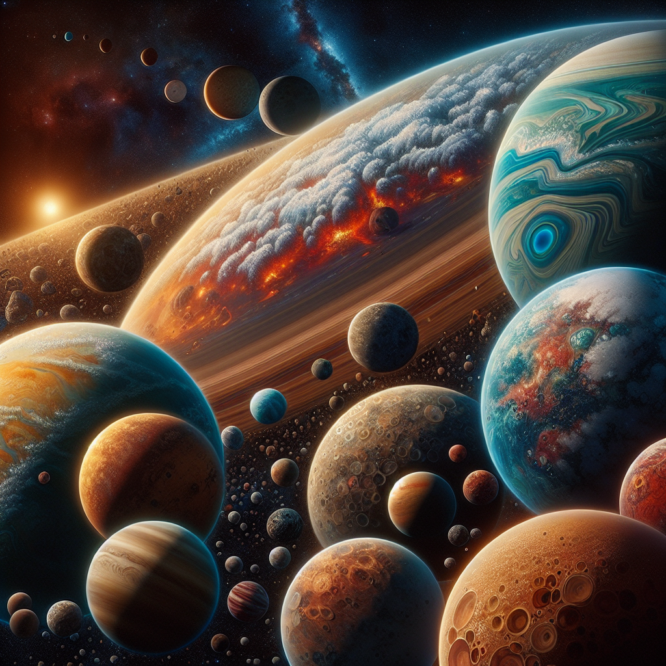
Planets of the Solar System
The solar system is home to eight planets, each with its own unique characteristics.
1. Mercury: The smallest and closest planet to the Sun. It has a thin atmosphere and extreme temperature variations.
2. Venus: Known as Earth's sister planet due to its similar size and composition. It has a dense atmosphere and a runaway greenhouse effect.
3. Earth: Our home planet. It has a diverse biosphere and supports a wide variety of life forms.
4. Mars: Nicknamed the 'Red Planet' due to its reddish appearance. It has polar ice caps and was once potentially habitable.
5. Jupiter: The largest planet in the solar system. It is known for its colorful cloud bands and the Great Red Spot, a giant storm.
6. Saturn: Recognizable by its prominent ring system. It is composed mostly of hydrogen and helium gases.
7. Uranus: A gas giant with a tilted axis of rotation, causing extreme seasons and unique magnetic properties.
8. Neptune: The farthest known planet from the Sun. It has active weather patterns and a deep blue color.
The Eight Planets

Slide 5
Moons and Other Celestial Bodies
In addition to the planets, the solar system is also home to numerous moons, asteroids, comets, and dwarf planets.
Moons: Many planets in the solar system have their own moons. For example, Earth has one moon, while Jupiter has over 70 known moons, including Europa, Ganymede, Callisto, and Io.
Asteroids: These rocky objects can be found in the asteroid belt between Mars and Jupiter. They range in size from small boulders to bodies several hundred kilometers in diameter. Some asteroids contain valuable resources and have been the subject of exploration missions.
Comets: Comets are icy bodies that originate from the outer regions of the solar system. When they approach the Sun, the heat causes them to develop a glowing coma and sometimes a tail. Famous comets include Halley's Comet and Comet Hale-Bopp.
Dwarf Planets: These are celestial bodies similar to planets but do not meet the criteria to be classified as full planets. The best-known dwarf planet is Pluto, which was reclassified as a dwarf planet in 2006.

Slide 6
Exploring the Solar System
Humanity has been fascinated with the solar system for centuries and has undertaken various missions to explore its mysteries. Some notable missions include:
- Viking program: Sent the first successful landers to Mars in the 1970s.
- Voyager program: Launched two spacecraft, Voyager 1 and Voyager 2, to explore the outer planets and continue their journey into interstellar space.
- Hubble Space Telescope: Allows astronomers to observe and study distant objects in the solar system and beyond.
- Mars rovers (e.g., Curiosity, Perseverance): Sent robotic explorers to study the environment, geology, and potential for life on Mars.
These missions have provided valuable insights into the solar system's formation, evolution, and potential for habitability.

Slide 7
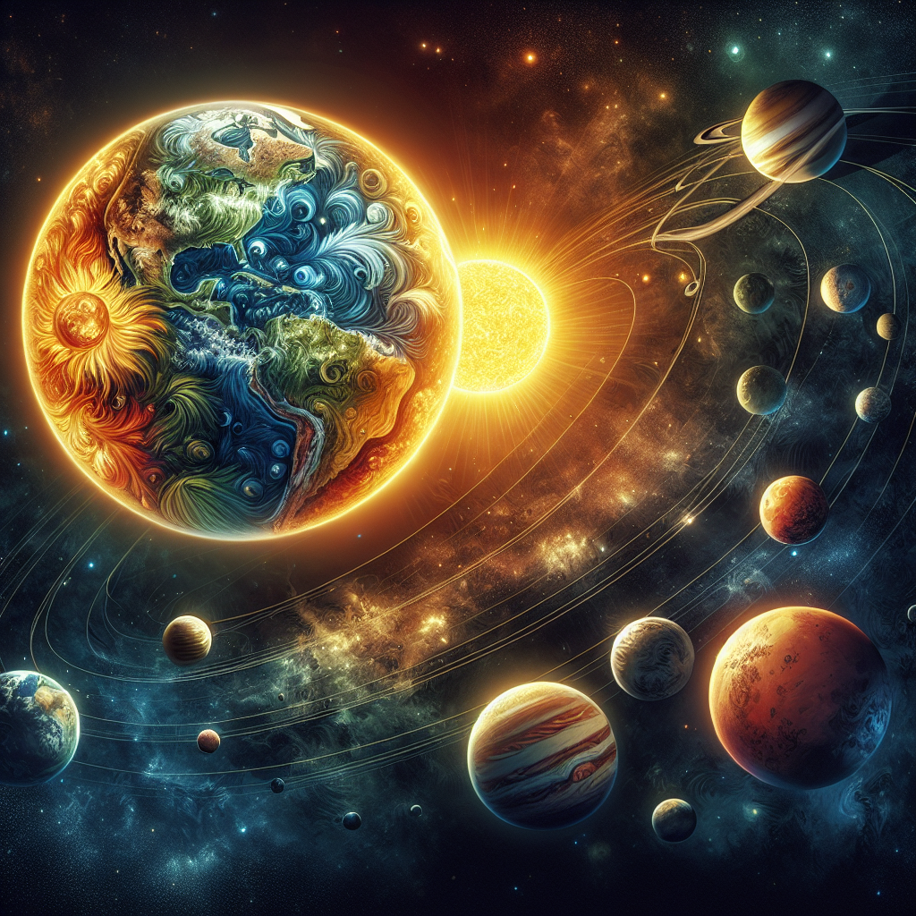
The Sun as a Star
The Sun is not only the center of our solar system but also a star in the Milky Way galaxy.
It belongs to a classification of stars called 'main sequence stars' and is of spectral type G2V. The Sun's energy is produced through nuclear fusion in its core, where hydrogen atoms combine to form helium.
Understanding the Sun's behavior and studying other stars in the galaxy help scientists gain insights into stellar evolution, the formation of planetary systems, and the potential for extraterrestrial life.
The Sun

Slide 8
Conclusion
The solar system is a fascinating and diverse collection of planets, moons, asteroids, comets, and other celestial bodies that orbit the Sun.
By exploring the solar system, we gain a better understanding of our place in the universe and how the different components of the system interact.
The ongoing advancements in space exploration and research continue to unveil new discoveries and mysteries, fueling our curiosity and inspiring future generations.

Slide 9
References
1. Aguilar, D. A., & Schindler, K. (2016). Exploring the Solar System and Beyond: A History of Space Science. Cambridge University Press.
2. Morison, I. (2015). The Solar System. DK Publishing.
3. NASA. (n.d.). Solar System Exploration. Retrieved from https://solarsystem.nasa.gov/

Slide 10
Thank You
Thank you for your attention!
Any questions?

