Slide 1
Introduction to the Roman Empire
A Brief Overview of Ancient Rome

Slide 2
Founding of Rome
The city of Rome was founded in 753 BC by Romulus and Remus, who were raised by wolves according to legend.
Rome started as a small hilltop settlement and eventually grew into one of the greatest empires in history.

Slide 3
Expansion of the Roman Republic
The Roman Republic expanded its territory through military conquests and skilled diplomacy.
It conquered the Italian Peninsula, defeated Carthage in the Punic Wars, and expanded its influence throughout the Mediterranean region.

Slide 4
Julius Caesar and the Roman Empire
Julius Caesar played a crucial role in the transition from the Roman Republic to the Roman Empire.
He was a military general who gained power and eventually declared himself dictator for life.

Slide 5
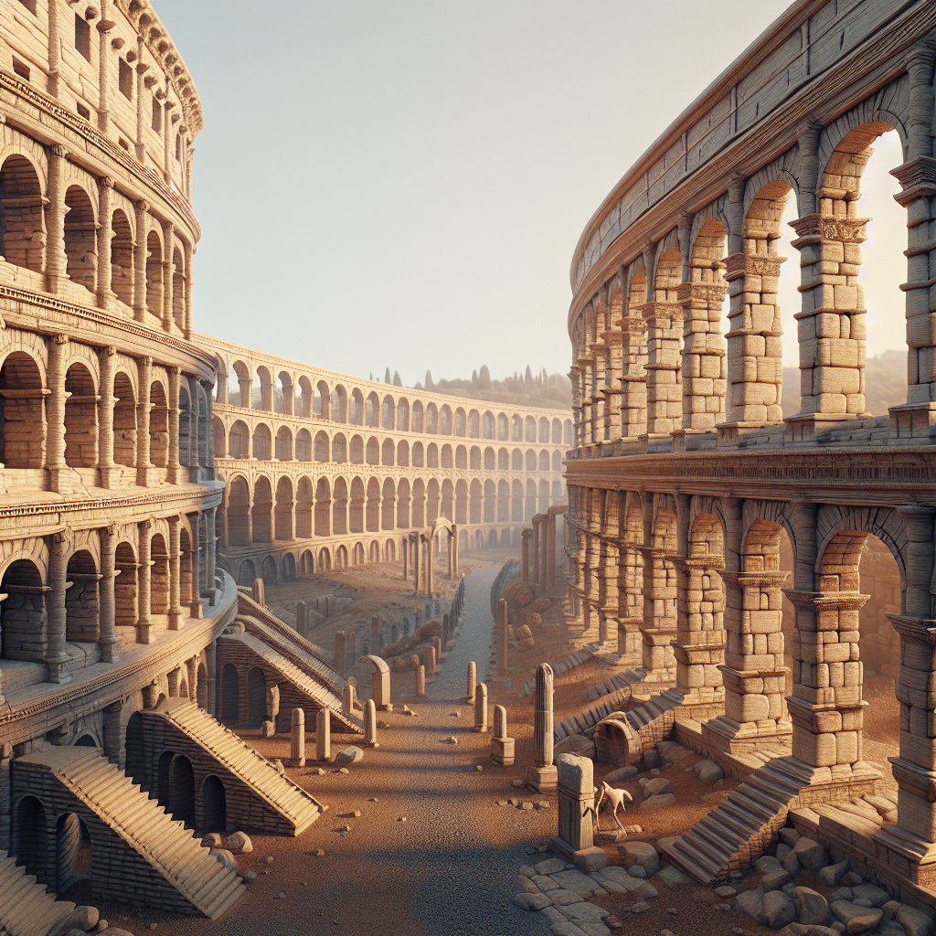
Roman Architecture and Engineering
The Roman Empire is famous for its architectural and engineering achievements.
The Colosseum, aqueducts, and roads are some of the remarkable structures that still stand today.
These structures reflect the Roman Empire's technological advancements and focus on urban planning.
Colosseum

Slide 6
Roman Law and Governance
The Roman Empire had a complex legal system and efficient governance.
The Twelve Tables established the foundation of Roman law.
The empire was divided into provinces ruled by governors appointed by the emperor.

Slide 7
Pax Romana
Pax Romana, meaning Roman Peace, was a period of relative peace and stability throughout the empire.
It lasted for over 200 years and allowed for cultural and economic prosperity.
During this time, the empire experienced advancements in arts, literature, and science.

Slide 8
Fall of the Roman Empire
The fall of the Roman Empire is a complex event with various contributing factors.
Some key factors include invasions by barbarian tribes, economic decline, and internal conflicts.
The Western Roman Empire fell in 476 AD, while the Eastern Roman Empire (Byzantine Empire) survived for another millennium.

Slide 9
Legacy of the Roman Empire
The Roman Empire left a lasting impact on Western civilization.
Roman law, language, and architecture influenced subsequent empires and civilizations.
The legacy of the Roman Empire can be seen in various aspects of modern society.

Slide 10
References
1. Beard, M. (2015). SPQR: A History of Ancient Rome. Liveright Publishing.
2. Grant, M. (1978). The History of Rome. Orion Publishing Group.
3. Goldsworthy, A. (2007). How Rome Fell: Death of a Superpower. Yale University Press.

Slide 11
Thank You
Thank you for your attention!
Any questions?

