Slide 1
Introduction to Electricity
Understanding the Basics of Electricity

Slide 2
What is Electricity?
Electricity is a form of energy resulting from the existence of charged particles (such as electrons or protons) and their interactions.
It is generated through various processes such as chemical reactions, electromagnetic induction, and nuclear reactions.
Electricity is widely used for powering devices, lighting homes, and running industries.

Slide 3
How is Electricity Generated?
Electricity can be generated from various sources such as fossil fuels, nuclear power, renewable energy (solar, wind, hydropower), and more.
In power plants, energy from these sources is converted into electricity through turbines, generators, or solar panels.
The generated electricity is then distributed through power grids to homes and businesses.

Slide 4
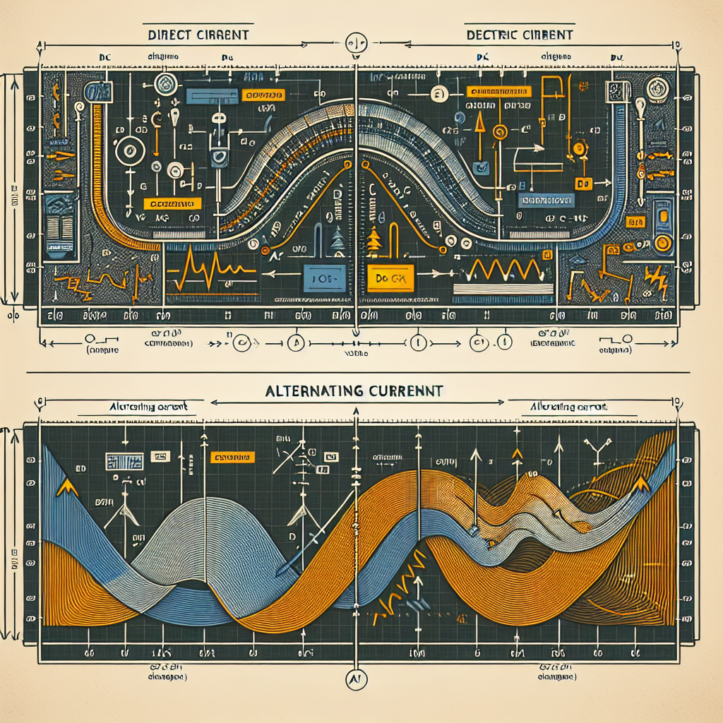
Types of Electricity
There are two main types of electricity: Direct Current (DC) and Alternating Current (AC).
DC flows in one direction and is commonly used in batteries and electronic devices.
AC periodically changes direction and is used for power transmission and in most household appliances.
DC and AC

Slide 5
Electric Circuits
An electric circuit is a closed loop through which electric current flows.
It consists of various components such as resistors, capacitors, and inductors.
Circuits can be series or parallel, and they allow the controlled flow of electricity to power devices.

Slide 6
Electrical Safety
Electrical safety is crucial to prevent accidents and hazards.
It involves proper insulation, grounding, and the use of safety devices like circuit breakers and fuses.
Electricity should always be handled with caution and only by trained professionals.

Slide 7
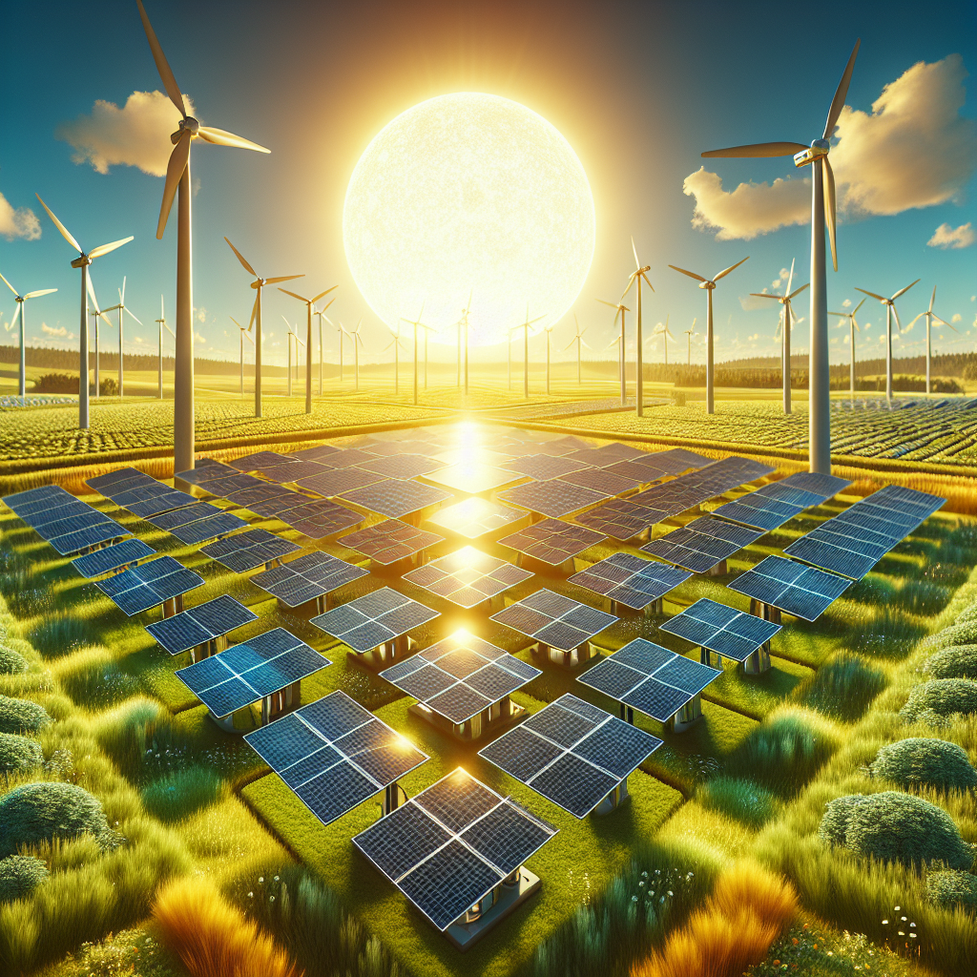
Renewable Energy Sources
Renewable energy sources such as solar power and wind energy have gained popularity due to their environmental benefits.
Solar panels convert sunlight into electricity, while wind turbines generate electricity from the wind's kinetic energy.
These sustainable alternatives help reduce reliance on fossil fuels and combat climate change.
Renewable Energy

Slide 8
Electricity Consumption
Electricity consumption varies across sectors, including residential, commercial, and industrial.
Residential usage includes lighting, appliances, and heating/cooling systems.
Commercial and industrial sectors consume electricity for operations, manufacturing, and data centers.

Slide 9
Current and Future Challenges
The electricity sector faces challenges like energy shortages, grid stability, and transitioning to sustainable sources.
Improving energy storage, grid infrastructure, and promoting energy efficiency are important goals.
In the future, advancements in smart grids and renewable energy technologies are expected to transform the electricity industry.

Slide 10
Conclusion
In conclusion, electricity is a vital form of energy that powers our modern world.
Understanding its generation, types, and safety is essential for everyone.
By embracing renewable energy and addressing challenges, we can create a more sustainable and reliable electricity system.

Slide 11
References
1. M. V. Deshpande and S. A. Channiwala, Solar radiation resource assessment program of India, Energy Policy, vol. 34, no. 6, pp. 710–723, 2006.
2. G. Boyle, R. Everett, and J. Ramage, Renewable Energy: Power for a Sustainable Future, 3rd ed. Oxford, UK: Oxford University Press, 2012.
3. T. L. Skjolsvold, Electrical Safety Handbook, 3rd ed. New York, NY: McGraw-Hill Education, 2015.

Slide 12
Thank You
Thank you for your attention!
If you have any questions, feel free to ask.

