Slide 1
Introduction to Electricity
Understanding the Basics of Electricity

Slide 2
What is Electricity?
Electricity is a form of energy resulting from the movement of charged particles, such as electrons. It is a fundamental force in nature and plays a crucial role in our daily lives.
Electricity can be generated through various methods, such as burning fossil fuels, harnessing renewable energy sources like solar and wind, or through nuclear reactions.
The flow of electricity is measured in units called volts, and it can be harnessed and utilized for electrical power, lighting, heating, and various other applications.

Slide 3
How Does Electricity Work?
Electricity is produced when electrons flow through a conductor, such as a wire. This flow of electrons is called an electric current.
The flow of electric current is driven by a voltage difference, which creates a force that pushes the electrons. The voltage is provided by a power source, such as a battery or a power plant.
Electricity can be controlled and used for various purposes by devices such as switches, circuits, and transformers.

Slide 4
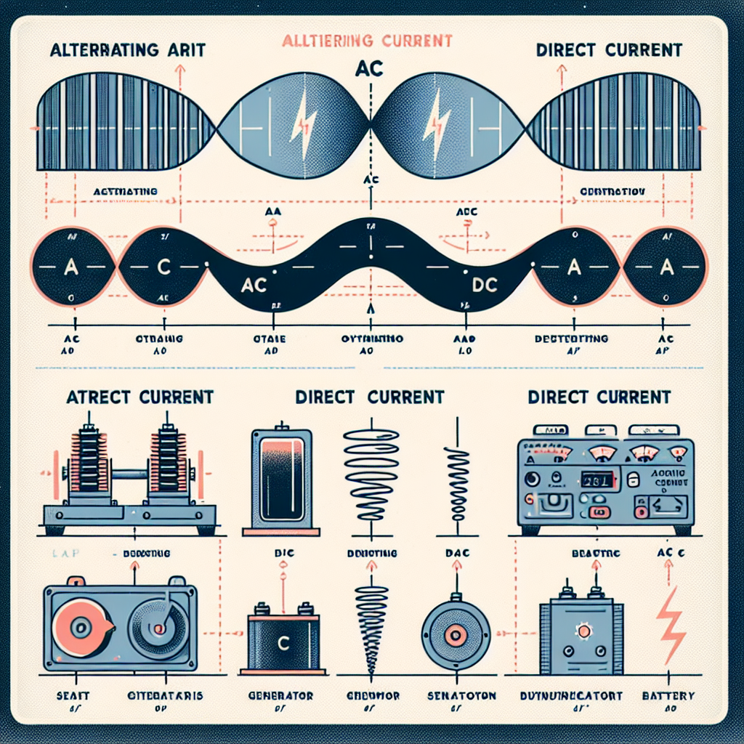
Types of Electricity
There are two main types of electricity: Alternating Current (AC) and Direct Current (DC).
AC is the type of electricity commonly used in homes and businesses. It constantly changes direction, oscillating back and forth at a specific frequency.
DC, on the other hand, flows in only one direction. It is often used in batteries, electronic devices, and some specialized applications.
AC and DC Electricity

Slide 5
Electric Circuits
An electric circuit is a closed loop through which electric current can flow. It consists of various components, including a power source, conductors, switches, and loads.
Circuits can be simple or complex, depending on the number and arrangement of components. They can be series circuits, parallel circuits, or a combination of both.
Understanding circuits is crucial for safely and effectively using electricity in homes, industries, and other applications.

Slide 6
Electrical Safety
Electrical safety is essential to prevent accidents, injuries, and property damage. Here are some important safety practices:
1. Avoid overloading electrical outlets and circuits.
2. Keep water away from electrical devices and outlets.
3. Make sure electrical cords are in good condition and not frayed or damaged.
4. Use proper insulation and grounding techniques.
5. Follow electrical codes and regulations.
By following these safety guidelines, we can minimize the risks associated with electricity and ensure a safe environment.

Slide 7
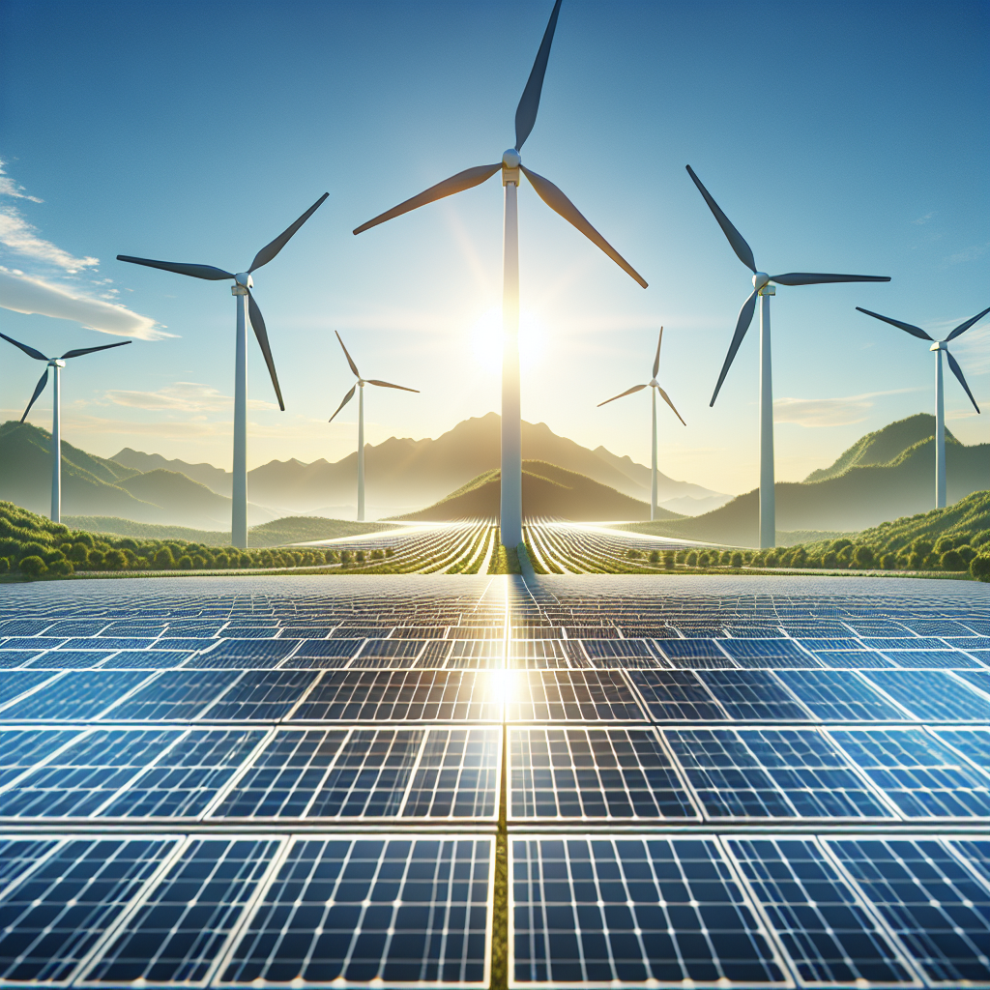
Renewable Energy
Renewable energy sources, such as solar, wind, hydro, and geothermal power, play an increasingly important role in electricity generation.
Solar panels convert sunlight into electricity, while wind turbines harness the power of wind to generate energy.
Unlike fossil fuels, renewable energy sources are sustainable and have a lower environmental impact, making them a crucial part of our transition to a cleaner and more sustainable energy future.
Renewable Energy Sources

Slide 8
Electricity in Everyday Life
Electricity is pervasive in our daily lives and is used in various ways, including:
1. Providing lighting in homes, offices, and streets.
2. Powering appliances and electronic devices, such as computers, televisions, and refrigerators.
3. Enabling communication through the internet, phones, and other electronic devices.
4. Supporting transportation through electric vehicles and charging infrastructure.
5. Powering industrial processes and machinery.
Electricity is a vital resource that enhances our quality of life and drives technological advancements in various fields.

Slide 9
The Future of Electricity
The future of electricity holds exciting possibilities and advancements:
1. Continued development of renewable energy sources and grid technologies.
2. Integration of smart grids and smart meters for efficient energy management.
3. Advancements in energy storage technologies, such as batteries.
4. Electrification of transportation to reduce reliance on fossil fuels.
5. Exploration of new energy generation technologies, such as fusion power.
By embracing these advancements, we can create a sustainable energy system that meets our needs while minimizing environmental impact.

Slide 10
Conclusion
In conclusion, electricity is a fundamental aspect of our modern society. It powers our homes, industries, and technological advancements.
Understanding the basics of electricity, including its generation, flow, and safety considerations, is crucial for utilizing it effectively and safely.
As we continue to explore renewable energy sources and advancements in electrical technologies, we pave the way for a sustainable and electrified future.

Slide 11
References
1. Beiser, A. (2018). Concepts of Modern Physics. McGraw-Hill Education.
2. Rizzoni, G., & Kearns, L. (2015). Principles and Applications of Electrical Engineering. McGraw-Hill Education.
3. U.S. Department of Energy. (n.d.). Electricity Basics. Retrieved from [link]

Slide 12
Thank You
Thank you for your attention!
Any questions?

