Slide 1
Introduction to the Roman Empire
A Journey Through Ancient Rome's Rise and Fall

Slide 2
What is the Roman Empire?
The Roman Empire was one of the largest and most influential civilizations in history.
Spanning over 500 years, it emerged from the city of Rome in Italy and expanded to become a vast empire, encompassing parts of Europe, Africa, and Asia.

Slide 3
The Rise of the Roman Empire
The Roman Empire began as a small kingdom and gradually transformed into a republic.
Through military conquests and strategic alliances, Rome expanded its territory and established itself as a dominant power in the Mediterranean region.
Under the leadership of influential figures like Julius Caesar and Augustus, the empire reached its peak of prosperity and stability.

Slide 4
Roman Society and Culture
Roman society was divided into various classes, including patricians (wealthy elites) and plebeians (commoners).
The Romans excelled in architecture, engineering, and art, leaving behind iconic structures like the Colosseum and aqueducts.
They also had a rich mythology, a complex legal system, and a vibrant entertainment culture.

Slide 5
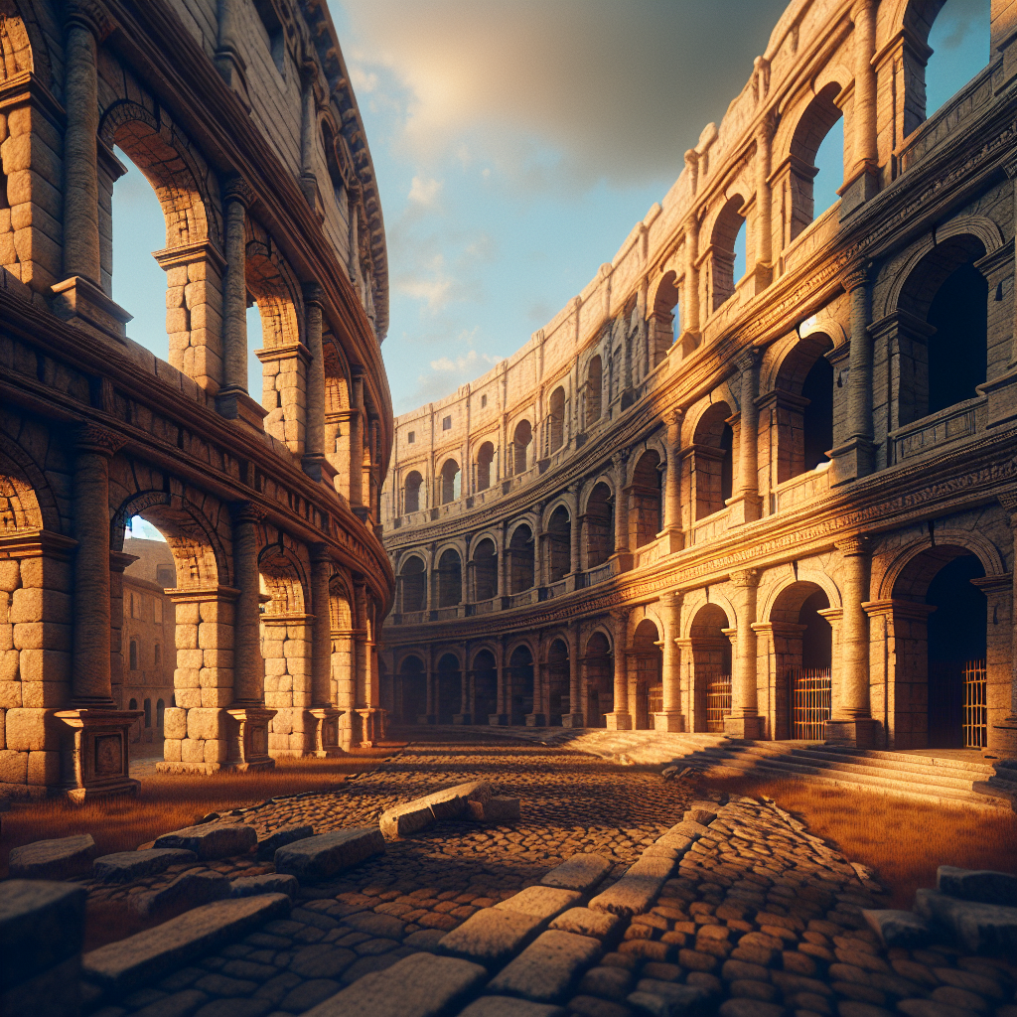
Roman Architecture and Engineering
Roman architecture was characterized by its grandeur and innovation.
They pioneered techniques such as the use of arches, domes, and concrete, allowing them to construct monumental structures like the Colosseum.
Roman engineering feats also include aqueducts, roads, and bridges, which facilitated trade and transportation throughout the empire.
Colosseum

Slide 6
Roman Achievements and Innovations
The Romans made significant contributions to fields such as literature, philosophy, and law.
Famous writers like Virgil and Ovid produced timeless works like the Aeneid and Metamorphoses.
Additionally, Roman law greatly influenced Western legal systems, and their philosophy laid the groundwork for future philosophical movements.

Slide 7
The Decline and Fall of the Roman Empire
Several factors contributed to the decline and fall of the Roman Empire.
Internal conflicts, economic instability, and external invasions weakened the empire over time.
The fall of Rome in 476 AD marked the end of the Western Roman Empire, while the Eastern Roman Empire (Byzantine Empire) endured for several more centuries.

Slide 8
Legacy of the Roman Empire
Despite its eventual collapse, the Roman Empire left a lasting legacy.
Its legal and administrative systems influenced future governments, and Latin, the language of the Romans, evolved into the Romance languages spoken today.
Roman architecture, engineering, and cultural achievements continue to inspire and captivate people worldwide.

Slide 9
References
1. Grant, M. (1994). The history of Rome.
2. Beard, M., & Crawford, M. H. (2019). Rome: The story of an empire.
3. Ward-Perkins, B. (2007). The fall of Rome and the end of civilization.

Slide 10
Thank You
Thank you for your attention!
Are there any questions?

